Slide 1
March 18, 2020 Online
Content Objective | Students will demonstrate comprehension of the formation of a rainbow’s reflection and refraction by completing a CER focus question and answering comprehension questions.
Language Objective | Students will read and write to summarize information about the formation of a rainbow’s reflection and refraction using complete sentences to answer comprehension question and a CER focus question.

Slide 2
Bell Work 3/18
1. Draw and label the incident ray, the reflected ray and the refracted ray •
2. The Law of Reflection states that the angle of incident ray is ________________ to the angle of the _______________________.
3. Which type of medium (air, water or glass) does light travel the fastest in? The slowest in? Why do you think this is?

Slide 3
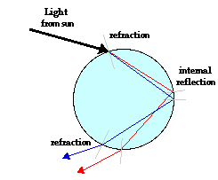
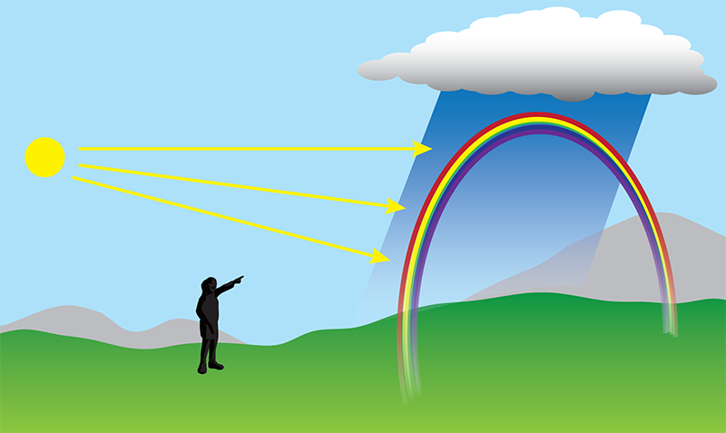
Dispersion is the separation of light into its colors and occurs when light refracts.
1. Explain how you think a rainbow is formed using what you know about dispersion and the diagram below:

Slide 4
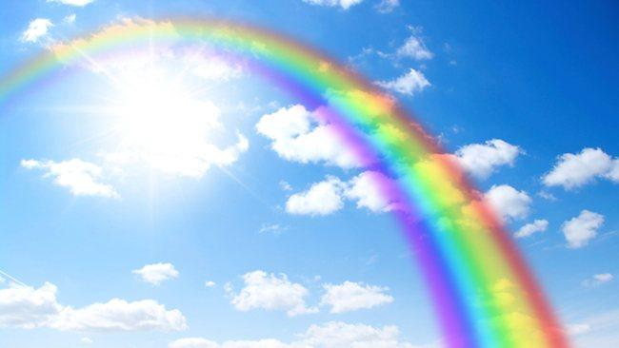
Focus Question: If light traveled at the same speed in raindrops as it does in air, would we still have rainbows?
Prediction:
Claim:
Evidence: Visual: According to my notes….. Based on the reading.. | Reasoning: The evidence shows….

Slide 5
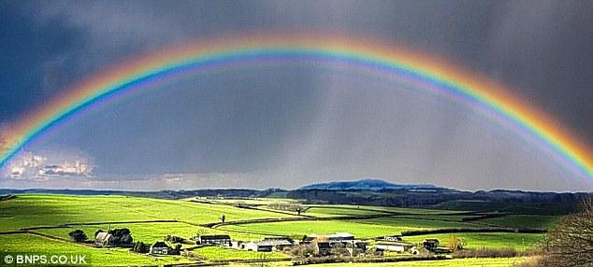
EXIT TICKET- 3/18
How does light behavior such refraction and reflection allow us to see a rainbow? Provide evidence to support our essential question and today’s objectives.

