Slide 2
Bell Work 3/18
1. Draw and label the incident ray, the reflected ray and the refracted ray •
2. The Law of Reflection states that the angle of incident ray is EQUAL to the angle of the Reflection.
3.Light will travel faster in air and slower in glass. This is because light refract when it cross the boundary of another material such as glass.

Slide 3
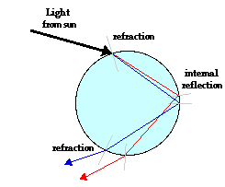
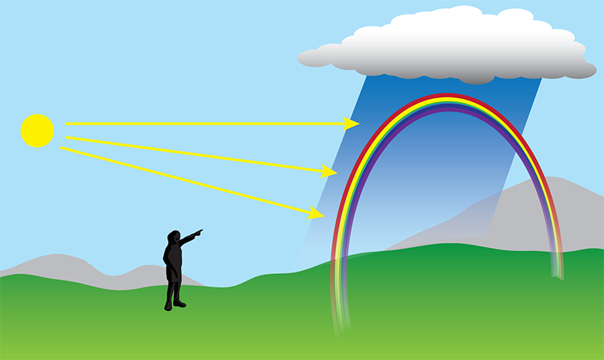
Dispersion is the separation of light into its colors and occurs when light refracts.
When light rays enter the drops of water it refract and disperse into colors inside the water drop, then it the rays experience total internal reflection at the other end of the water drop reflecting back and out of the water drop to refract again causing another dispersion of colors forming the rainbow we see.

Slide 4
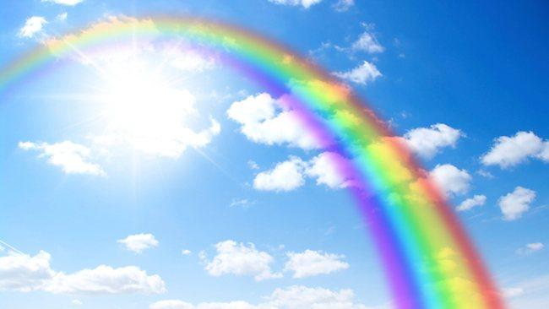
Focus Question: If light traveled at the same speed in raindrops as it does in air, would we still have rainbows?
Prediction: If light traveled at the same speed in raindrops as it does in air, we would not still have rainbows
Claim:
Evidence: According to my notes dispersion is the separation of light into its colors and occurs when light refracts. •Based on the reading.. If there is no change in speed, there is no refraction. If there is no refraction, there is no dispersion of light and hence, no rainbow! | Reasoning: The evidence shows if light traveled at the same speed in raindrops as it does in air, we would not still have rainbows because dispersion which is the separation of colors happens when light refract and If there is no change in speed, there is no refraction. If there is no refraction, there is no dispersion of light and hence, no rainbow!

Slide 5
EXIT TICKET- 3/18
How does light behavior such refraction and reflection allow us to see a rainbow? Provide evidence to support our essential question and today’s objectives.
Refraction of light as it enters and exit the water droplet causes dispersion of colors and the number of reflection back shows the number of rainbow produced.

Slide 6
Rainbow order
1. Light rays leave sun
2. Water droplets opposite in the sky
3. Light rays refract passing into water drop
4. Dispersion and light spreads into colors
5. Light rays reflect off back of water drop
6. Light rays refract passing out of water drop
7. Dispersion and light spreads into colors
8. Wavelengths of color enter our eyes

Slide 7
1. If light traveled at the same speed in raindrops as it does in air, would we still have rainbows?
No, we would not have a rainbow because if there is no change in speed, there is no refraction and no separation of color
2. At the green circle, what do light waves do?
Refraction because light traveled from air to water.
3. What happens to white light, as it bends?
Light will disperse into colors.
4. At the pink circle, what happens to light waves?
Light will have total internal reflection.
5. At the orange circle, what happens to the speed of light?
Speed of light will increase because light travel faster in air than water.

