Slide 1
The Urban Game
Aim:
How did industrialization reshape the English countryside?

Slide 2
You will need:
Blank legal sized-paper
Pencil with eraser
Background Material reading
Change over Time chart
Drawing guide

Slide 3
Opening Activity
Read the Background Material and complete the first half of the Change over Time chart (BEFORE Industrialization).

Slide 4
Set-up
IN PENCIL, draw a river across your paper connecting east to west. The river should be about 1 inch wide. Draw a wooden bridge across the river and draw 4 roads originating from each direction. Mark off a portion of the land in your village as the commons (land that can be used by all in the village). Draw 10 houses, 1 church, 1 cemetery, 1 store, 1 pub, 1 coal mine, and lots of trees.
You do not have to use the symbols on the drawing guide, but whatever symbols you choose must be consistent throughout the game
Everyone’s papers will look different!

Slide 5
Round 1
It is now 1745. England’s geography is unique in that no section of the country is more than 90 miles from the sea and there are many navigable rivers that crisscross the countryside. An enterprising young capitalist (you!) decides to invest money in the construction of a canal. This is not a public venture but rather a private one. The profits from your canal are astonishing! For example, one canal built in 1745, the Oxford Canal, yielded a 100% annual return for its investors for more than 30 years. This new revolution in transportation reduced the prices of raw materials and reduced the costs of transportation drastically. Coal could now be transported from the mine to the towns for half the price of horse-wagon transportation.
Construct the canal (it must be parallel to the river). Since you invested your money, thereby making a tidy profit, build yourself 1 nice home anywhere on the map you would like it to be.

Slide 6
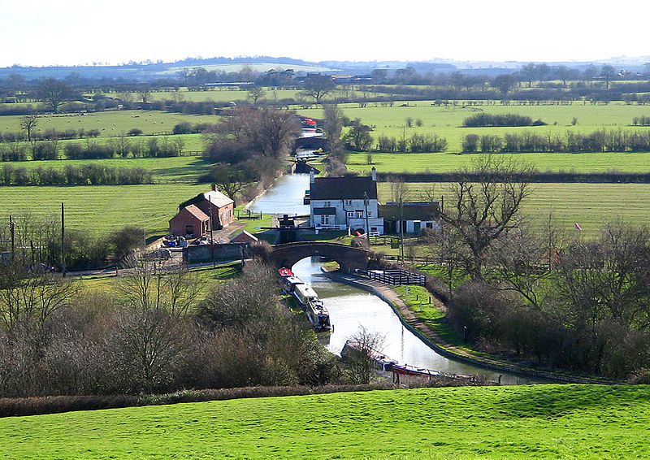
Oxford Canal

Slide 7
Round 2
It is now 1750. For a variety of different reasons (soap, sanitation, diet) there is a population explosion in England, and your village. The cursed Bubonic Plague which for centuries wiped out your village has been virtually eliminated due to the disposal of sewage in the canals and then ultimately the ocean.
Add 5 houses.

Slide 8
Round 3
It is 1760. The people of your village need a bit more food and goods to meet the needs of the new inhabitants. Coincidentally, a number of other noteworthy events occurred around 1760. First, a number of new mechanical inventions for farms are developed. One is called the seed drill and another is the horse-drawn cultivator. Also, farmers begin to experiment with new, more productive farming practices like crop rotation, new fertilizers, and new livestock breeding techniques. Consequently, farm production is significantly increased. But there is one problem. Most farmers own small tracts of land. Why should they, or how could they, invest in expensive machines when their land is so small? What’s more, it’s almost impossible to buy more land from anyone! At the same time, pressure was placed on Parliament by large and small landowning farmers to make more land available. Where is that land to come from? The Commons, of course! A series of laws called the Enclosure Acts is passed by Parliament. This means that landowners can buy pieces of common land from the government.
Erase half of your commons and add 1 more nice house.

Slide 9
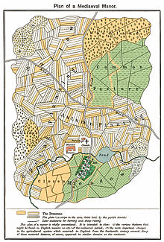
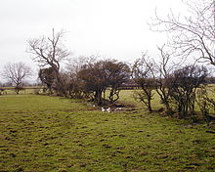
Left: The green areas show the Commons areas in a traditional village
Above: The remains of hedges marking the first enclosed fields created by the Enclosure Acts

Slide 10
Round 4
It is now 1773. A man named Richard Arkwright invents a new machine that can spin and weave cloth a hundred times faster than could be done by hand in a farm cottage (the cottage industry/the domestic system/the putting-out system). He called his machine the Water Frame because its principle source of power was water. As a result, the first factory for producing cotton cloth was built.
Add 1 factory. Remember, the cotton factory must be placed on the riverbank. Canal water is not swift enough to generate the power to move the parts of the water frame. Do not add any smoke to this factory!

Slide 11
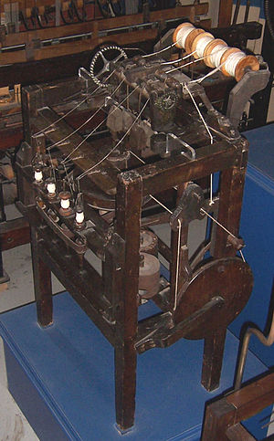
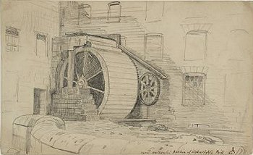
The Arkwright Machine/
Water Frame

Slide 12
Round 5
It is now 1774. Workers are needed to work in this new factory. Since many people (women) cannot compete with the spinning and weaving of cloth made in the factory and there are large numbers of poor families who have lost their livelihood due to the Enclosure Acts, people begin moving to your village to find work.
Add 5 houses, 1 church, 1 pub, and 1 store. You may draw additional roads and 1 additional bridge. You may find at this point that you need to erase trees to fit in your new drawings – that’s fine; trees may be erased at any point through the rounds.

Slide 13
Round 6
The profits from the first textile factory are enormous. It should be no surprise that Richard Arkwright is referred to with two titles: the first millionaire and the father of the factory. New factories are built in your community. The early owners of these factories called themselves capitalists because they had the capital (money) to purchase the raw material, the building, the water frame, pay their workers a fixed wage, and make a profit!
Add 5 new factories.

Slide 14
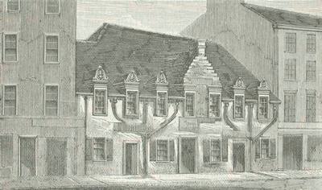
Round 7
It is 1780. Unemployed workers from surrounding area flood into your community looking for work. Although wages are very low, they still look attractive to starving families. Housing is in great demand. For the first time a new kind of housing is constructed, called tenements. Here, dozens of families reside under one roof.
Add 5 tenements.

Slide 15
Round 8
It is now 1780. More workers need to live, eat, shop, drink, and worship. They need social support services to go along with this demand.
Since workers in the factories work 6 days a week, the only day of rest is Sunday. Add 1 church. People flock to your churches so make them convenient for their tired feet. Also, add 1 store, 1 pub, and 1 school for those families wealthy enough to send their children (boys only) to school.

Slide 16
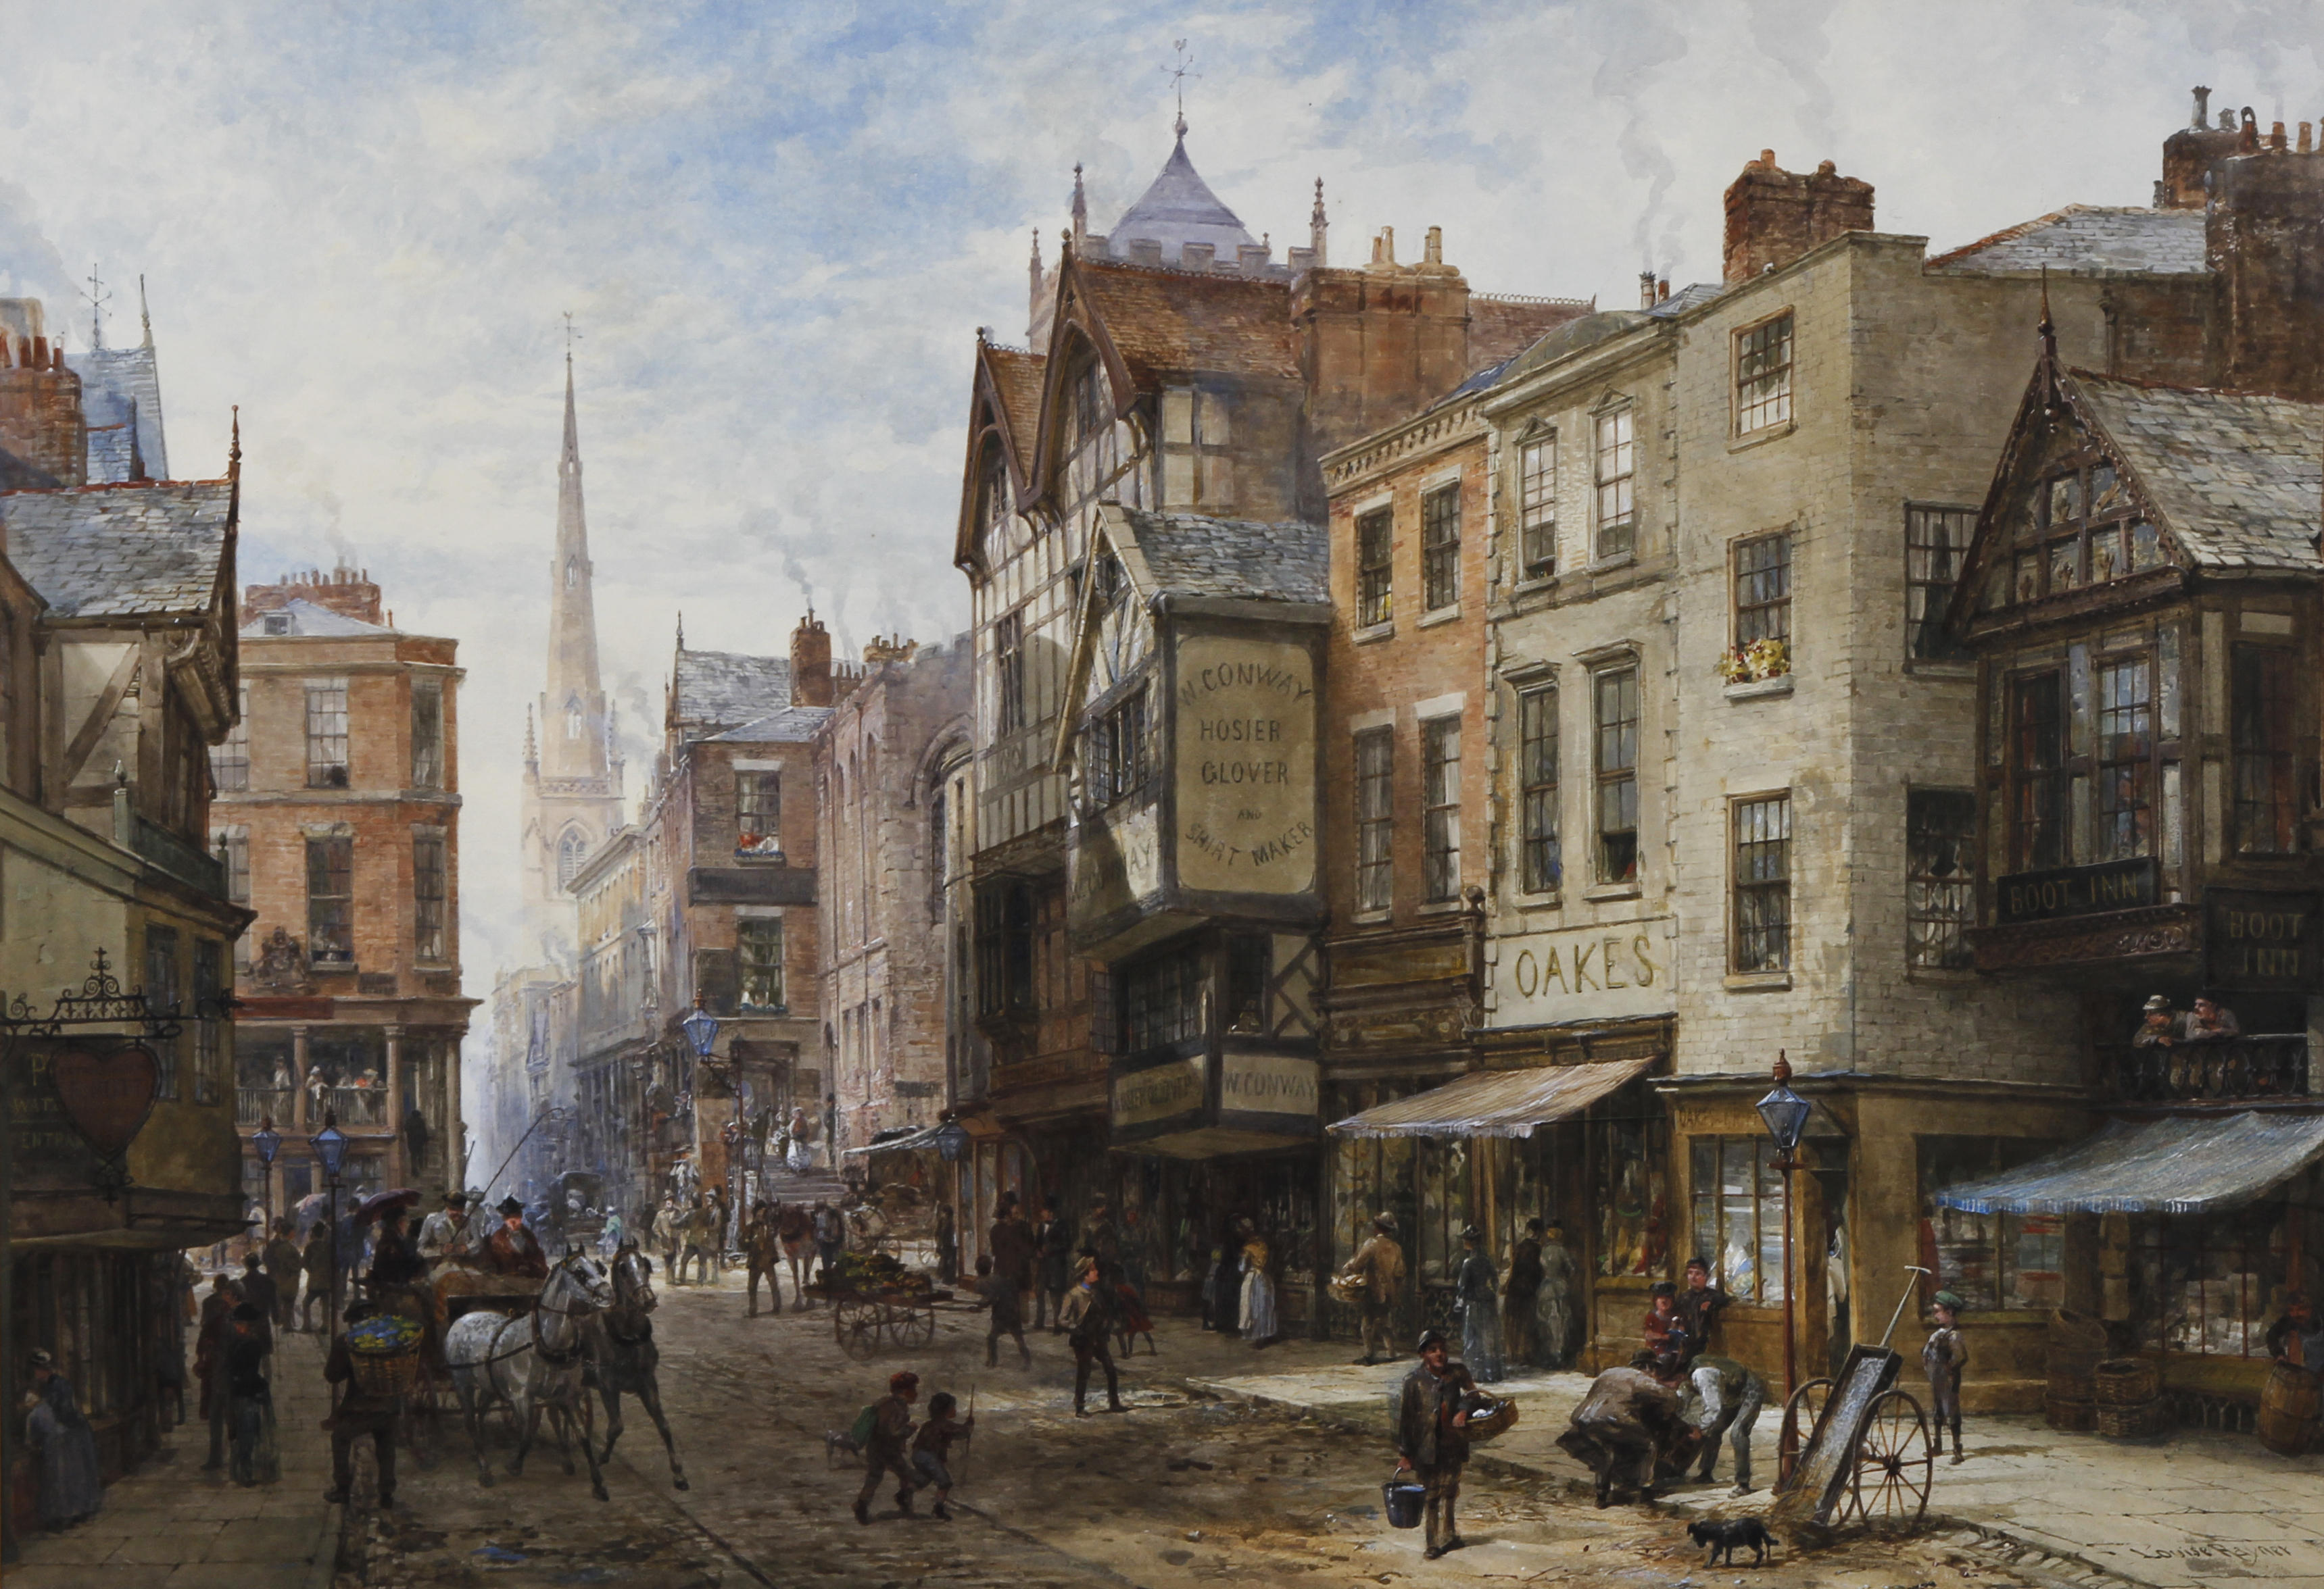

Slide 17
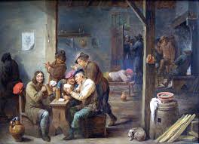
Round 9
It is now 1782. Workers work long, hard hours in the factories. The average day begins at 6:00am and ends at 9:00pm. There is only a 30-minute break for lunch. After work, exhausted “stressed out” workers stop at their favorite pub for some relaxation. Alcohol begins to be consumed throughout England in record amounts.
Add 2 more pubs.

Slide 18
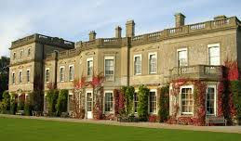
Round 10
It is now 1783. Workers barely eke out a marginal existence. There is never enough money to save and some workers go into debt. Few, if any, could afford to send their children to school. Still, there are a few families whose lifestyle is quite affordable, even luxurious. Who are they? They are the large landowning farmers and factory owners. Handsome manor houses are built and some are lavishly furnished with art. These new rich (nouveau riche) are not part of the old aristocratic rich.
Add 2 more special homes.

Slide 19
Round 11
The year is 1785. A man named James Watt invents a new machine called the steam engine. The steam engine replaces the water frame. First, it is far more efficient. Second, it allows factories to be built away from the river. This source of power is more mobile. Capitalists quickly replace their water frames with steam-powered weaving and spinning machines. The main business in England is still textile manufacturing.
Add 10 factories with smoke. Add smoke to all other pre-existing factories. Also, add 1 nicer house since people continue to get rich.

Slide 20
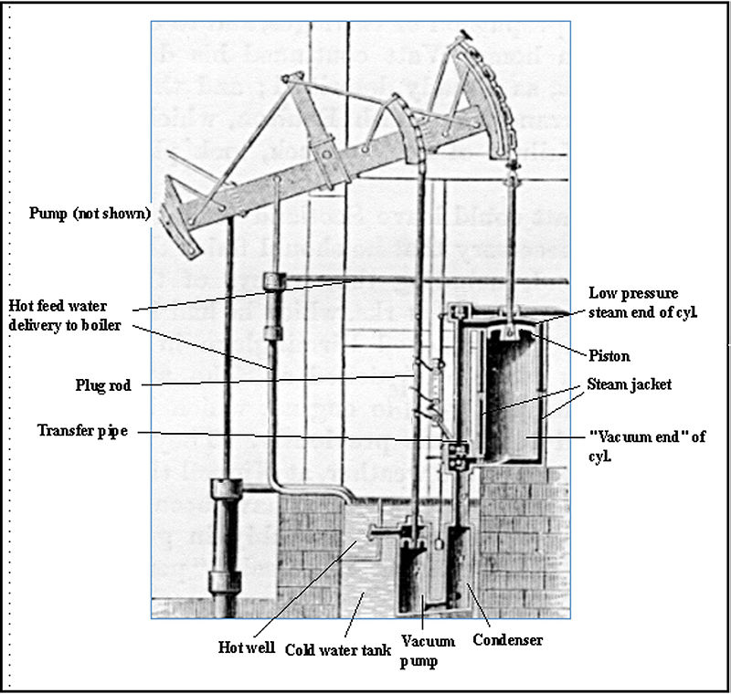
Watt Steam Engine

Slide 21
Round 12
The year is 1800. A man named Henry Cort has just invented the puddling process. This process makes it possible for coal, which is, fortunately, in abundant supply in England, to be used as the primary fuel in the new iron industry. Consequently, your town is thrust into the “New Age of Heavy Industry.” Large factory districts appear which manufacture iron at low prices, which can then be transported by your canal.
Add 1 new coal mine and a new iron bridge to replace the old wooden bridge.

Slide 22
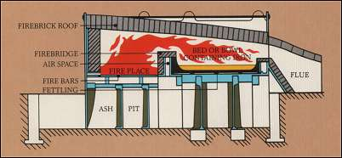
Cort’s Puddling Furnace

Slide 23
Round 13
The year is 1815. Coal miners are busy mining coal because of great demand for home-heating, fuel for their steam engines, and production of iron. In the 1700’s coal miners were adults who worked in the winter to supplement their wages; by the 1800’s they are typically children between the ages of 8 and 14. The work is dangerous and unhealthy. Children become victims of “black lung,” accidents and explosions. Their growth is stunted as they spend most of their 14-hour day stooped over; they are malnourished. Casualty rates go up.
Draw 1 cemetery.

Slide 24
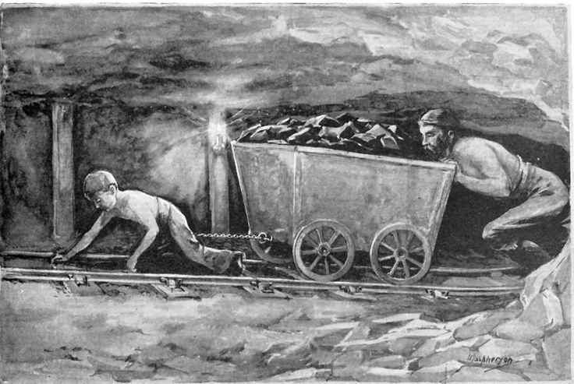
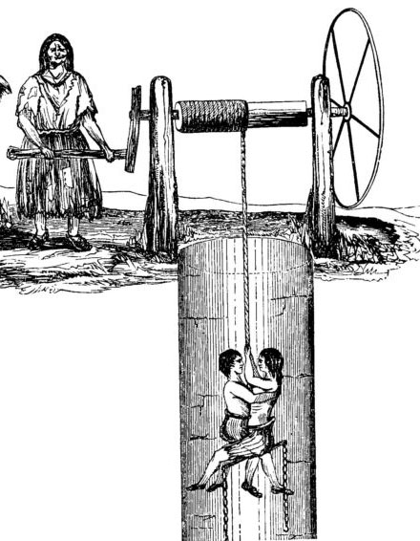
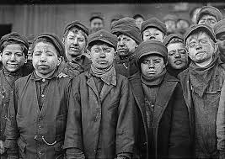

Slide 25
Round 14
It is 1820. The existing canals and dirt roads cannot accommodate the heavy industrial traffic. New experiments with transportation using the power of a steam engine are tried. The most successful one appears to be a steam-engine that pulls a series of wagons or cars on an iron track. The first railroad is tested and is quite effective.
Add 1 major railroad line connecting your factory districts to your coal mining regions.

Slide 26
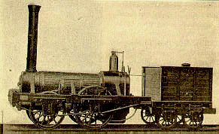
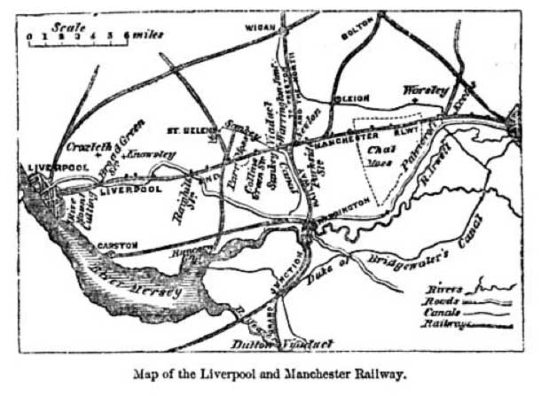

Slide 27
Round 15
It is 1827. This new “revolution” in transportation draws thousands of people to your community. Soon there becomes a surplus of workers. Capitalists who wish to ensure their profits decide to hire women and children over men because they will perform the same factory labor at one-half to one-quarter the price. More and more children leave their homes to work in factories. Unemployed men are unable to find work. Depressed, ashamed, and angry at their wives and children toiling in factories, many men turn to crime and the social life of the pub. For the first time in England’s history, alcoholism appears in epidemic proportions. Family life that existed for hundreds of years in England is disrupted. Family members seldom eat together or see each other.
Add 1 jail and 2 pubs.

Slide 28
Round 16
It is 1835. Using steam engines, iron, and soon steel, British manufacturers introduced power-driven machinery in many industries. The production of shoes, clothing, ammunition, and furniture became mechanized, as did printing and paper-making. People used machines to cut and finish lumber, to process foods, and to make other machines. Some new inventions and innovative processes had important by-products. These by-products often developed into separate industries. For example, iron smelteries used coke, a by-product of coal, to improve the smelting process. Then someone discovered that the gasses that coal released during the coke-making process could be burned to give light. During the 1830s London and other large towns became the first communities to pipe in gas to burn in streetlights. Soon all around England hundreds of towns used gas to light streets and homes.
Add 20 street lamps.

Slide 29
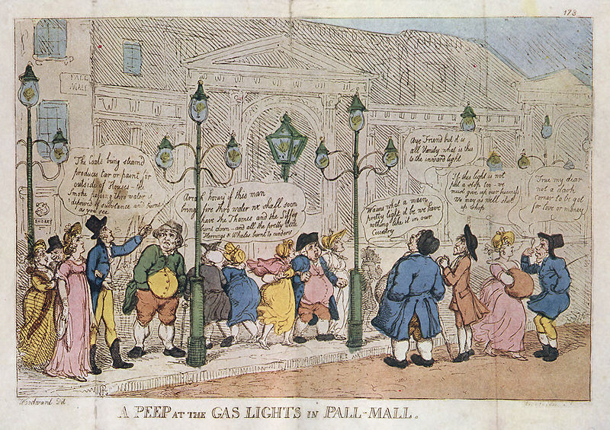
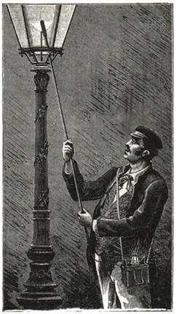

Slide 30
Round 17
It is 1838. Let’s look at the working conditions in the factories. The two most important factories are textile and iron (steel). Working conditions were appalling. Many workers contracted the deadly factory fever or white lung disease; it was probably cancer, tuberculosis, or emphysema. Other workers were injured on the job in factory accidents. Children, weakened from lack of proper sleep or diet, stumbled into machinery and were mutilated. Women’s long hair came undone and caught in moving machinery. Regardless, if you were unable to work, you were fired. There was no health insurance. There was always a daily line of unemployed workers waiting to fill vacant jobs.
Add 2 hospitals and 1 more cemetery.

Slide 31
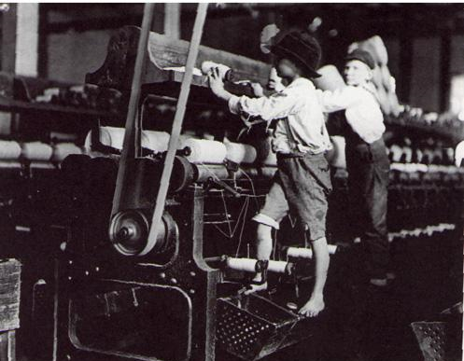
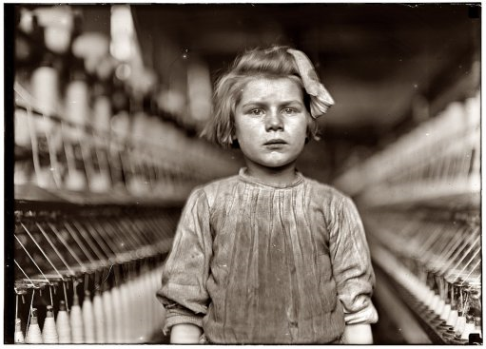
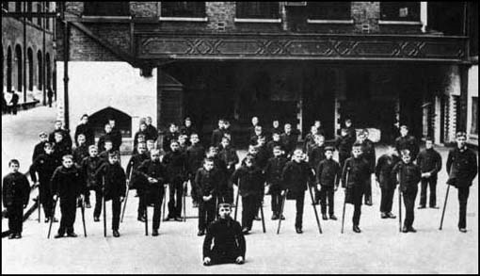

Slide 32
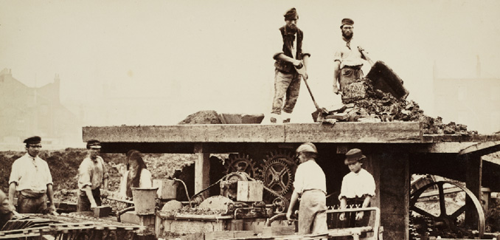
Round 18
It is 1840. The need for quicker and cheaper transportation quickens. Coal, iron, finished products, and raw materials must all be transported from one area of England to another. In the late 1830’s, a devastating potato famine drove hundreds of thousands of Irish to England. Here was the cheapest of labor possible to build more railroads.
Add 1 more railroad line.

Slide 33
Round 19
It is 1842. By this year, several million acres of good English land has been enclosed and sold to private parties. This created England’s landless poor and the economic benefits for the rich are obvious. These large landowning farmers purchase the newest power-driven machinery and can easily grow enough food to feed the working class of England. The small landowning famer is crushed by the enclosed commons. They cannot afford the machinery and cannot grow food profitably. Thousands of these folks leave their villages (where their ancestors had lived for hundreds of years) and move to towns and cities looking for work to feed their families. Some refused to leave but took jobs working for large landowning farmers. By the thousands, they moved to the bleak, uninviting towns of the north in new cotton mills.
Add 20 houses, 5 restaurants, 2 stores, 1 church, 5 factories, 1 pub, and 1 nicer house.

Slide 34
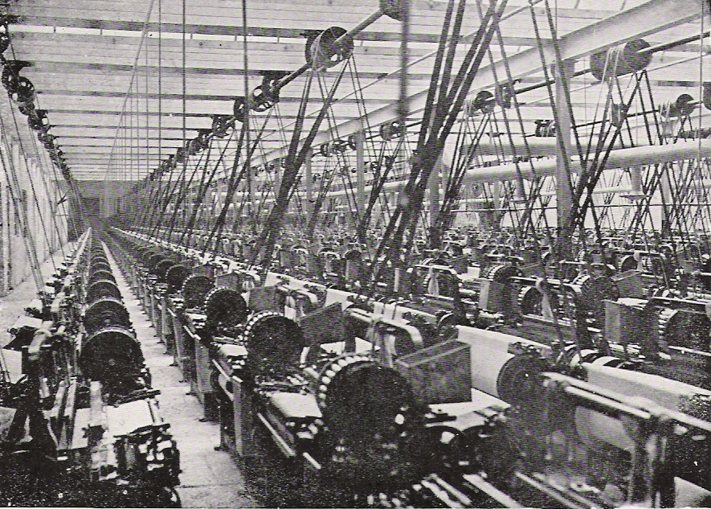
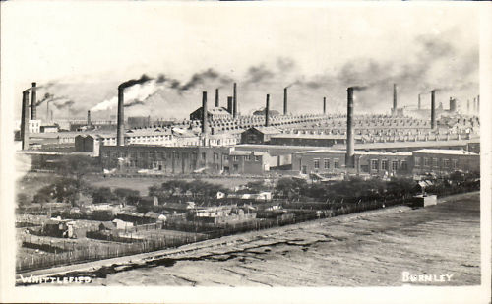

Slide 35
Round 20
It is 1845. There are some advantages for many of the urban dwellers. City life is quite different from country life. For the small but growing middle classes, a whole new cultural life is available. Museums, theatres, opera, restaurants, plays and concerts are made available. Whereas before only the aristocrats could afford the arts, now the middle class enjoys the fine life of culture and good living.
Add 2 theatres, 1 restaurant, and 2 private schools.

Slide 36
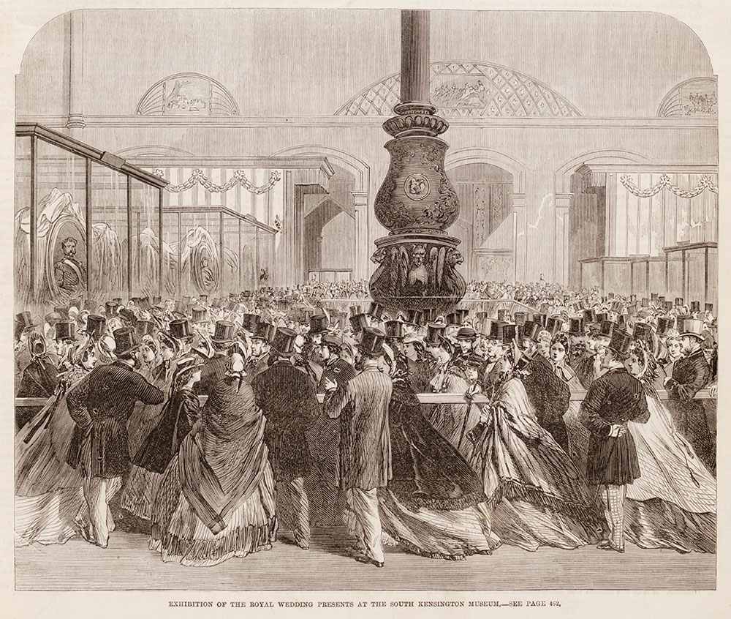
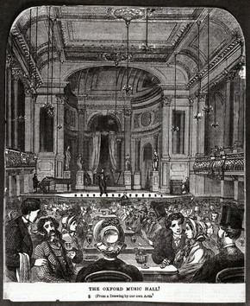

Slide 37
Round 21
It is 1850. There are no pollution controls so the air in your community looks dark. Windows, walls, even trees are covered with layers of soot and coke. The river that once flowed through your quiet village for hundreds of years is now unfit for drinking, bathing, or laundry. Malignant tumors grown in people’s bodies and the term cancer is first used in the medical profession. The average life expectancy for the poor classes is now 30 years of age. Your city is overcrowded and shrouded in factory smoke. The noise, the loss of privacy, the loss of family unity, shatters the peace of the old ways. Suicide rates double, then triple.
To accommodate the victims of urban life, add 1 cemetery, 1 jail, and 1 hospital.

Slide 39
Closing Activity
Use the Urban Game to complete the second half of the Change over Time chart (AFTER Industrialization).

Slide 40
Summary
Was it worth it??

