Slide 2
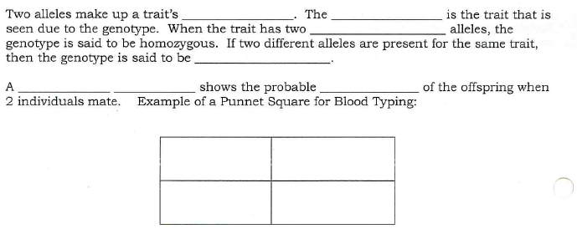

Slide 3
Phenotypes | Possible Genotypes

