Slide 1
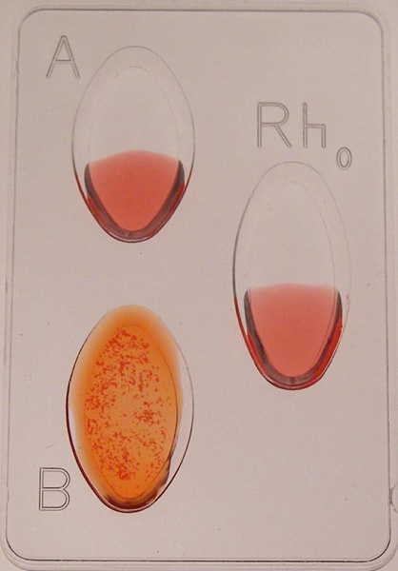
What type of blood does this person have based on the results?
Reminder: Fingerprint Test Retake Today AFTER SCHOOL.
Meet me in the LMC!

Slide 2
Blood Typing Continued…
Today’s Learning Targets:
*I can determine a suspect’s blood type using simulated agglutination tests.
*I can defend a claim based on evidence. (CER)
*I can describe blood types based on their antigen and antibody.
*I can define antigen, antibody, and agglutination.

Slide 3
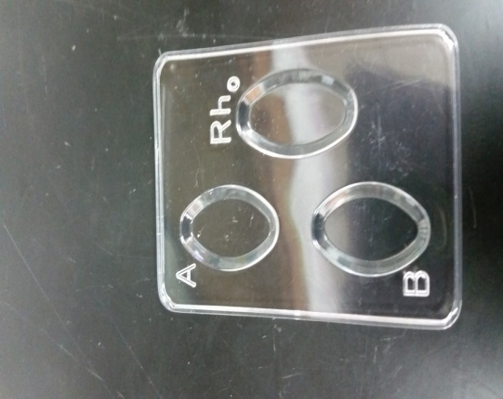
Blood Typing Lab
You will be working in a group of NO MORE than 4 people.
You can choose your group this time!
Obtain 6 spot plates and clean them using water.
(Yes, they should be clean, but students like you said they were clean when they returned them…)
Obtain blood samples (as seen below), & anti-serums. You will need to share these!
Also obtain about 20 toothpicks.

Slide 4
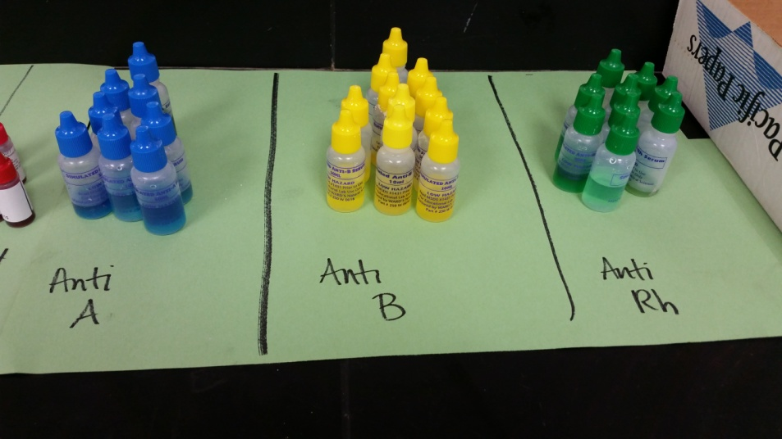
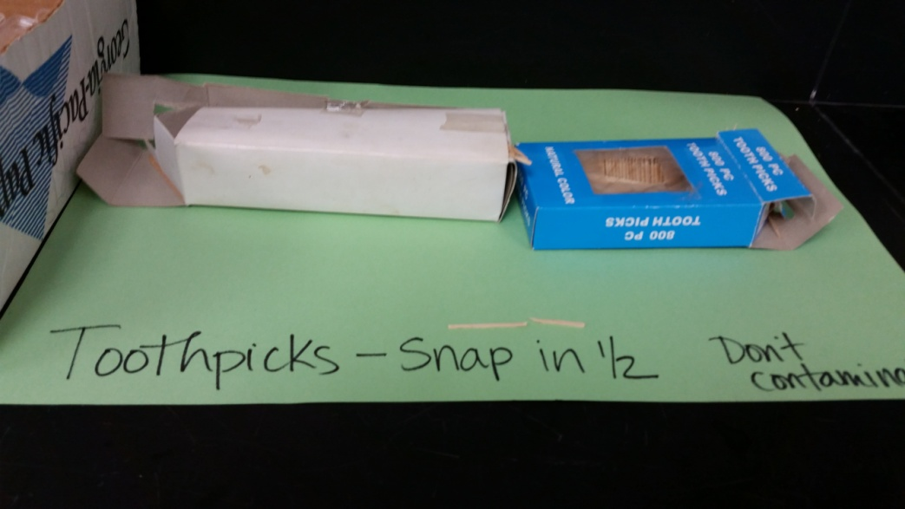
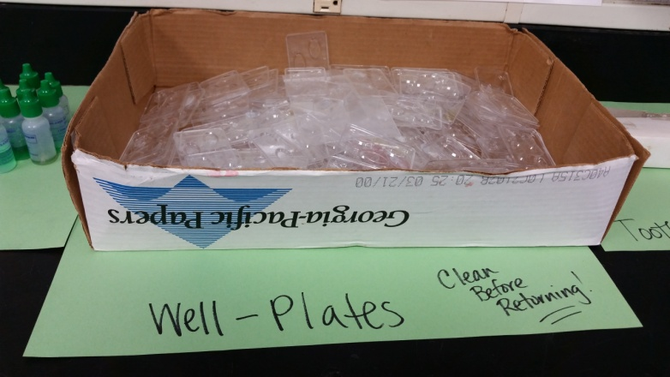
Blood Samples
Anti-Serums (antibodies)
Well plate
Snap toothpicks in ½ and use a new one for each sample!
Clean before & after use!

Slide 5
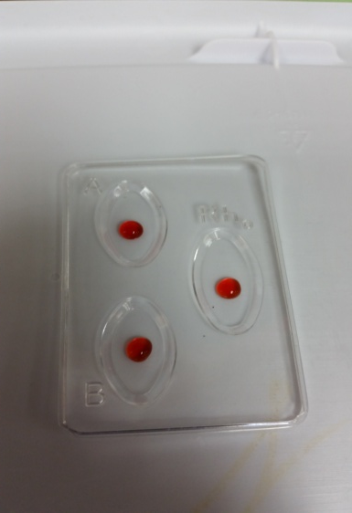
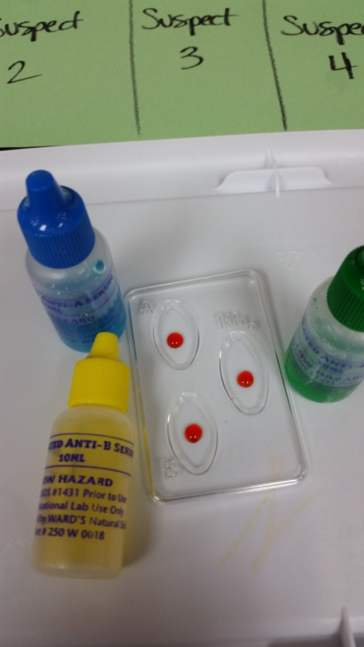
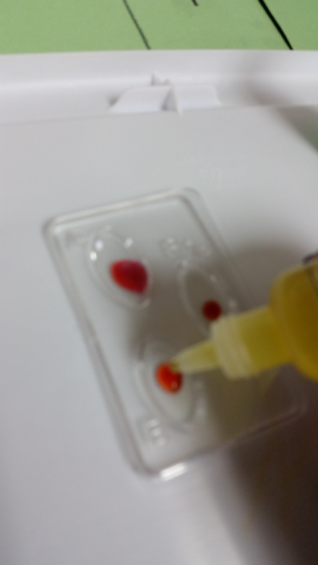
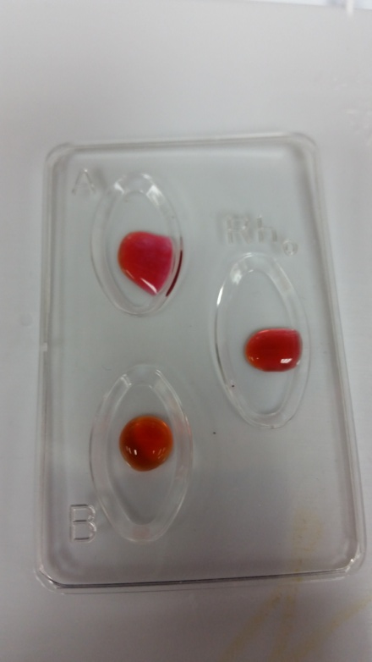
4. For each sample, place one drop of blood in the A, B, and Rh wells.
Be careful not to mix up which sample it came from!
In the A well, add 1-2 drops of Anti-A serum. (Blue)
In the B well, add 1-2 drops of Anti-B serum. (Yellow)
In the Rh well, add 1-2 drops of Anti-Rh serum. (Green)

Slide 6
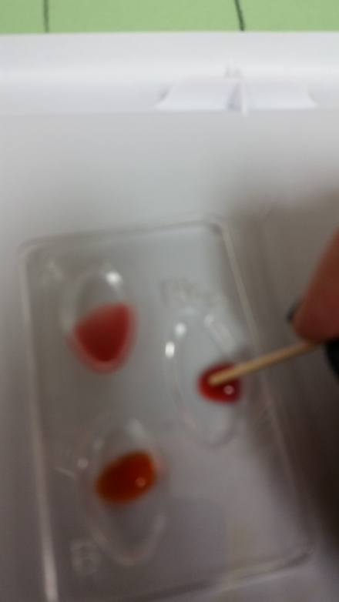
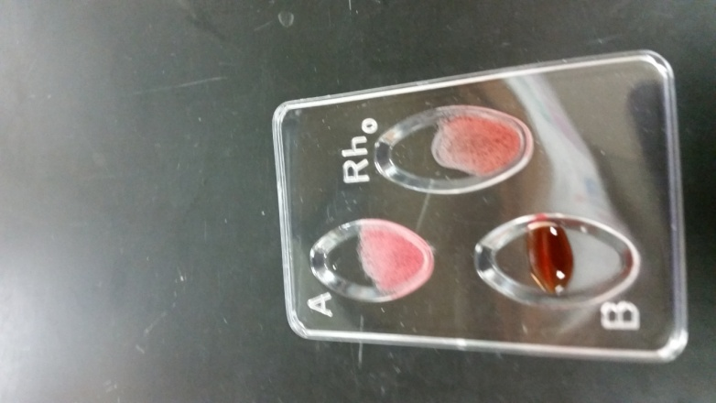
8. Using a ½ toothpick, gently stir each blood drop. Use a separate toothpick for each so that you don’t cross-contaminate!
CLUMP
9. Read the results (clump or no clump) and record them in your data table. Use this data to determine the blood type.
CLUMP
NO CLUMP

Slide 7
CER Claim, Evidence, Reasoning Template with Sentence Stems
Claim: The crime scene blood matches _____________________________.
Evidence: In the agglutination test, the crime scene blood clumped in ___________________________. In the agglutination test, suspect _______ also clumped in ______________________________.
Reasoning: The blood stain from the crime scene is type ____________. We know this because _____________________________. Suspect # _________ also has type ________ blood. We know this because ___________________________________. Because the crime scene and the suspect’s blood is the same type we can conclude that the suspect is a person of interest in the case. We cannot say that the suspect committed the crime because _____________________.
Counterclaim: We know that the victim didn’t commit the crime because _________________________________.

