Slide 1
WHAT’S YOUR GOAL?
What will it take to that goal a reality?

Slide 2
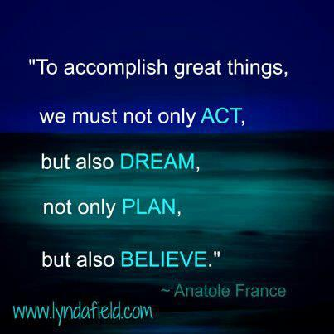

Slide 3
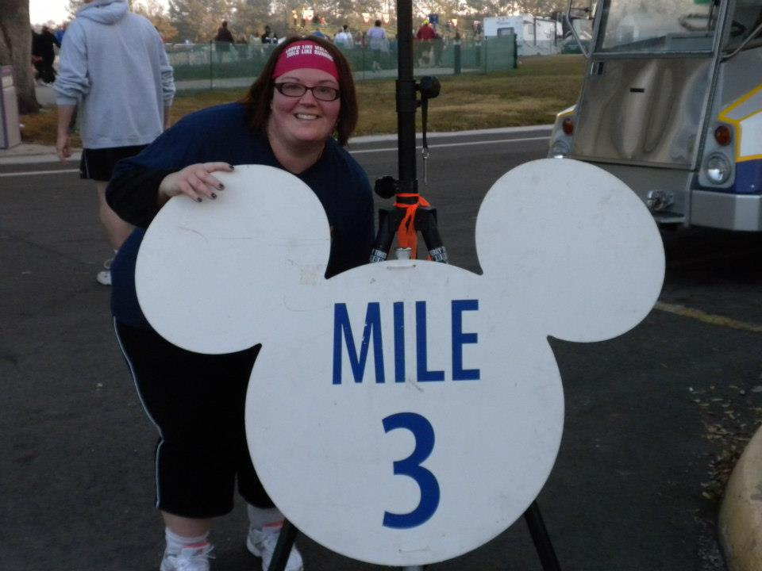
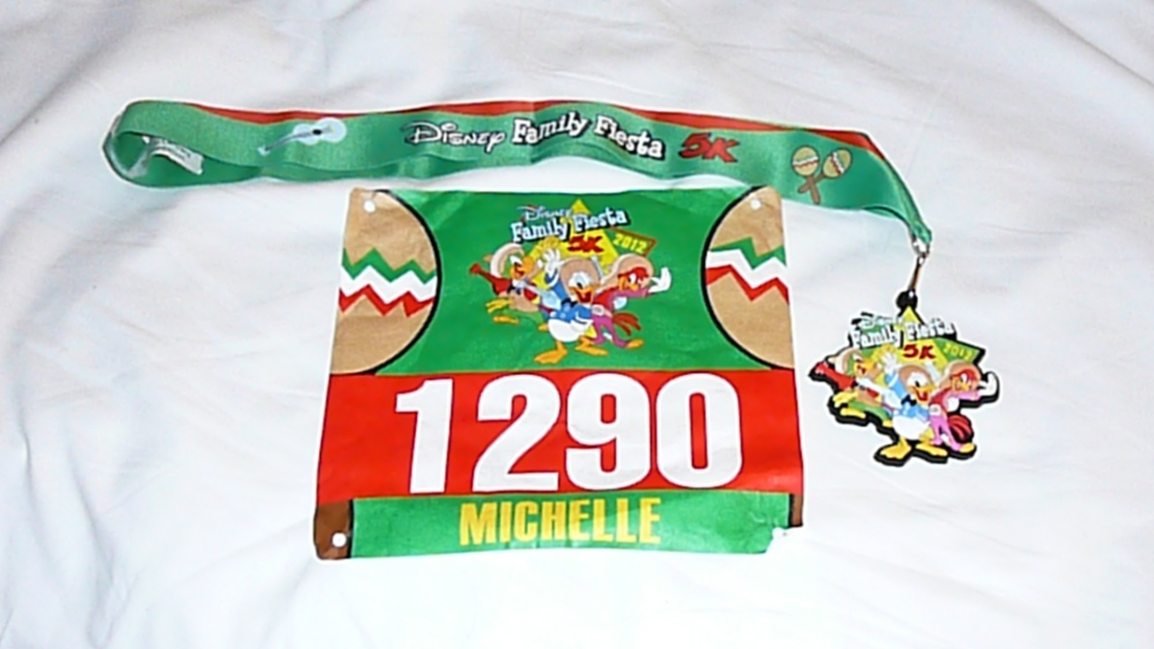
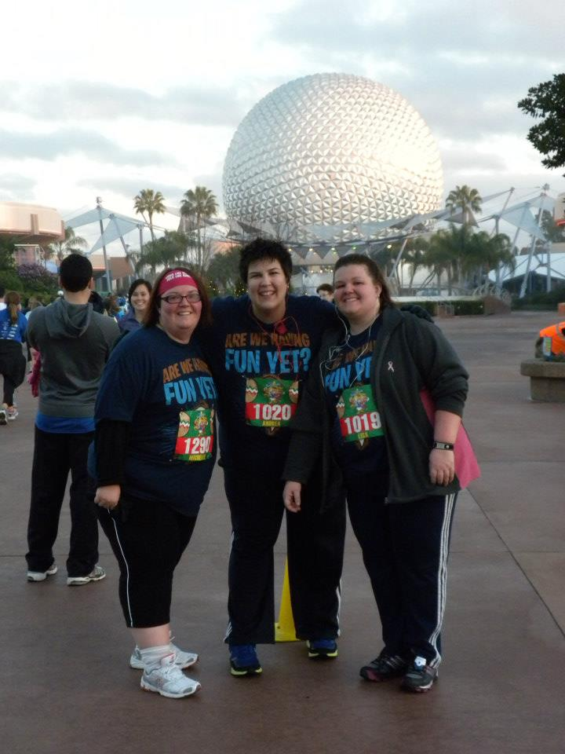
I ‘ran’ a 5K (3.1 miles) at Walt Disney World!
January 2012

Slide 4
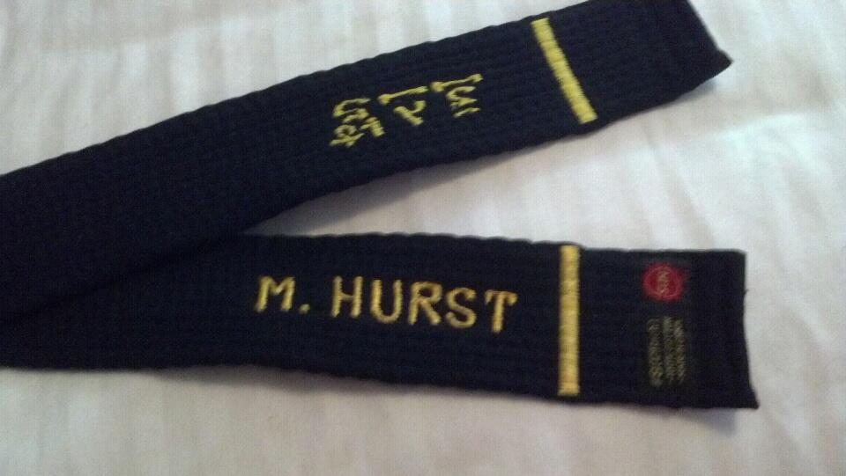
I earned my black belt in Tae Kwon Do! August 2012

Slide 5
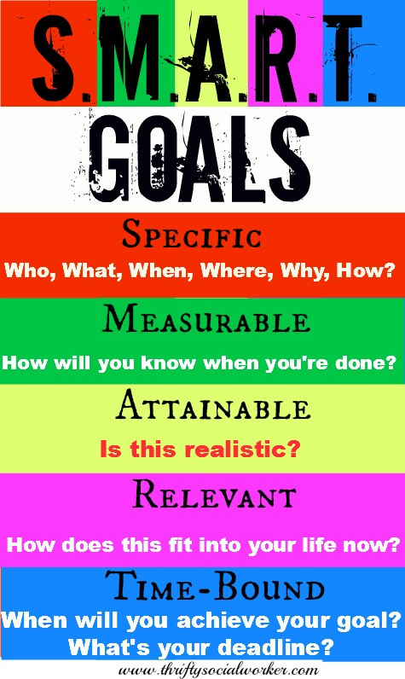
Is your goal SMART?

