Slide 1
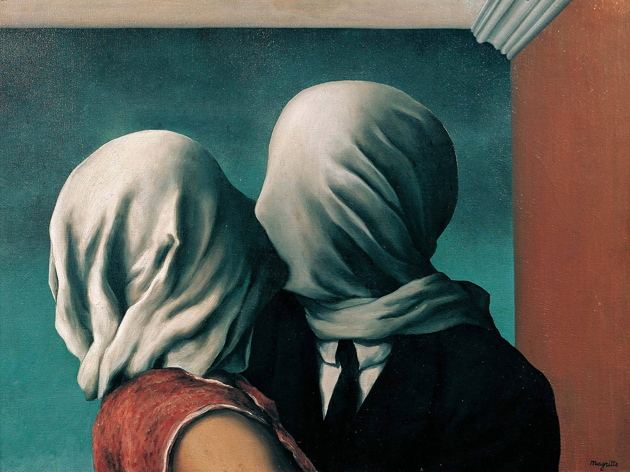

Slide 2
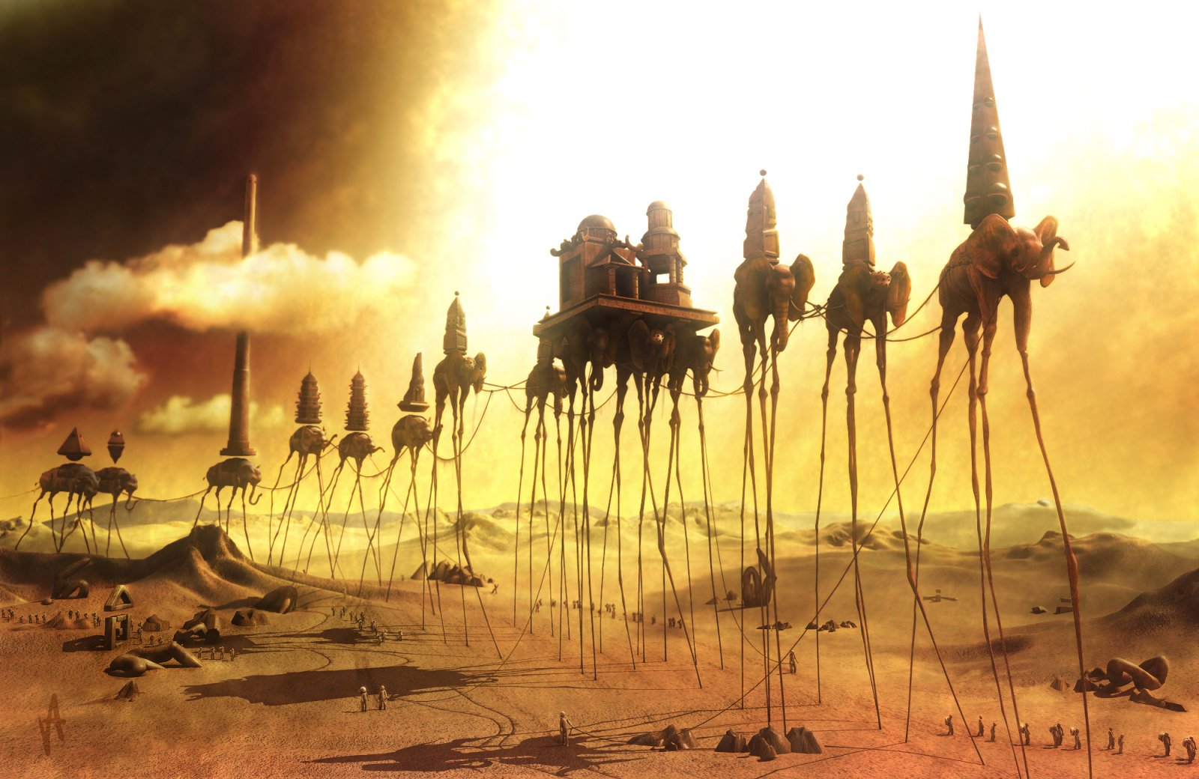

Slide 3
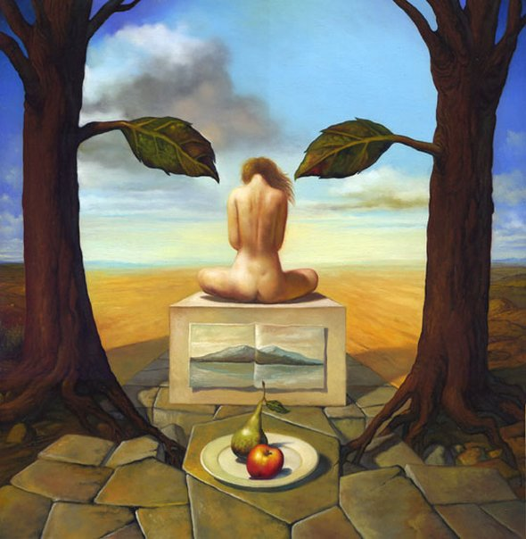

Slide 4
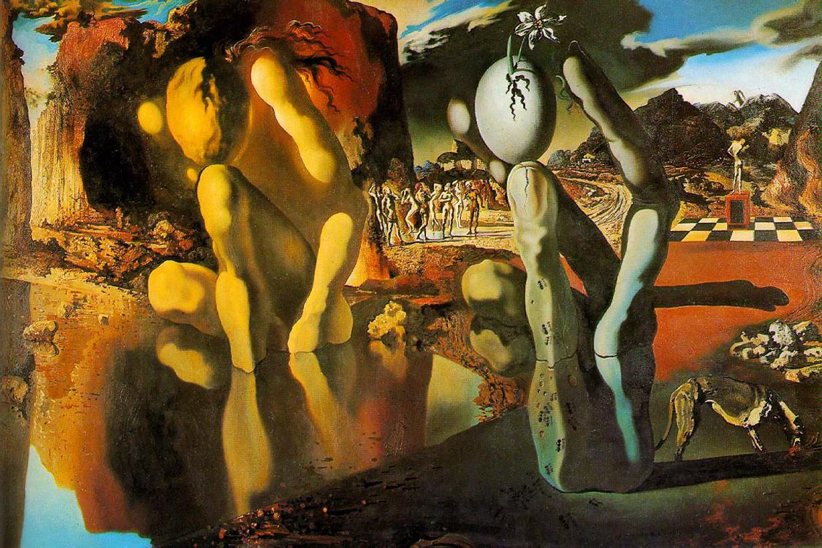

Slide 5
You are to use one of these surrealistic paintings and create a story:
1. The story must be a minimum of two pages in length (if you write big, three pages).
2. Develop a plot and characters.
3. The story must have a theme with a message, but make it so the reader has to look for it:
a. use symbols
b. metaphors and similes
c. allusions
d. motifs
4.

