Slide 1
Community Edition
With your host: Ms. Philips

Slide 2
Communities | Transportation | Consequences | Regions | Maps
100 | 100 | 100 | 100 | 100
200 | 200 | 200 | 200 | 200
300 | 300 | 300 | 300 | 300
400 | 400 | 400 | 400 | 400
500 | 500 | 500 | 500 | 500

Slide 3
Communities - 100
Which building is a place where people live in a community?
Store
House
School

Slide 4
Communities – 100
Which building is a place where people live in a community?
Store
House
School

Slide 5
Communities - 200
What might be found in a community where people play?
Bank
Factory
Park

Slide 6
Communities – 200
What might be found in a community where people play?
Bank
Factory
Park

Slide 7
Communities - 300
Where might people shop in a community?
School
Park
Grocery Store

Slide 8
Communities – 300
Where might people shop in a community?
School
Park
Grocery Store

Slide 9
Communities - 400
Which is a way people take care of their community?
Picking up trash
Putting toys away
Going to school

Slide 10
Communities – 400
Which is a way people take care of their community?
Picking up trash
Putting toys away
Going to school

Slide 11
Communities - 500
Communities are divided:
into different places where people work, play, live, and shop
into places with streets
into places with people and without people

Slide 12
Communities – 500
Communities are divided:
into different places where people work, play, live, and shop
into places with streets
into places with people and without people

Slide 13
Transportation - 100
What is a type of transportation that people can move by water?

Slide 14
Transportation – 100
What is a type of transportation that people can move by water?
Boat
Ship
Ferry

Slide 15
Transportation - 200
A grocery store needs apples. What form of transportation could be used to get the apples there?
Apple orchard
Truck
Highway
CHECK

Slide 16
Transportation – 200
A grocery store needs apples. What form of transportation could be used to get the apples there?
Apple orchard
Truck
Highway

Slide 17
Transportation - 300
What are the three categories we can divide transportation into?

Slide 18
Transportation – 300
What are the three categories we can divide transportation into?
Land
Air
Water

Slide 19
Transportation - 400
What are 3 examples of different forms of transportation?

Slide 20
Transportation – 400
What are 3 examples of different forms of transportation?
Boat
Car
Bus
Taxi
Truck
Subway

Slide 21
Transportation - 500
What does the word transportation mean?
A way to move ONLY people from one place to another.
A way to move BOTH goods and people from one place to another.
A way to move ONLY goods from one place to another.

Slide 22
Transportation – 500
What does the word transportation mean?
A way to move ONLY people from one place to another.
A way to move BOTH goods and people from one place to another.
A way to move ONLY goods from one place to another.

Slide 23
Consequences - 100
What does a negative consequence mean?
When good things happen as a result of an action a group or person takes
When bad things happen as a result of an action a group or person takes
When bad things happen in nature

Slide 24
Consequences – 100
What does a negative consequence mean?
When good things happen as a result of an action a group or person takes
When bad things happen as a result of an action a group or person takes
When bad things happen in nature

Slide 25
Consequences - 200
What does a positive consequence mean?
When something good happens because of a person or group of people
When something good happens because of the weather
When something does not work out as planned

Slide 26
Consequences – 200
What does a positive consequence mean?
When something good happens because of a person or group of people
When something good happens because of the weather
When something does not work out as planned

Slide 27
Consequences - 300
A group of second graders went to the park. They ate candy bars and left their wrappers on the ground. What type of consequence is this?

Slide 28
Consequences – 300
A group of second graders went to the park. They ate candy bars and left their wrappers on the ground. What type of consequence is this?
Negative Consequence

Slide 29
Consequences - 400
Name one positive and one negative consequence of cutting down trees in a community.
Notes:
You will have to move the Daily Double picture out of the way to write the question. If you do not wish to have the Daily Double in the game, delete it and the sound clip (speaker) from this slide. For a Daily Double, the contestant has to wager at least $5 and at most the highest point value of any player/team at that point in the game. It is considered a True Daily Double if they wager all of their points and go “double or nothing”.

Slide 30
Consequences – 400
Name one positive and one negative consequence of cutting down trees in a community.
Examples:
Negative: lose trees; decrease oxygen output; get rid of natural characteristic
Positive: room for a new house/building/store

Slide 31
Consequences - 500
What is one way you can create a positive consequence in your community?

Slide 32
Consequences – 500
What is one way you can create a positive consequence in your community?
Examples:
Planting a tree
Not littering/picking up litter
Riding a bike when you can instead of in a car

Slide 33
Regions - 100
What type of region is Dearborn?

Slide 34
Regions – 100
What type of region is Dearborn?
A community

Slide 35
Regions - 200
What type of region is Michigan?

Slide 36
Regions – 200
What type of region is Michigan?
A state

Slide 37
Regions - 300
What type of region is the United States of America?

Slide 38
Regions – 300
What type of region is the United States of America?
A country

Slide 39
Regions - 400
Which region is smaller than a state?
Country
World
Community

Slide 40
Regions– 400
Which region is smaller than a state?
Country
World
Community

Slide 41
Regions - 500
Which set of regions goes from smallest to largest?
Country --- State --- Community
Community --- Country --- State
Community --- State --- Country

Slide 42
Regions– 500
Which set of regions goes from smallest to largest?
Country --- State --- Community
Community --- Country --- State
Community --- State --- Country

Slide 43
Maps - 100
What is a map?
A picture of my family
A place to shop at
A drawing that shows what a place looks like from above

Slide 44
Maps – 100
What is a map?
A picture of my family
A place to shop at
A drawing that shows what a place looks like from above

Slide 45
Maps - 200
What is the purpose of a map key?
To show different colors on a map
To show different places and things located on the map
To show distance between things found on a map

Slide 46
Maps – 200
What is the purpose of a map key?
To show different colors on a map
To show different places and things located on the map
To show distance between things found on a map

Slide 47
Maps – 300
Look at the map key.
What is a natural characteristic found on the map key?

Slide 48
Maps – 300
Look at the map key.
What is a natural characteristic found on the map key?
Tree

Slide 49
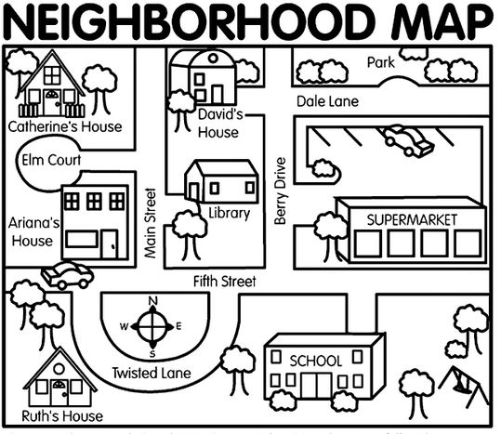
Maps - 400
A person is going from the library to Ariana’s House. What direction are they going?

Slide 50
Maps – 400
A person is going from the library to Ariana’s House. What direction are they going?
West

Slide 51
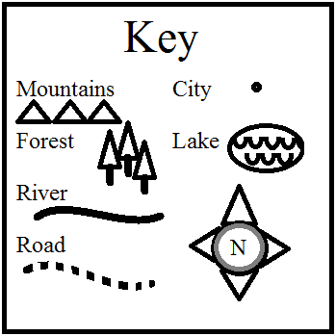
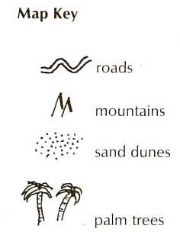
Maps - 500
What is a natural characteristic that is found in BOTH communities?

Slide 52
Maps – 500
What is a natural characteristic that is found in BOTH communities? Mountains

Slide 53
FINAL JEOPARDY
CATEGORY: Treeville

Slide 54
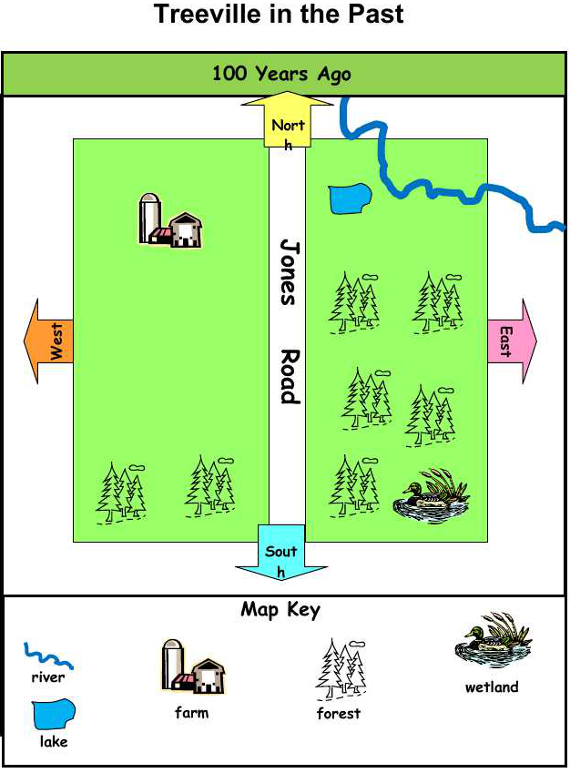
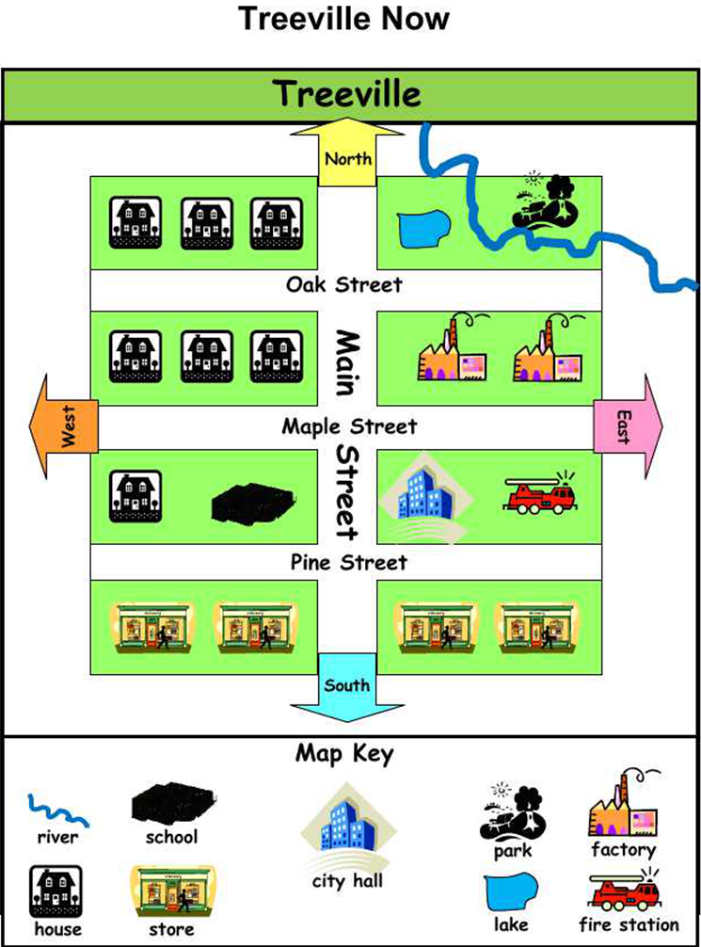
FINAL JEOPARDY
Name at least 3 differences between Treeville 100 years ago and Treeville now.

Slide 55
FINAL JEOPARDY
Name at least 3 differences between Treeville 100 years ago and Treeville now.
No more forests
No more farm
Lots of stores/homes/factories now
Fire station/City Hall/school now
Both have a lake and a river
Both have a road (more now)

