Slide 1

Water Edition
With your host: Mrs. Turk

Slide 2

Property or Example? | Solid or Liquid Water? | Where do we get water? | How do we use water? | Wild Card
100 | 100 | 100 | 100 | 100
200 | 200 | 200 | 200 | 200
300 | 300 | 300 | 300 | 300
400 | 400 | 400 | 400 | 400
500 | 500 | 500 | 500 | 500

Slide 3
Property or Example? - 100
A property is how you __________ an object.
Describe
Use
like

Slide 4

Property or Example? - 100
A property is how you __________ an object.
Describe
Use
like

Slide 5
Property or Example? - 200
Wet is a _____________ of water as a liquid.

Slide 6
Property or Example? - 200
Wet is a property of water as a liquid.

Slide 7
Property or Example? - 300
Snow is an ________________ of water as a solid.

Slide 8
Property or Example? - 300
Snow is an example of water as a solid.

Slide 9
Property or Example? - 400
Property or example: hard

Slide 10
Property or Example? - 400
property

Slide 11
Property or Example? - 500
Property or example: frozen

Slide 12
Property or Example? - 500
property

Slide 13
Solid or Liquid Water? - 100
‘Clear’ is a property of water as a ___________.

Slide 14
Solid or Liquid Water? - 100
‘Clear’ is a property of water as a liquid.

Slide 15
Solid or Liquid Water? - 200
Which one is a property of water as a liquid?
Hard
Rain
wet
CHECK

Slide 16
Solid or Liquid Water? - 200
Which one is a property of water as a liquid?
Hard
Rain
wet

Slide 17
Solid or Liquid Water? - 300
Choose the 2 that are examples of water as a solid?
Hail
Icicle
lake

Slide 18
Solid or Liquid Water? - 300
Choose the 2 that are examples of water as a solid?
Hail
Icicle
lake

Slide 19
Solid or Liquid Water? - 400
What is one property of water as a solid?

Slide 20
Solid or Liquid Water? - 400
What is one property of water as a solid?
Hard, cold, frozen, white or clear, has its own shape, slippery

Slide 21
Solid or Liquid Water? - 500
What are 2 examples of water as a liquid?

Slide 22
Solid or Liquid Water? - 500
What are 2 examples of water as a liquid?
Rain, lake, pond, ocean, river, stream

Slide 23
Where do we get water? - 100
True or False: A sink is a source of water.

Slide 24
Where do we get water? - 100
True or False: A sink is a source of water.
False!

Slide 25


Where do we get water? - 200
True or False: We can get fresh water from the ocean.

Slide 26
Where do we get water? - 200
True or False: We can get fresh water from the ocean.
False! The ocean is actually salt water.

Slide 27
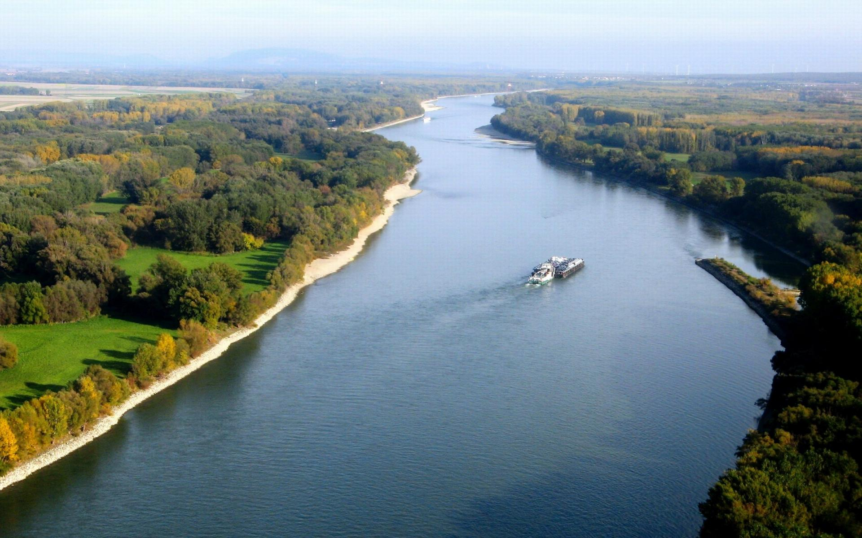
Where do we get water? - 300
Name this source of water:

Slide 28
Where do we get water? - 300
Name this source of water:
RIVER

Slide 29
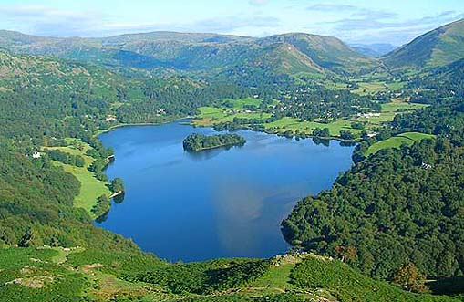
Where do we get water? - 400
Name this source of water:
Notes:
You will have to move the Daily Double picture out of the way to write the question. If you do not wish to have the Daily Double in the game, delete it and the sound clip (speaker) from this slide. For a Daily Double, the contestant has to wager at least $5 and at most the highest point value of any player/team at that point in the game. It is considered a True Daily Double if they wager all of their points and go “double or nothing”.

Slide 30
Where do we get water? - 400
Name this source of water:
LAKE

Slide 31
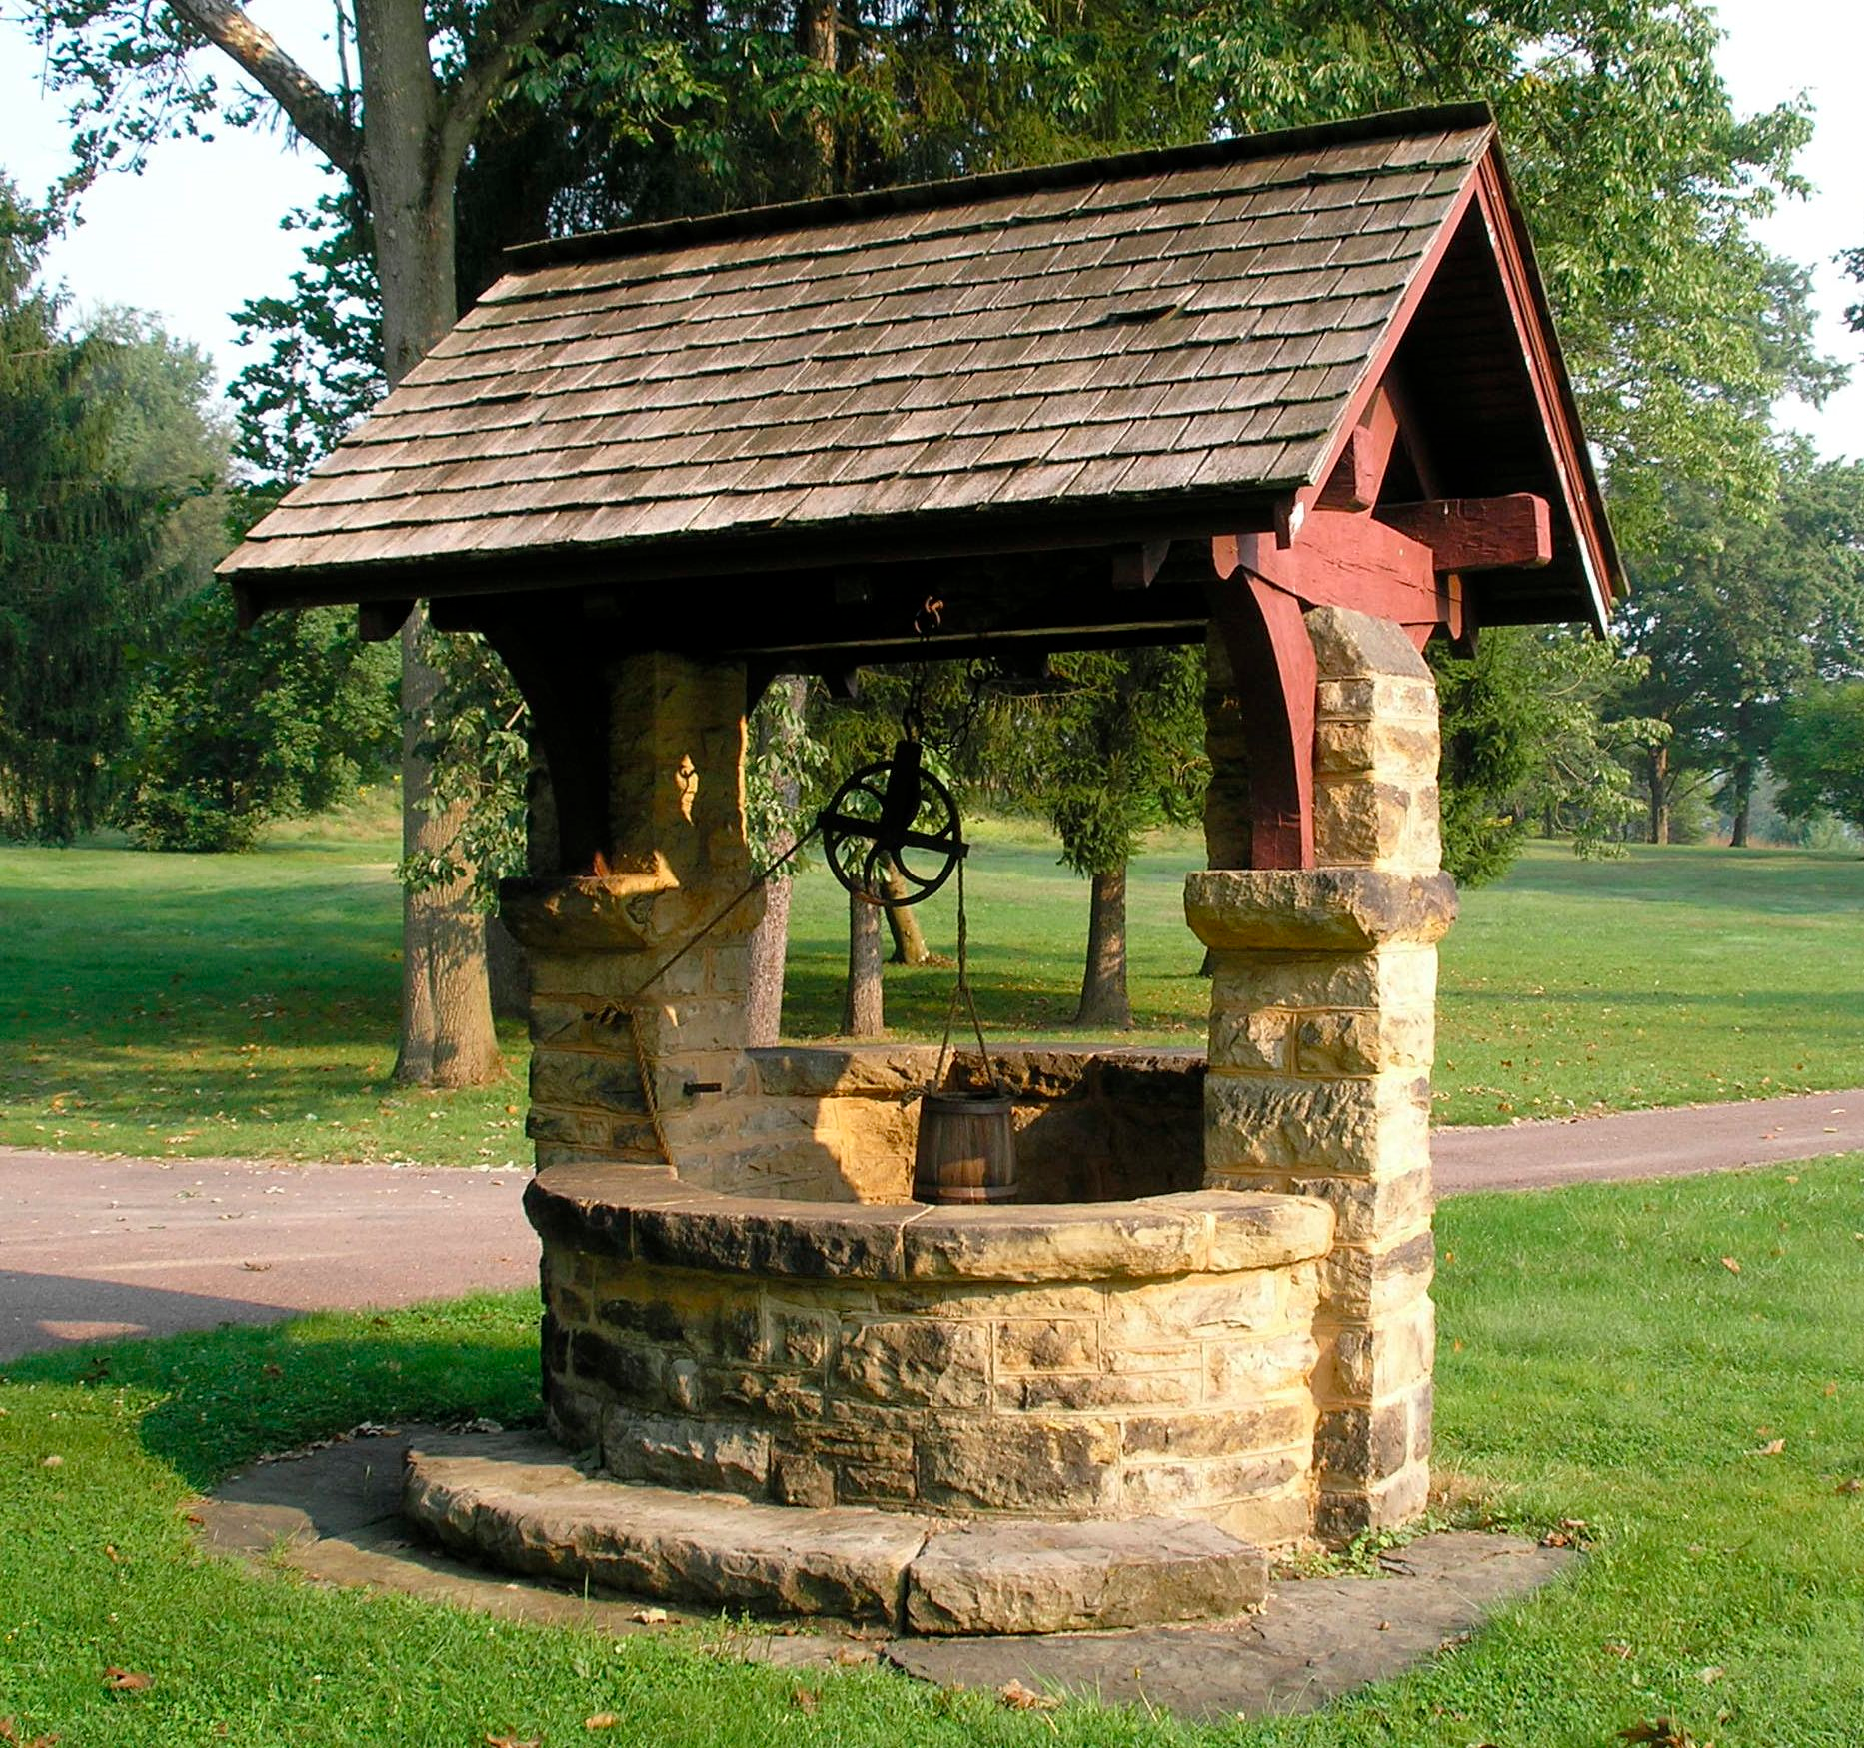
Where do we get water? - 500
A well is a human feature. The water in the
well really comes from ____________________.

Slide 32
Where do we get water? - 500
A well is a human feature. The water in the well really comes from underground.

Slide 33
How do we use water? - 100
Describe 2 ways we use water in our home.

Slide 34
How do we use water? – 100
Describe 2 ways we use water in our home.
wash dishes
take a shower or bath
flush the toilet
drink
for cooking
Brushing teeth
Wash hands
Wash clothes
clean

Slide 35
How do we use water? - 200
What are 2 ways farmers may use water?

Slide 36
How do we use water? – 200
What are 2 ways farmers may use water?
Water crops and feed animals

Slide 37
How do we use water? - 300
True or False: Water can be used to create electricity.

Slide 38
How do we use water? – 300
True or False: Water can be used to create electricity.
TRUE

Slide 39
How do we use water? - 400
What forms of transportation use water?

Slide 40
How do we use water? – 400
What forms of transportation use water?
Boat, ship, jet-ski, submarine, sailboat, ferry, canoe

Slide 41
How do we use water? - 500
How do we use water for recreation (for fun)?

Slide 42
How do we use water? – 500
How do we use water for recreation (for fun)?
Fishing, swimming, surfing, sprinklers, water balloons, sailing, water slides,

Slide 43
Wild Card - 100
True or False: All living things need water.

Slide 44
Wild Card – 100
True or False: All living things need water.
True.

Slide 45
Wild Card - 200
Slippery is a property of water as a:
Liquid
Solid
Both

Slide 46
Wild Card – 200
Slippery is a property of water as a:
Liquid
Solid
Both**
In class we mainly used slippery as a property of a solid, since ice is very slippery. However, it is acceptable for students to say ‘both’ as their answer.

Slide 47
Wild Card - 300
An iceberg is an example of water as a ________.

Slide 48
Wild Card – 300
An iceberg is an example of water as a solid.

Slide 49
Wild Card - 400
True or False: Miners and loggers both have reasons to use water as part of their job.

Slide 50
Wild Card – 400
True or False: Miners and loggers both have reasons to use water as part of their job.
TRUE

Slide 51
Wild Card - 500
True or False: One of the uses we saw on the map was a fish farm.

Slide 52
Wild Card – 500
True or False: One of the uses we saw on the map was a fish farm.
TRUE

Slide 53
FINAL JEOPARDY
CATEGORY: THE TEST

Slide 54
FINAL JEOPARDY
What day is our test?

Slide 55
FINAL JEOPARDY
What day is our test?
Monday

