Slide 1
Welcome to Mrs. Bailey’s Class
Sixth Grade Language Arts

Slide 2
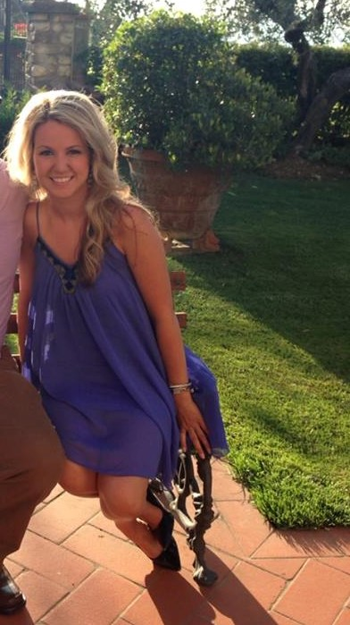
Let me start off by sharing a few facts about me…

Slide 3
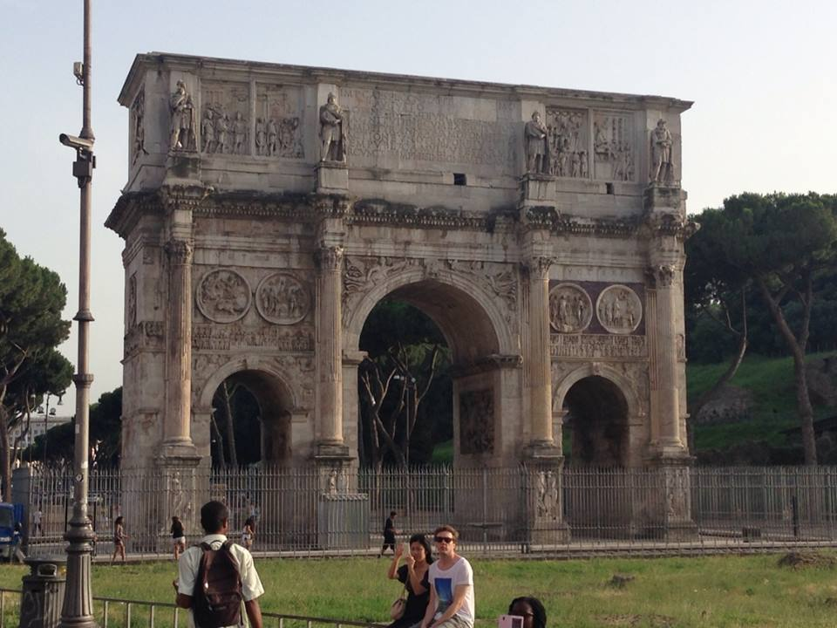
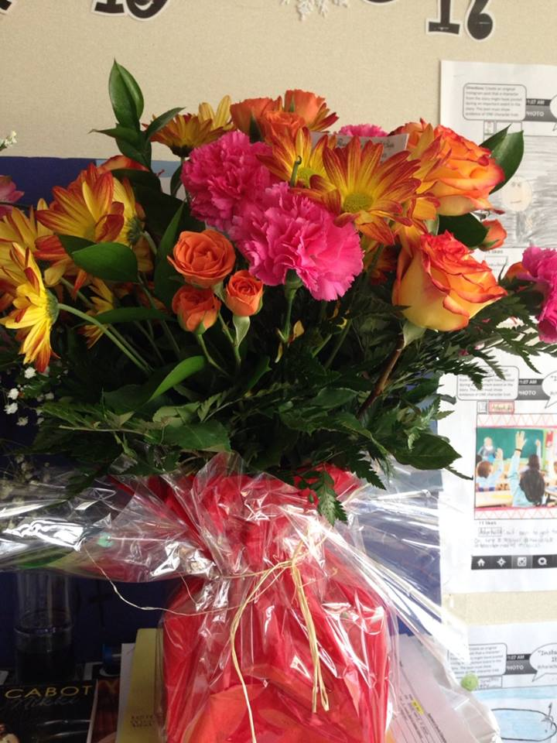
I like flowers.
I also enjoy traveling.

Slide 4
Reading is one of my favorite activities. Playing The Sims is a lot of fun too.

Slide 5
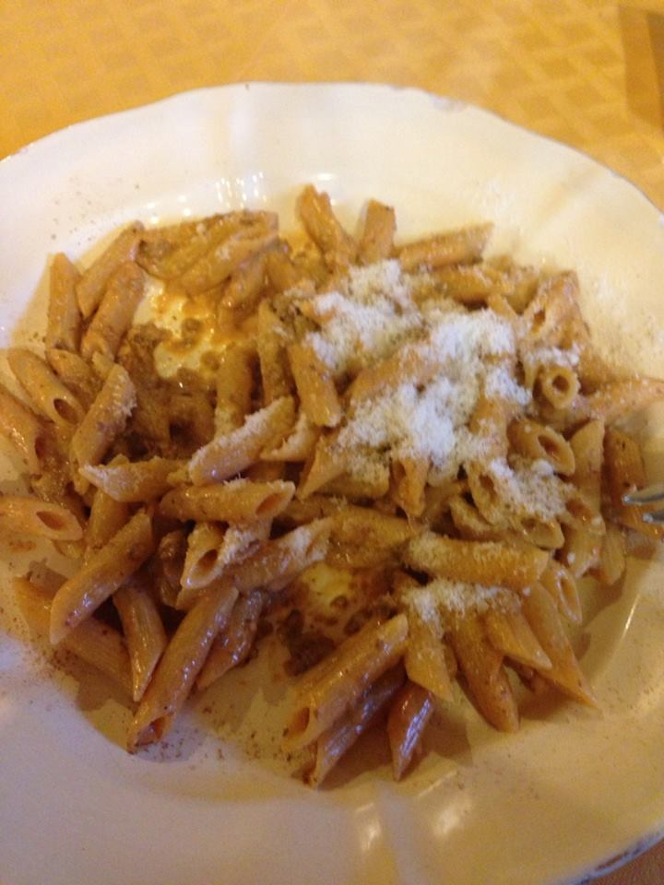
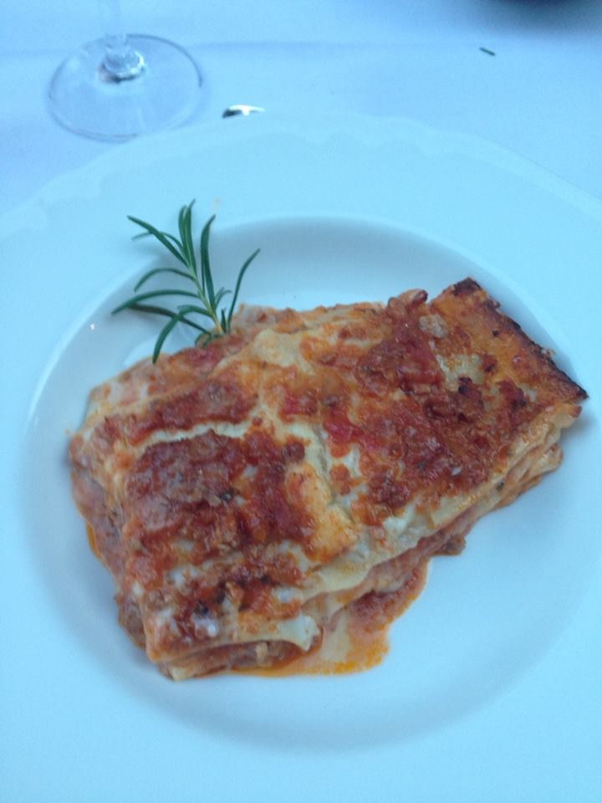
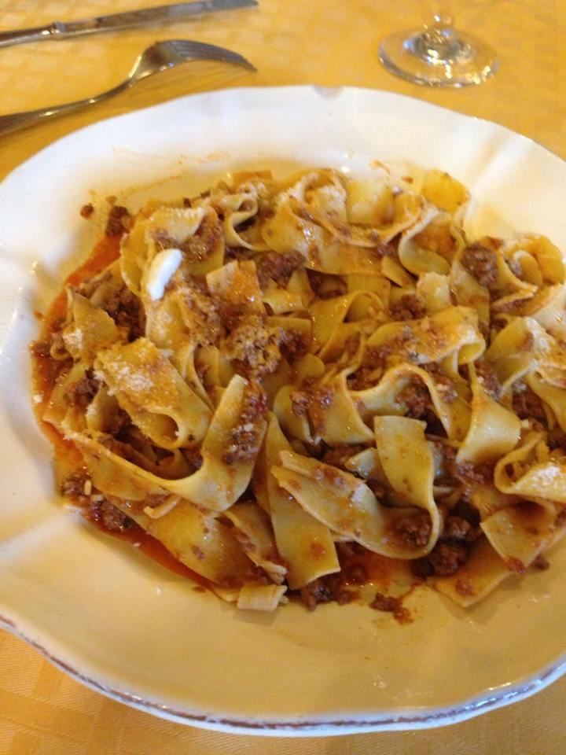
My favorite food is any type of pasta.

Slide 6
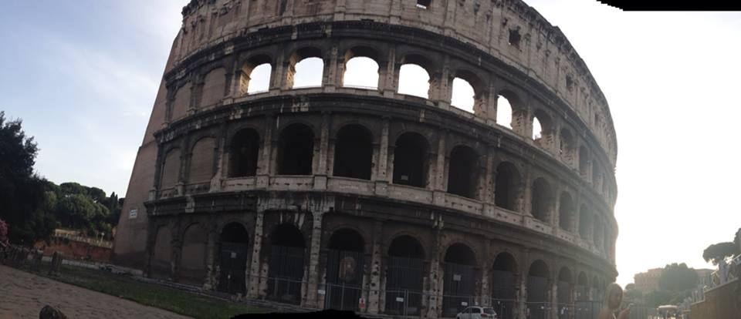
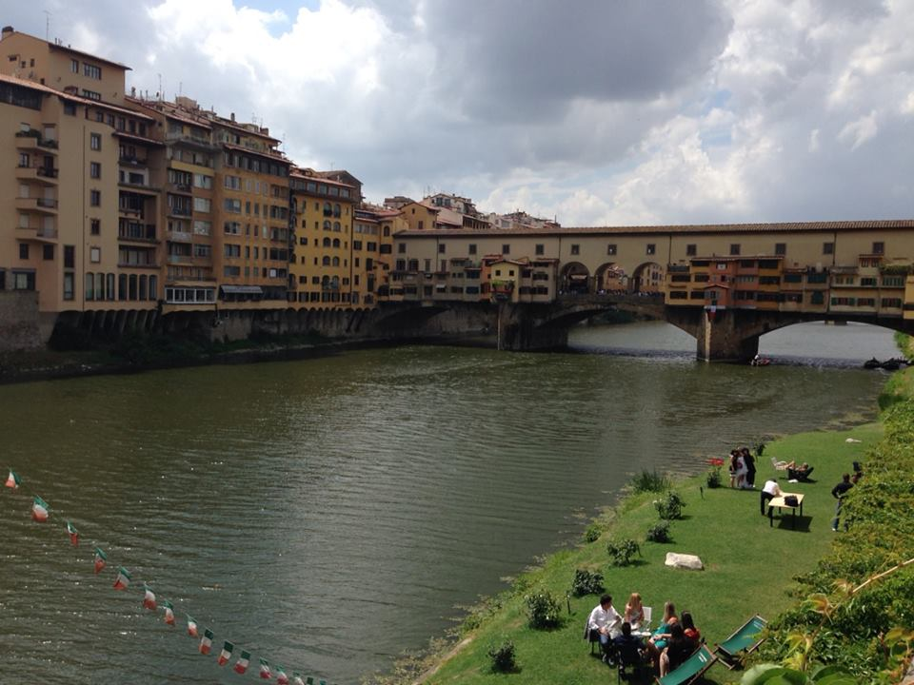
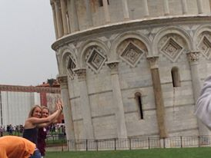
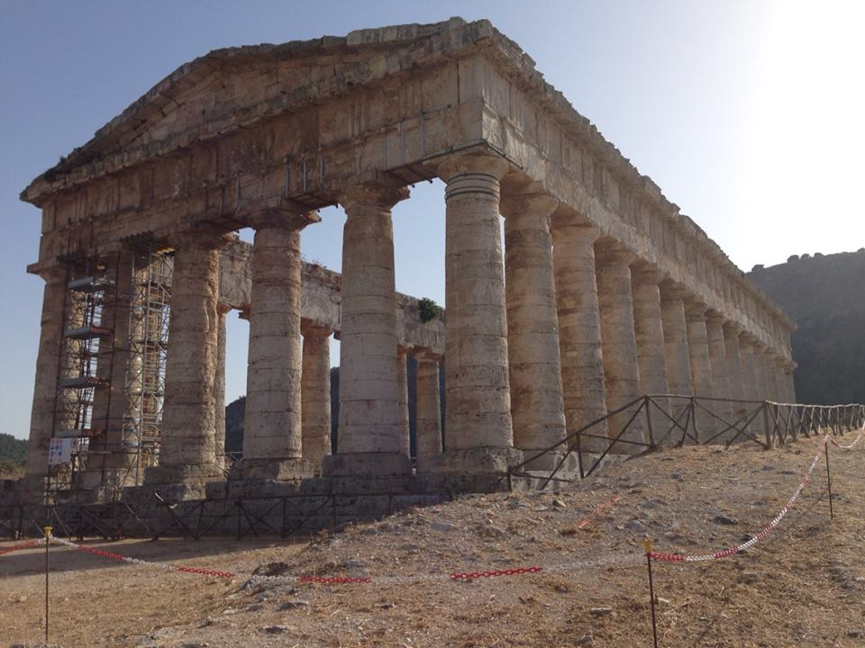
Two summers ago I went to Italy and ate a lot of pasta!

Slide 7
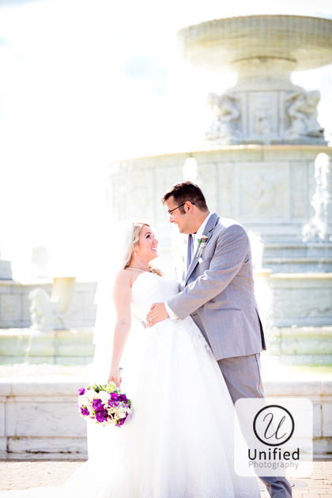
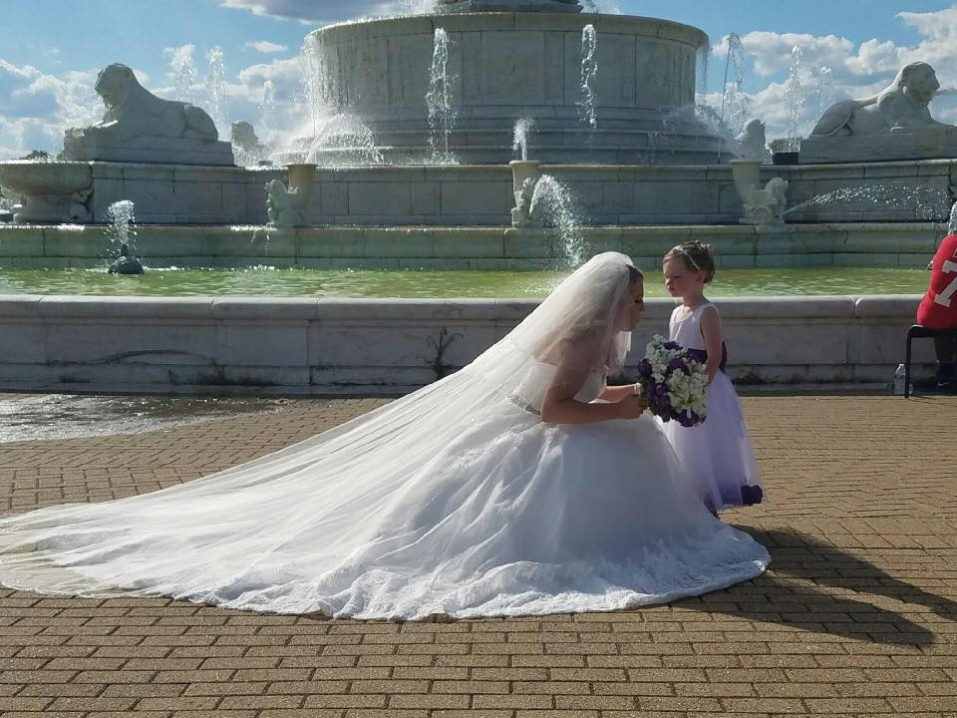
This summer I got married! My husband is a teacher at Bryant too. You may have science with him next year.

Slide 8
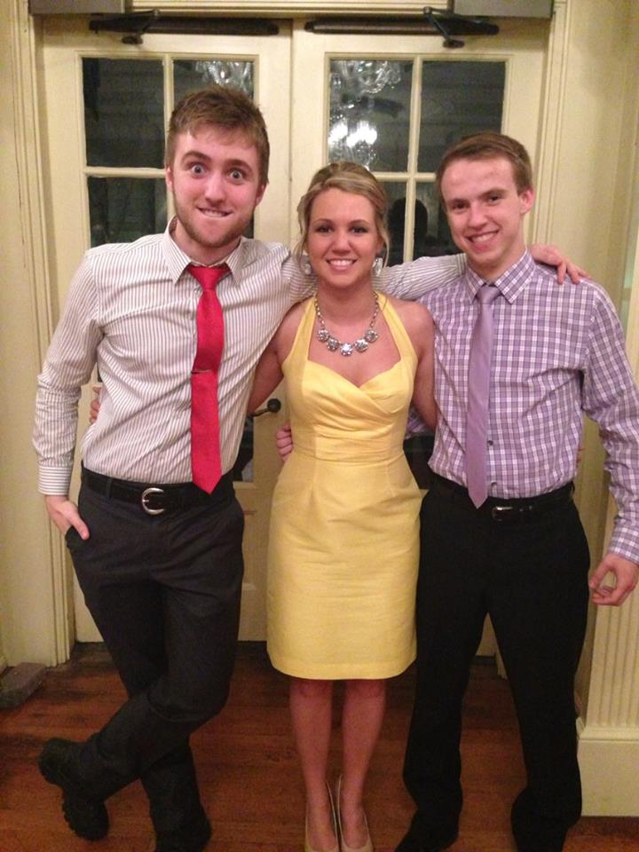
When I have free time, I enjoy spending it with my family.
Josh is 21.
I have two little brothers.
Chris is 24.

Slide 9
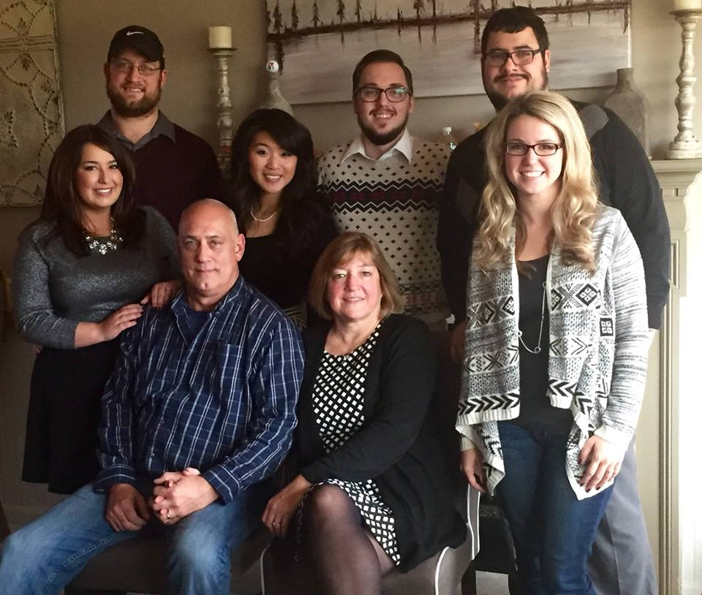
Now I also have a brother-in-law and two sister-in-laws!
Their names are Adam, Elaina, and Kristen.

Slide 10
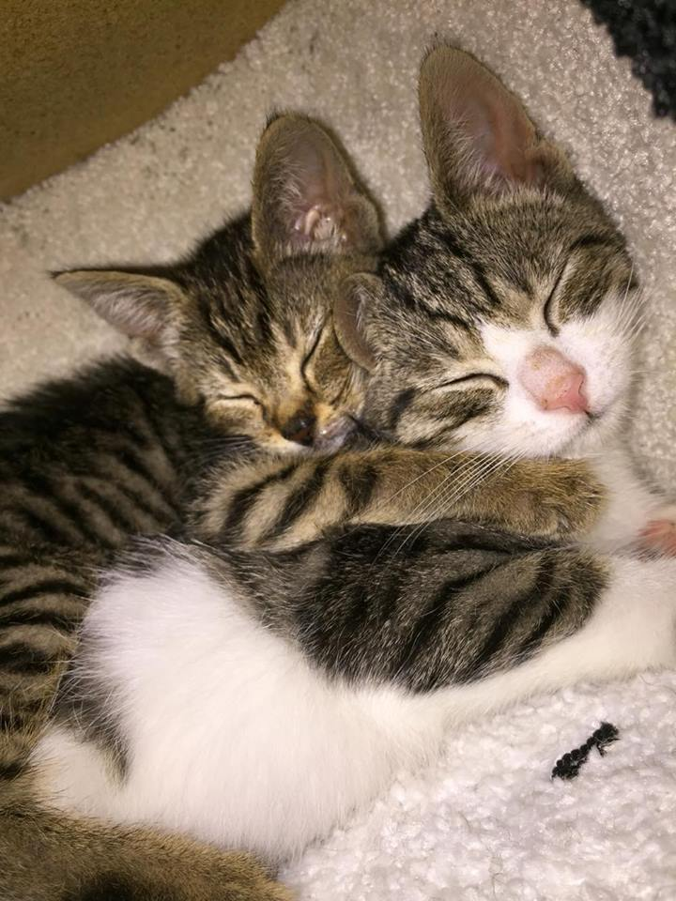
I also have two kittens…and they are cousins!

Slide 11
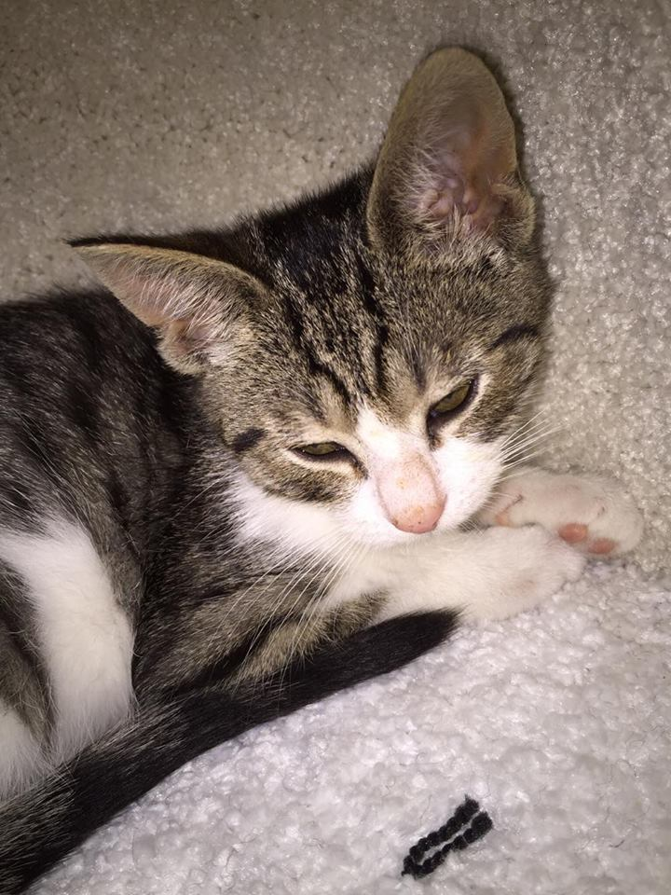
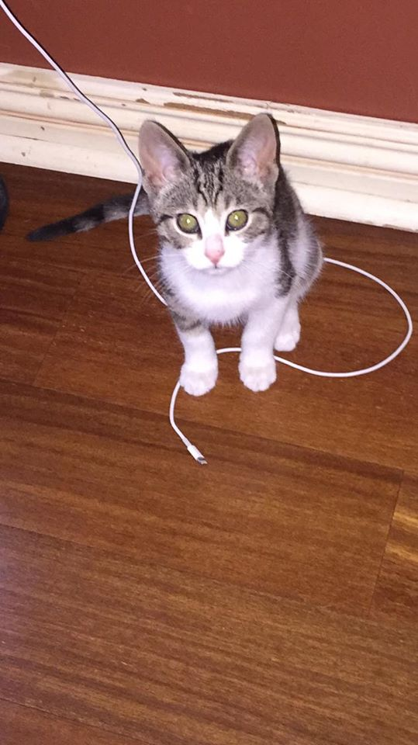
Aria is eleven weeks old and LOVES to snuggle!

Slide 12
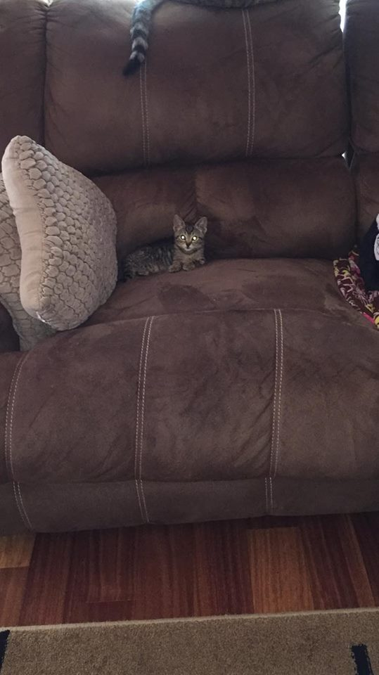
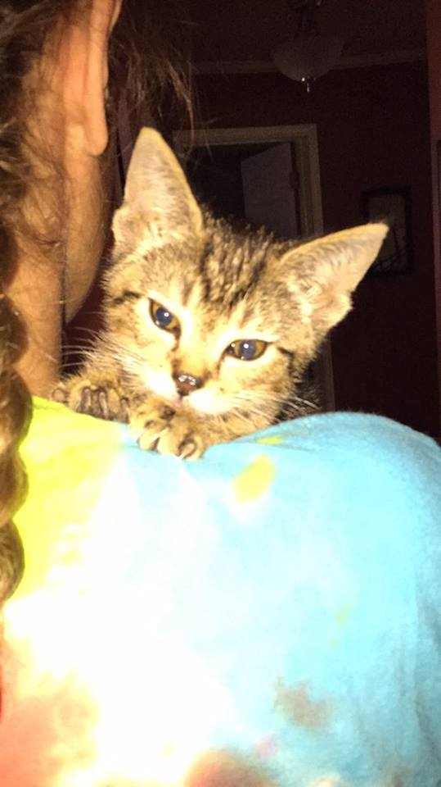
Loki is nine weeks old and has to be careful because she lacks depth perception. That means she has a hard time seeing how far away things are.

Slide 13
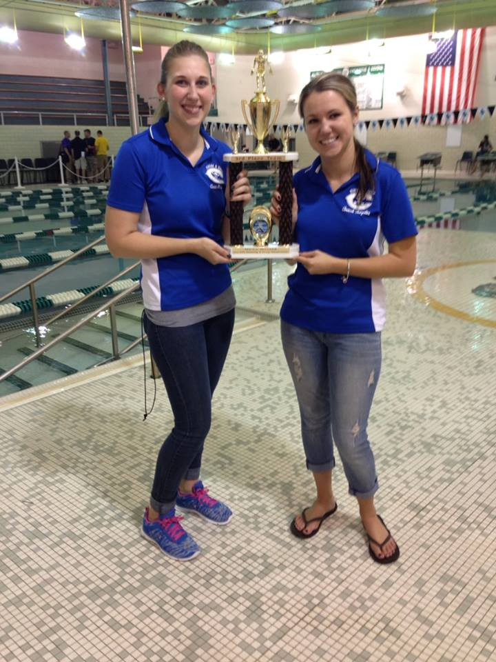
I also coach swimming at Carlson High School…

Slide 14
…and I run the National Junior Honor Society here at Bryant. Next year you can apply to join!

Slide 15
I am so excited for this school year!
I hope you are too.

Slide 16
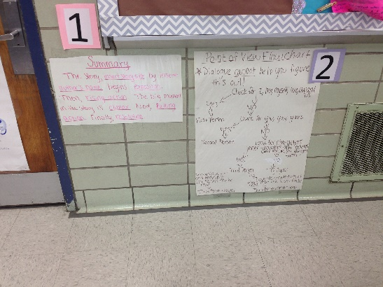
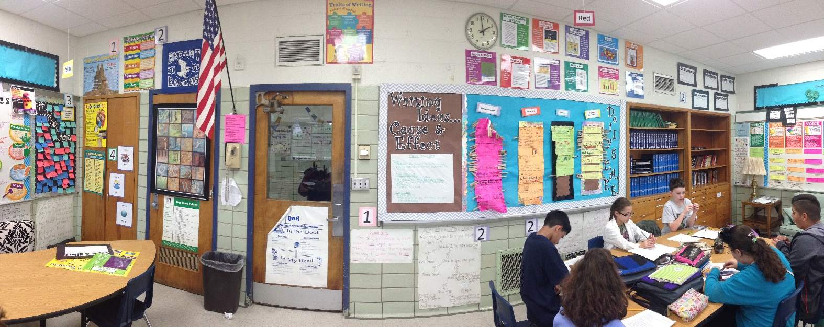
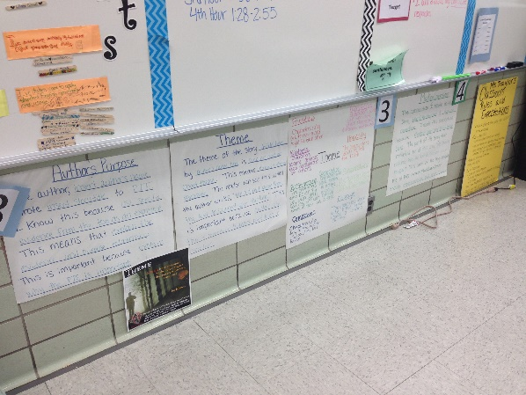
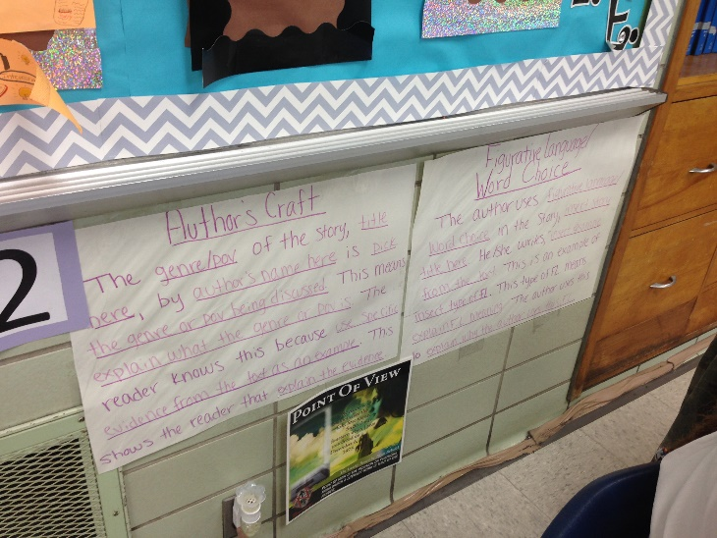
This year we will be learning a LOT!

Slide 17
We will create word walls to help us learn new vocabulary.

Slide 18
We will learn to identify examples of figurative language and eventually incorporate it into our writing.

Slide 19
We will read stories… and create our own

Slide 20
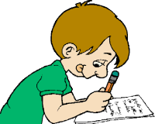
We will build our writing skills too.

Slide 21
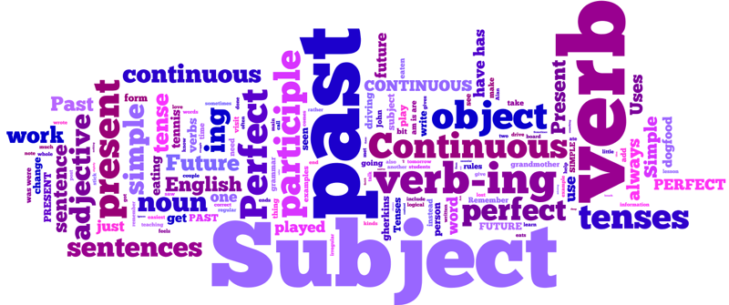
Which means we will need to work on grammar.

Slide 22
I know this is a lot to learn…

Slide 23
…but I am here to help you, every step of the way.

Slide 24
All I ask, is that you keep a few things in mind.

Slide 25
First, advocate for yourself by asking questions when you do not understand. It’s how we learn.

Slide 26
Make sure to ALWAYS respect the ideas of your classmates. They are all welcome in this room.

Slide 27
Everyone needs to be a team player. We are a community of learners and we need to help each other.

Slide 28
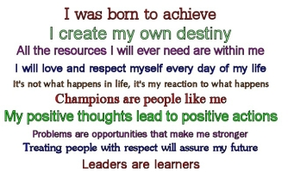
Most importantly, always come prepared and try your BEST.

Slide 29
We are going to have a great year!

Slide 30
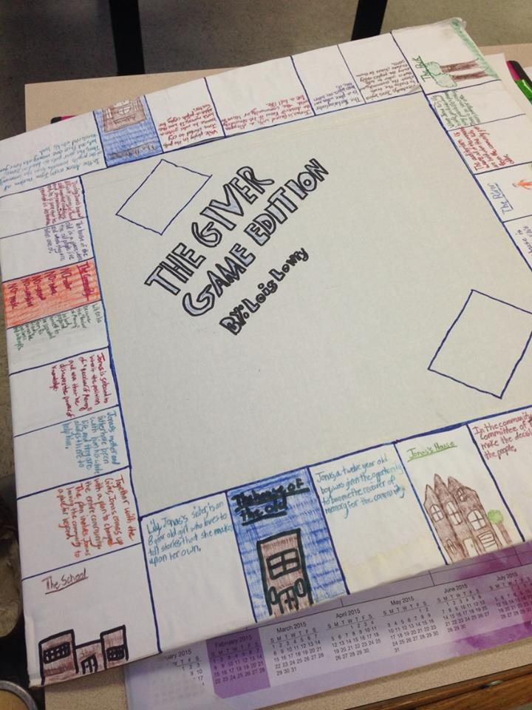
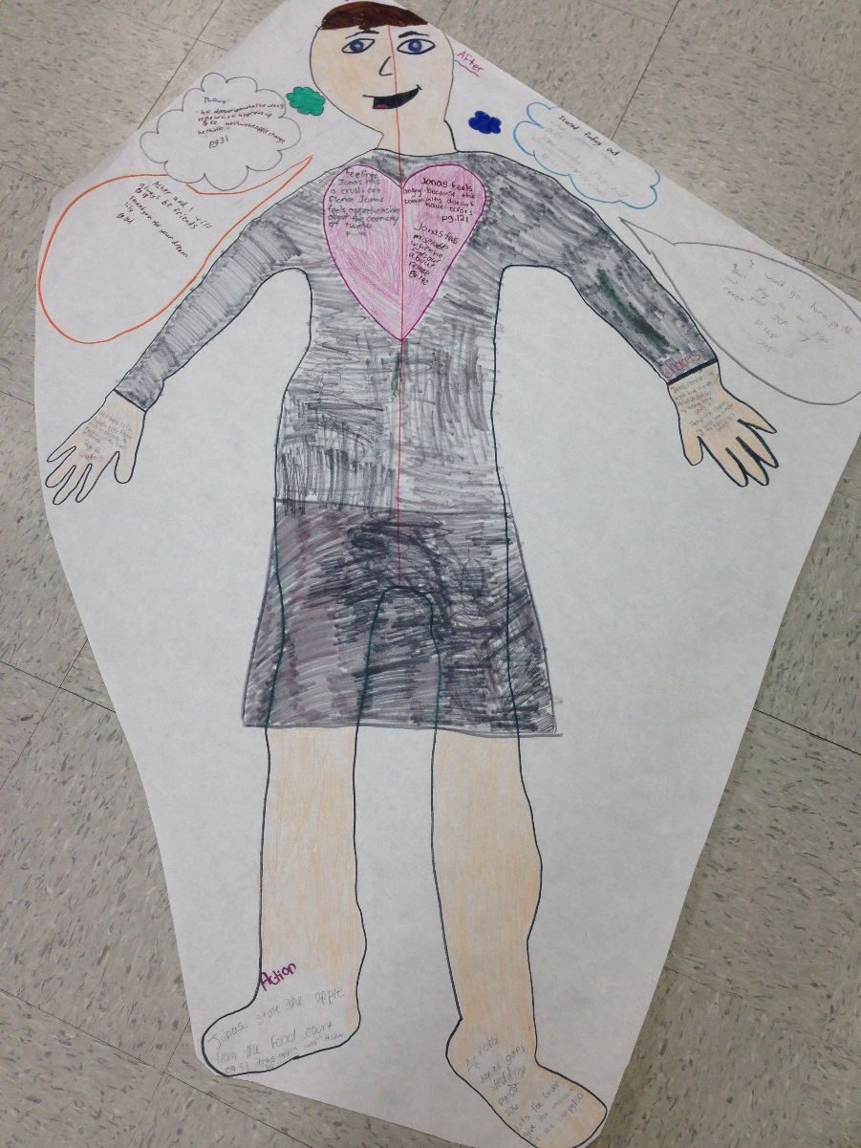
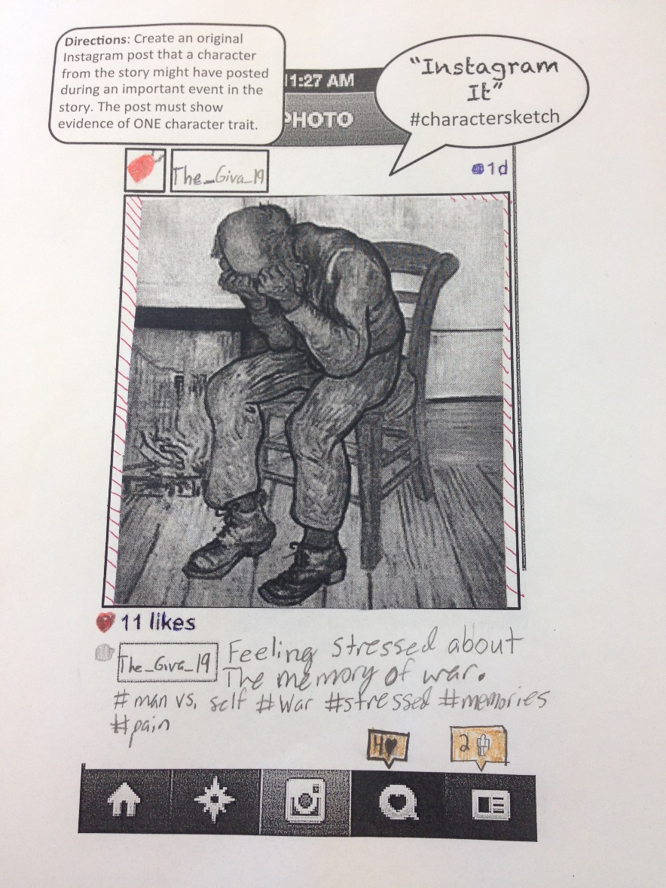
There will be lots of laughs and fun activities.

Slide 31
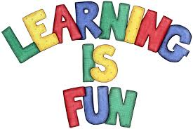
I love learning and I hope that you do too! If not, my goal is to change that this year.

Slide 32
I look forward to getting to know all of you!

Slide 33
Welcome to Bryant Middle School!

