Slide 1
Welcome to Ms. Traylor’s Class
Sixth Grade Language Arts

Slide 2
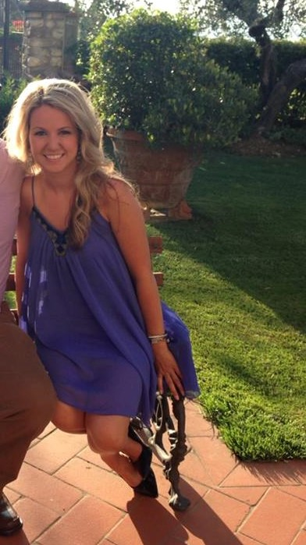
Let me start off by sharing a few facts about me…

Slide 3
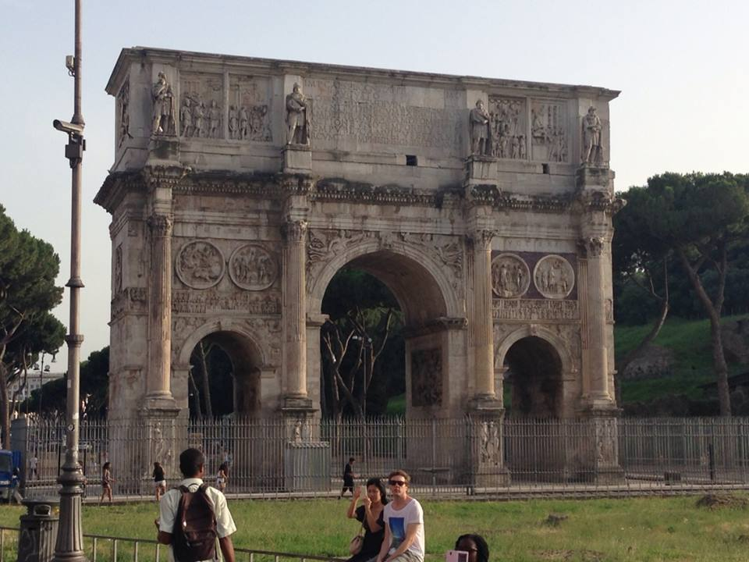
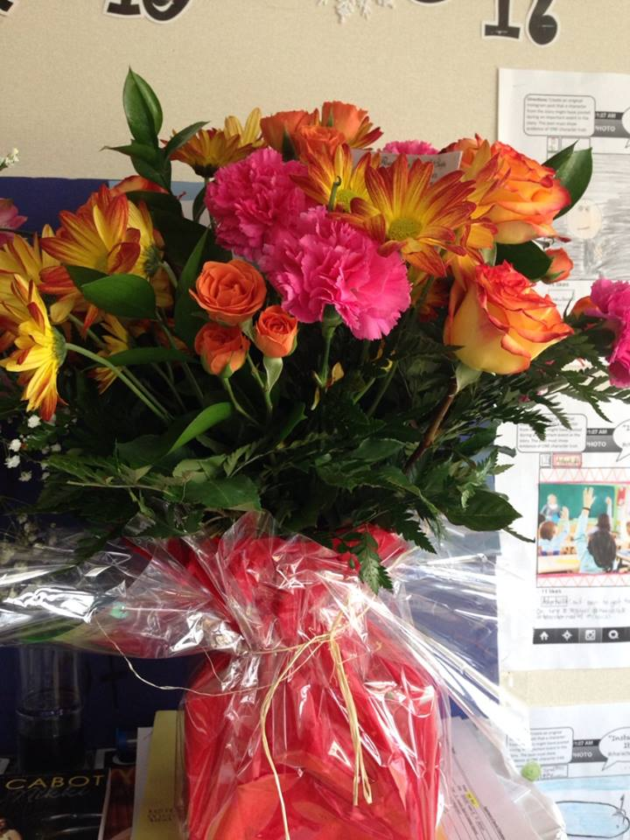
I like flowers.
I also enjoy traveling.

Slide 4
Reading is one of my favorite activities. Playing The Sims is a lot of fun too.

Slide 5
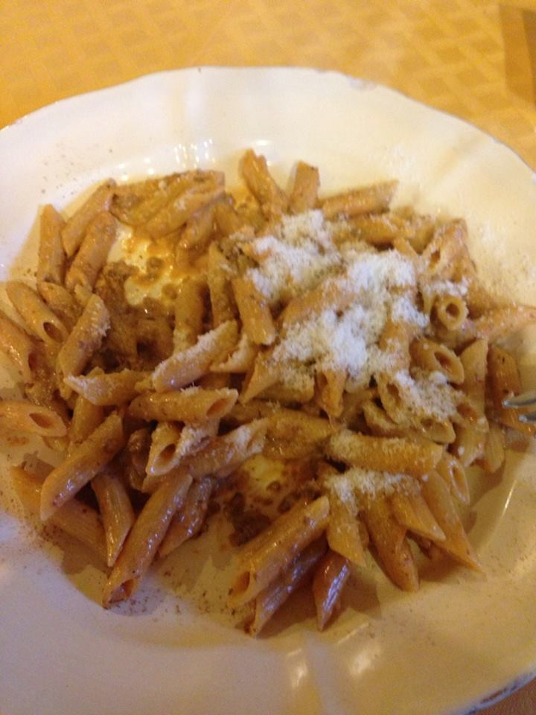
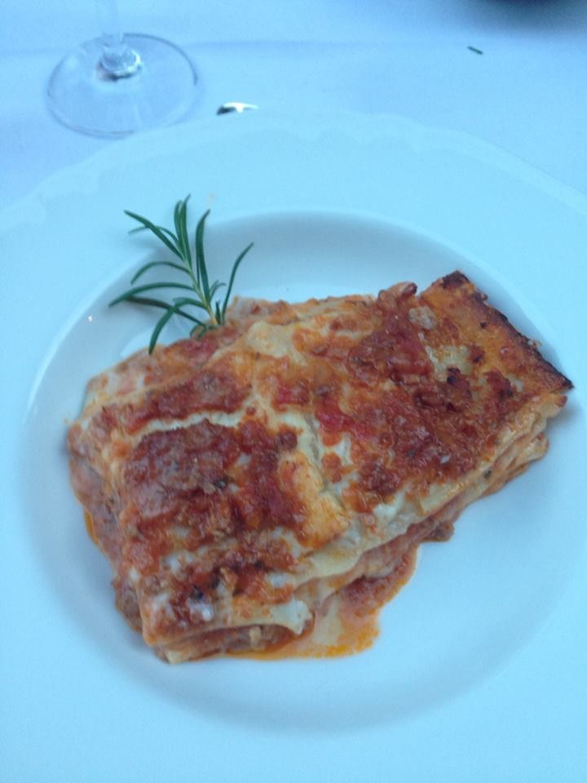
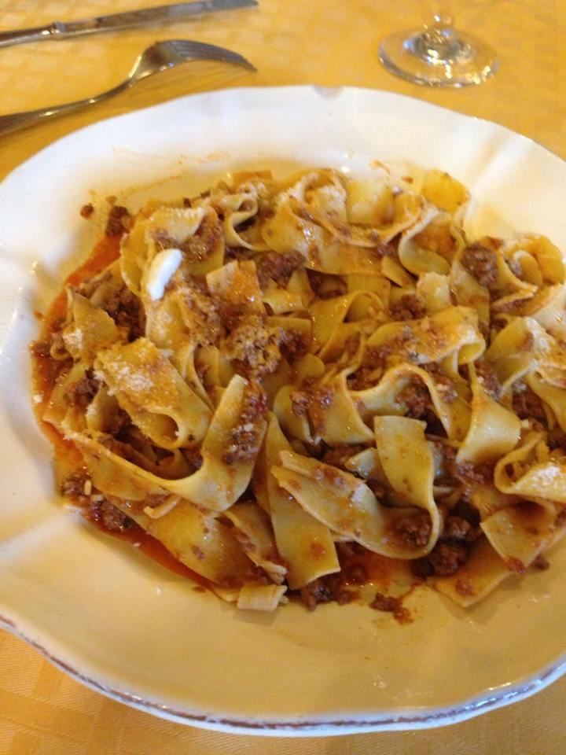
My favorite food is any type of pasta.

Slide 6
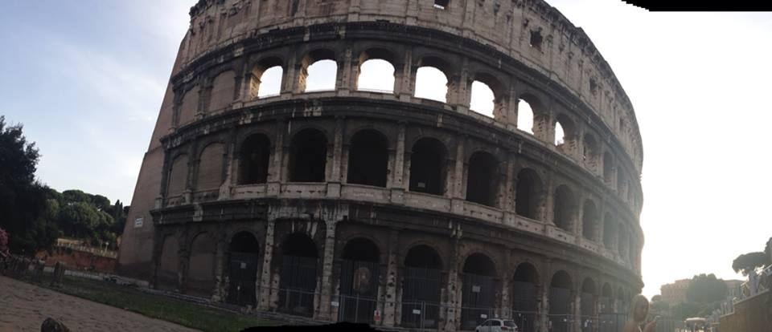
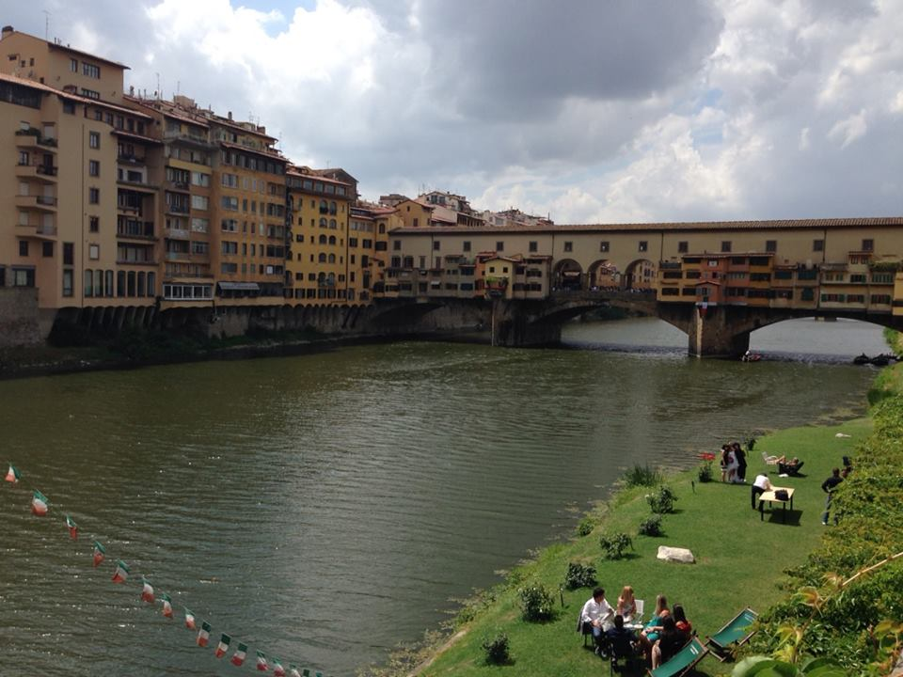
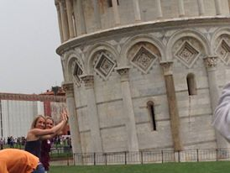
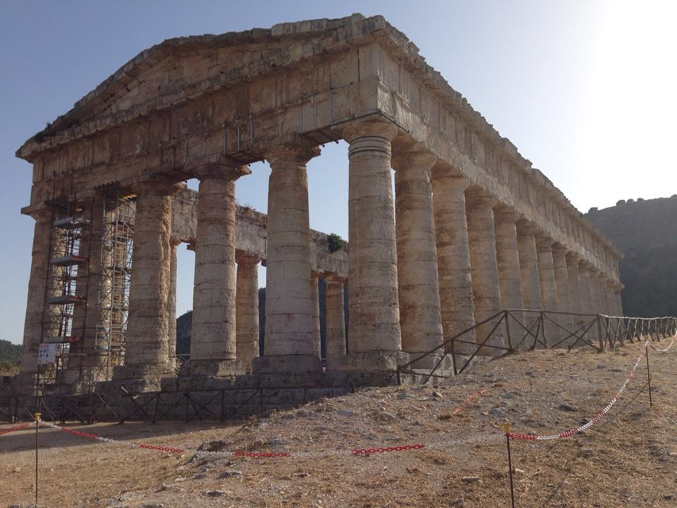
Last summer I went to Italy and ate a lot of pasta!

Slide 7
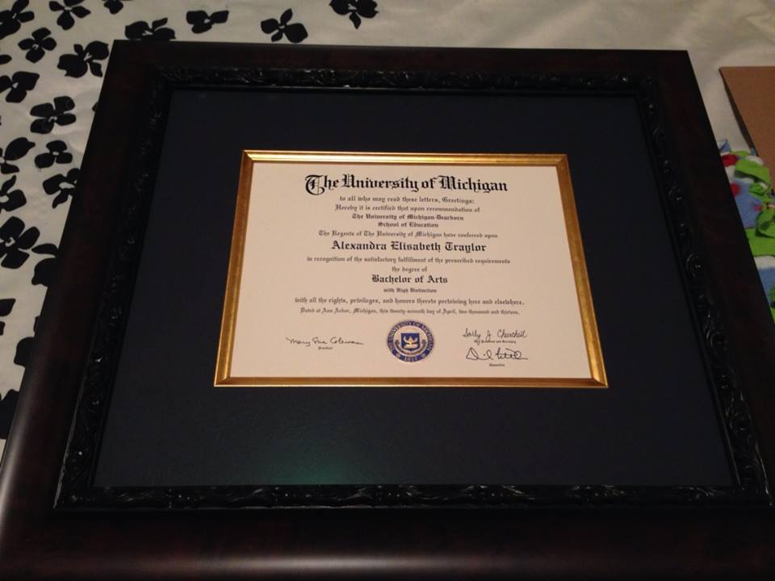
This summer I spent a lot of time doing homework and I ended up finishing my master’s degree!

Slide 8
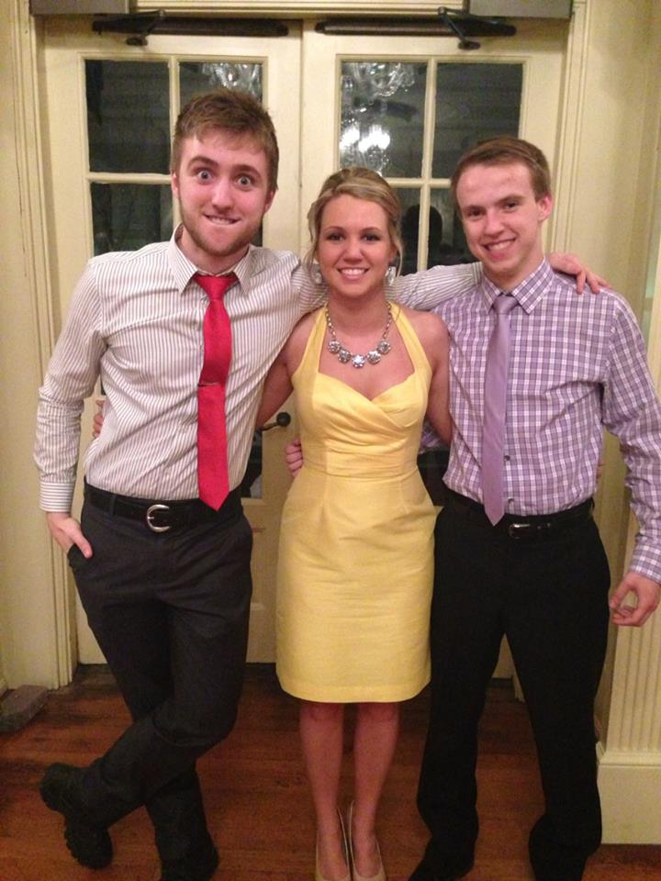
When I have free time, I enjoy spending it with my family.
Josh is 20.
I have two little brothers.
Chris is 23.

Slide 9
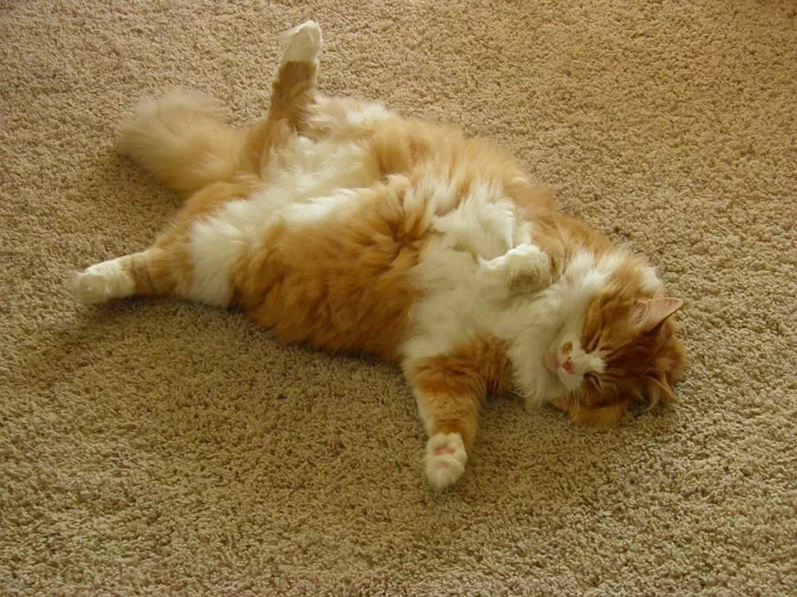
I also have four cats…yes FOUR!

Slide 10
Gilligan is 12…he’s really BIG!

Slide 11
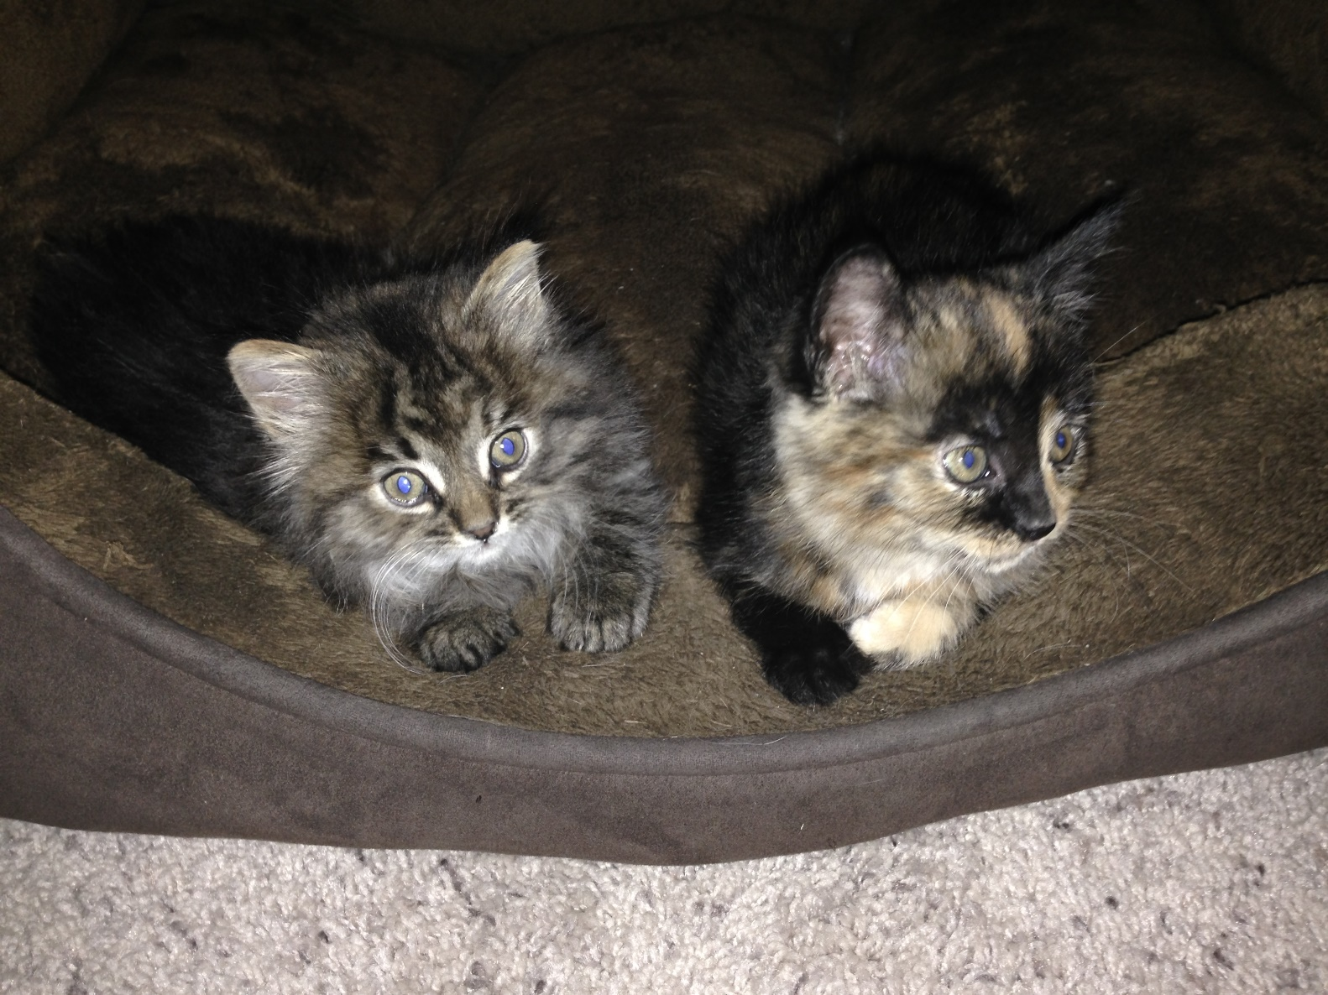
The other three are sisters and they just turned one.

Slide 12
Zoey likes to eat and snuggle.

Slide 13
Zazzy is very adventurous and yes, she is named after The Big Bang Theory.

Slide 14
Sadie is much more reserved…she’s also the softest.

Slide 15
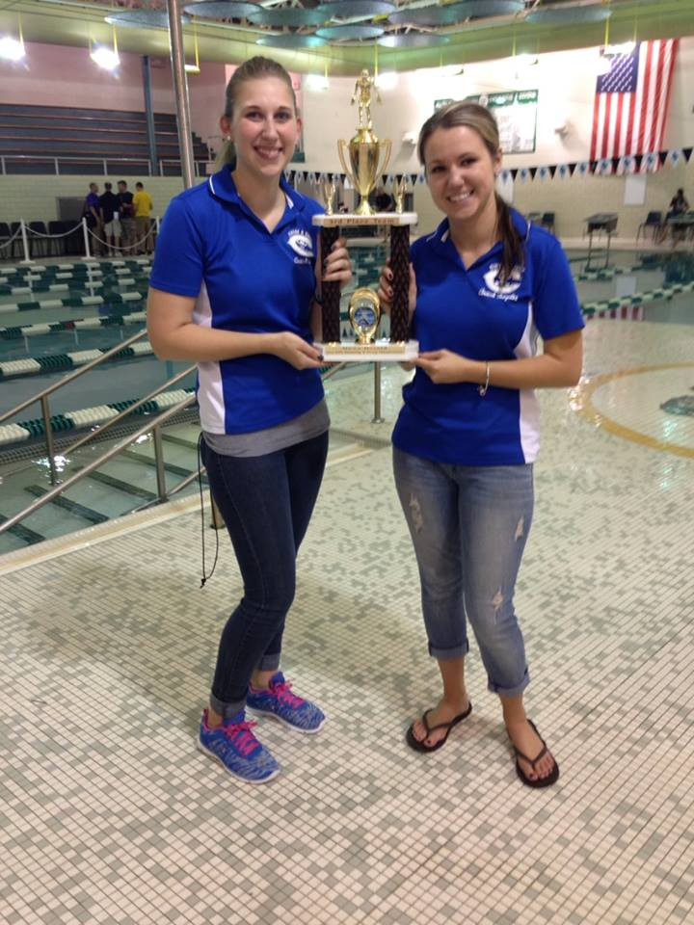
I also coach swimming at Carlson High School…

Slide 16
…and I run the National Junior Honor Society here at Bryant.

Slide 17
I am so excited for this school year!
I hope you are too.

Slide 18
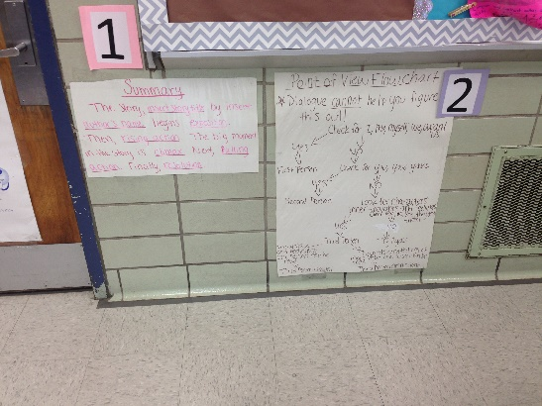
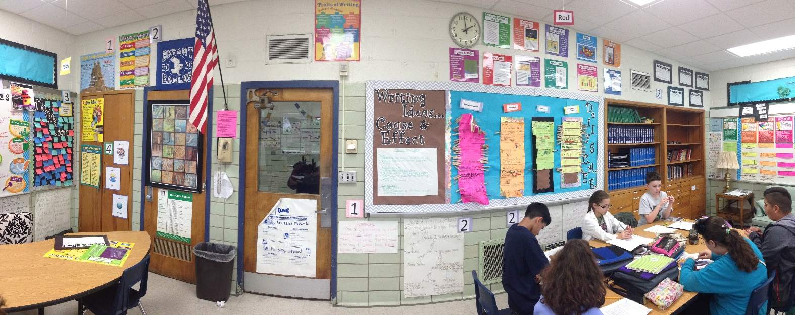
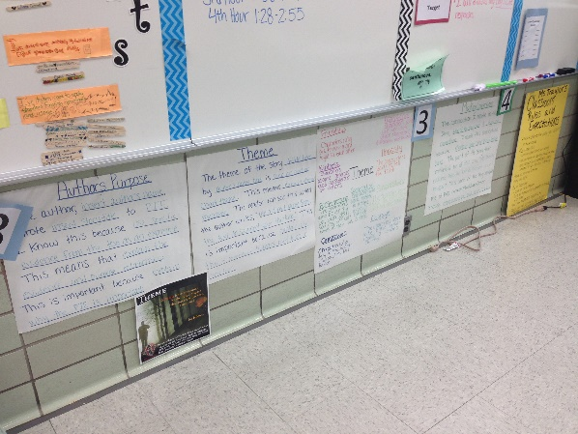
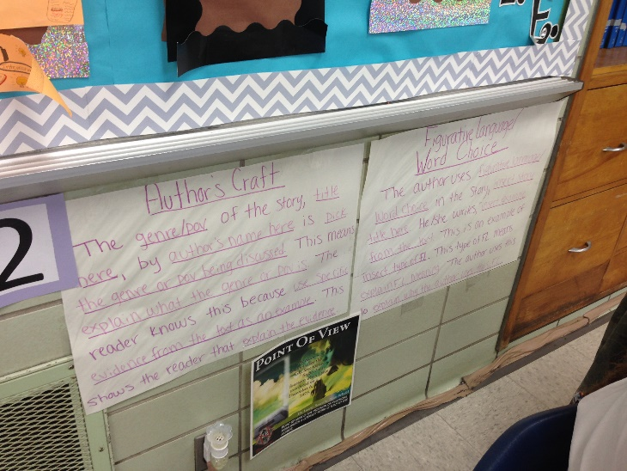
This year we will be learning a LOT!

Slide 19
We will create word walls to help us learn new vocabulary.

Slide 20
We will learn to identify examples of figurative language and eventually incorporate it into our writing.

Slide 21
We will read stories… and create our own

Slide 22
We will build our writing skills too.

Slide 23
Which means we will need to work on grammar.

Slide 24
I know this is a lot to learn…

Slide 25
…but I am here to help you, every step of the way.

Slide 26
All I ask, is that you keep a few things in mind.

Slide 27
First, advocate for yourself by asking questions when you do not understand. It’s how we learn.

Slide 28
Make sure to ALWAYS respect the ideas of your classmates. They are all welcome in this room.

Slide 29
Everyone needs to be a team player. We are a community of learners and we need to help each other.

Slide 30
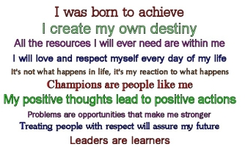
Most importantly, always come prepared and try your BEST.

Slide 31
We are going to have a great year!

Slide 32
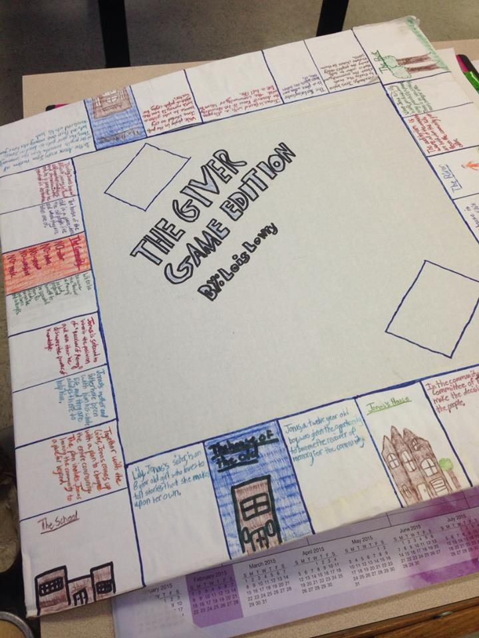
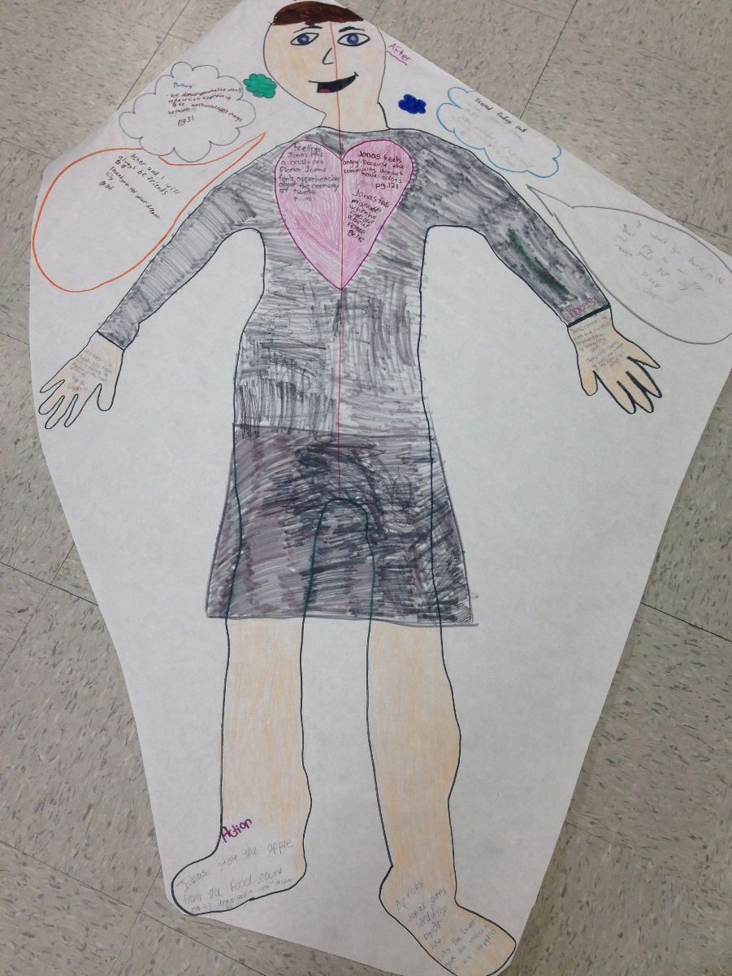
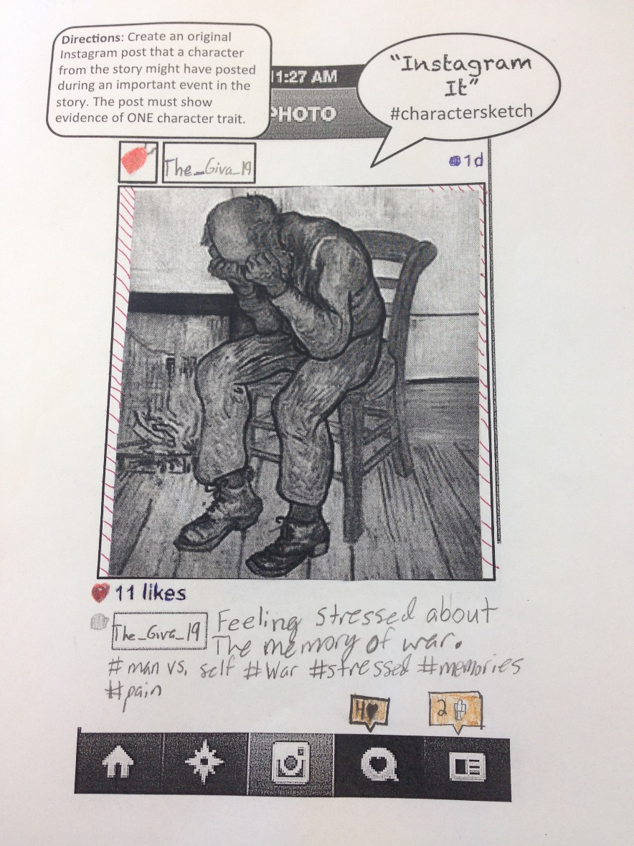
There will be lots of laughs and fun activities.

Slide 33
I love learning and I hope that you do too! If not, my goal is to change that this year.

Slide 34
I look forward to getting to know all of you!

Slide 35
Welcome to Bryant Middle School!

