Slide 1
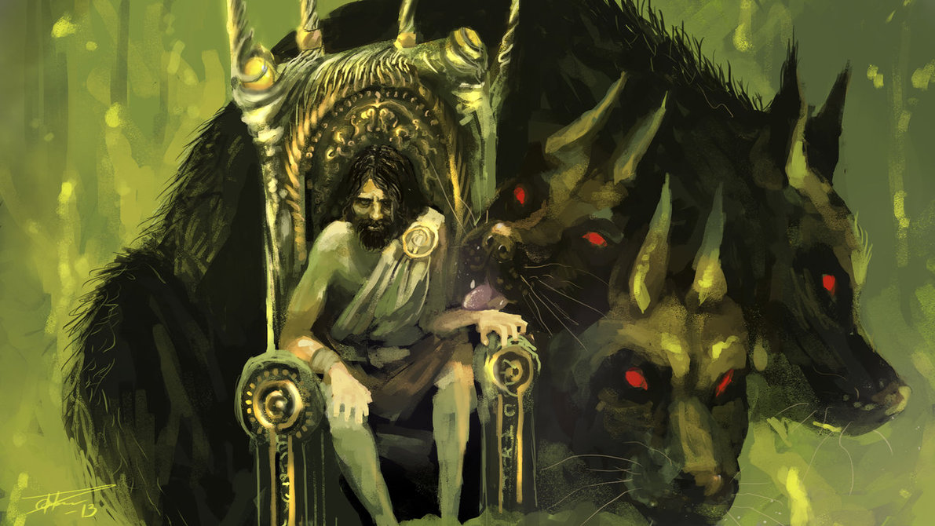
Greek Mythology: Hades
By: Sean Riley

Slide 2
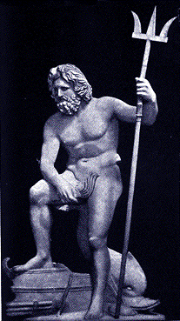
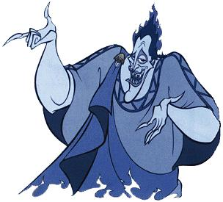
Hades
Hades wears a long, black toga
He has dark holes as eyes
Hades also has rows of sharp teeth, like a sharks
Hades has a three-headed dog that guards the entrance to the underworld named Cerebus
Hades’ weapon is a dark, 3-tipped spear, called a “Trident”
Hades (/ˈheɪdiːz/; from Ancient Greek Ἅιδης/ᾍδης, Hāidēs; Doric Ἀΐδας Aidas) was the ancient Greek god of the underworld. Eventually, the god's name came to designate the abode of the dead. In Greek mythology, Hades is the oldest male child of Cronus and Rhea considering the order of birth from the mother, or the youngest, considering the regurgitation by the father

Slide 3
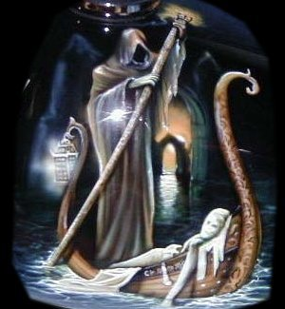
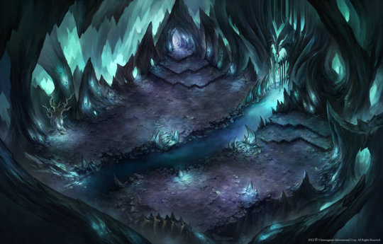
The Underworld
Hades is the god of the underworld
Everyone goes there when they die
There are different realms in the underworld, and you live in them, depending on how you behaved when you where alive
There is a dead soul named Cheron that takes souls from the entrance, across the River Stix, and into the underworld

Slide 4
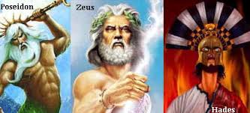
Hades’ Family
Hades has two brothers, there names are Zeus, and Poseidon
Zeus is the god of the heavens, and Poseidon is the god of the seas
The three of them together are the top 3 gods out of all the gods, they are known as, “The Big Three”

Slide 5

Hades’ Flaws
Hades has many flaws, including causing earthquakes, stealing souls, and trying to take over Mount Olympus
He also kidnapped one of the goddesses that controls weather, and every year between September, and March, we have Fall and Winter

Slide 6
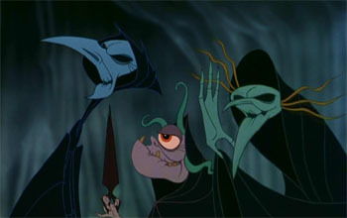
Hades’ Allies
Hades’ companions that kind of help him out are The 3 Fates that cut a string every time someone dies, and gives their soul to Hades
The 3 of them all share one eye, and can tell the past, and the future

Slide 7
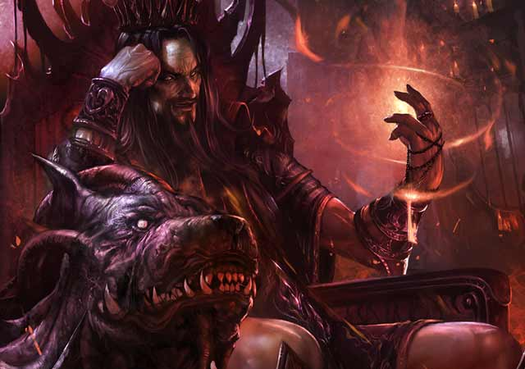
Hades’ Domain
If you were trying to find Hades, you would most likely find him in the underworld
He rarely ever leaves his home, and he would be helping to sort the different souls into the different realms

Slide 8
Hades’ Symbol
Hades’ meaning is that, Hades exemplifies what Greek Gods stood for, gods were to be feared and revered as powerful by man
Hades’ symbol is the scepter, this stands for power and that men should be fearfull
Another one of Hades’ symbol is the Transneptunian Points

Slide 9
Work Cited
"Hades' Symbol - Google Search." Hades' Symbol - Google Search. N.p., n.d. Web. 04 June 2014.
"Greek Gods." Where Everyone Lists Everything. N.p., n.d. Web. 04 June 2014.
"Mythology - Ancient Greek Gods and Myths." Mythology - Ancient Greek Gods and Myths. N.p., n.d. Web. 04 June 2014.
Mythweb Search." Mythweb Search. N.p., n.d. Web. 03 June 2014.
"Meet the Greek Gods - Welcome to Camp Half-Blood: The Online World of Rick Riordan." Meet the Greek Gods - Welcome to Camp Half-Blood: The Online World of Rick Riordan. N.p., n.d. Web. 02 June 2014.

