Slide 1
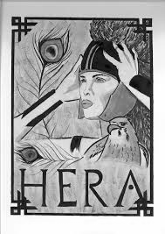


HERA
By: Noor Moughni

Slide 2
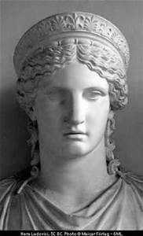
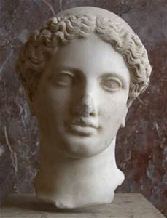
overview
was usually depicted as a beautiful woman wearing a crown and holding a royal, lotus-tipped staff, She took great pride in her looks. Her sandals, chariot, and throne were all of pure gold. She wore a high, cylindrical crown.
Her animal was the cow, the peacock, and sometimes the cuckoo.

Slide 3
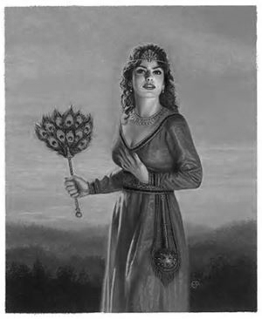
domain
was the Olympian queen of the gods and the goddess of women and marriage. She was also a goddess of the sky and starry heavens

Slide 4
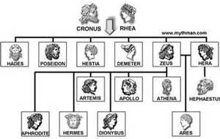
Family relationships

Slide 5
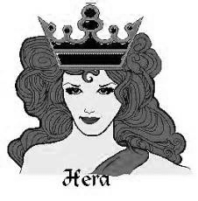
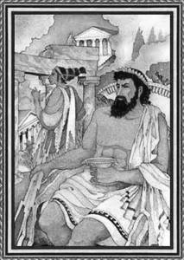
flaws
Weaknesses: Vindictiveness, vanity and jealousy.
She often misused her position and powers to punish the Zeus's lovers. Her retribution was also extended to the women's children.
When Antigone boasted that her hair was more beautiful than Hera, the Goddess became so enraged that she transformed the long locks of hair into snakes

Slide 6
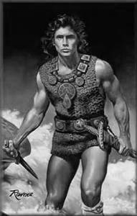
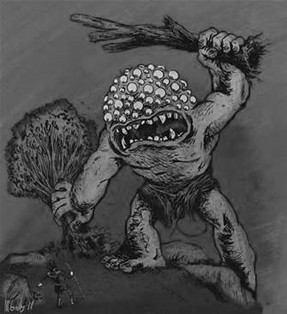
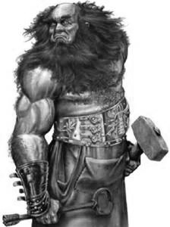
allies
Jason argus hephastus

Slide 7
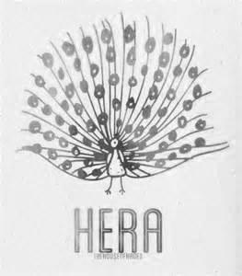
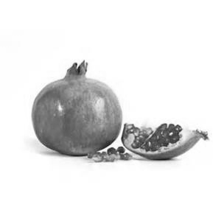
symbols
Hera's symbols are: the cuckoo, it symbolized Zeus' love for her because Zeus was disguised in a cuckoo when he conquered her, the pomegranate- symbol of fertility because Hera was also the goddess patron of childbirth. Some of the most known Hera's symbols are the peacock- ancient symbol of immortality, the scepter and the diadem.There are also some minor symbols such as the lily, the cow, the orange tree, the apple tree, the salix (willow), the fig and the myrrh.

Slide 8
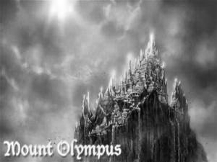
hangouts
She dwells on Mount Olympus with Zeus and the other Gods

Slide 9
Works Cited Page
"Greek Mythology :: Greek Gods :: Greek Goddesses :: Greek Myths." Greek Mythology :: Greek Gods :: Greek Goddesses :: Greek Myths. N.p., n.d. Web. 01 June 2014.
"HERA : Greek Goddess of Marriage, Queen of Heaven | Mythology, W/ Pictures | Roman Juno." HERA : Greek Goddess of Marriage, Queen of Heaven | Mythology, W/ Pictures | Roman Juno. N.p., n.d. Web. 03 June 2014.
"Appearance, Personality, and Special Abilities - Per,.3 Hera." Appearance, Personality, and Special Abilities - Per,.3 Hera. N.p., n.d. Web. 03 June 2014.
"Hera." Hera. N.p., n.d. Web. 01 June 2014.
"CHAPTER V: THE HIEROPHANT." Hera. N.p., n.d. Web. 03 June 2014.

