Slide 1
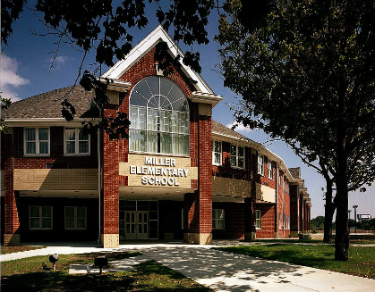
Our Vision – Students First – Inspire, Educate, Celebrate
Miller Elementary
School News
March is Reading Month 2019
Principal: Radewin Awada
March 2019
Important February Dates
1st – March is Reading Month Begins
8th – PTA Meeting / Open House 9 a.m. Miller Cafeteria
10th – Daylight Savings Time, move clocks forward 1 HOUR, Sunday Night
13th – Late Start
28th – Literacy Night
April 1st April Fools Day
A Message from Mr. Awada
Greetings Miller Families, looking forward to an exciting March is Reading Month (MRM) filled with wonderful and exciting learning activities for all to enjoy. Attached is a (MRM) Calendar listing wonderful and engaging educational opportunities students will partake in throughout the month of March. Our next PTA / Open House Meeting is scheduled for Friday March 8th , at 9 a.m. in the Miller Cafeteria. Friendly reminder all subject matter discussed with parents are being discussed in with students in hopes the conversation continues at home as a family. PTA meeting will be followed by Open House where parents may experience classroom instruction at Miller Elementary. The Miller Community extend their deepest appreciation to all parents for continuing to support educational initiatives at Miller Elementary. IMPORTANT: All 3rd – 5th Grade students will be engaging in M-Step testing next month. The M-Step is a state assessment measuring students academic abilities.
Reading and Math Practice Daily
Please help Miller students be the best they can be by ensuring they are practicing reading and math skills daily using i-Ready and Zern. All students have access to instructional material required to be successful, we need parents to spend quality time with students reading, practicing math and completing homework daily.
Check-in and Student Drop Off – Help!
Please ensure you check-in to the Office anytime you are entering Miller Elementary . Be prepared to present a valid Michigan ID / Driver License when picking up your child. Do not drop students off across the street on Lois, parents are risking the safety of their child when they do not use the appropriate drop off zone on the school side of Lois or the parking lot. Please travel at a low rate of speed, taking your time ensures everyone remains safe! Working together is the only way forward, thanks for being proactive with safety and making our community a safe place for all.
Proper Attire
Per district policy, students will be going outdoors until wind-chill temperatures reach 20 degrees Fahrenheit. Ensure students are dressed appropriately with a winter coat, gloves, waterproof shoes and a hat being worn daily. Students need to be responsible and account for their clothing, if a clothing item is lost please check the lost and found in the Cafeteria. Lost and Found will be emptied monthly with contents being donated to the Salvation Army.
Daily Schedule
Students should not arrive before 8 a.m. as there is no supervision. Breakfast is served from 8:00 –8:25 a.m., first bell rings at 8:30 a.m. and instruction begins at 8:35 a.m. Children entering school after 8:45 a.m. are considered late and must be signed-in at the main office by a parent. Dismissal is at 3:35 p.m., (Half-day dismissal is at 11:45 am). Students must leave school promptly at 3:35 dismissal as supervision ends at 3:50 pm. Dismissal: All 1st & 2nd grade students are to be picked up from the Cafeteria. Kindergarten students will be picked up from the classrooms by a parent or guardian.

Slide 2
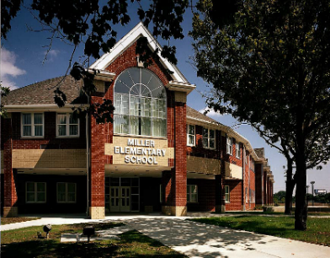
Our Vision – Students First – Inspire, Educate, Celebrate
Miller Elementary
Policy and Procedures
March is Reading Month 2019
Principal: Radewin Awada
Attendance /Absence Policy
Consistent and timely attendance to school is critical and enhances your child’s educational experience and vastly improves their chances of success. Excessive absence may be referred to the court system. Avoid removing students from the classroom during the school day. Avoid making doctor and dental appointments during the school day.
If your child is unable to attend school, please contact the school office at: (313) 827 – 6851 before 9:00 am. When calling, parents should give the following information: student and teacher name, grade, reason for and length of absence.
When the student returns to school, it is his or her responsibility to check with teachers for missed work. If a student will be absent for more than two days, please contact the teacher to make arrangements for homework to be picked up from the office. Homework will be ready for pick up the following school day by 3p.m. Weekly lesson plans and daily homework are posted on the teacher blog.
Visitors & Class Interruptions
Our goal is to limit class interruptions as much as possible so that students are not distracted from their academic learning. Therefore, all visitors must check-in to the office upon entering the school. NO Exceptions!
Late-arrival
Parents/guardians are required to sign students in the school office. Students will not be allowed a pass to enter class without a parent signature.
Lunch Schedule
Kindergarten 11 – 11:38 a.m.
1st 11:20 – 11:58 a.m.
2nd 11:40 – 12:18 p.m.
3rd 12 – 12:38 p.m.
4th 12:20 – 12:58 p.m.
5th 12:40 – 1:18 p.m.
Illness & Medication
Students should stay at home if they are vomiting, fever over 99 degrees, strep throat, pink eye and any type of rash (may not be in school without consent from a doctor). Parents must notify the school office if their child has any preexisting conditions such as allergies, diabetes, or asthma, ensuring proper precautions are taken. No child is to carry any prescription or over the counter medication in school, no exceptions. The office staff will administer any medication when a "Medication Authorization Form" is signed in the main office.
Lost & Found
When a child has lost an article of clothing or school item, check the Lost & Found located in the cafeteria. Any items not claimed will be donated to the Salvation Army.
Celebrations and Snacks
Classroom snacks are limited to fruits or vegetables . Each teacher has her/his own preference for celebrating student birthdays and holidays. NO CUPCAKES or food is allowed at Miller.
Early-release
The office will not call students down early to wait for parents to arrive. When it becomes necessary for your child to leave the school due to illness or injury, a parent will be called. If a parent cannot be reached, a person designated on the child’s emergency card will be contacted. the person picking up the student must report to the office to sign the student out. There is no student check-out after 3:00 p.m.
Remind: Send short code text in body of message @8276850 to the number 81010. You’ll receive a welcome text from Remind.
Important Phone Numbers
Attendance# (313) 827-6500
Office # (313) 827-6501
Fax # (313) 827 - 6505
Office:
Attendance: 313 827-6851
Fax: 313 827 - 6855

