Slide 1
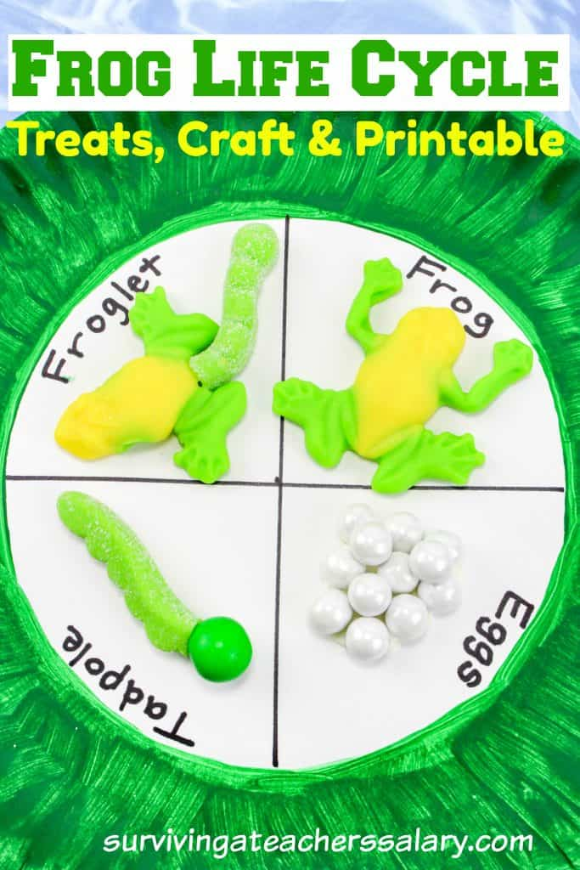
Mrs. Polgar’s Learning Plan May 18-22 Kindergarten work time 10-12 minutes per subject.
Music https://iblog.dearbornschools.org/bagnalj/ Art https://iblog.dearbornschools.org/thomas/ Gym https://iblog.dearbornschools.org/elementaryphysicaleducation/
http://www.embarc.online http://www.zearn.org http://www.razkids.com https://www.getepic.com
Specials: Art, Music and Gym Google Meets Mondays 10am refer to Special area Blogs links above for Google meet codes and information. | Monday | Tuesday | Wednesday | Thursday | Friday No School - Friday, May 22 and Monday, May 25 Memorial Day Weekend
Reading/Phonics Spelling words “ed” word family - bed,fed,led,red,wed,sled Sight words: do, blue, be Word Work: Review l-blends: bl,cl,gl,fl,pl,sl Informational Writing - Life Cycle of Frog | Read Razkids assignment. Spelling: Watch video: Word Family -ed https://www.youtube.com/watch?v=hKWzFLe5HwM Spelling: Write spelling words in upper and then in lower case letters. Writing: Watch the video - The life cycle of a Frog https://www.youtube.com/watch?v=Hkyv_msRS6w | Read Razkids assignment. Word work: Watch video: Phonics Kids 4B Unit 2 Consonants https://www.youtube.com/watch?v=VTCLQhq2_wE Word work: Write one word with each beginning l blend (bl,cl,gl,fl,pl). Writing: Watch video -. Metamorphosis Song- Frog’s Life Cycle. Jack Hartmann https://www.youtube.com/watch?v=ZUi0pNE0bVg | Read Razkids assignment. Spelling: Write each sight word in a sentence. Writing/ Project: Draw and label the four stages of the Life Cycle of a Frog. You can also show the stages with playdough or candy as below and label (Frog Life Cycle Craft - The Relaxed Homeschool.com). | Read Razkids assignment. Word work: Watch video: What is a Blend? Jack Hartmann https://www.youtube.com/watch?v=QZ1Uu2MRXTY Word work: Write one word with each L blend (bl,cl,gl,fl,pl,sl) Send picture of Frog Cycle Project. Review the Life Cycle of a Frog. Watch video: Froggy, Froggy! Harry Kindergarten https://www.youtube.com/watch?v=JrXww4oZrsI
Math | Embarc online or Workbook Module 5 Lesson 19 Video: https://www.youtube.com/watch?v=cLydEkQSllY | Go to Zearn and complete a lesson. | Embarc online or Workbook Module 5 Lesson 20 Video: https://www.youtube.com/watch?v=yjC2NurCG8A | Go to Zearn and complete a lesson.
Science/Social Studies | Science will be integrated with Writing this week. Refer to Writing lesson. |  |  |  | Highlighted areas in yellow will be graded.

