Slide 1
Smith Cares to the Core

Slide 3
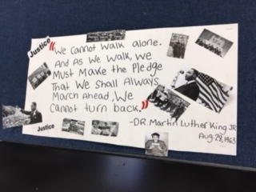
Strength Comes in Numbers

Slide 4
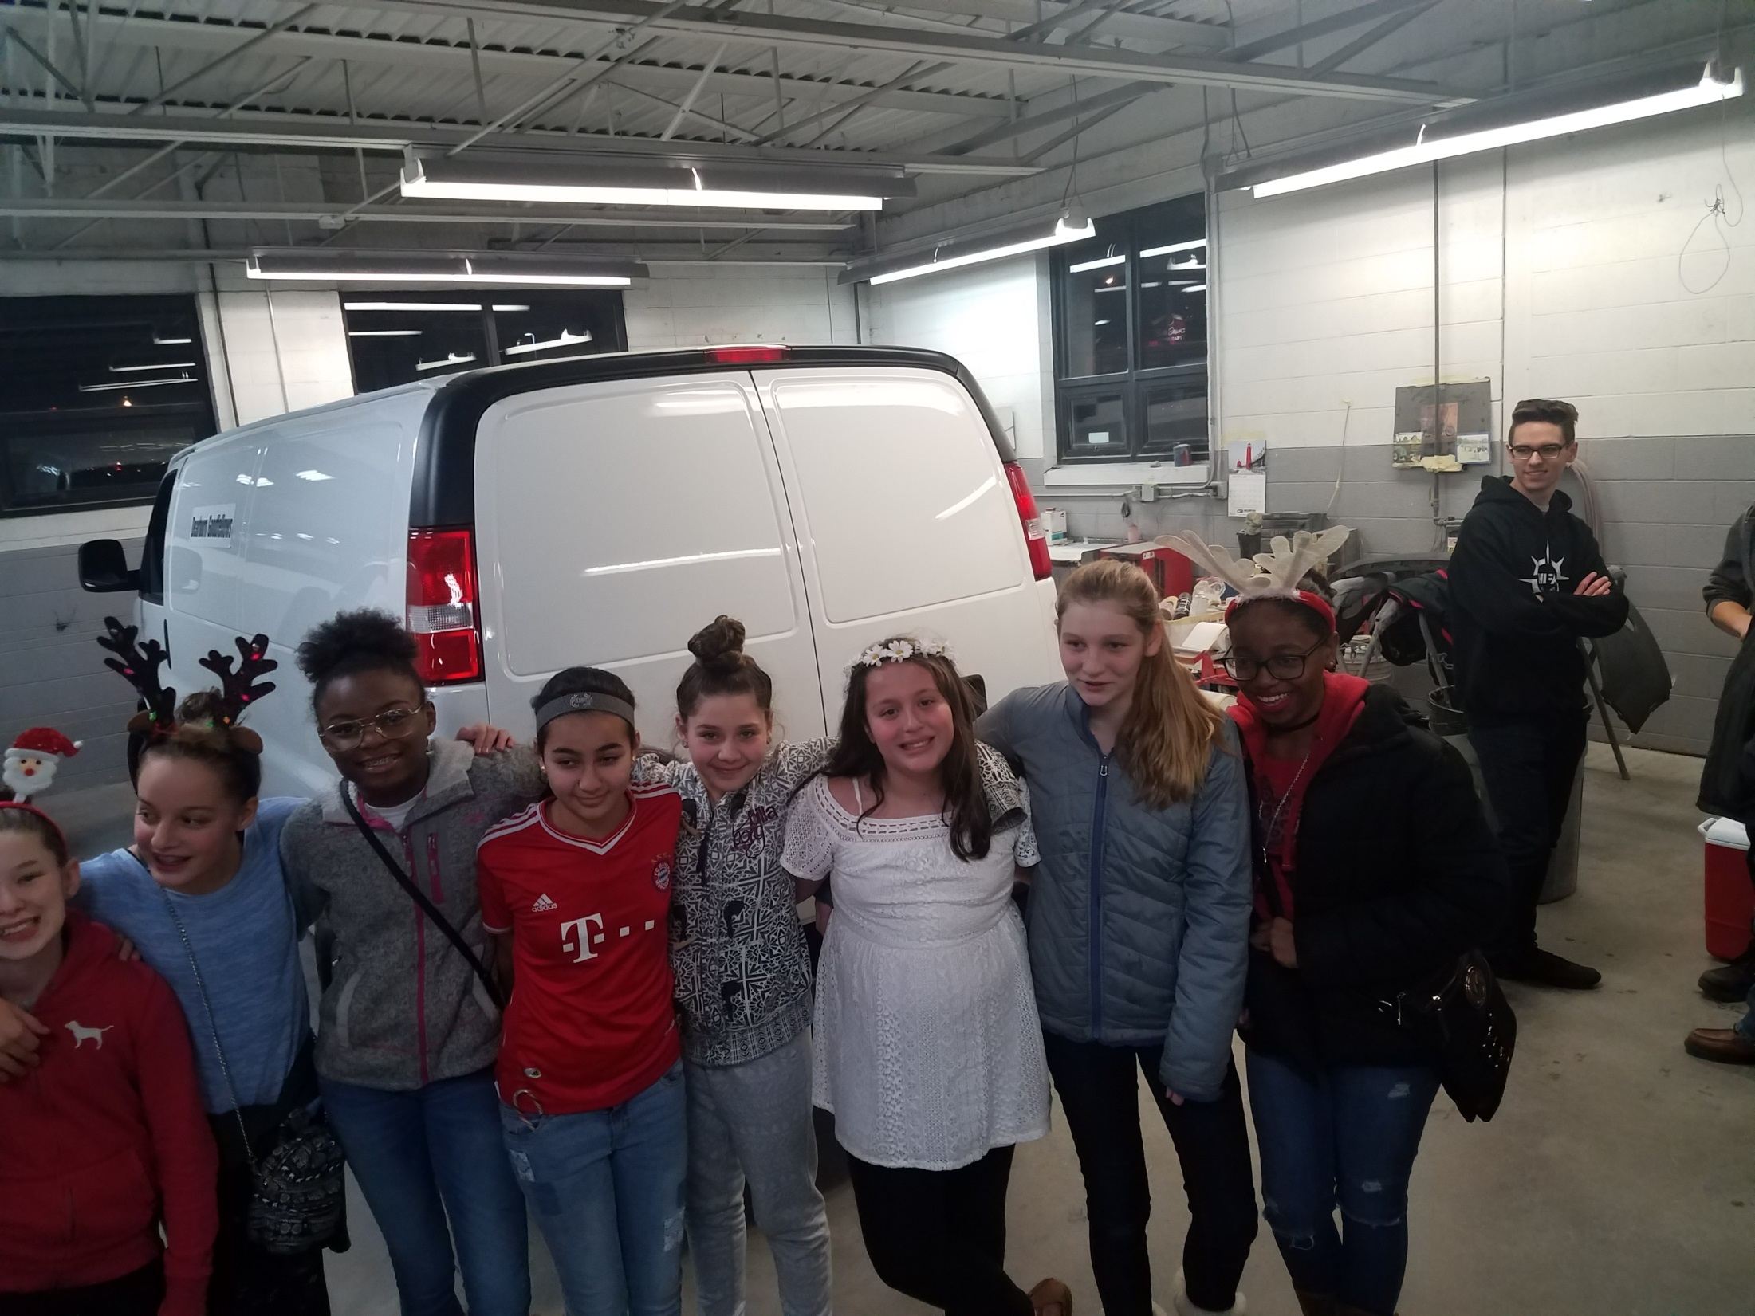
NJHS Volunteering for Goodfellows

Slide 5
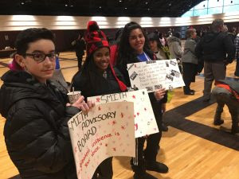
Listening to Speeches

Slide 6
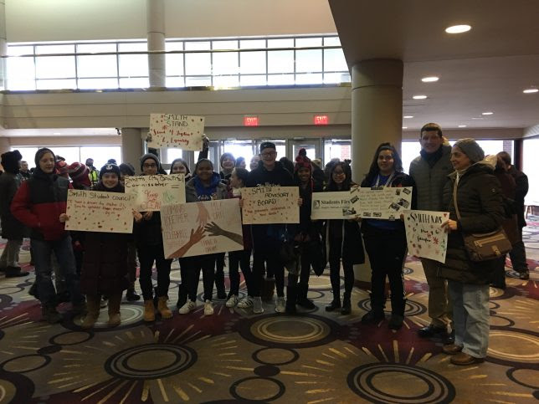
MLK March 2018

Slide 7
WE PLEDGE
TO THE CORE

Slide 8
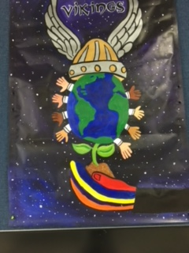

Slide 10
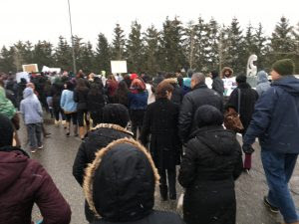
A Glimpse at MLK’s March

Slide 11
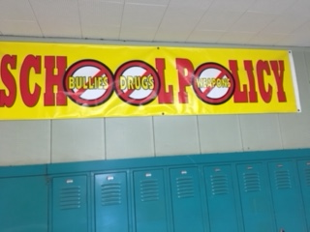

Slide 12
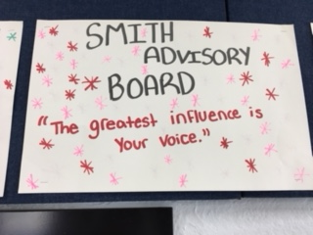

Slide 13
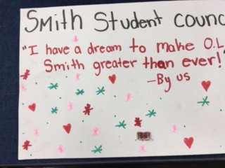

Slide 14
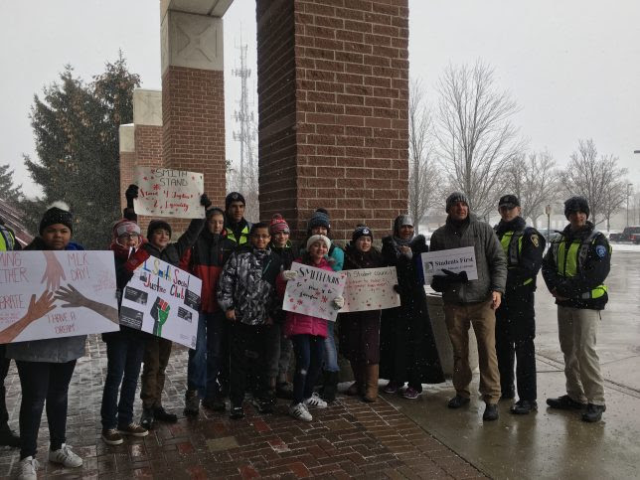
MLK Day 2018

Slide 15
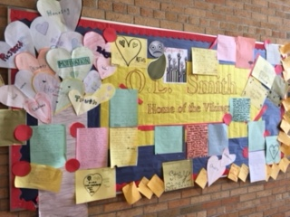
Smith Empathy Board - letters TO Marjory Stoneman Douglas high school. "Empathy Tree" created by Mr. Kade's amazing art students.

Slide 16
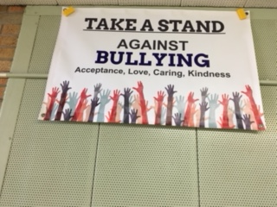

Slide 17
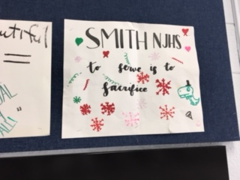
THE SACRIFICE OF GIVING

Slide 18
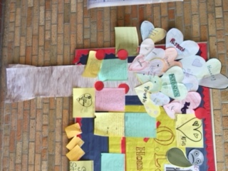
Letters to Parkland “We Care to the Core”

Slide 19
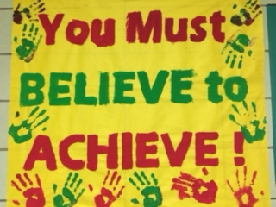

Slide 20
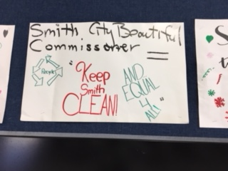

Slide 22
THANKS TO THE SOCIAL JUSTICE STUDENTS,
Mr. BAIZ & THE MIDDLE SCHOOL ADVISORY COMMITTEE FOR LEADING OUR AWWWWWSOMMME SCHOOL!!!

Slide 23
2018

