Slide 1
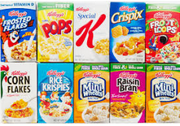
10th ANNUAL CEREAL DRIVE
Over 1.9 million servings were collected to help those suffering from hunger throughout SE Michigan.
Collected cereal will be donated to Gleaners Community Food Bank of Southeast Michigan, who will distribute the cereal collection to children and their families over the summer.
Please drop cereal donations off before class.
The Last day to collect will be June 6, Thursday THANK YOU FOR YOUR SUPPORT!

