Slide 1
Welcome to Eureka Math
Please sit next to your child

Slide 2
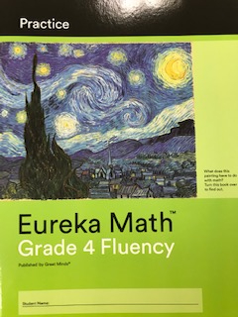
PRACTICE BOOK
Sprints

Slide 3
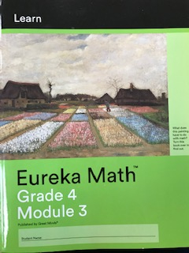
LEARN BOOK
Application
Problem Set
Exit Ticket
Lesson Templates

Slide 4
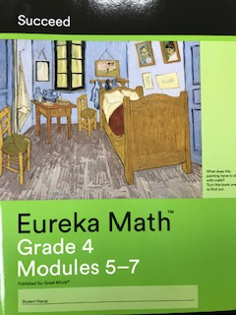
SUCCEED BOOK
Homework Helper
Homework

Slide 5
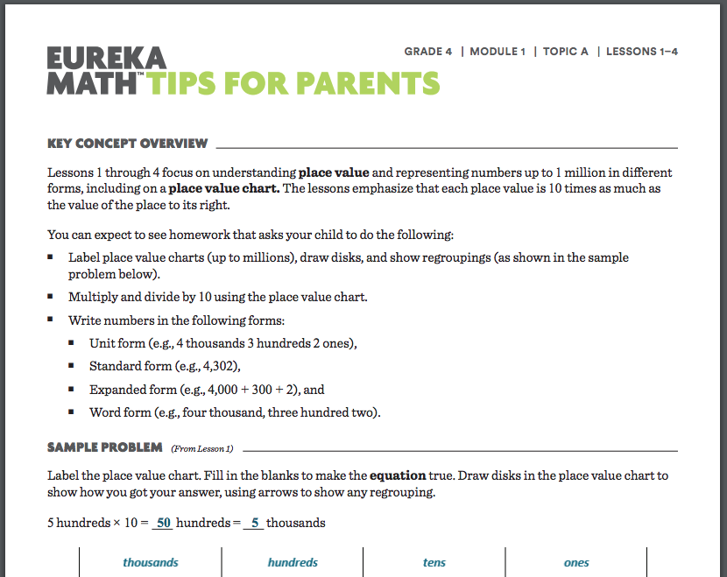
Parent Tip Sheets
Located on each teacher’s blog or Class Dojo

Slide 6
Resources
Websites
Teacher Blogs
www.embarc.online
www.zearn.org
Ms. Shene
Ms. Guadiana (see Class Dojo)
Mrs. Majetic
Presentation Notes

