Slide 1
Language Arts 5 & 6 Daily Agenda
Mr. Schmitt

Slide 2
Start of Semester 2 for 2017-18 school year

Slide 3
Monday Jan. 29, 2018 Agenda
Bell Work:
You have assigned seats. The bottom of the board is the front of the room. Seating most likely will change.
In class activities:
Take Attendance
Building Announcements
Introduce Remind and sign up for new Remind class
Sign up for new Google Classroom pages
Subscribe to my blog
**If there is time, fill out notecard about you
First name, Last Name, Grade, Birthday, 3 interesting/fun facts about you, and a symbol to represent you.
Assign partners and assign Starter Pack Assignment (due Friday)
Homework:
Sign up for Remind
Save my blog and my email to your contacts:
Blog = iblog.dearbornschools.org/schmitthappens
Email = schmitm1@dearbornschools.org
Learning Targets:
I can follow directions the first time they are given.
I can recognize and comply with classroom policies.

Slide 4
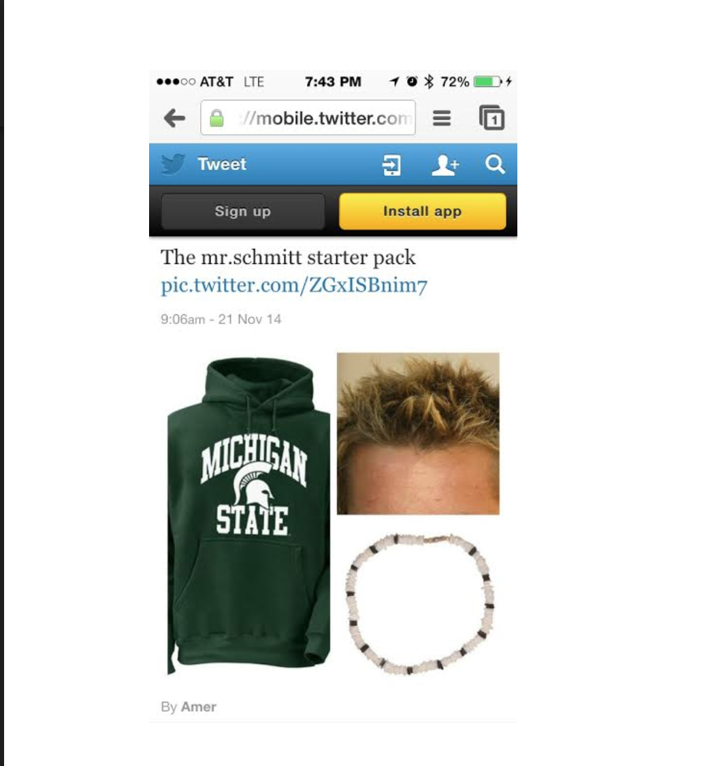
Starter Pack Assignment
Requirements:
A minimum of four items to represent your partner
2-4 complete and detailed sentences to explain how each item represents your partner
The final product can be presented using a presentation program/app or drawn out
Final product must be uploaded to Google Classroom by Thursday evening

Slide 5
Tuesday 1/30/18 Agenda
Bell Work:
Pass out syllabus
In class activities:
Go over syllabus (nice to know vs. need to know)
Day Two Procedures Form
Complete Student Identities (Google Form)
Go over results from last year’s SAT survey
https://goo.gl/forms/MABgHKQQJsKtRhh03
Introduce Khan Challenge (due before the SAT in April)
https://magic.piktochart.com/output/20233534-new-piktochart
Homework:
Complete the Student Identities (Google Form) = 40 Formative pts.
Save my blog and my email to your contacts:
Blog = iblog.dearbornschools.org/schmitthappens
Email = schmitm1@dearbornschools.org
Learning Targets:
I can follow directions the first time they are given.
I can recognize and comply with classroom policies.

Slide 6
Wednesday 1/31/18 Agenda
Bell Work: WOTD – infer (verb)
In class activities:
Bell Work = WOTD, infer (verb)
Review and discuss expectations for annotations: With your table, you will be given a set of four annotations. Based on the rubric you will be provided, you will need to score each example. We will share results with the class. **20-25 minutes
AOTW #1: At the end of the hour, you will be given AOTW #1 on how Detroit should implement a ban on pit bulls. Your job is to start the annotations before you leave. **25-30 minutes
Debrief: As a class, the last 8 minutes of class, we will discuss techniques the author used to build her argument and her purpose for using each technique (goal for using each technique). **8 minutes
Learning Targets:
Content Learning Target
I can analyze an article in order to identify techniques he or she used to build the argument.
Language Learning Target
I can use the following sentence stem in order to discuss the techniques and goals for author Rochelle Riley’s article from 2015: Author Rochelle Riley helped build her argument by (insert technique #1) in order to (insert goal #1).

Slide 7
Word: infer
Part of speech: verb
Pronunciation: in-fur
Origins: --Latin: “in” + “ferre” (to bring, carry)
Related Forms: inference (noun), misinfer (verb)
Synonyms:
Sentence: Based on the collection of knives on the walls, the decomposing skeletons rotting in alcoves, and the blood stains on the ceiling, it was easy for the Joker’s latest victim to infer that he was going to die in that basement
Predicted Definition: I believe this word means… (include 3 guesses)
Definition:
conclude, reason, interpret
to derive by reasoning; conclude or judge from premises or evidence; to guess; speculate; surmise.

Slide 8
Thursday 1/31/18 Agenda
Bell Work: WOTD – autonomy (noun)
In class activities:
Bell Work = WOTD, autonomy (noun)
Video Clip on Pit bulls: http://media.freep.com/pitbulls/index.html
Finish annotations from Banning Pit bulls in Detroit, article: On your own, finish writing the annotations (techniques, goals, and mini summaries). **20-25 minutes
Discuss and Review SOAPS and what needs to be filled out: We will quickly review what needs to be written as far as evidence and your explanation. 10 minutes
Rhetorical Analysis Intro. Paragraph: Using the sentence stems and outline I provided you in your packet, you will need to write out the intro. paragraph to the Rhetorical Analysis essay (as if you were going to write the essay). **10 minutes
Exit Ticket: You will need to show me your intro. paragraph and have me sign off on it before you leave.
Learning Targets:
Content Learning Target
I can analyze an article in order to identify techniques he or she used to build the argument.
Language Learning Target
I can use the following sentence stem in order to discuss the techniques and goals for author Rochelle Riley’s article from 2015: Author Rochelle Riley helped build her argument by (insert technique #1) in order to (insert goal #1).

Slide 9
Word: autonomy
Part of speech: noun
Pronunciation: aw-ton-uh-mee
Origins: Greek = “autonomia” (independence)
Related Forms: autonomous (adjective)
Synonyms:
Sentence: As children age, they want more autonomy, so frequently they rebel against their parents’ rules, which, unfortunately for them, just proves to their parents that they deserve less autonomy and not more.
Predicted Definition: I believe this word means… (include 3 guesses)
Definition:
Self-government, self-rule, freedom, liberty
independence or freedom; the right or state of self-government, especially when limited; freedom to determine one's own actions, behavior, etc.

Slide 10
Friday 2/2/18 Agenda
Bell Work: WOTD – implicit (adjective)
In class activities:
Bell Work = WOTD, implicit (adjective)
Starter Pack Assignment = Go over directions and expectations (due tonight on Google Classroom).
Finish annotations from Banning Pit bulls in Detroit, article: On your own, finish writing the annotations (techniques, goals, and mini summaries). **15 minutes
Discuss and Review SOAPS and what needs to be filled out: We will quickly review what needs to be written as far as evidence and your explanation. 15 minutes
Write two SAT style questions + include the answers for both questions: Have a partner answer them and see if they can get them right. **15 minutes
Homework: Annotations, 2 SAT Questions w/ answers, plus Rhetorical Analysis intro. Paragraph = due Monday. ☺
Learning Targets:
Content Learning Target
I can analyze an article in order to identify techniques he or she used to build the argument.
Language Learning Target
I can use the following sentence stem in order to discuss the techniques and goals for author Rochelle Riley’s article from 2015: Author Rochelle Riley helped build her argument by (insert technique #1) in order to (insert goal #1).

Slide 11
Monday 2/5/18 Agenda
Bell Work: WOTD – implicit (adjective)
In class activities
Bell Work = WOTD, implicit (adjective)
Rhetorical Analysis Essay Training: We will take a look at a sample which received a 4 (highest score) and name key parts. Next, we will review the rubric and discuss steps that need to be taken in order to achieve the highest score possible. **25 minutes
Crafting the body paragraph: After we have finished analyzing the example and reviewing the rubric, you will craft your own body paragraph using the article on pit bulls. **15 minutes
Partner Assess SAT style questions: Swap with a person from your table and have your partner answer them and see if they can get them right using the article. **10 minutes
Exit Ticket: Turn in everything to your hour’s folder (1=blue, 3 = red, 5=yellow and 6=green) for AOTW (Annotations, SOAPs Analysis, 2 SAT style questions w/ correct answers identified, and intro. and body paragraph for Rhetorical Analysis.
Learning Targets
Content Learning Target
I can analyze an article and find examples of the main technique the author used to build his/her argument in order to craft the body paragraph for the Rhetorical Analysis Essay.
Language Learning Target
I can use an exemplar of a body paragraph for the Rhetorical Analysis Essay in order to emulate the format while crafting my own writing.

Slide 12
Monday 2/5/18 Agenda
Bell Work: WOTD – implicit (adjective)
In class activities
Bell Work = WOTD, implicit (adjective)
Rhetorical Analysis Essay Training: We will take a look at a sample which received a 4 (highest score) and name key parts. Next, we will review the rubric and discuss steps that need to be taken in order to achieve the highest score possible. **25 minutes
Crafting the body paragraph: After we have finished analyzing the example and reviewing the rubric, you will craft your own body paragraph using the article on pit bulls. **15 minutes
Partner Assess SAT style questions: Swap with a person from your table and have your partner answer them and see if they can get them right using the article. **10 minutes
Exit Ticket: Turn in everything to your hour’s folder (1=blue, 3 = red, 5=yellow and 6=green) for AOTW (Annotations, SOAPs Analysis, 2 SAT style questions w/ correct answers identified, and intro. and body paragraph for Rhetorical Analysis.
Learning Targets
Content Learning Target
I can analyze an article and find examples of the main technique the author used to build his/her argument in order to craft the body paragraph for the Rhetorical Analysis Essay.
Language Learning Target
I can use an exemplar of a body paragraph for the Rhetorical Analysis Essay in order to emulate the format while crafting my own writing.

Slide 13
WOTD 2/5/18
Word: implicit
Part of speech: adjective
Pronunciation: im-plis-it
Origins: Latin: “Implicitus” (Involved; obscure)
Related Forms: implicitly (adverb)
Synonyms:
Sentence: While they never wrote it down or spoke of it, the Joker and Bane had an implicit agreement that whoever kidnapped their victim got to deliver the killing blow when the time was right.
Predicted Definition: I believe this word means… (include 3 guesses)
Definition:
absolute, constant, unspoken, implied
Implied, rather than directly stated; hinted at; understood without being spoken or written.

Slide 14
Tuesday 2/6/18 Agenda
Bell Work: Pick up your chromebook and sign in to Khan Academy. You will be taking one of the practice reading quizzes. Reminder, you must do at least 3 and upload a screenshot or picture of your “review page” by 2/11/18 in order to give proof you attempted the first challenge.
In class activities
Bell Work = SAT Practice Reading Quiz (13 minutes)
Rhetorical Analysis Essay Training: We will take a look at a sample which received a 4 (highest score) and name key parts (like we did yesterday). **10 minutes
Crafting the body paragraph: After we have finished analyzing the example you will use the example given to you today in order to serve as a model for you to write a new body paragraph. If you were not here, yesterday, you will need to write one paragraph at home for homework. **10 minutes
Trade and grade (provide feedback): Switch with a partner at your table and then give one another feedback on his/her paragraph. 1) Include one area that was written well. 2) Write at least two suggestions on how to improve this paragraph.
Learning Targets
Content Learning Target
I can analyze an article and find examples of the main technique the author used to build his/her argument in order to craft the body paragraph for the Rhetorical Analysis Essay.
Language Learning Target
I can use an exemplar of a body paragraph for the Rhetorical Analysis Essay in order to emulate the format while crafting my own writing.

Slide 15
Steps to get to Khan Academy Practice
Go to khanacademy.org
Click “Sign in with Google”
Click “Subjects” (top left), “Test Prep” (on the right), “SAT” is underneath “Test Prep.”
Click “Practice,” then switch from “Math” to “Reading and Writing”
Scroll down and click ”Practice” next to one of the Reading quizzes (i.e. Reading: Social Studies)

Slide 16
Wednesday 2/7/18 Agenda
Bell Work: WOTD, immutable (adj.) & desecrate (verb)
In class activities
Bell Work: WOTD, immutable (adj.) & desecrate (verb)
Book Pass Activity: You will need to review three books. **Note: You will not be able to check out a book from my library until tomorrow (or you can come after 6th hour, today). You must have a book to read in class for SSR by 2/12/18. Even if you will be bringing in a book from home or purchasing one to read on a device, you will need to review 3 books from my class library.
Khan Academy Challenge: If you are finished with the book pass, you can grab a chromebook and work on Khan Academy for the remainder of the hour. Reminder, you need to submit proof you took 3 of the Reading Quizzes between now and 2/11/18 and upload the screenshot of your Review page to Google Classroom.
Learning Targets
Content Learning Target
I can continue find a book (text) which peaks my interest in order to then continue to practice various literary skills (i.e. summarize, make inferences, track theme development, identify author’s craft and assess the various techniques being used, make meaning of words in context, etc.)
Language Learning Target
I can determine whether a book is fiction or non-fiction based on various observations and reading specific sections (front cover, back cover, on-line reviews, etc). I can also determine if the books fits my own tastes and interests.

Slide 17
WOTD 2/7/18
Word: immutable
Part of speech: adjective
Pronunciation: ih-myoo-tuh-buhl
Origins: Latin: “im” (not) + ”mutabilis” (changeable)
Related Forms: immutably (adverb)
Synonyms:
Sentence: No matter how much Batman’s surgeons worked to reattach his limbs, the immutable fact was that Bane had turned him into a quadriplegic.
Predicted Definition: I believe this word means… (include 3 guesses)
Definition:
Constant, fixed, stable, permanent
Not mutable, unchangeable, changeless

Slide 18
WOTD 2/7/18
Word: desecrate
Part of speech: verb
Pronunciation: des-i-kreyt
Origins: Latin: “de” (do the opposite of) + “sacer” (holy)
Related Forms: desecration (noun)
Synonyms:
Sentence: The Joker was a violent sociopath with hardly any morals, but even he refused to desecrate any mosques, churches, or synagogues by dumping the bodies of his victims inside these holy buildings.
Predicted Definition: I believe this word means… (include 3 guesses)
Definition:
defile, dishonor, mess up, violate
to violate or outrage the sacred character of (an object or place) by destructive, blasphemous, or sacrilegious action; to disrespect, defile, deface, or dishonor something holy or sacred.

Slide 19
Thursday 2/8/18 Agenda
Bell Work: WOTD, subservient (adjective)
In class activities
Bell Work: WOTD, subservient (adjective)
Rhetorical Analysis Practice: We will be using Tupac Shakur’s hit song, “Changes” in order to analyze and eventually craft an intro. and body paragraph for the rhetorical analysis essay. We will first listen to the song while follow along with the lyrics in front of you. Then, you and your partner will fill out the first table (15 minutes). Then, we will play the video in order for you and your partner to identify three visual techniques that are used to support Tupac’s argument. https://www.youtube.com/watch?v=eXvBjCO19QY
Exit Ticket: On your own, using the frame provided, you will need to write the intro. paragraph and body paragraph of the rhetorical analysis essay for this text (song).
Reminders: You must have an approved book to read in class for SSR by 2/12/18. You will be allowed to bringing an approved book from home, or an approved book you purchased on a device.
Khan Academy Challenge: Reminder, you need to submit proof you took 3 of the Reading Quizzes between now and 2/11/18 and upload the screenshot of your Review page to Google Classroom. In order to receive 40/40 summative points, you must show proof of scoring 8/11 or better on 3 consecutive (in a row) quizzes.
Homework: Study for your vocabulary quiz, tomorrow. There are six words (18 questions = total).
Learning Targets
Content Learning Target
I can continue find a book (text) which peaks my interest in order to then continue to practice various literary skills (i.e. summarize, make inferences, track theme development, identify author’s craft and assess the various techniques being used, make meaning of words in context, etc.)
Language Learning Target
I can determine whether a book is fiction or non-fiction based on various observations and reading specific sections (front cover, back cover, on-line reviews, etc). I can also determine if the books fits my own tastes and interests.

Slide 20
Word: subservient
Part of speech: adj
Pronunciation: suh b-sur-vee-uh nt
Origins:
Related Forms: subservience (noun); subserviently (adverb)
Synonyms:
Sentence: Alfred was the perfect assistant for Batman because he was so subservient, running immediately to do what Batman told him and saying, “yes, sir!” with a smile and a bow.
Predicted Definition:
Definition:
Latin: “sub” (under) + “servire” (to serve)
1. serving or acting in a subordinate capacity; subordinate.
2. servile; excessively submissive; obsequious

Slide 21
This presentation is up to date at this point for the 2017-18 school year. The agenda will be updated on a daily/weekly basis.
The following slides are plans from the 2016-17 school year.

