Slide 1
The Capulets &
The Montagues
From Romeo & Juliet by William Shakespeare
Diabolical Opposition

Slide 2
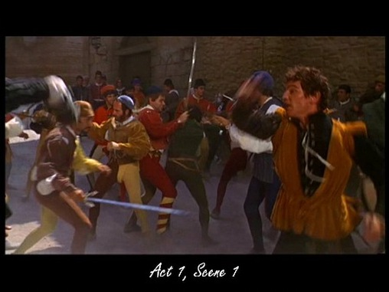
So what’s their deal?
The Capulets and the Montagues are both families that live in Verona, Italy in Shakespeare’s play, Romeo & Juliet.
The two families are wealthy and well-respected but they have a long-standing feud.
Two households, both alike in dignity, / In fair Verona, where we lay our scene, / From ancient grudge break to new mutiny, / Where civil blood makes civil hands unclean (Prologue 1-4).
It is unclear in the play why the feud began but it is clear the feud is serious. Even their servants cannot meet in the market without insults and brawling.
Diabolical Opposition

Slide 3
Who are the Capulets?
The Capulets

Slide 4
Who are the Montagues?
The Montagues

Slide 5
The Major Points of Contention
The pre-existing feud including two public fights
A brawl in the marketplace by the servants of the Montagues and Capulets which is the third recent public fight.
The Prince of Verona demands peace between the families or those who fight again will be put to death..
Romeo Montague sneaks into a Capulet party and is recognized by Tybalt who vows revenge.
When Tybalt accidentally kills Romeo’s friend, Mercutio, Romeo kills Tybalt.
Lady Capulet demands that the Prince of Verona execute Romeo but instead he orders Romeo banished.

Slide 6
What do the Capulets & Montagues have in common?
Wealthy and well-respected citizens of the same town
Family reputation is important.
Prince of Verona is angry at both families.
Parents seem to care for their children very much and want them to be happy.

