Slide 1
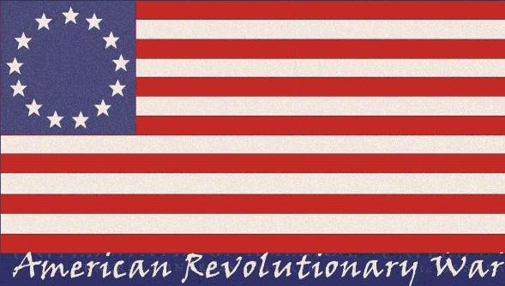
The Causes of the American Revolution

Slide 2
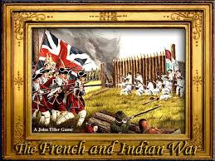
Background
French and Indian War: Britain gains control of the 13 Colonies from France
Britain in massive debt
Looks towards the colonies to relieve the debt in the form of taxation on the colonies
Prior to this, colonies mostly left to rule and control themselves….

Slide 3
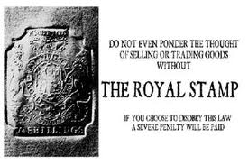
The Stamp Act
March 1765: Passed by Parliament
Required all legal documents to have a stamp (newspapers were included)
When the tax was paid, the document would be stamped
Direct Tax, if Tax not paid, they would be tried

Slide 4
Reaction to the Stamp Act
Colonies beginning to act as one
Merchants in Boston, New York and Philadelphia agreed not to import Brit goods
March 1766: Parliament repealed the Stamp Act
BUT issued the Declaratory Act asserting their right to tax
Resulted in Protests
May 1765: Sons of Liberty formed
October 1765: Stamp Act Congress formed by 9 colonies, issued a Declaration of Rights and Grievances
It said Parliament cannot impose the tax because the colonies were not represented in Parliament

Slide 5
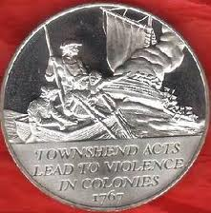
Townshend Acts
A year after the Stamp Act was repealed these were passed by Parliament in 1767
Indirect tax on imported goods: glass, lead paint and paper
Three penny tax on tea THE MOST POPULAR DRINK

Slide 6
Colonial Reaction
British seized the ship Liberty belonging to John Hancock
Riots against British custom agents
British station 2,000 “redcoats” or British soldiers (named after their red jackets) in Boston
Protests and Outrage
Colonists shouted “taxation without representation”
Samuel Adams called for a boycott of all British goods
June 1768: Conflict got worse

Slide 7
The Boston Massacre
Colonists angered at the presence of British troops, tension was very high
March 5, 1770: a fist fight broke out over jobs (British soldiers looked for work on their off time as dockhands)
A mob (large group of people) gathered, taunting the guards
Crispus Attucks and several dockhands, angered over losing work to British guards, arrived and an armed clash began
Attucks and 4 others were dead
Samuel Adams and other named this the Boston Massacre

Slide 8
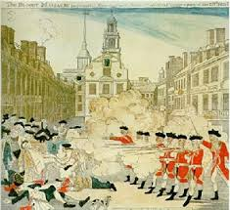

Slide 9
The Boston Tea Party
1773: Tea Act was passed to help the British East India Company giving the Co. the right to sell tea to the colonies without a tax BUT colonial tea merchants still had to pay a tax
British tea was made cheaper as a result of no tax
December 1773: a group of Boston rebels disguised themselves as Native Americans dumped 18,000 pounds of East India Co. tea into Boston Harbor

Slide 10
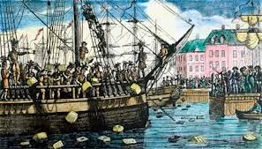

Slide 11
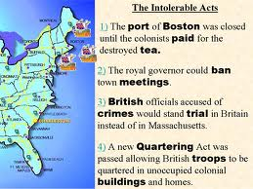
Intolerable Acts
1774: King George III furious over the Boston Tea Party passed:

