Slide 1
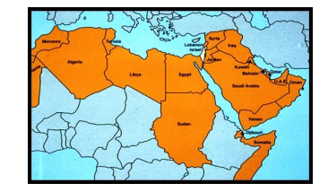
WHERE IS THE ARAB WORLD?
The Arab world stretches from Morocco across
Northern Africa to the Persian Gulf. The Arab world is more or less equal to the area known as the Middle East and North Africa (MENA). Although this excludes Somalia, Djibouti, and the Comoros Islands which are part of the Arab league.

Slide 2
WHAT IS AN ARAB?
 Over 300 million Arabs worldwide.
 To be an Arab, is not to come from a particular race or lineage.
The Arab world includes Muslims, Christians and Jews.
 Any person who adopts the Arabic language is typically
called an Arab.
 Arabic is the official and the original language of the
Qur’an, the Islamic holy book.

Slide 3
Language
Arabic is the dominant language.
Arab countries are religiously diverse with Islam being the dominant religion
in most countries.
22 Arab countries/areas: Algeria, Bahrain, the
Comoros Islands, Djibouti, Egypt, Iraq, Jordan,
Kuwait, Lebanon, Libya, Morocco, Mauritania, Oman,
Palestine, Qatar, Saudi Arabia, Somalia, Sudan,
Syria, Tunisia, United Arab Emirates, and Yemen.
Iran and Turkey are not Arab countries.

Slide 4
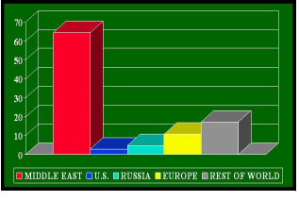
STRATEGIC IMPORTANCE OF ARAB WORLD
 Close to 60% of earth’s oil reserves are at or near
the Arabian Peninsula.
 Saudi Arabia possesses the world’s largest
reserves of oil.

Slide 5
ARAB Governments
Politically diverse types of government in Arab world.
Republics in Algeria, Egypt,
Lebanon, Tunisia, Syria, Iraq, Libya and
Yemen.
Traditional monarchies in Oman, Qatar,
Bahrain, Kuwait, United Arab Emirates and
Saudi Arabia.
Jordan and Morocco are constitutional
monarchies. ( The King follow the constitution)
Lebanon – Parliamentary representation is divided according to religious affiliation
(Muslim Sunni, Muslim Shi'a, Christian, and Druze).

Slide 6
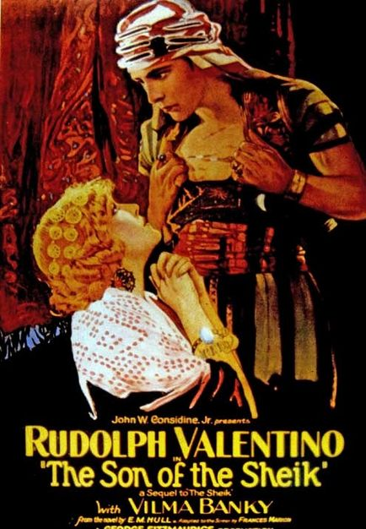
Common Misconceptions about Arabs
All Arabs are Muslims, and all Muslims are Arab.
The Arab world is backwards and uncivilized
The Arab world is one big desert.
The Western media has often projected individuals of Arab descent in a negative manner:
Stereotypes of Arab males:
Often portrayed dressed in flowing robes,
living against desert hardships, surrounded by
submissive females
Portrayed as warlike and predatory
All are “oil-rich Sheiks”.
Stereotypes of Arab women:
  All are oppressed by men.
  All are veiled.
Notes:
Filmmakers too often dip into their script bags for the "Instant Arab Kit." For women, it contains belly dancers' outfits and veils; for men, it consists of kuffiyahs, flowing robes, sunglasses, scimitars, limousines and camels. Oil wells, sand dunes and souks set the scene.

Slide 7
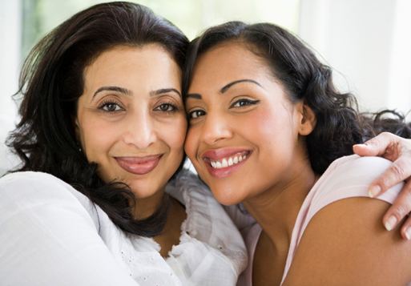
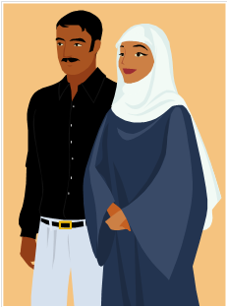
Stereotypes of Arab women
1-All are oppressed by men. Not true.
2- All are veiled. According to Islam, women are supposed to wear veils.
3- In some countries, like Lebanon, Syria and Egypt, it is not imposed upon them, and women are free to choose whether to wear veils or not.

Slide 8
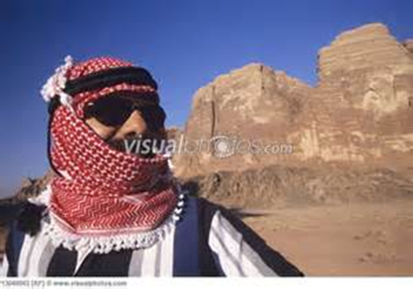
Men Dress
Arab dress for men ranges from the traditional flowing robes to blue jeans, T-shirts and western business suits.
The robes allow for maximum circulation of air around the body to help keep it cool, and
the head dress provides protection from the sun.

Slide 9
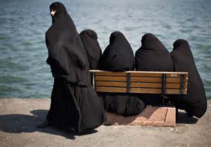
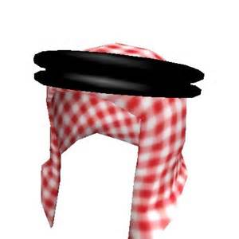
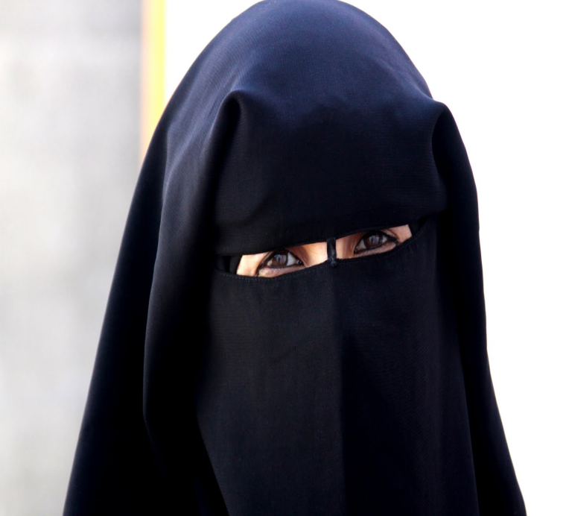
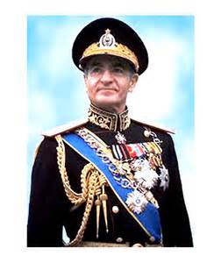
Head dress

Slide 10
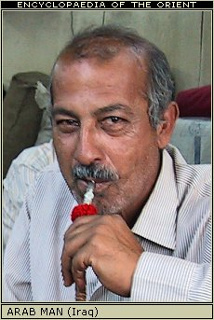

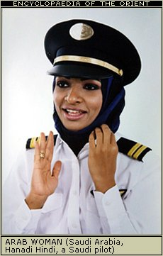

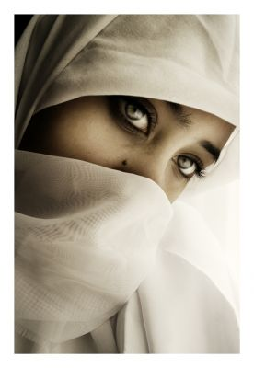
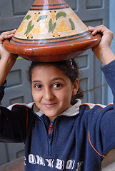

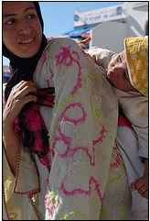
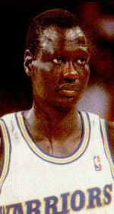
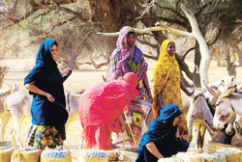
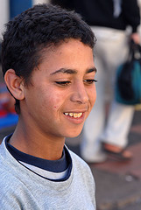
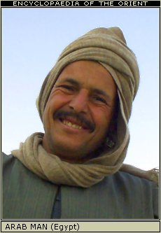

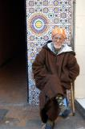
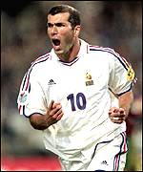
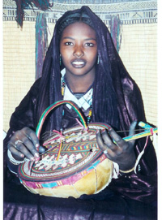
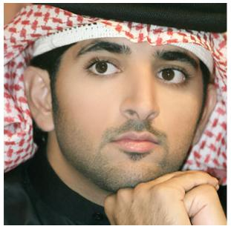

Who is Arab?
Notes:
From the US census: Arabs are officially classified as White, yet in reality and practice, are treated as a minority.
various studies over the years have found that Arab Americans tend to be economically above average. As such, the argument goes, there has been no real need on the part of the U.S. Census bureau to conduct this type of analysis.

Slide 11
Children
1- Male offspring are favored, since a son is expected to care for his parents in their advanced age, whereas a daughter becomes part of the son-in-law’s family.

Slide 12
ISLAM
Islam’ in Arabic means ‘Submission’,
or specifically, submission to Allah’s well
and obedience to His law.
One God. Islam is a strictly monotheistic
religion.

Slide 13
Islam
According to Muslims, Islam is the final word of God. Although Judaism and Christianity preceded Islam and worships the same God as Islam, Islam claims to be more refined than them in that it built upon both.
Muhammad is God’s Prophet. Muhammad
is not to be worshiped but is to be respected
and revered. Muhammad’s life and teachings
provide the examples of how one is to live his
life

Slide 14
The QUR’AN
 Means “Recitation”
 Honorable to memorize it.
 There are 114 “Surah” & 30 chapters arranged by length
longest to shortest
Muslims will keep Qur’an texts on the highest
bookcase shelf.
Place nothing on top of the Qur’an.
Prior to reading the Qur’an, Muslims will often
recite the following, "I seek refuge in God
from Satan.

Slide 15
MUSLIMS
Followers of Islam are called Muslims.
There are 1.3 billion Muslims worldwide.
Muslims are not to be confused with
Arabs. Muslims may be Arabs, Turks,
Persians, Indians, Pakistanis, Malaysians,
Indonesians, Europeans, Africans, Americans, Chinese, or other nationalities.

Slide 16
Muslims Population
12% of the world’s Muslims are Arabs.
The US, with 10-15 million Muslims, has the
20th largest Muslim population.
Turkey and Iran, not Arab countries, but they are
the most population of Muslim nations in the
Middle East.
The most population of Muslim nation in the
world is Indonesia.

Slide 17
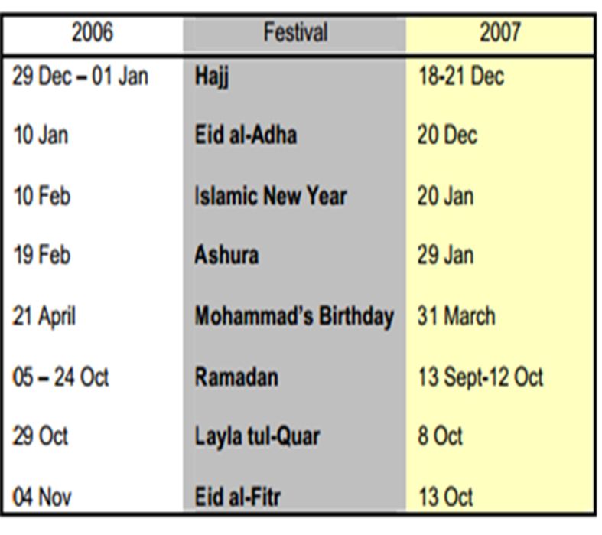
ARABIC CALENDAR/HOLIDAYS
Islamic practices are based on the lunar calendar or cycle, consisting of twelve months of 29 or 30 days each, totaling 353 or 354 days.
• Each new month begins at the sighting of a new moon.

Slide 18
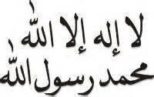
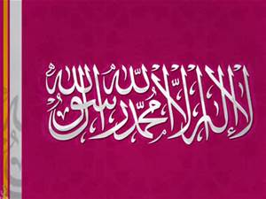
ISLAM’S FIVE PILLERS OF FAITH
SHAHADAH - Declaration of Faith
This declaration of faith is called the Shahadah. The
significance of this declaration is the belief that the only
purpose of life is to serve and obey God, and this is
achieved through the teachings and practices of the Last
Prophet, Muhammad.

Slide 19
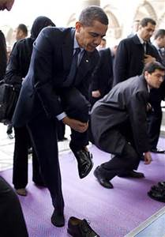
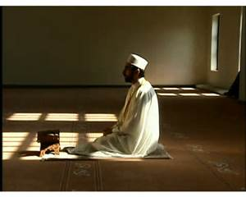
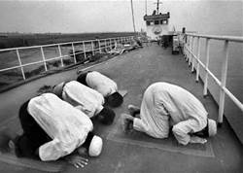
SALAH – Prayer
Salah is the name for the obligatory prayers that are performed
five times a day, and are a direct link between the worshipper and God.

Slide 20
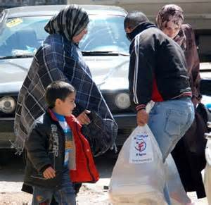
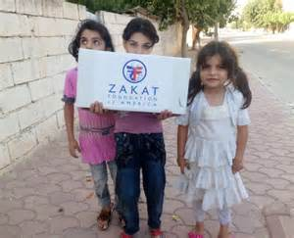
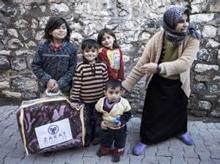
ZAKAH
An important principle of Islam is that everything belongs to
God, and that wealth is therefore held by human beings in trust.
The word zakah means purification.
Possessions
are purified by setting aside a proportion for those in need and for the society in general.

Slide 21
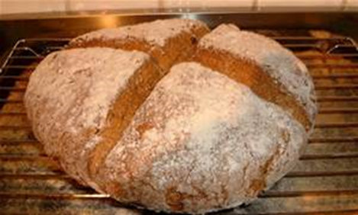
SAWM – Fasting
Every year in the month of Ramadan, all Muslims fast from
dawn until sundown--abstaining from food, drink, and sexual relations with their spouses.

Slide 22
HAJJ – Pilgrimage
The journey to Mecca is an obligation only for those who are physically and financially able to do so. Over two million people go to Mecca each year from every corner of the globe providing a unique opportunity for those of different nations to meet one another.

Slide 23
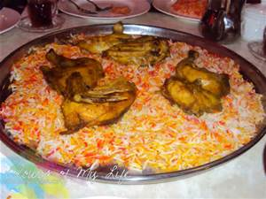
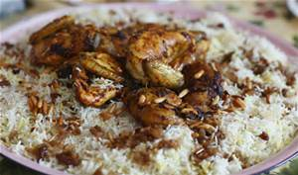
EATING ETIQUETTE
Arabs are restricted by Islamic law from eating pork, most wild animals, and un-scaled fish. Alcohol is forbidden.
Meat must be butchered in line with Qur’anic ritual (know as Hallal = “permitted”)
The staple of the Arab diet is dark pita bread. Lamb is the most common meat.

Slide 24
Guests
It is assumed that guests will accept at least a small quantity of drink (tea usually or sometimes Arabic coffee) offered as an expression of friendship.
It is considered rude to decline the offer of drink.

Slide 25
Hygiene
Personal hygiene is extremely important to Arabs for both spiritual and practical reasons.
Because meals are frequently eaten by hand, it is typical to wash the hands before and after eating.
Formal washing of face, hands, and forearm required before daily prayers.

Slide 26
Arab Perspective vs. Western Perspective
 | Arab | Western
Family | Center of everything | Important but not as central to individual
Friends | important to some, but courteous to all | Core to some, important to most
Honor | Very Important | Typically not as important
Time | less rigid | Very structured, deadlines must be met
Religion | Central to all things for most | Varies by individual, very personal
Society | Family is most important | Individual rights
Government | Most governments are secular, but still emphasize religion. | Purpose is to protect rights and improve standard of living.
Wealth | honored | honored
Other | Age and Wisdom honored | Youth and Beauty praised

Slide 27
Sunni and Shi’a in Islam
Sunni are the vast, dominant majority of Islam (secular political leadership accepted).
Sunni Muslims believe in the teachings of the prophet. Sunni comes from the Arabic word “Sunnah” meaning follower of the Prophet.
Shi’a Muslims believe that leadership should have stayed within the Prophet’s direct family, and therefore has been passed on to his cousin and son-in-law Ali.
The term "Shi’a" itself actually means Supporter, as in the supporters of Ali.
About 10% of all Muslims are Shi’a. They are in the majority in Iran, Iraq and Bahrain.

