Slide 1
1
If the rate of a reaction is going to
increase, one should _____________
the size of the particles, __________
the concentration of the reactants,
and _____________ the
temperature of the system.

Slide 2
1
If the rate of a reaction is going to
increase, one should _____________
the size of the particles, __________
the concentration of the reactants,
and _____________ the
temperature of the system.
DECREASE
INCREASE
INCREASE

Slide 3
2
At equilibrium there is
An increase
A decrease
No change
in the total number of reactant and product particles.

Slide 4
2
At equilibrium there is
An increase
A decrease
No change
in the total number of reactant and product particles.

Slide 5
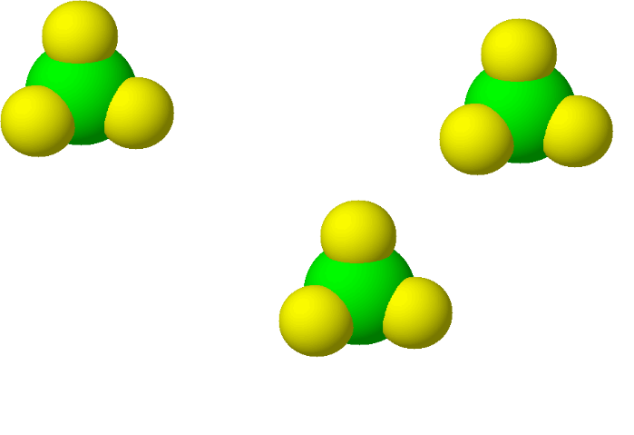
3
Nitrogen =
Chlorine =
Write the chemical formula for one
of the molecules shown above.

Slide 6
3
Nitrogen =
Chlorine =
NCl₃
Write the chemical formula for one
of the molecules shown above.

Slide 7
4
Which set of coefficients will
correctly balance the equation below?
CaH₂ + CBr₄ CH₄ + CaBr₂
2, 2, 1, 1
1, 2, 1, 1
2, 1, 2, 1
1, 1, 2, 2
2, 1, 1, 2

Slide 8
4
Which set of coefficients will
correctly balance the equation below?
CaH₂ + CBr₄ CH₄ + CaBr₂
2, 2, 1, 1
1, 2, 1, 1
2, 1, 2, 1
1, 1, 2, 2
2, 1, 1, 2

Slide 9
5
What type of chemical reaction
does the equation below represent?
CaH₂ + CBr₄ CH₄ + CaBr₂
DOUBLE REPLACEMENT
What reactant must be present for a
combustion reaction to occur?
OXYGEN – O₂

Slide 10
5
What type of chemical reaction
does the equation below represent?
CaH₂ + CBr₄ CH₄ + CaBr₂
What reactant must be present for a
combustion reaction to occur?

Slide 11
6
How many total atoms are
represented by
4 Ca(ClO₃)₂ ?
(1 x 4)+ (1 x 2 x 4) + (3 x 2 x 4) = 36

Slide 12
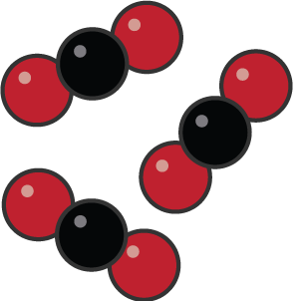
7
Using coefficients, subscripts
and the symbols of the elements,
write the correct notation for the
picture below.
Red = Oxygen
Black = Carbon

Slide 13
7
Using coefficients, subscripts
and the symbols of the elements,
write the correct notation for the
picture below.
Red = Oxygen
Black = Carbon
3 CO₂

Slide 14
8
Based on the equation below,
what is happening and is the system
at equilibrium?
H₂O _{(l)} H₂O _{(s)}

Slide 15
8
Based on the equation below,
what is happening and is the system
at equilibrium?
H₂O _{(l)} H₂O _{(s)}
Liquid H₂O is forming solid H₂O.
It’s not at equilibrium because the
process isn’t happening in reverse.

Slide 16
9
Why does a chemical reaction
happen more slowly if the
temperature is decreased?

Slide 17
9
Why does a chemical reaction
happen more slowly if the
temperature is decreased?

Slide 18
10
At equilibrium, how does the
rate of the forward reaction
compare to the rate of the
reverse reaction?

Slide 19
10
At equilibrium, how does the
Rate of the forward reaction
compare to the rate of the
reverse reaction?
Rate of Forward
Reaction
=
Rate of Reverse
Reaction

Slide 20
11
As the size of the particles _____,
the rate of a reaction will ______,
because there are more ________.

Slide 21
11
As the size of the particles
________________, the rate of
a reaction will _______________,
because there are
__________________________.
INCREASE/DECREASE
DECREASE/INCREASE
FEWER/MORE PARTICLE COLLISIONS

Slide 22
Write the balanced chemical
equation for the model shown
below: A = B =
12

Slide 23
Write the balanced chemical
equation for the model shown
below: A = B =
12
4 B + 3 A₂ → 2 B₂A₃

Slide 24
13
What are the products of a
Synthesis reaction?
A single replacement reaction?

Slide 25
13
What are the products of a
Synthesis reaction?
A single replacement reaction?
ONLY ONE COMPOUND
ONE ELEMENT AND ONE COMPOUND

Slide 26
What type of reaction is represented by the equation?
2 FeO 2 Fe + O₂
14

Slide 27
What type of reaction is represented by the equation?
2 FeO 2 Fe + O₂
14
DECOMPOSITION

Slide 28
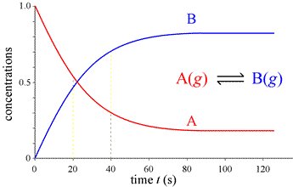
15
At what time has this
reaction reached equilibrium?

Slide 29
15
At what time has this
reaction reached equilibrium?
80 s

Slide 30
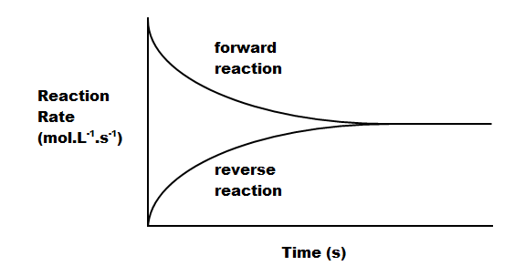
16
Does this graph represent a
system at equilibrium? How can you
tell?

Slide 31
16
Does this graph represent a
system at equilibrium? How can you
tell?
The system is at
equilibrium -
The rates
are equal!

Slide 32
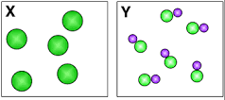
16
Match each model with the correct
notation written below.
1. 2. 3.

Slide 33
17
Match each model with the correct
notation written below.
Z
Y
X
1. 5 AB₂C 2. 6 DE 3. 5 FG₂

Slide 34
18
Balance the following equation:
C₃H₆ + O₂ CO₂ + H₂O

Slide 35
18
Balance the following equation:
C₃H₆ + O₂ CO₂ + H₂O
2
9
6
6

