Slide 1
LLI Kindergarten Reading Intervention
Mrs. Christine Rydlicki, ECS
Mrs. Kelly Muston, ECS

Slide 2
Who are we?
Mrs. Muston-Early Childhood Specialist
21 years of teaching
Mrs. Rydlicki-Early Childhood Specialist
16 years of teaching

Slide 3
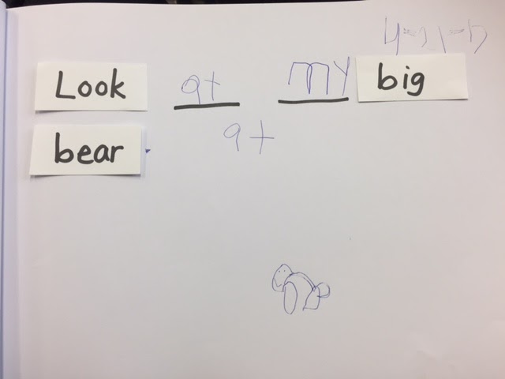
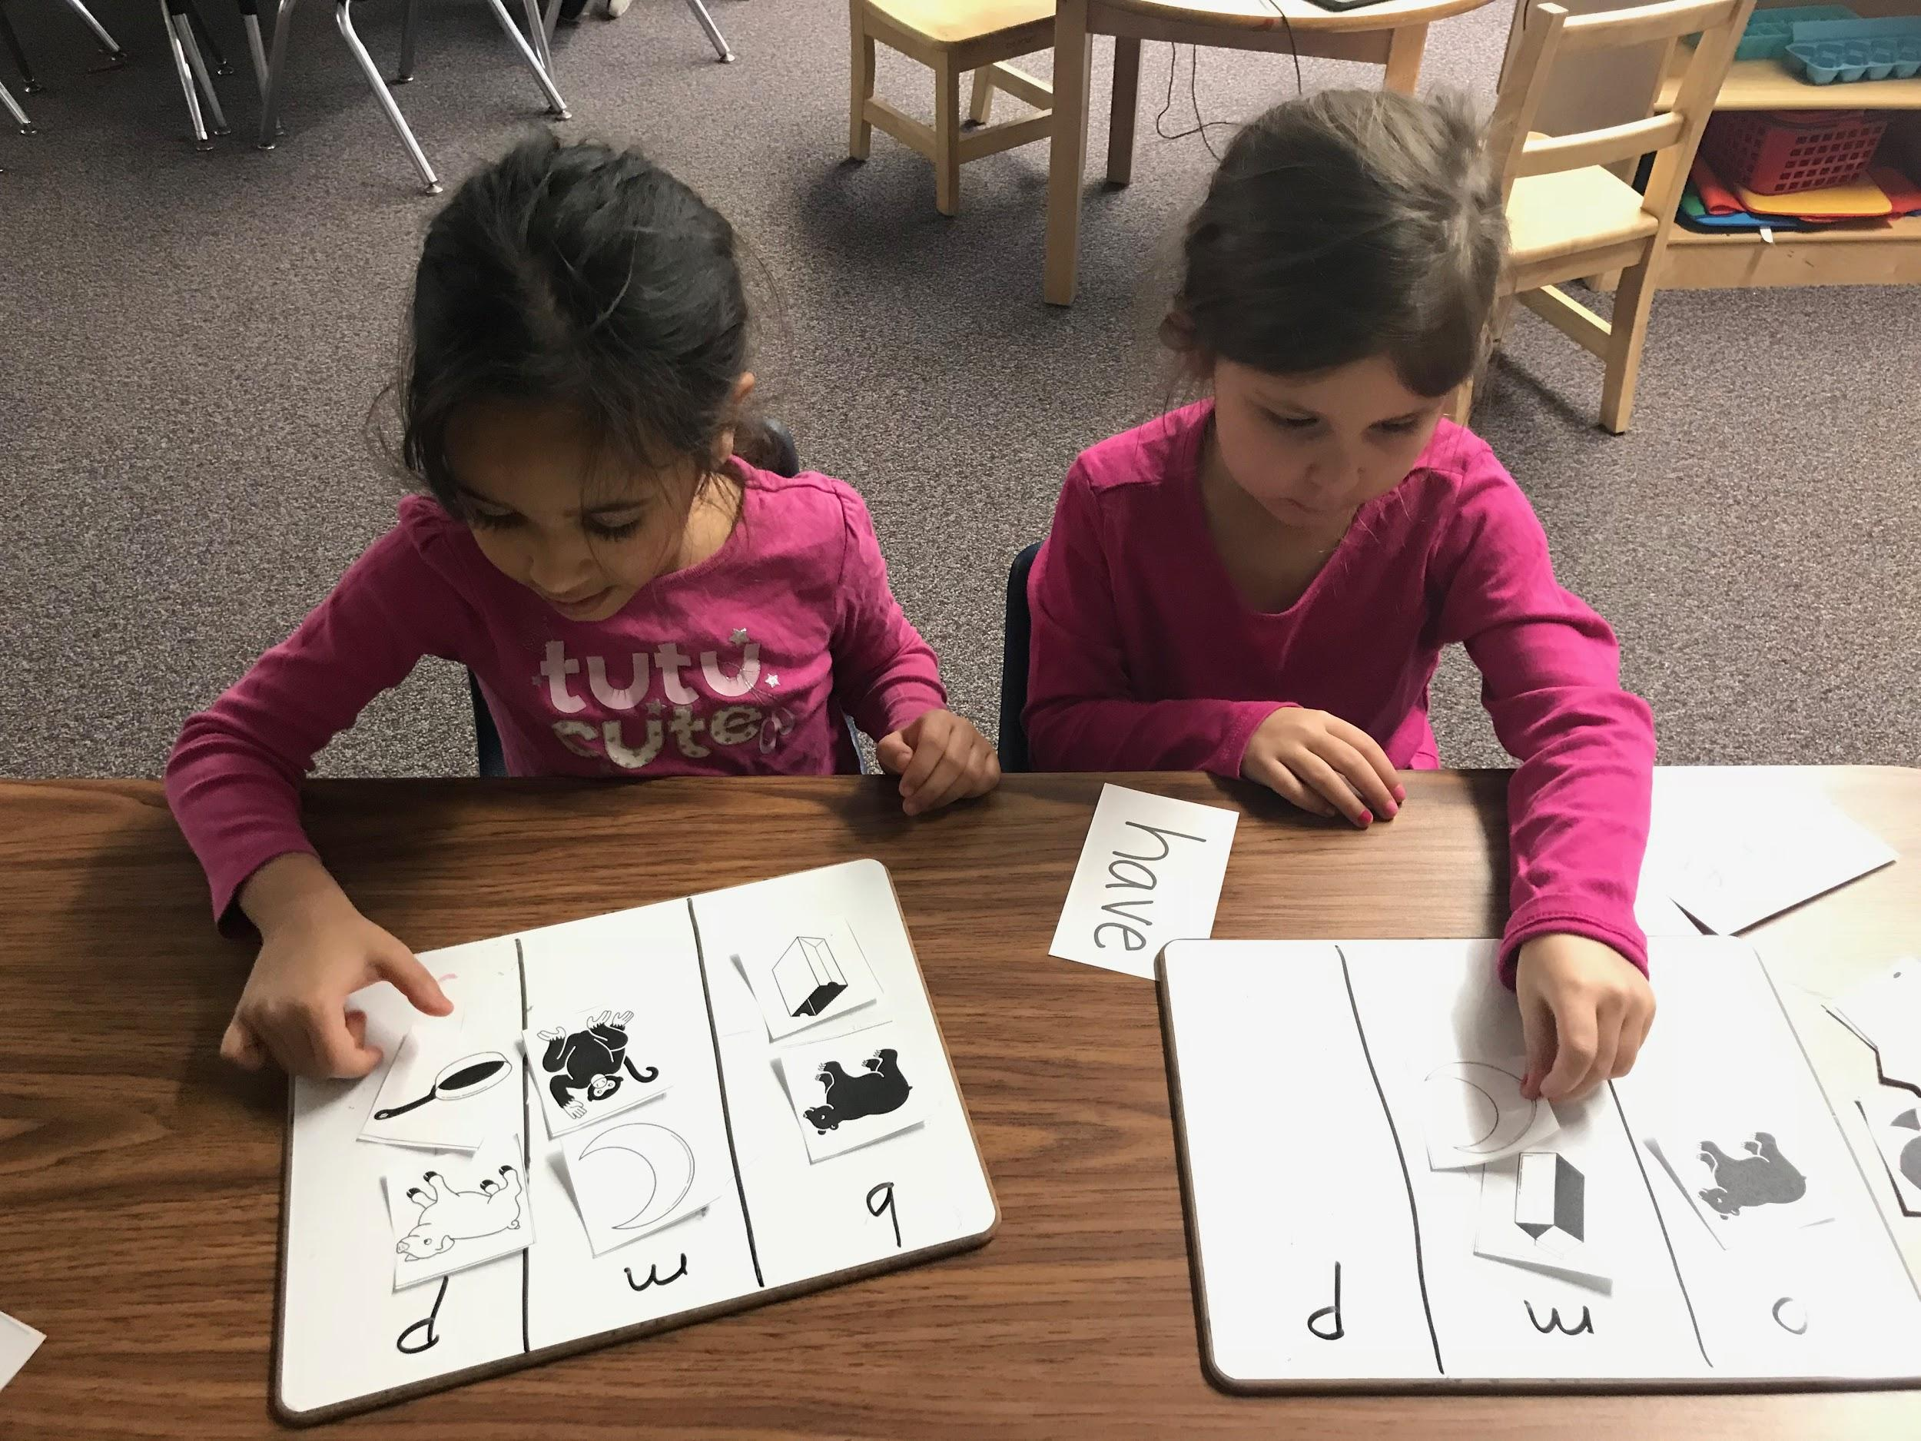
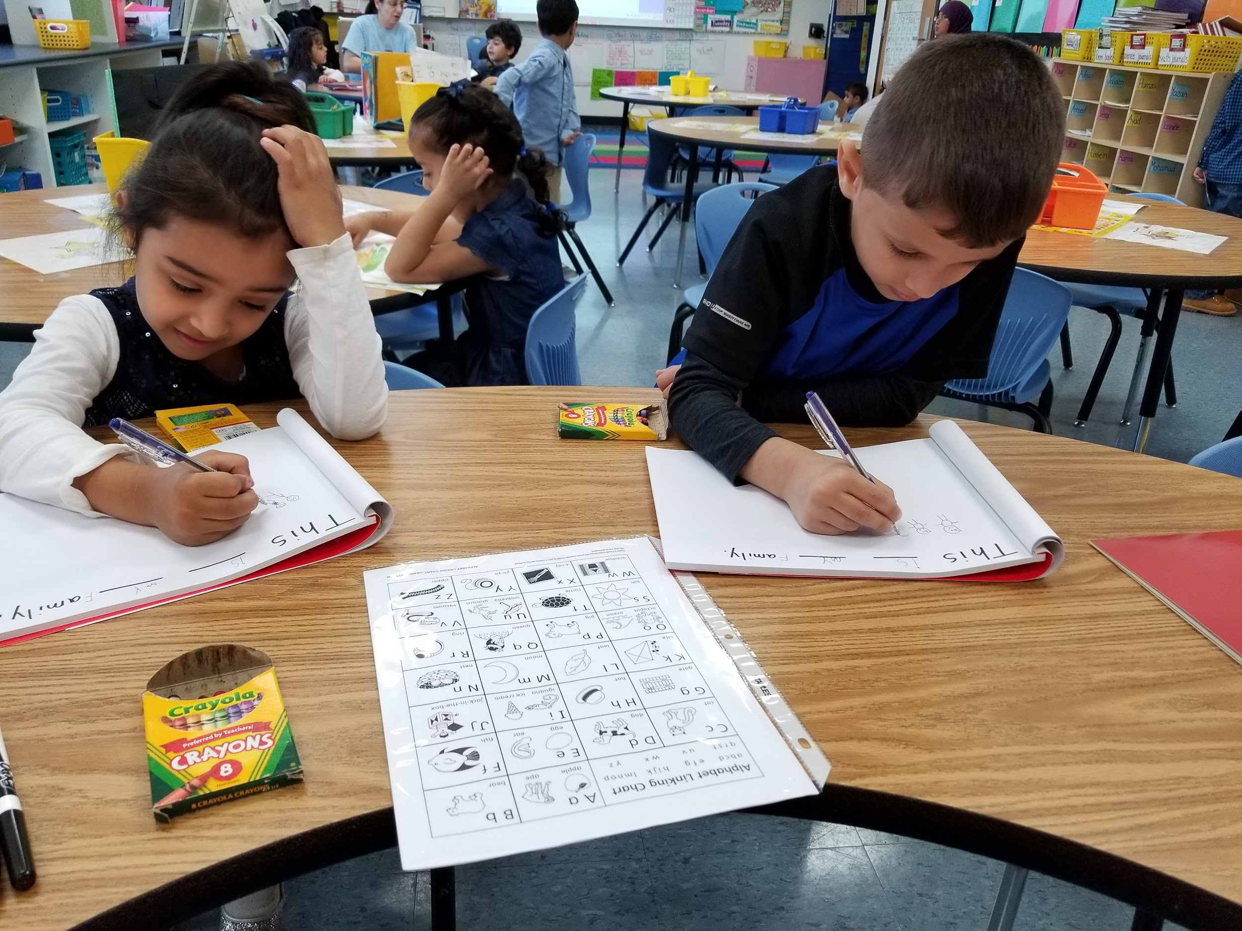
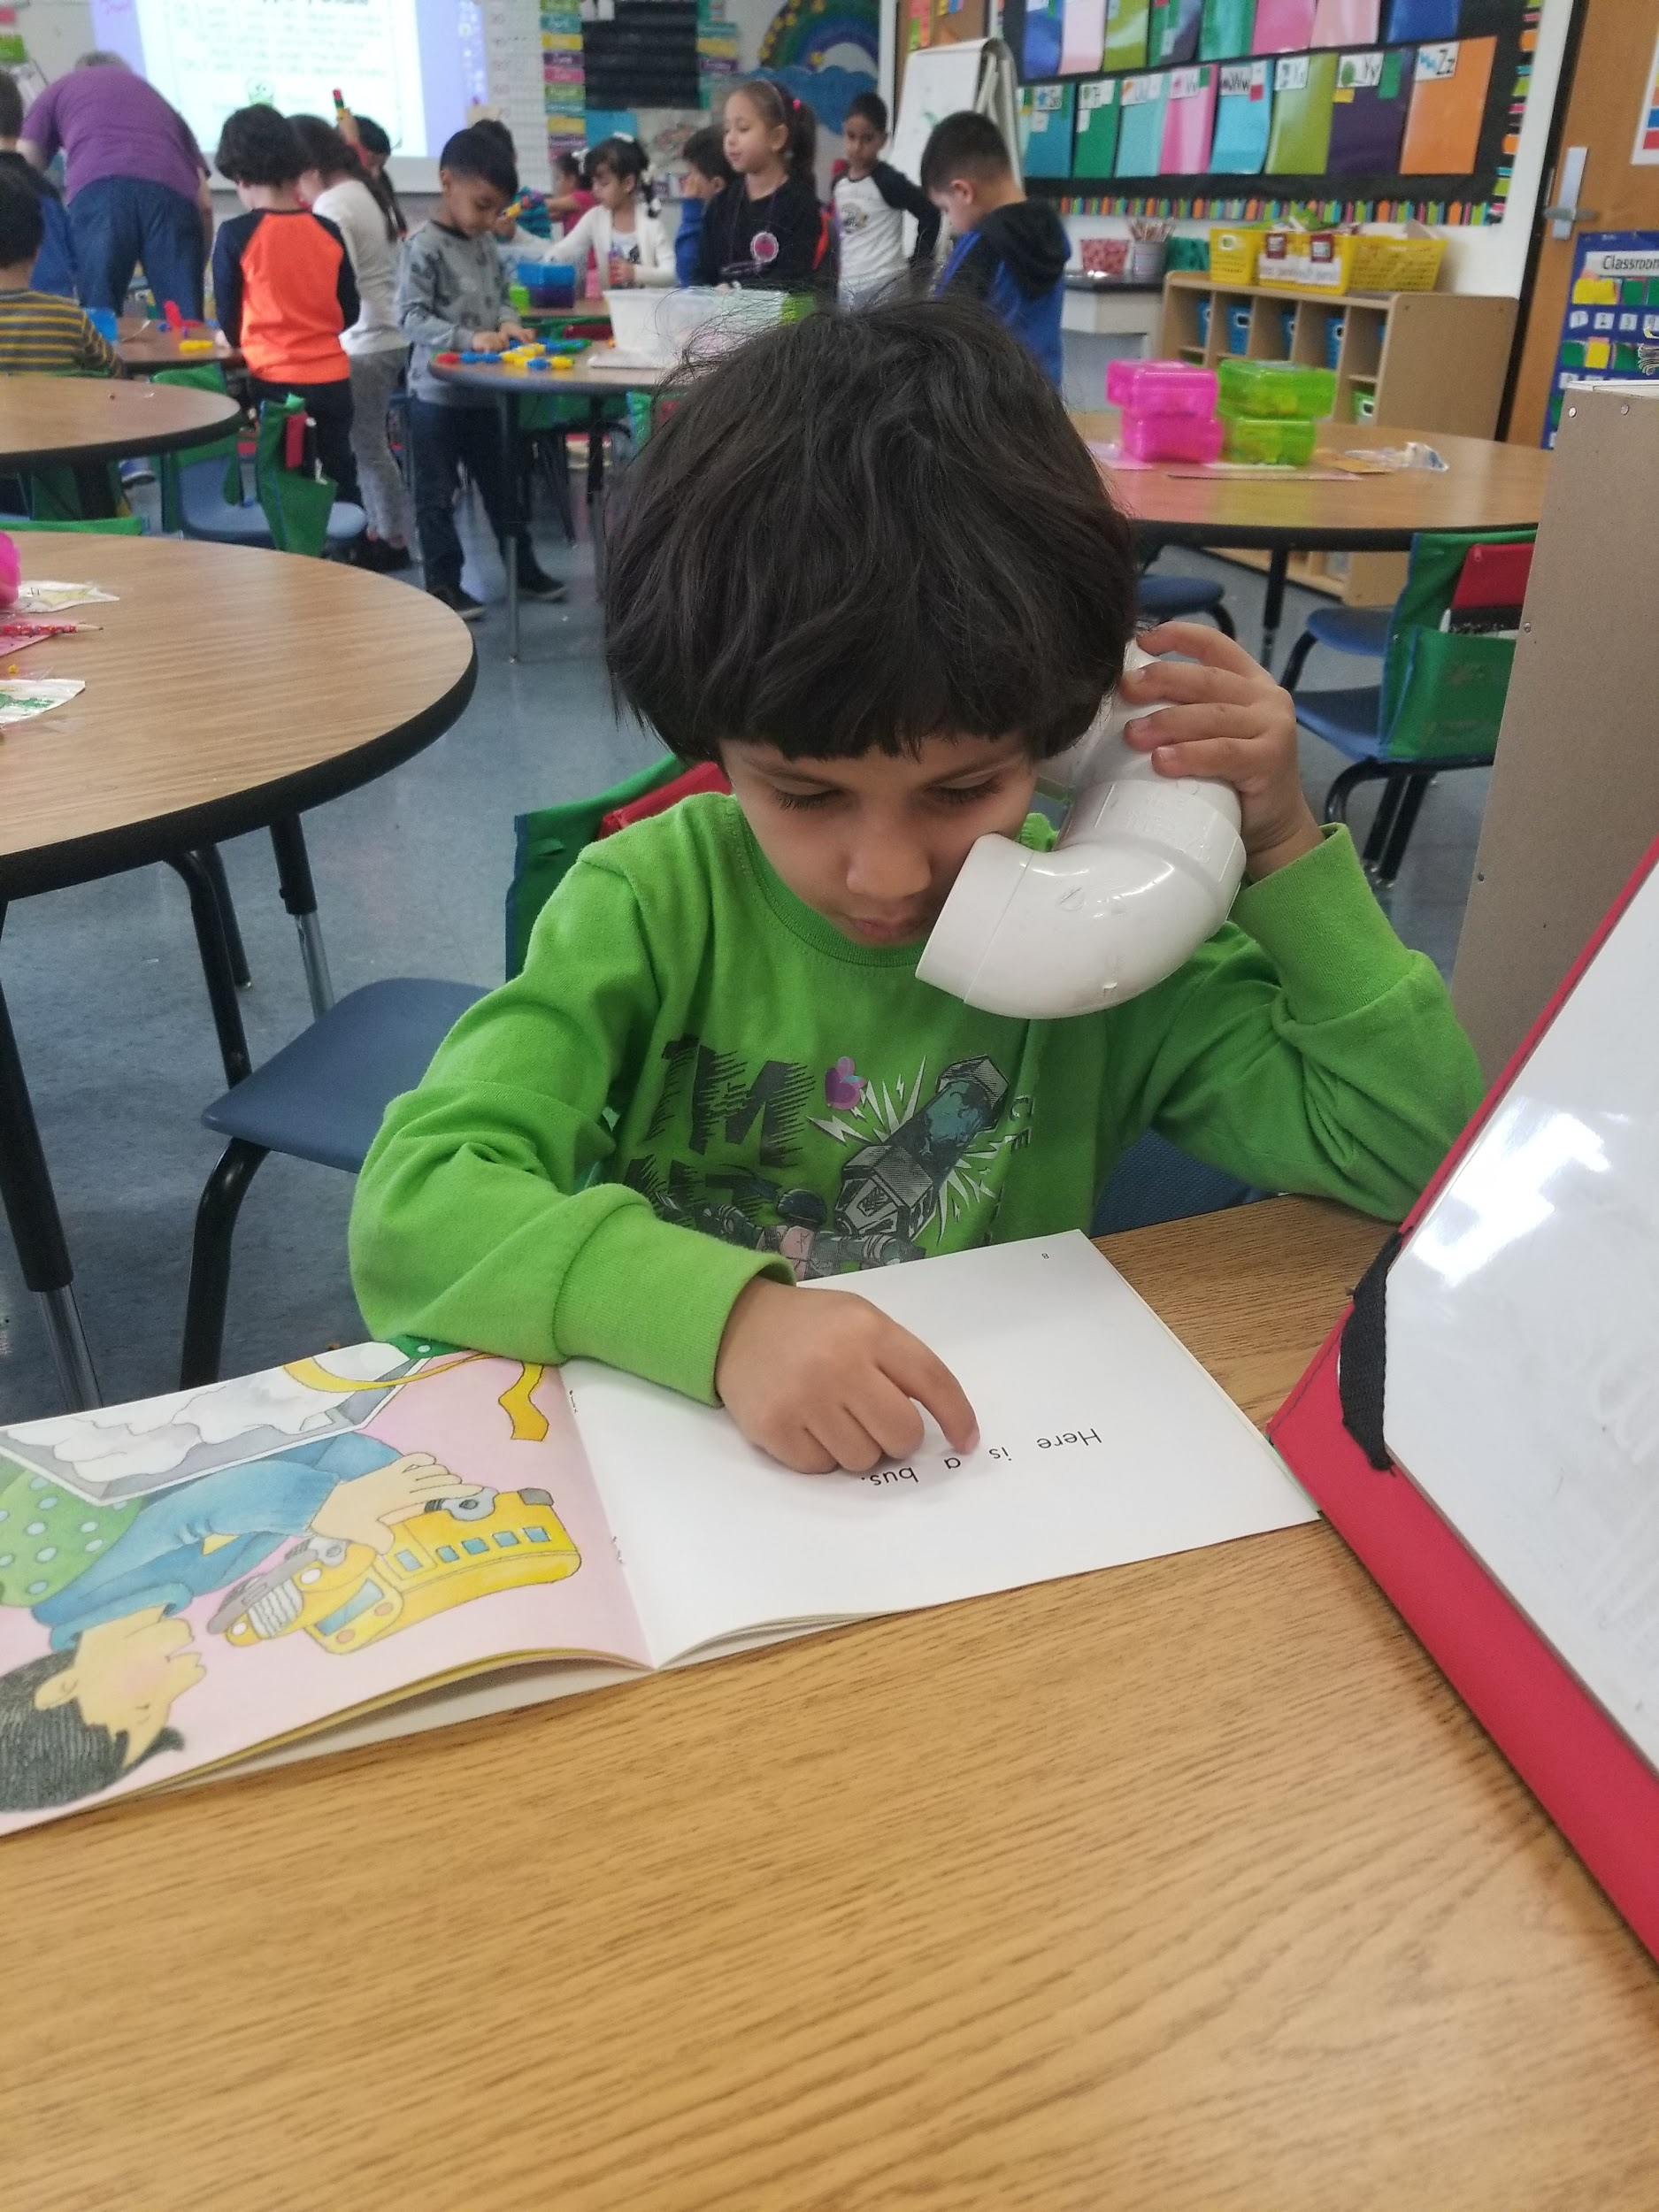
What do we do?
Each day we meet with your child for 10-15 minutes in a small group of 3.
We work on language, vocabulary, reading and writing strategies, letters, sounds and words.
Your child’s teacher also meets with your child in the same small group 1-2 more times each day.

Slide 4
Why was your child selected for LLI?
*Your child was given a series of 8 assessments, their scores determined whether they were selected for LLI or not.
*According to your child’s score, they were considered “at risk” for reading. Because of this, your child was chosen to receive intervention in reading.

Slide 5
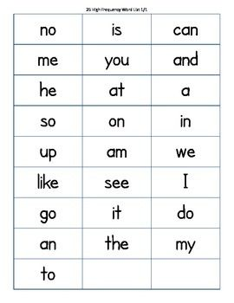
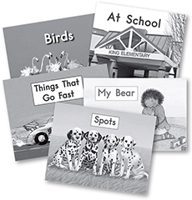
What should you do at home?
READ every night.
Word/letter cards should also be practiced every night.
Make sure your child has their book bag for school.
Make sure your child gets at 9-10 hours of sleep and arrives to school ON TIME.
Limit screen time to 30 minutes per day.

Slide 6
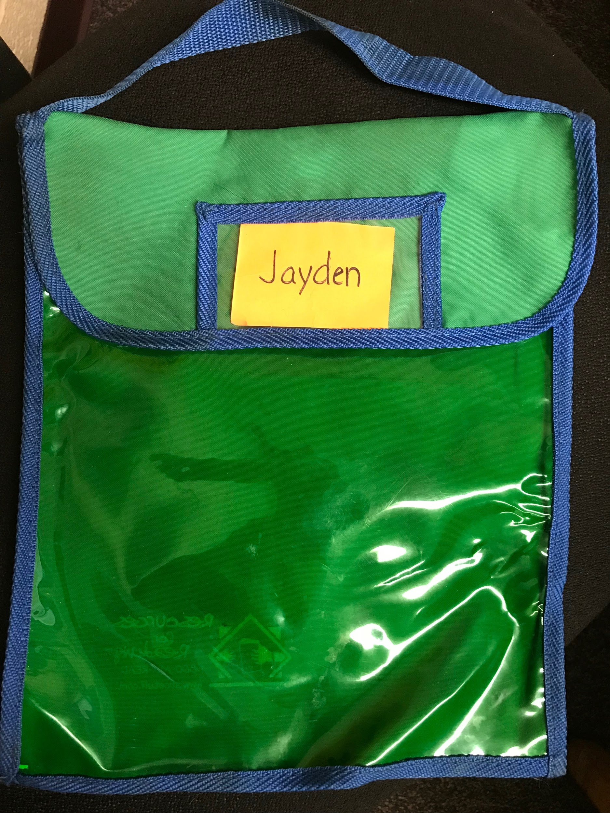
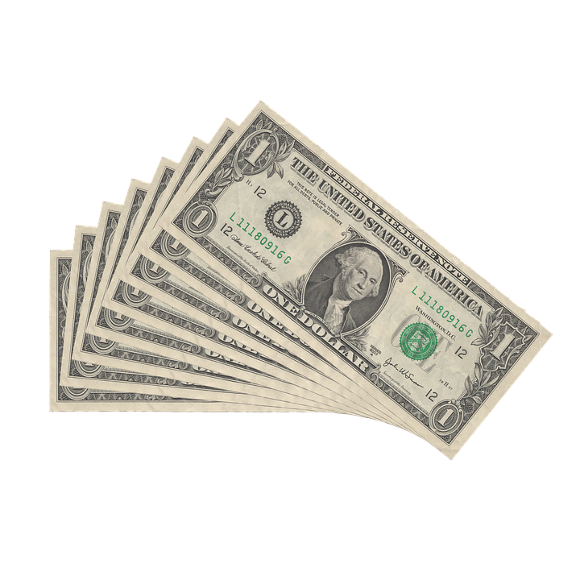
Rules for Book Bags
No food, drink or smoking near the books or bags.
Bags must be at school every day.
If books are lost or damaged, there is a $5 per book replacement cost along with $7 for the book bag.
Your child will not receive new books if they do not have their bag OR if lost/damaged books are not paid for.

Slide 7
