Slide 1
Connection to Circular Flow Model
Do individuals supply or demand?
Do business supply or demand?
Who demands in the product market?
Who supplies in the product market?
1

Slide 2
2

Slide 3
Unit 2: Supply, Demand, and Consumer Choice
3

Slide 4
I am willing to sell several A’s in AP Economics. How much will you pay?
Price | Quantity Demanded
$1,000 $2,000 $3,000 | 30 20 10
Demand Schedule
Consumer Surplus??
4

Slide 5
DEMAND DEFINED
What is Demand?
Demand is the different quantities of goods that consumers are willing and able to buy at different prices.
(Ex: Bill Gates is able to purchase a Ferrari, but if he isn’t willing he has NO demand for one)
What is the Law of Demand?
There is an INVERSE relationship between price and quantity demanded
5

Slide 6
LAW OF DEMAND
As Price Falls…
…Quantity Demanded Rises
As Price Rises…
…Quantity Demanded Falls
Quantity Demanded
Price
6

Slide 7
Why does the Law of Demand occur?
The law of demand is the result of three separate behavior patterns that overlap:
The Substitution effect
The Income effect
The Law of Diminishing Marginal Utility
We will define and explain each…
7

Slide 8
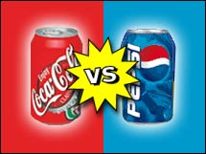
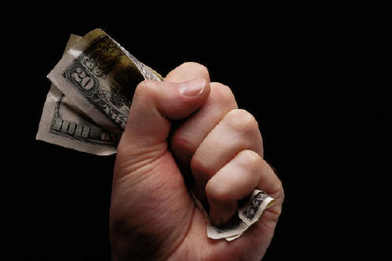
Why does the Law of Demand occur?
1. The Substitution Effect
If the price goes up for a product, consumers buy less of that product and more of another substitute product (and vice versa)
2. The Income Effect
If the price goes down for a product, the purchasing power increases for consumers -allowing them to purchase more.
8

Slide 9
Graphing Demand
9

Slide 10
The Demand Curve
A demand curve is a graphical representation of a demand schedule.
The demand curve is downward sloping showing the inverse relationship between price (on the y-axis) and quantity demanded (on the x-axis)
When reading a demand curve, assume all outside factors, such as income, are held constant. (This is called ceteris paribus)
Let’s draw a new demand curve for cereal…
10

Slide 11
GRAPHING DEMAND
Demand Schedule
Price of Cereal
Draw this large in your notes
$5
4
3
2
1
Price | Quantity Demanded
$5 | 10
$4 | 20
$3 | 30
$2 | 50
$1 | 80
o
Q
10 20 30 40 50 60 70 80
Quantity of Cereal
11

Slide 12
GRAPHING DEMAND
Demand Schedule
Price of Cereal
$5
4
3
2
1
Price | Quantity Demanded
$5 | 10
$4 | 20
$3 | 30
$2 | 50
$1 | 80
Demand
o
Q
10 20 30 40 50 60 70 80
Quantity of Cereal
12

Slide 13
Where do you get the Market Demand?
Billy
Jean
Other Individuals
Market
Price | Q Demd
$5 | 1
$4 | 2
$3 | 3
$2 | 5
$1 | 7
Price | Q Demd
$5 | 0
$4 | 1
$3 | 2
$2 | 3
$1 | 5
Price | Q Demd
$5 | 9
$4 | 17
$3 | 25
$2 | 42
$1 | 68
Price | Q Demd
$5 | 10
$4 | 20
$3 | 30
$2 | 50
$1 | 80
P
P
P
P
$3
$3
$3
$3
D
D
D
D
3
Q
2
Q
25
Q
30
Q

Slide 14
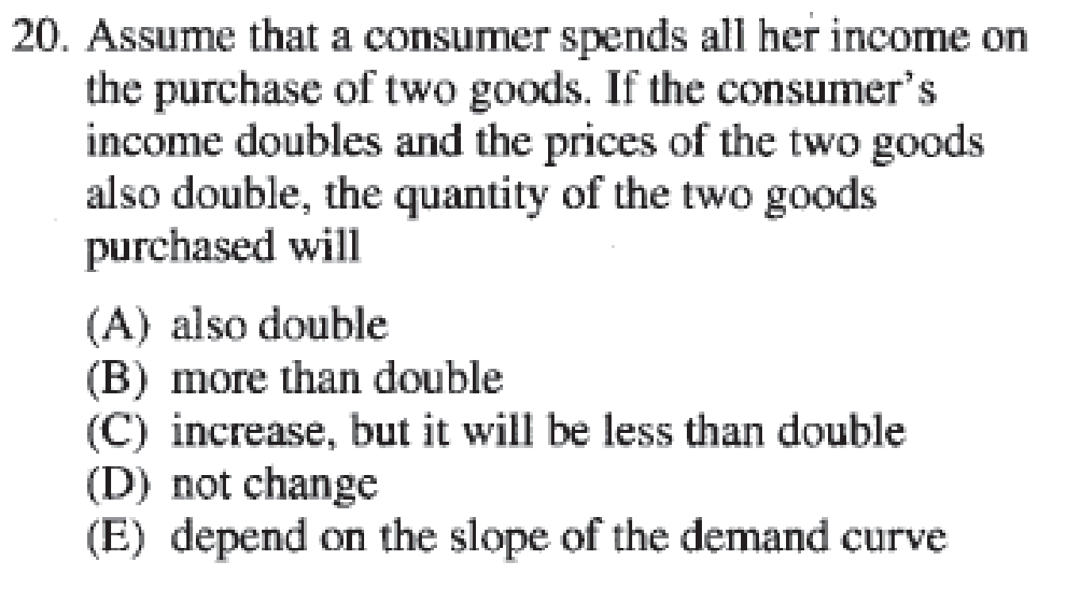
14

Slide 15
15

