Slide 1
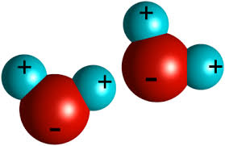
Properties of Water

Slide 2
Learning Targets
1. Describe how the structure of water leads to its unique properties.
2. Explain the properties of water and its importance of life.

Slide 3
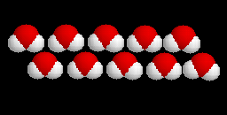
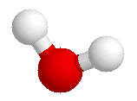
Water
A water molecule (H₂O), is made up of three atoms --- one oxygen and two hydrogen.
H
H
O

Slide 4
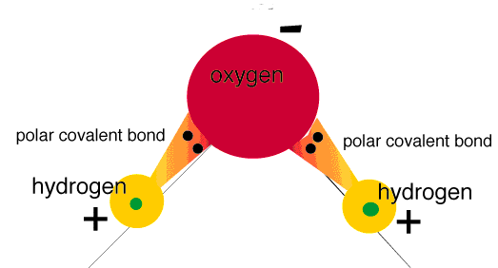
Water is Polar
POLAR – an unequal sharing of electrons leads to an uneven distribution of charge
The oxygen end “acts” negative
The hydrogen end “acts” positive
Causes the water to be POLAR However, Water is neutral (equal number of e- and p+) with a Net charge of Zero
Notes:
4

Slide 5
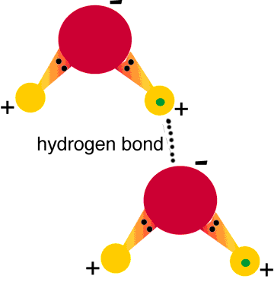
Hydrogen Bonds Exist Between Water Molecules
One hydrogen bond is weak , but many hydrogen bonds are strong

Slide 6
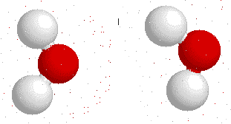
Interaction Between Water Molecules
Negative Oxygen end of one water molecule is attracted to the Positive Hydrogen end of another water molecule to form a HYDROGEN BOND
+

Slide 7
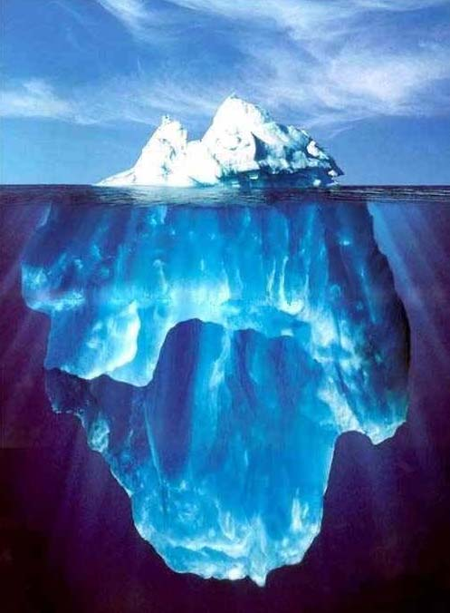
What are the Properties of Water?

Slide 8
Properties of Water
Cohesion
Adhesion
High Specific Heat
High Heat of Vaporization
Less Dense as a Solid

Slide 9
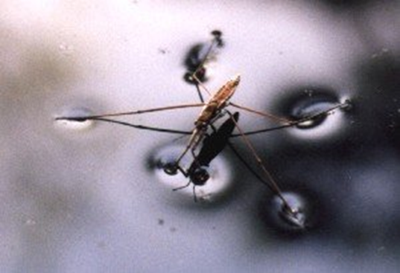
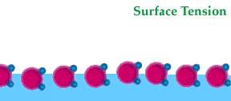
Cohesion
Cohesion is the attraction between particles of the same substance ( why water is attracted to itself)
Results in Surface tension (a measure of the strength of water’s surface)
Produces a surface film on water that allows insects to walk on the surface of water

Slide 10
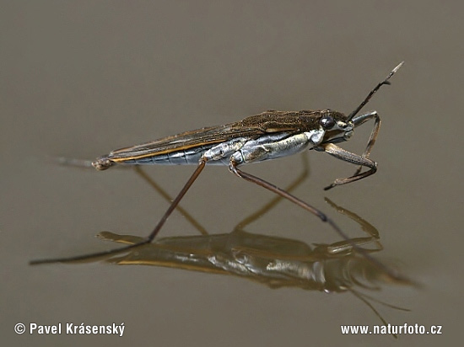
Cohesion …
Helps insects walk across water

Slide 11
Adhesion
Adhesion is the attraction between two different substances (why water is attracted to other types of molecules).
Water will form hydrogen bonds with other surfaces such as glass, soil, plant tissues, and cotton.
Capillary action-water molecules will “tow” each other along when in a thin glass tube.
Example: transpiration process which plants and trees remove water from the soil, and paper towels soak up water.

Slide 12
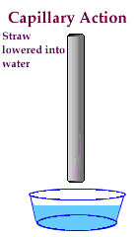
Adhesion Causes Capillary Action
Which gives water the ability to “climb” structures

Slide 13
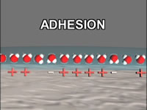
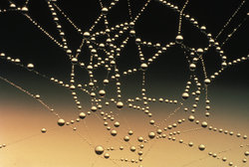
Adhesion Also Causes Water to …
Attach to a silken spider web
Form spheres & hold onto plant leaves

Slide 14
High Specific Heat
Amount of heat needed to raise or lower 1g of a substance 1° C.
Water resists temperature change, both for heating and cooling.
Water can absorb or release large amounts of heat energy with little change in actual temperature.

Slide 15
Water is Less Dense as a Solid
Ice is less dense as a solid than as a liquid (ice floats)
Liquid water has hydrogen bonds that are constantly being broken and reformed.
Frozen water forms a crystal-like lattice whereby molecules are set at fixed distances.

Slide 16
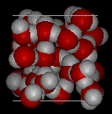
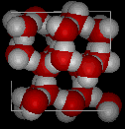
Water is Less Dense as a Solid
Which is ice and which is water?
Notes:
1

Slide 17
Water is Less Dense as a Solid
Water
Ice

Slide 18
Homeostasis
Ability to maintain a steady state despite changing conditions
Water is important to this process because:
a. Makes a good insulator
b. Resists temperature change
c. Universal solvent
d. Coolant
e. Ice protects against temperature extremes (insulates frozen lakes)
Notes:
1

