Slide 1
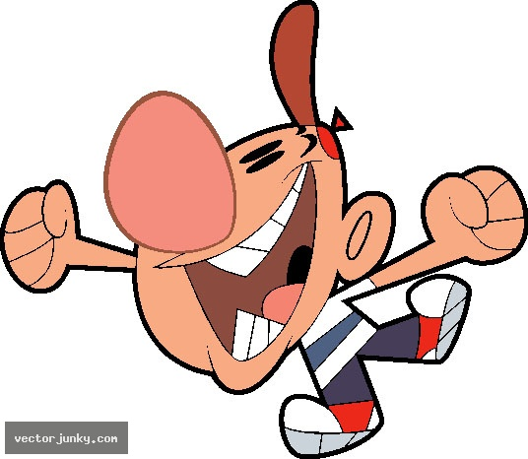
Cell Transport Review
Are you ready?...

Slide 2
Rules of the game
You will be working with your table partners.
You’ll be shown set of 4 or 5 questions. Together write your answers on the board. Make sure you write down the question number. (Take turns writing)
4 minutes to answer each set of quest. 2 points each.
Raise your board once you think you’ve got the right answers. I will check. Points for questions answered correctly (I must be able to read your answers). And we’ll go over them out loud.
Questions you have incorrect will be given to rest of the class (NOT YOUR GROUP) to answer again..must write the answer again after I ask it.

Slide 3
In order to stay alive, cells must maintain..?
What does selectively permeable mean?
What are the three forms of passive transport we learned about?
What is it called when ink is dispersed in a beaker of water?

Slide 4
In order to stay alive, cells must maintain..?
homeostasis
2. What does selectively permeable mean?
Allows certain materials to pass through
3. What are the three forms of passive transport we learned about?
Osmosis, diffusion , facilitated diffuson
4. What is it called when ink is dispersed in a beaker of water?
diffusion

Slide 5
5. True/False. Exocytosis is a type of active transport. If false, give the correct answer.
6.If a plant is placed in a hypertonic solution, what will happen to its cells?
7. What type of transport is the entering of water into a cell?
8. What is this process (from #7) called?

Slide 6
5. True/False. Exocytosis is a type of active transport. If false, give the correct answer.
True
6.If a plant is placed in a hypertonic solution, what will happen to its cells?
Shrink, shrivel
7. What type of transport is the entering of water into a cell?
Passive transport
8. What is this process (from #7) called?
osmosis

Slide 7
9. How do sugar molecules pass through the cell membrane?
10. How do molecules move in diffusion?
11. True/False. In active transport molecules move with their concentration gradient. If false, correct it.
12. Which of the following requires energy:
diffusion, endocytosis, active transport, sodium-potassium pump

Slide 8
9. How do sugar molecules pass through the cell membrane?
Facilitated Diffusion with carrier protein
10. How do molecules move in diffusion?
high to low concentration
11. True/False. In active transport molecules move with their concentration gradient. If false, correct it.
False, against it
12. Which of the following requires energy:
Endocytosis, active transport, sodium-potassium pump

Slide 9
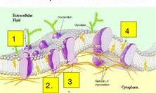
13. What is shown in the picture below?
14. What is it made of?
15. What is labeled #2?
16. What are the proteins that act like selective passageways for solutes in/out of the membrane called?

Slide 10
13. What is shown in the picture below?
Cell or
plasma membrane
14. What is it made of?
Lipid bi-layer
15. What is labeled #2?
protein
16. What are the proteins that act like selective passageways for solutes in/out of the membrane called?
Carrier proteins

Slide 11
17. How are molecules too large to move through the cell membrane moved into the cell? Out of the cell?
18. What is the goal of diffusion?
19. The movement of liquids across the membrane is called?
20. What type of transport is this (#19)?

Slide 12
17. How are molecules too large to move through the cell membrane moved into the cell? Out of the cell?
Endocytosis, exocytosis
18. What is the goal of diffusion?
To reach equilibrium (equal concentrations in and out)
19. The movement of liquids across the membrane is called?
pinocytosis
20. What type of transport is this (#19)?
Active transport

Slide 13
21. Which way is sodium pumped in the Na⁺/K⁺ pump? What about potassium?
22. What will a calcium ion channel allow to pass through it?
23. T/F. Ion channels transport ions from low to high concentrations. If false, correct it.
24. Ridding the cell of materials by discharging them in vesicles is called?

Slide 14
21. Which way is sodium pumped in the Na⁺/K⁺ pump? What about potassium?
Out, In
22. What will a calcium ion channel allow to pass through it?
Calcium only
23. T/F. Ion channels transport ions from low to high concentrations. If false, correct it.
False, high to low
24. Ridding the cell of materials by discharging them in vesicles is called?
exocytosis

Slide 15
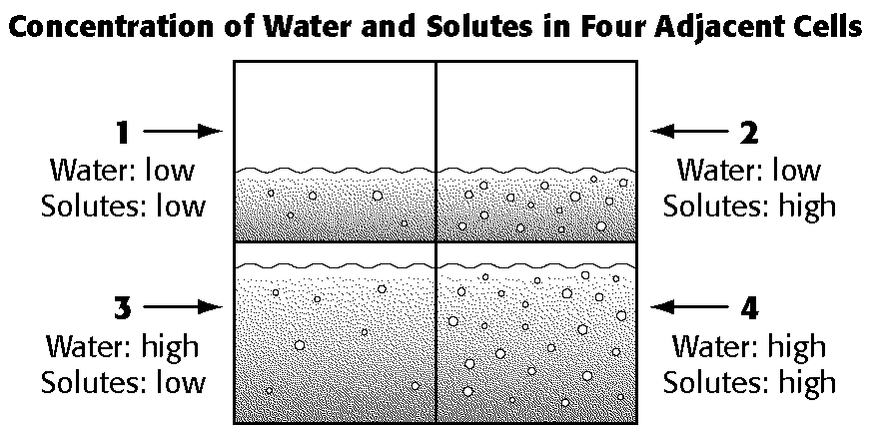
25. Which cell is going to lose both water and solute molecules?
Into which cells are solutes from cell 2 going to diffuse?

Slide 16
25. Which cell is going to lose both water and solute molecules?
Cell 4
Into which cells are solutes from cell 2 going to diffuse?
Cell 1 and 3

Slide 17
27. What is it called when cells lose turgor pressure?
28. We see this in which type of cells, plant or animal?
This happens when the cells are placed in what type of solution, hypotonic or hypertonic?
What happened to the egg after it sat in corn syrup? Which direction did the water molecules move..out of the__ into the__?

Slide 18
27. What is it called when cells lose turgor pressure?
plasmolysis
28. We see this in which type of cells, plant or animal?
plant
This happens when the cells are placed in what type of solution, hypotonic or hypertonic?
hypertonic
30. What happened to the egg after it sat in corn syrup? Which direction did the water molecules move..out of the__ into the__?
Shrinks,out of cell into the corn syrup

Slide 19
31. Which cell is going to gain water?
Cell 3
32. Which cell is in a hypertonic solution?
Cell 1
98% H₂O
98% H₂O
98% H₂0
95% H₂O
98% H₂O
100% H₂O
Cell 1
Cell 2
Cell 3

Slide 20
33. If a red blood cell that contains 75% H₂O is placed in an environment with 85% H₂O, which direction is water going to move?
34. What do the sodium-potassium pump and facilitated diffusion have in common?
35. List the 3 forms of active transport we learned.
36. In the egg demo, water continued to diffuse into the cell membrane and the egg grew until what was established?

Slide 21
33. If a red blood cell that contains 75% H₂O is placed in an environment with 85% H₂O, which direction is water going to move?
Into cell
34. What do the sodium-potassium pump and facilitated diffusion have in common?
Carrier proteins
35. List the 3 forms of active transport we learned.
Endocytosis, exocytosis, sodium-potasium pump
36. In the egg demo, water continued to diffuse into the cell membrane and the egg grew until what was established?
equilibrium

Slide 22
Think about our diffusion demo/lab that we did in class (BONUS 3 points each)
37. Was the bag or beaker more concentrated with iodine?
38. If the bag was permeable to the iodine, which way would the iodine move, in or out of the bag?
39. Based on our observations, which substance moved, the iodine or starch?
40. How do you know this, what happened?

Slide 23
(BONUS 3 points each)
37. Was the bag or beaker more concentrated with iodine?
beaker
38. If the bag was permeable to the iodine, which way would the iodine move, in or out of the bag?
in
39. Based on our observations, which substance moved, the iodine or starch?
iodine
40. How do you know this, what happened?
It turned purple inside the bag

