Slide 1
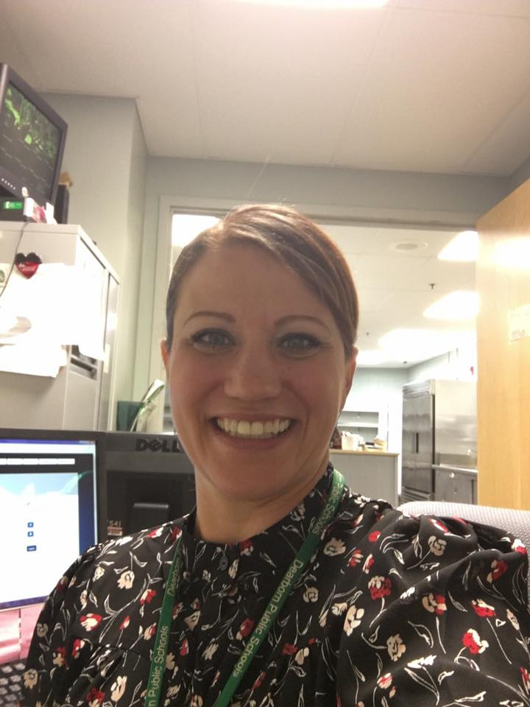
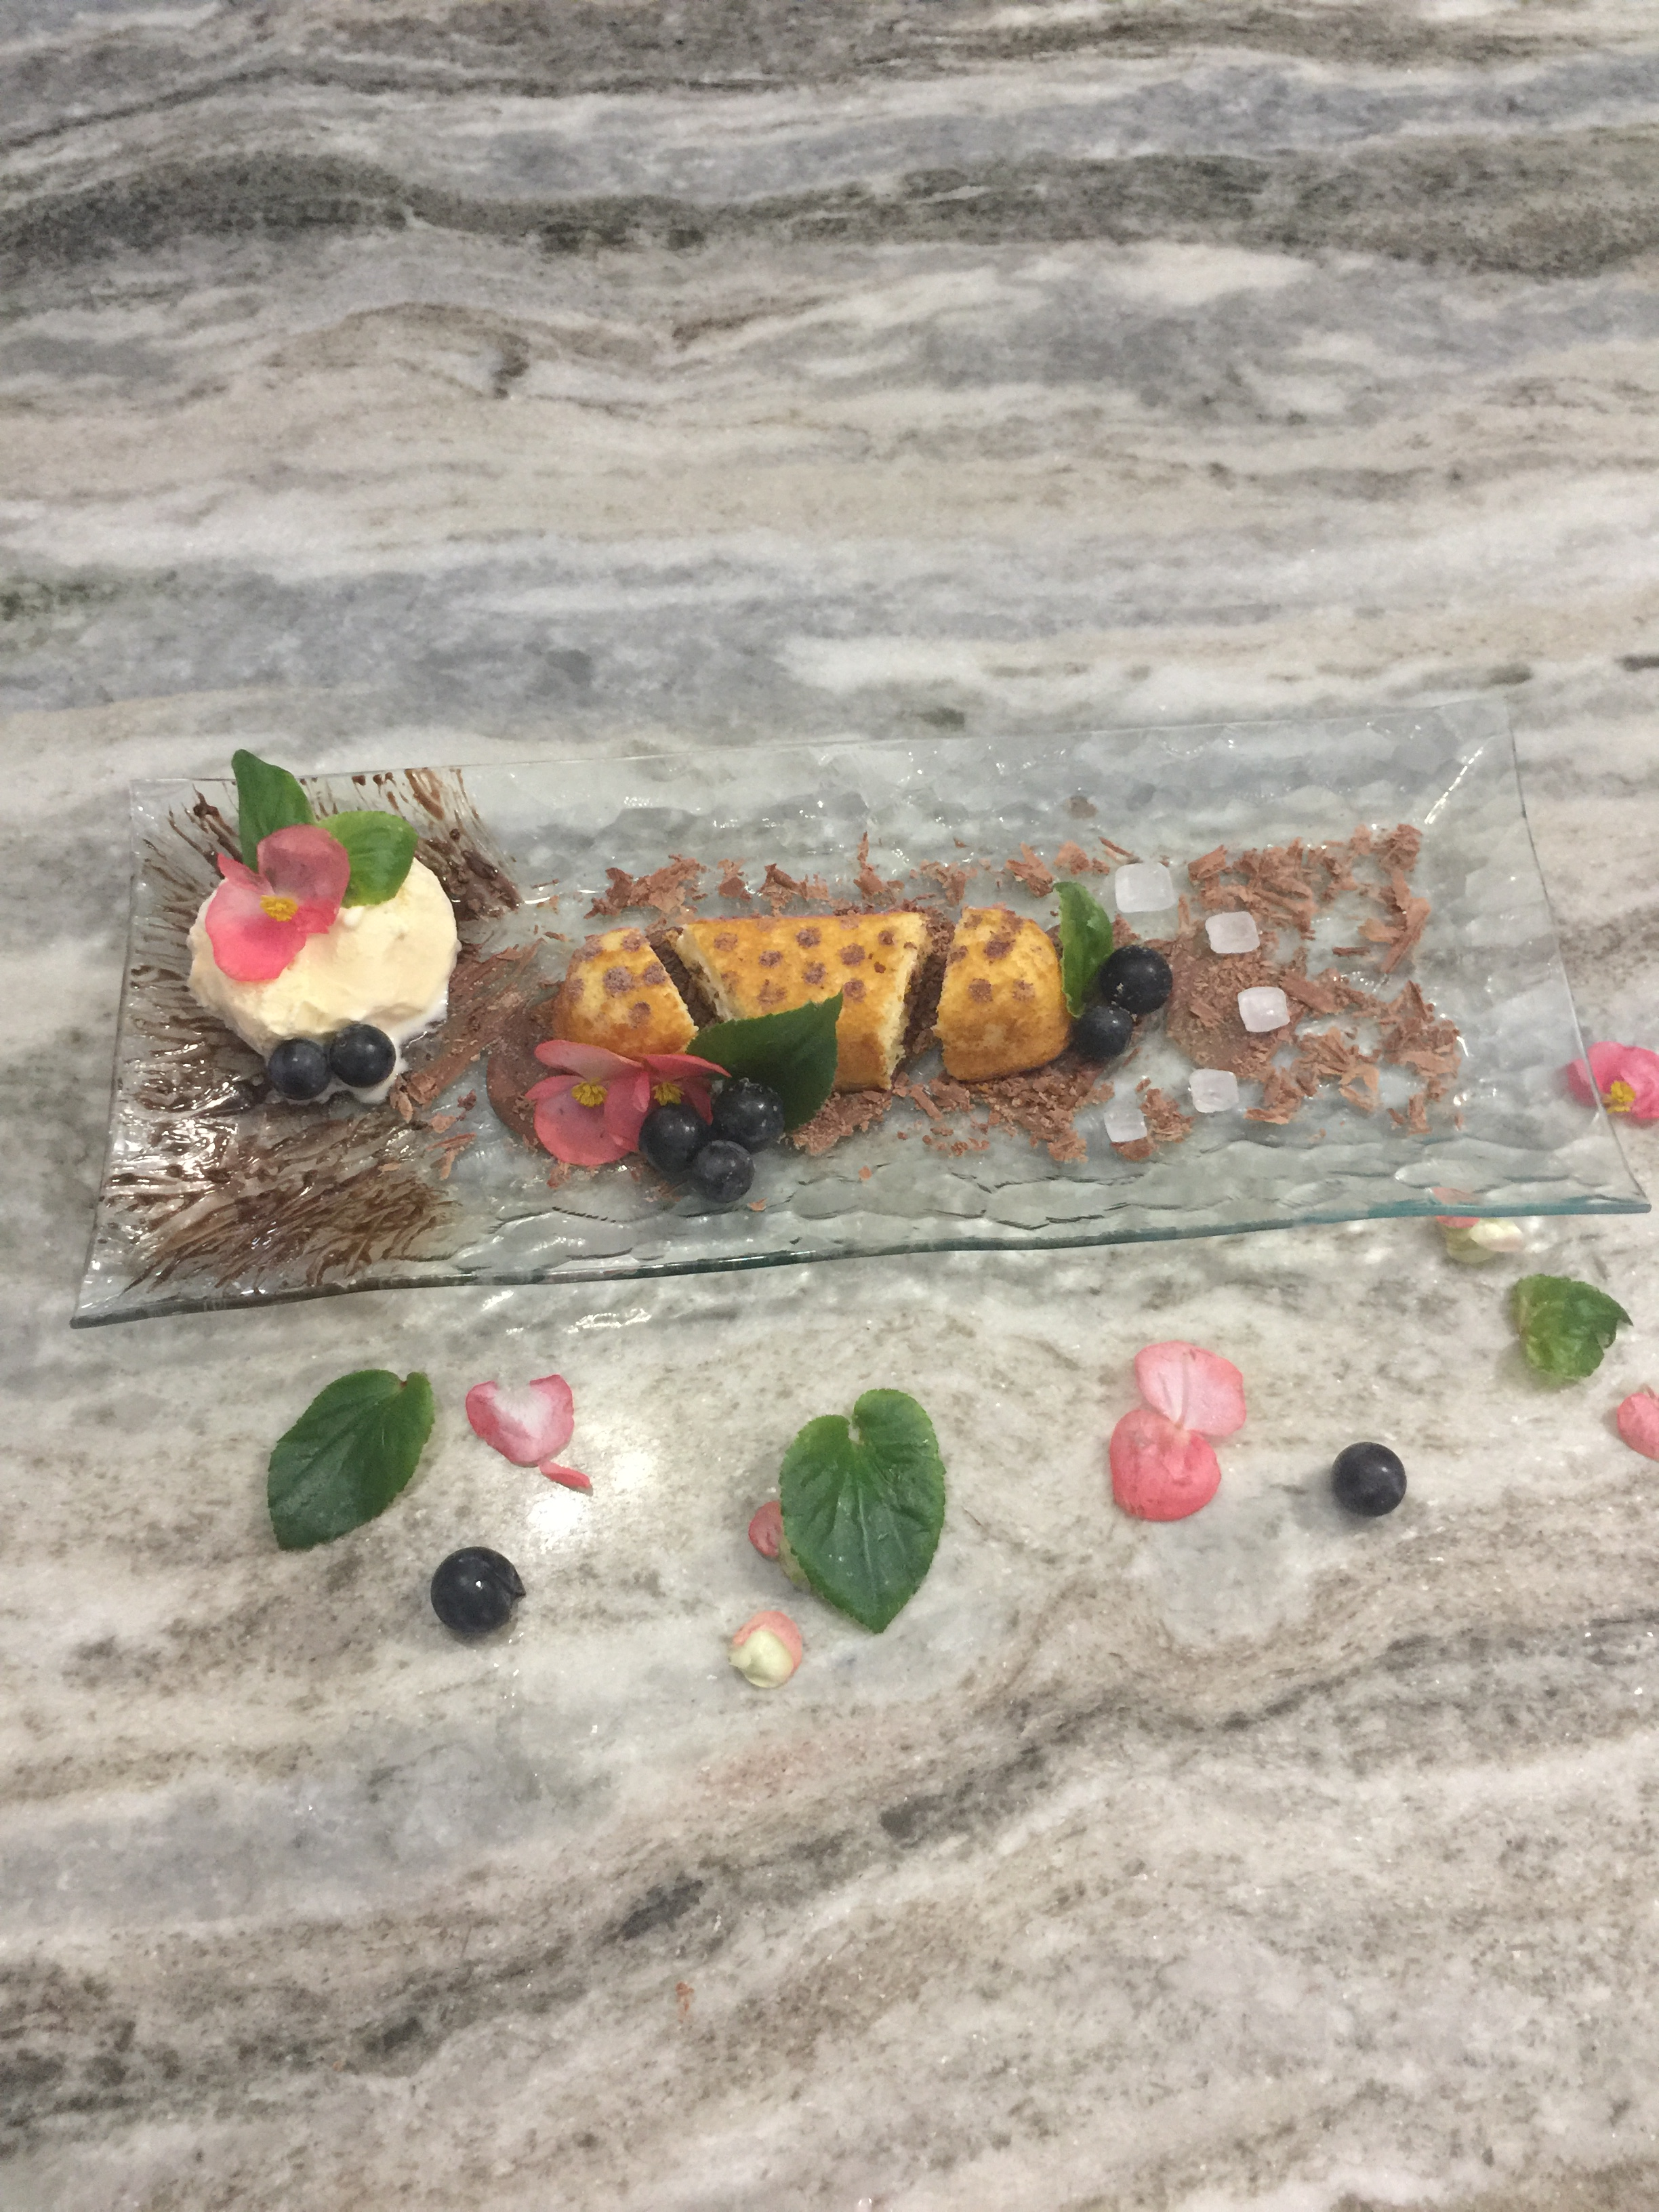
Welcome to Culinary Arts
1
Chef Pokrywki

Slide 2
What WILL you learn:
You’ll learn about management, marketing, and operation of restaurant and other food services; lodging, attractions, recreation events, and travel related services

Slide 3
You'll apply new skills
operational and management skills; event planning and organization; customer service; aspects of the travel industry; food preparation; time management; communication; decision making; project management and entrepreneurship.

Slide 4
You’ll receive hands on experience
School Restaurant

Slide 5
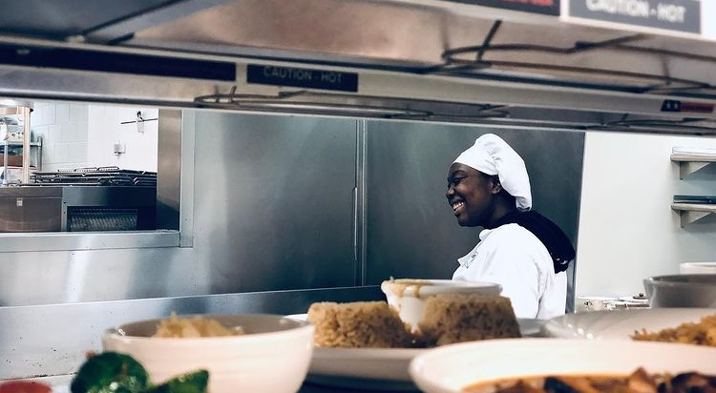
You’ll enjoy Learning new things

Slide 6
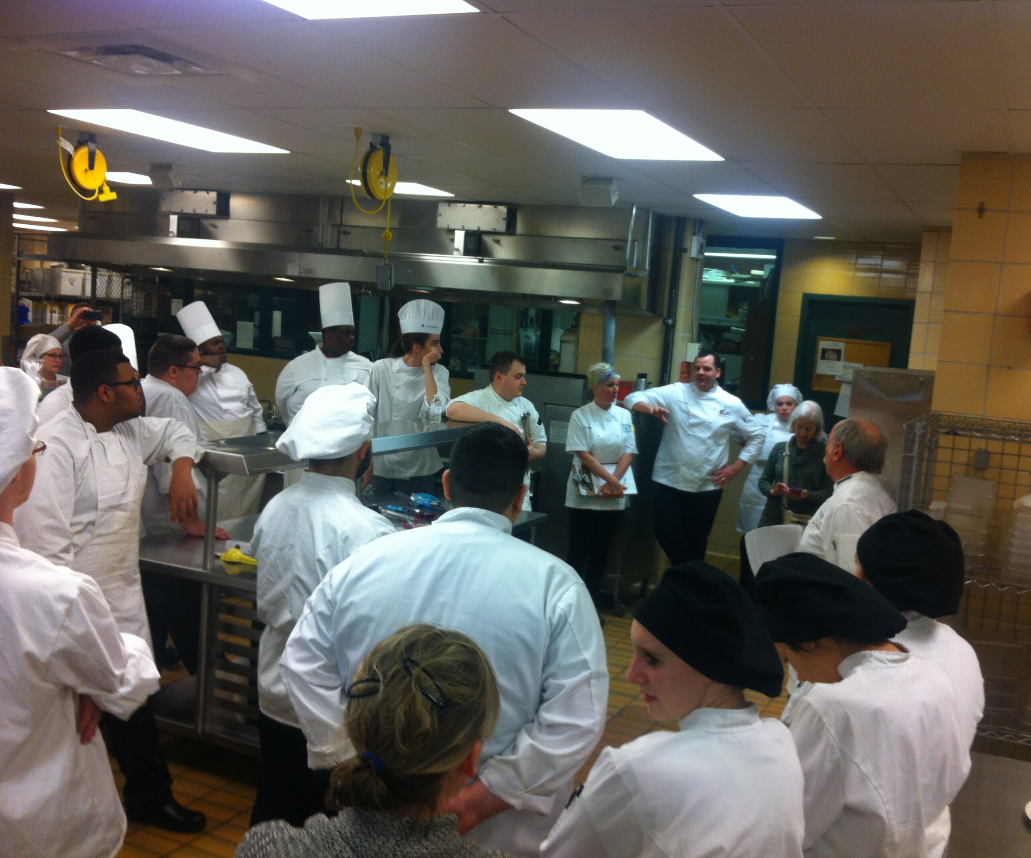
You’ll Be Part of Skills USA
Skills USA allows students to build relationships, learn leadership skills, gives you the opportunity to compete against others Skill Members from other districts, organizes fund raisers and so much more.

Slide 7
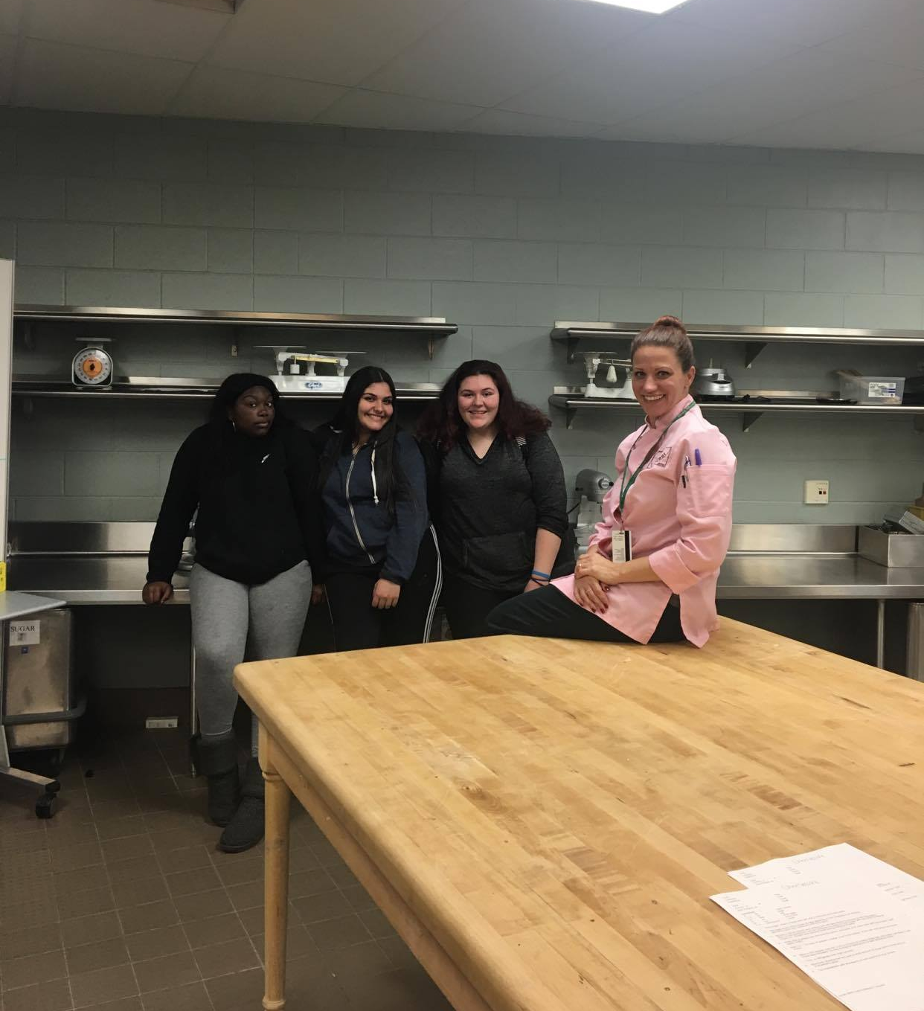
But most of all, you’ll enjoy learning…

Slide 8
For more information please email:
pokrywk@dearbornschools.org
Hospitality program link :
https://berry.dearbornschools.org/hospitality-courses/

