Slide 1
Plants Edition
With your host: Ms. Philips

Slide 2
Plant Needs | Parts of a Plant | Characteristics | Life Cycle | Grab Bag
100 | 100 | 100 | 100 | 100
200 | 200 | 200 | 200 | 200
300 | 300 | 300 | 300 | 300
400 | 400 | 400 | 400 | 400
500 | 500 | 500 | 500 | 500

Slide 3
Plant Needs - 100
True or False:
All plants need to hunt for food to survive.

Slide 4
Plant Needs - 100
True or False:
All plants need to hunt for food to survive.
FALSE!

Slide 5
Plant Needs - 200
Which of the following are NOT needs of a plant?
Air
Buds
Leaf
Space
Roots

Slide 6
Plant Needs - 200
Which of the following are NOT needs of a plant?
Air (need of a plant)
Buds
Leaf
Space (need of a plant)
Roots

Slide 7
Plant Needs - 300
Unscramble the letters to name three plant needs.
E P A C S
R A I
R I T T N N E U S

Slide 8
Plant Needs - 300
Unscramble the letters to name three plant needs.
S P A C E
A I R
N U T R I E N T S

Slide 9
Plant Needs - 400
Name all 5 things plants need to survive:

Slide 10
Plant Needs - 400
Name all 5 things plants need to survive:
Air
Nutrients/Soil
Space
Sun
Water

Slide 11
Plant Needs - 500
Explain what would happen if a plant did not have all 5 of its needs.

Slide 12
Plant Needs - 500
Explain what would happen if a plant did not have all 5 of its needs.
It would not be able to grow into a healthy adult plant.

Slide 13
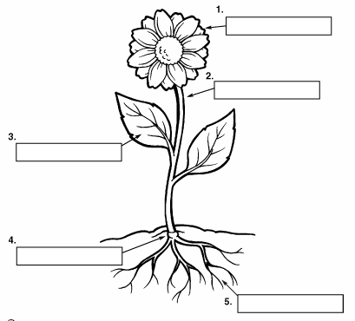
Parts of a Plant - 100
What #1 called?

Slide 14
Parts of a Plant - 100
What #1 called?
Flower

Slide 15
Parts of a Plant - 200
What #3 called?
CHECK

Slide 16
Parts of a Plant - 200
What #3 called?
Leaf

Slide 17
Parts of a Plant - 300
What #2 called?

Slide 18
Parts of a Plant - 300
What #2 called?
Stem

Slide 19
Parts of a Plant - 400
What #5 called?

Slide 20
Parts of a Plant - 400
What #1 called?
Roots

Slide 21
Parts of a Plant - 500
Describe the job of 2 parts of a plant.

Slide 22
Parts of a Plant - 500
Describe the job of 2 parts of the plant.
Flower – make seeds and fruit
Stem – holds plant up; transfers water and nutrients to the rest of the plant
Leaves – make food for the plant
Roots – absorb nutrients and water from the soil

Slide 23
Characteristics - 100
We can describe plants by explaining their:
Characteristics
Needs
Parts

Slide 24
Characteristics - 100
We can describe plants by explaining their:
Characteristics
Needs
Parts

Slide 25
Characteristics - 200
Plant characteristics are passed from __________________________.
Young plant to young plant
Parent plant to parent plant
Parent plant to young plant

Slide 26
Characteristics - 200
Plant characteristics are passed from __________________________.
Young plant to young plant
Parent plant to parent plant
Parent plant to young plant

Slide 27
Characteristics - 300
Unscramble the letters to name one characteristic passed from parent to young.
F L A E P H A S E

Slide 28
Characteristics - 300
Unscramble the letters to name one characteristic passed from parent to young.
L E A F S H A P E

Slide 29
Characteristics - 400
Fill in the blanks to name one characteristic passed from parent to young.
_ _ O W _ _ _ Y _ E

Slide 30
Characteristics - 400
Fill in the blanks to name one characteristic passed from parent to young.
F L O W E R T Y P E

Slide 31
Characteristics - 500
I grew carrots, tomatoes, and cabbage in my garden. I found a seed on the ground and planted it. The green vines grew long and there were small red vegetables growing.
Which plant did my seed come from? How do you know?

Slide 32
Characteristics - 500
I grew carrots, tomatoes, and cabbage in my garden. I found a seed on the ground and planted it. The green vines grew long and there were small red vegetables growing.
Which plant did my seed come from? How do you know?
The tomato plant! Characteristics are passed from parent to young, so the red vegetable must have come from the red tomato parent plant.

Slide 33
Life Cycle - 100
What part of the life cycle is this? What do we call this?

Slide 34
Life Cycle - 100
What part of the life cycle is this? What do we call this?
seed

Slide 35
Life Cycle - 200
What part of the life cycle is this? What do we call this?
What part of the life cycle is this? What do we call this?

Slide 36
Life Cycle - 200
What part of the life cycle is this? What do we call this?
sprout

Slide 37
Life Cycle - 300
What part of the life cycle is this? What do we call this?

Slide 38
Life Cycle - 300
What part of the life cycle is this? What do we call this?
Young plant

Slide 39
Life Cycle - 400
What is a life cycle?

Slide 40
Life Cycle - 400
What is a life cycle?
The stages a living thing goes through during its life.

Slide 41
Life Cycle - 500
Name all 5 stages in the life cycle of a plant.
Notes:
You will have to move the Daily Double picture out of the way to write the question. If you do not wish to have the Daily Double in the game, delete it and the sound clip (speaker) from this slide. For a Daily Double, the contestant has to wager at least $5 and at most the highest point value of any player/team at that point in the game. It is considered a True Daily Double if they wager all of their points and go “double or nothing”.

Slide 42
Life Cycle - 500
Name all 5 stages in the life cycle of a plant.
Seed → Sprout → Seedling → Young Plant → Mature Plant

Slide 43
Grab Bag - 100
When is your science test?

Slide 44
Grab Bag - 100
When is your science test?
Wednesday, May 25th

Slide 45
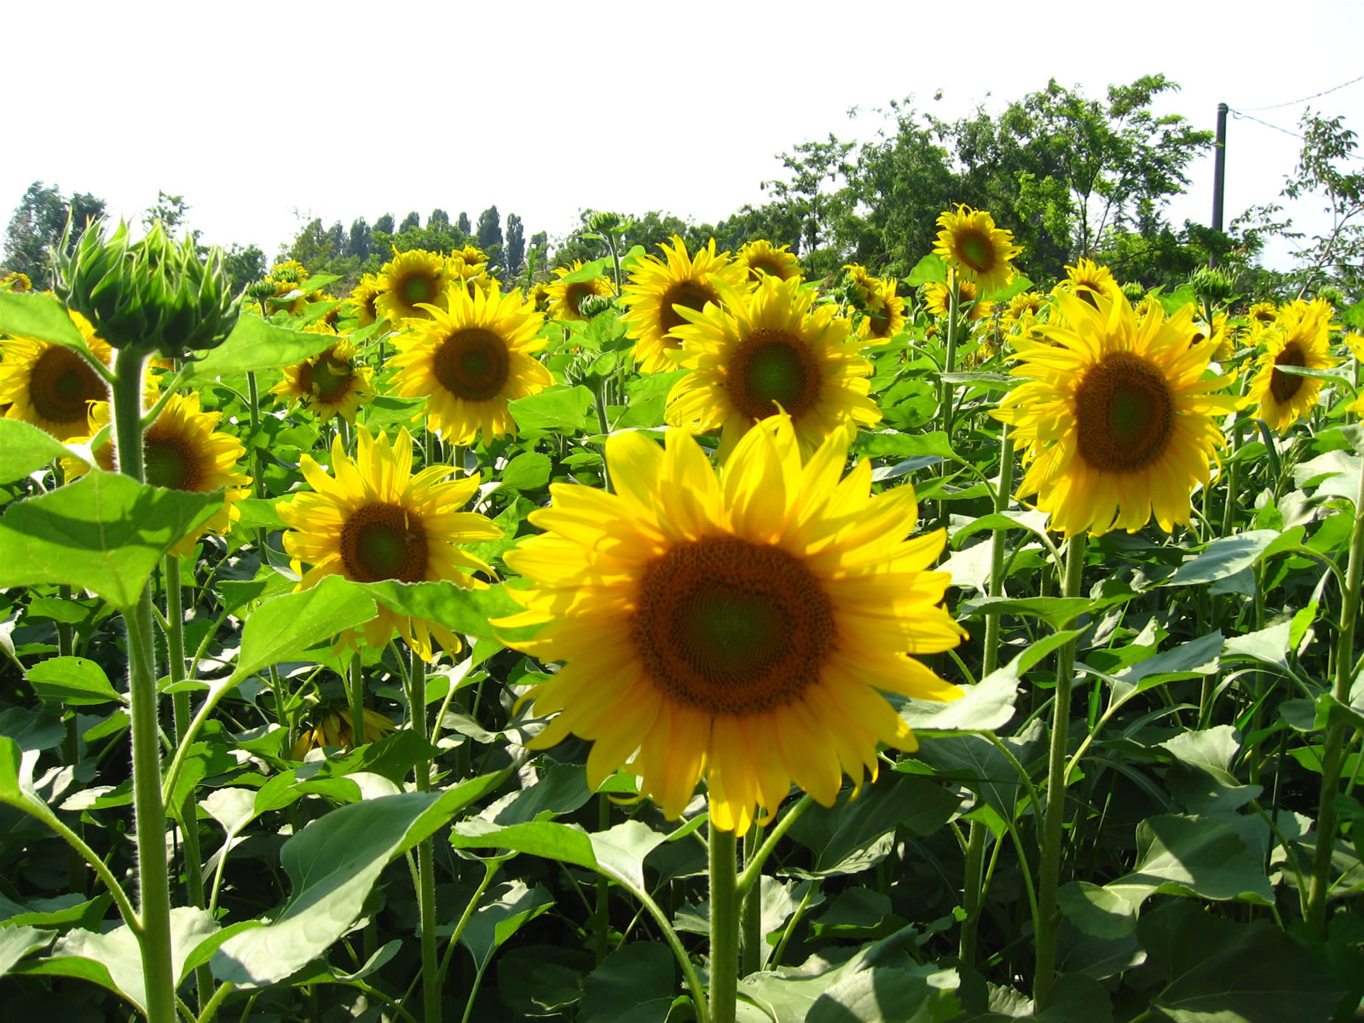
Grab Bag - 200
What is the name of this type of plant?

Slide 46
Grab Bag - 200
What is the name of this type of plant?
Sunflower

Slide 47
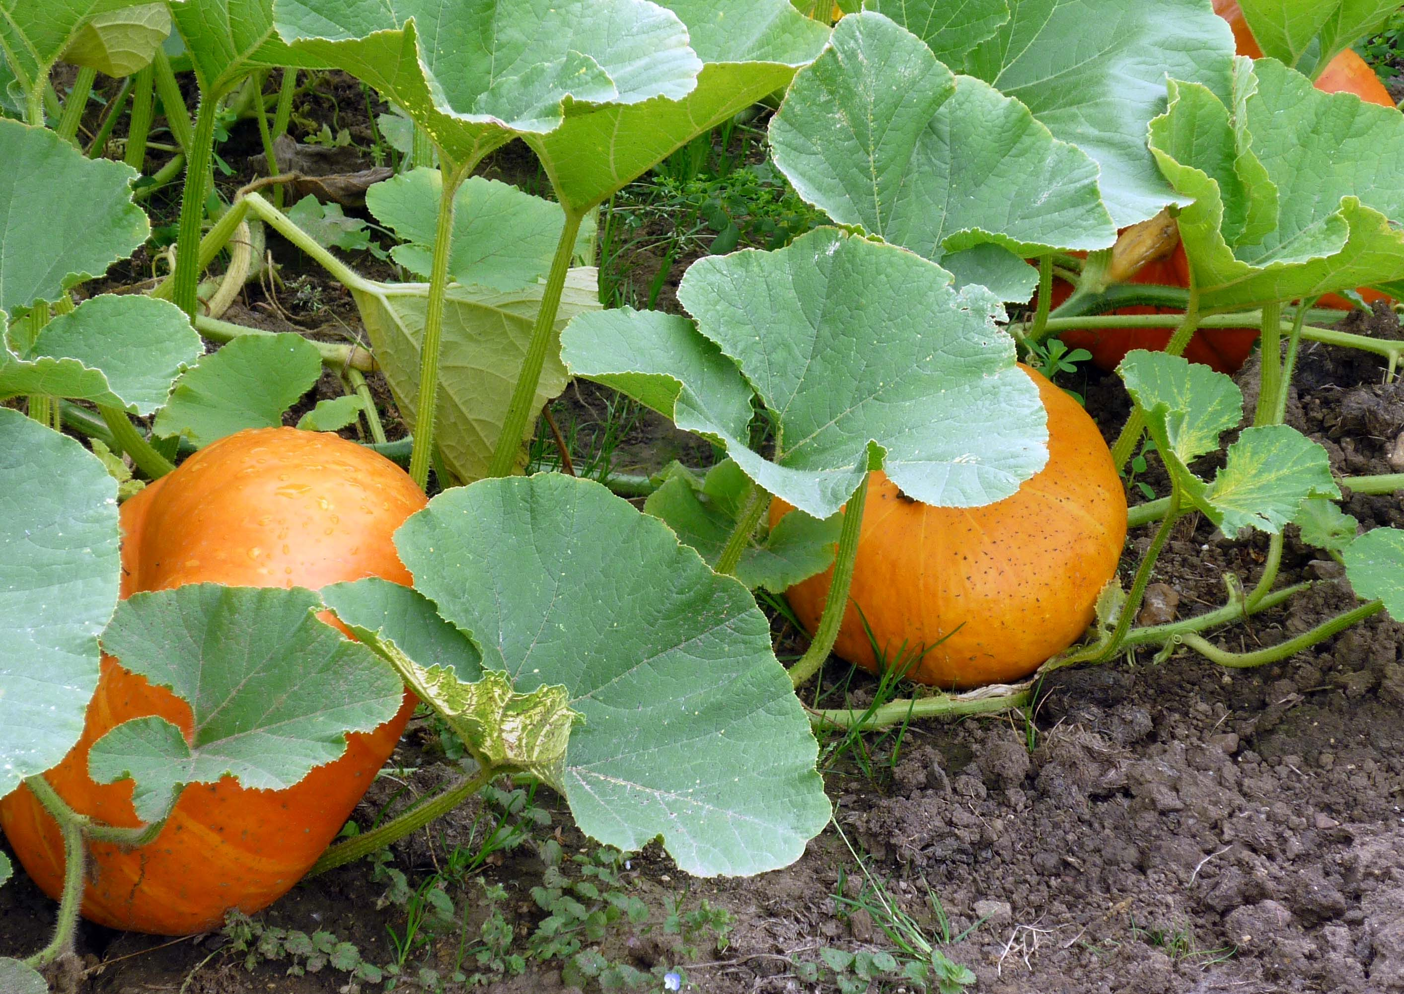
Grab Bag - 300
Describe what the young plant from this parent plant would look like:

Slide 48
Grab Bag - 300
Describe what the young plant from this parent plant would look like:
Big leaves, orange, pumpkins

Slide 49
Grab Bag - 400
What is a reason a plant may not grow?

Slide 50
Grab Bag - 400
What is a reason a plant may not grow?
Does not have all of the 5 needs
Being pulled out of the ground
Being stepped on
Pollution

Slide 51
Grab Bag - 500
What would be the best place to plant a seed?
A busy sidewalk
Next to your porch
In the sand

Slide 52
Grab Bag - 500
What would be the best place to plant a seed?
A busy sidewalk
Next to your porch
In the sand

Slide 53
FINAL JEOPARDY
CATEGORY: Jobs of Plant Parts

Slide 54
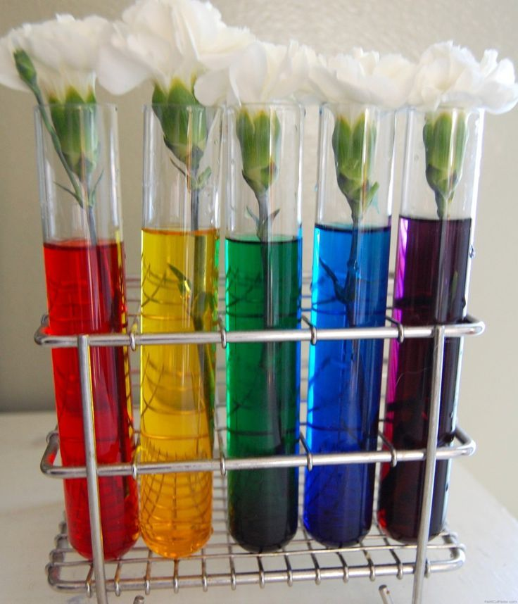
FINAL JEOPARDY
Use what you know about the parts of a plant to say what is going to happen to the flowers and explain why.

Slide 55
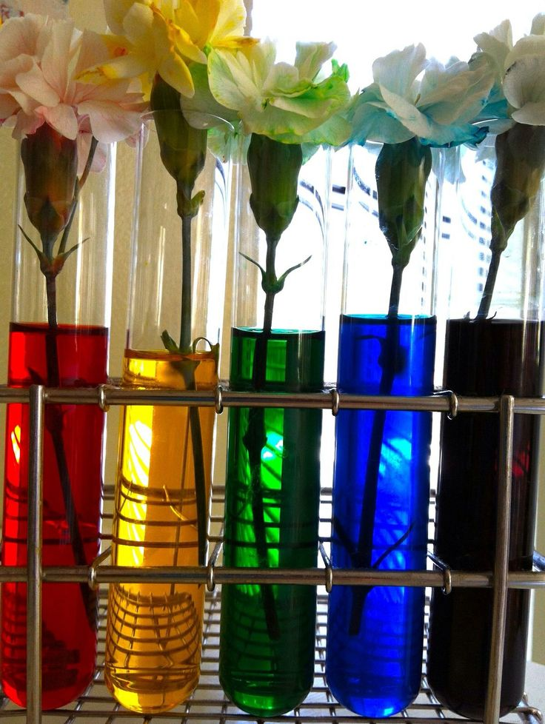
FINAL JEOPARDY
The stem of the flower sucked up
the colored water in the glass and
transferred it to the flower.

