Slide 1
Bell Work
What is an infographic? Why is it important to know how to read them?

Slide 2
January 7, 2019
Good Morning and Good Afternoon!

Slide 3
Objectives
Content Objective: Students will demonstrate analyzation of infographics by examining and interpreting the information they provide.
Language Objective: Students will read to synthesize information provided by infographics in their reading.

Slide 4
Agenda
Today’s Activities!!
Bell Work (5 Minutes)
SSR (15 Minutes)
Infographics:
Introduction
Explanation
Discussion
Quiz

Slide 5
Infographics
What are they and how are they used?
Infographics, short for informational graphic, convey information through a visual representation. This allows different patterns and trends to be seen, allowing conclusions to be drawn more easily.

Slide 6
Infographics
What are the different types of infographics?
The different types of infographics include:
Bar Charts
Line Graphs
Histograms
Tables
Pie Charts

Slide 7
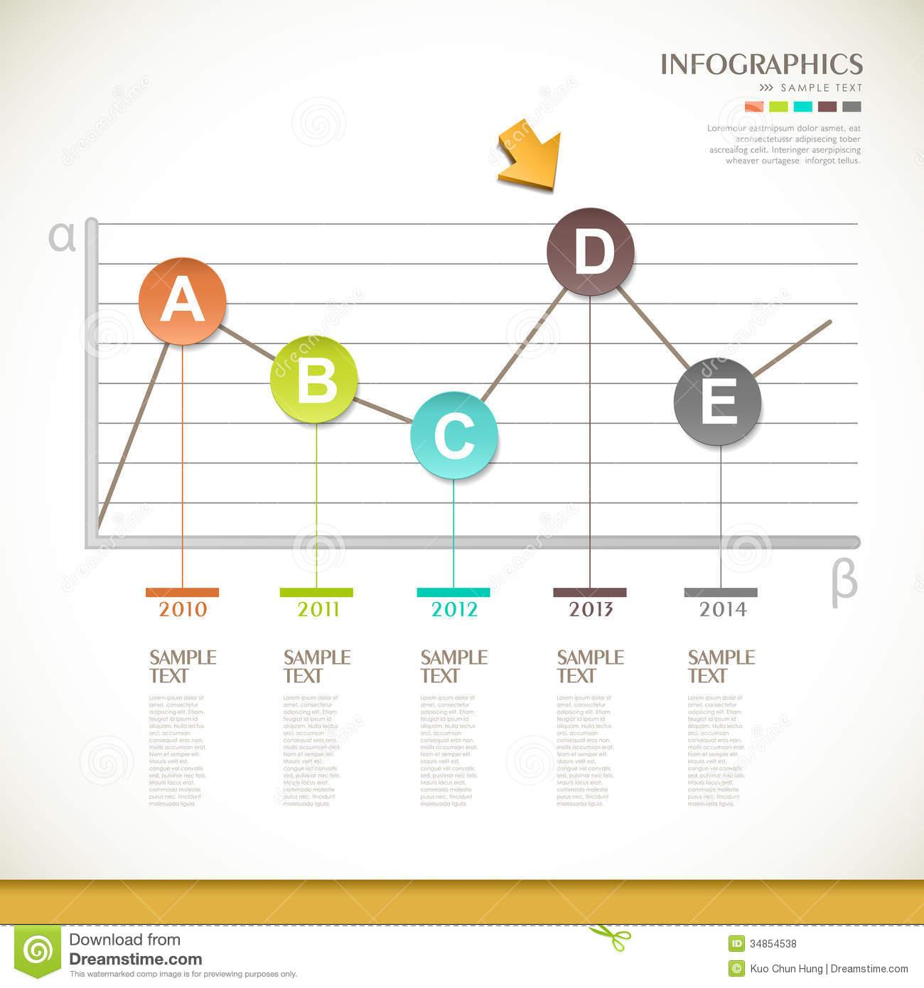
Here are some examples:
Line Chart Infographic:

Slide 8
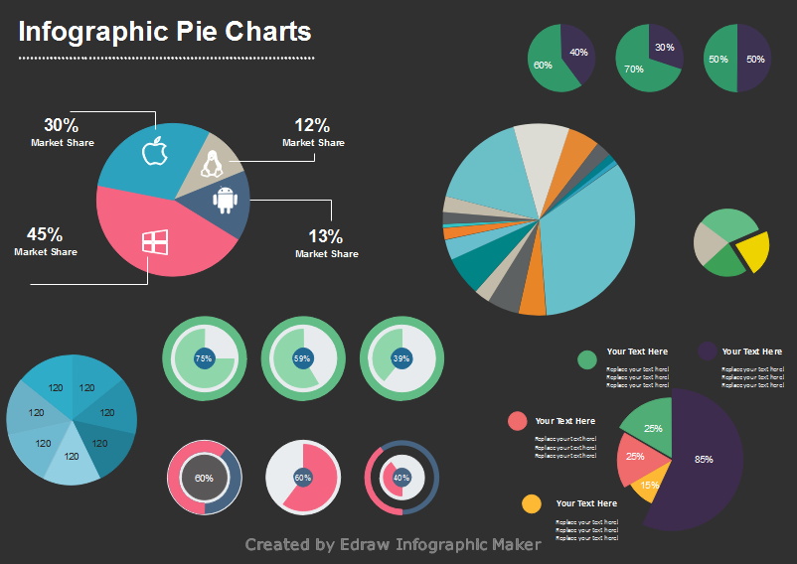
Here are some examples:
Pie Chart Infographic:

Slide 9
Infographics
How do I read and answer questions about infographics?
To read an infographic, examine the text including axis labels and numbers that are relevant to the data represented. Additionally, look for trends/patterns such as increases and decreases that may be relevant. If a pie chart is given, examine the largest and smallest sectors to get an idea on which items consume the most and least percentages. Infographics are accompanied by textual passages that have important information. You will be tested on your ability to connect the information in the graphics and the information in the text.

Slide 10
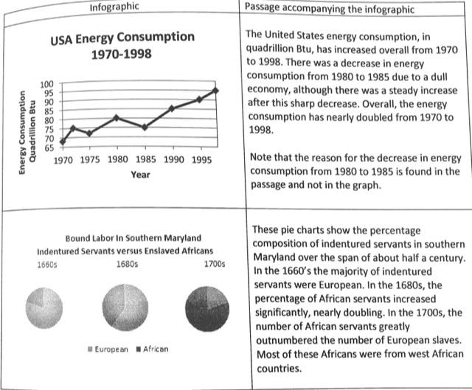
Infographics
Here’s an example of a passage with an infographic:

Slide 11
Infographics
How do I correlate textual data with infographic data?
Look for data presented in the infographic that relates to facts presented in the reading passage. You will be asked to correlate information from the passages to information shown in the infographics in order to make a conclusion.

Slide 12
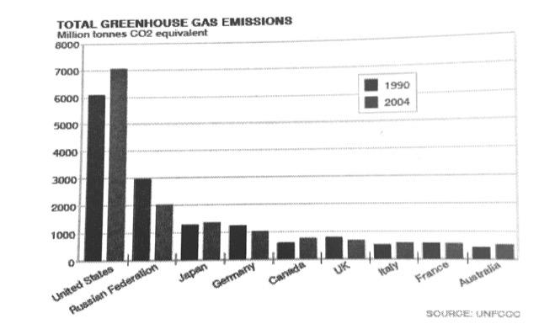
Example:
During the first commitment period, 37 industrialized countries and the European Community committed to reduce Greenhouse Gas emissions to an average of five percent against 1990 levels. During the second commitment period, parties committed to reduce GHG emissions by at least 18 percent below 1990 levels in the eight-year period from 2013-2020.

Slide 13
Example:
Based on the passage and the infographic on the previous slide, which of the following statements is true?
The greenhouse gas emissions of industrialized nations have all decreased due to the impacts of the Kyoto Protocol.
The countries presented in the graph above have not all decreased their greenhouse emissions and have not fulfilled the commitments of the Kyoto Protocol to reduce emissions.
The United States, Russia and Japan have all reduced greenhouse emissions in order to meet Kyoto Protocol standards.
Germany and the United Kingdom have reduced their emissions, which has helped reach the 5 percent Kyoto goal.

Slide 14
Example:
Answer:
B. The graph of greenhouse emissions shows a significant increase in the emissions of the US, as well as Japan and Canada. Although the passage states that these industrialized countries are trying to reduce their emissions, the graph shows otherwise. This means that the countries are not effectively reducing their emissions, and therefore are not meeting standards established by the Kyoto Protocol.

Slide 15
Reading Strategies:
Read the infographic carefully, noting its titles, x and y axes, legends, scale, etc.
Read the passage as you would any other passage - paying attention to main point/idea and evidence, author’s tone, etc.
For questions that ask you to connect the passage and the infographic, focus on the details in the passage and the infographic and look for answers that connect the two.

Slide 16
Bell Work
How was your weekend? Did you do anything exciting?

Slide 17
January 14, 2019
Good Morning and Good Afternoon!

Slide 18
Objectives
Content Objective: Students will demonstrate analyzation of words in context by examining sample SAT-style questions.
Language Objective: Students will read to infer the meaning of different words in context.

Slide 19
Agenda
Today’s Activities!
Bell Work (5 Minutes)
SSR (15 Minutes)
Review: Infographics
Quiz
Words in Context
Why do authors use specific words in their writing?

Slide 20
Words in Context
Why do authors choose specific words in their writing passages?
Authors carefully choose the words that they use in a passage in order do communicate very effectively. Authors will use words that are specific and correct in order to get their point across more effectively.
How does word choice affect the meaning of the message conveyed?
The words used in a passage affect the meaning of the message conveyed by creating the author’s tone or attitude. This will effectively explain to the reader how the author feels about the topic the passage is about.

Slide 21
Words in Context
Examples of words in context:
If an author uses words like odious, horrid and dastardly, that would most likely describe a vicious event.
If an author uses words like trembled, shivered, and quivered, that would indicate an even happening in a cold place.

Slide 22
Words in Context
How do I use context clues to find the meaning of the word?
To find out the meaning of a word using context clues, scan the other words and phrases that surround the word. This will help set up the context for the word being used and will allow you to deduce (find out) the meaning. Sometimes, you have to scan the whole paragraph or passage to get the meaning of a word or phrase.

Slide 23
Words in Context
Example:
The rich old man was a devout philanthropist, giving away his money to help feed poor children.
Which of the following is most similar to the meaning of the word, “philanthropist,” as used in the sentence above?
A. Wealthy
B. Donor
C. Elderly
D. Dedicated

Slide 24
Words in Context
To find the meaning of the word philanthropist, we can see that the sentence states that the man is rich and donates his money. This means that he is a donor of money -- indicated by answer choice B. Answer choice A is incorrect because the word wealthy does not indicate that the mean gives away his money. Answer choice C and D are incorrect because the fact that the man is elderly or dedicated does not relate to his donations.

Slide 25
Words in Context
How does a word take different meanings depending on context?
Some words have multiple definitions, and the definition used in a given sentence depends on the context of the situation.

Slide 26
Words in Context
Example of Multiple Meaning Words:
The man received a 10 year sentence for robbing a thrift store.
As used in the sentence above, the word, “sentence” most nearly means:
Statement
Punishment
Decision
Force

Slide 27
Words in Context
Answer:
In this sentence, the man received a sentence for his crime. This is the same as receiving a punishment for a crime, answer choice B. Answer choices A, C and D are incorrect since a sentence in this context is not a statement, decision or a force -- one does not receive a 10 year statement or a 10 year decision or a 10 year force.

Slide 28
Words in Context
Reading Strategies:
To find the meaning of the word used in a particular context, read the surrounding phrases and sentences and see if you can understand the meaning of the word used in that local context.
Pay attention to the author’s tone and why he or she uses that tone.

