Slide 1
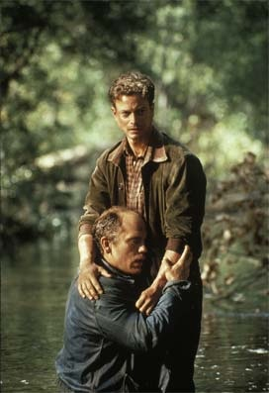
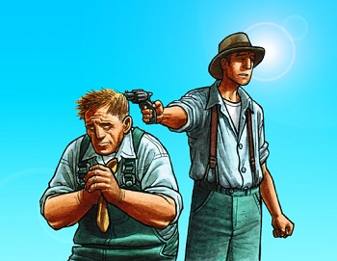
Friendship
Being a friend sometimes means having to make the hard choices for the person you love.
George best demonstrates this theme:
--He forces Lennie to give up the mice he wants to carry
--He won’t let Lennie talk to people (like the boss or Curley)
--He kills Lennie rather than letting him be hunted down
--“I ought to of shot that dog myself, George. I shouldn't ought to of let no stranger shoot my dog.”
By looking out for Lennie’s best interests about his health, money, and safety when Lennie is incapable of doing so for himself, George shows that friends take care of one another even when it is difficult or painful to do so. George learned the lesson from Candy letting someone else kill the dog and he determined to take care of Lennie himself.

