Slide 1
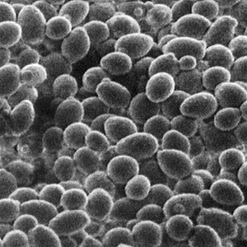
Yeast Lab

Slide 2
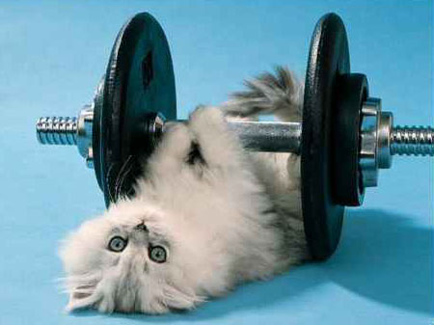
Introduction:
All living cells, including the cells in your body and the cells in yeast, need energy for cellular processes. ATP is a special molecule which provides energy in a form that cells can use for cellular processes.

Slide 3
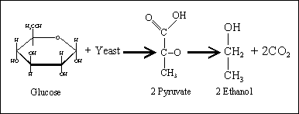
This lab focuses on how yeast perform cellular respiration in the absence of oxygen.
When oxygen is not present, glycolysis is followed by anaerobic respiration, aka fermentation.

Slide 4
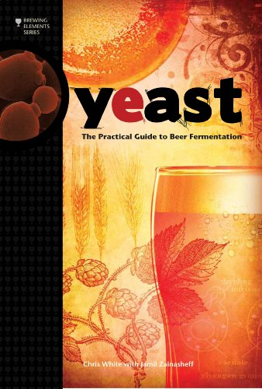
There are two types of fermentation, alcoholic and lactic acid.
The names come from the fate of the pyruvic acid formed at the end of glycolysis.
Which type of fermentation occurs depends on the organism.

Slide 5
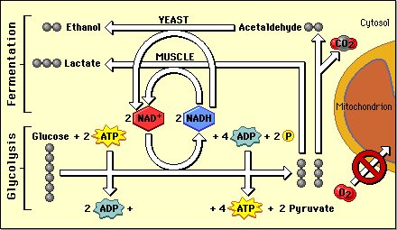
The disadvantage of fermentation is that it produces fewer ATP molecules than aerobic respiration.
The advantage, however, is that glycolysis can continue, so at least some ATP is still being produced.

Slide 6
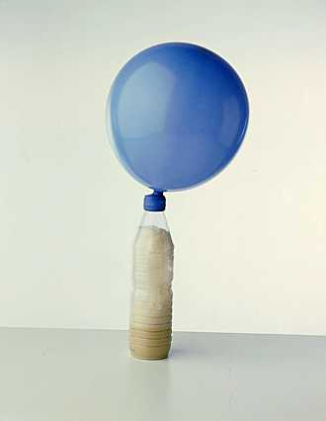
In this lab you will be using yeast.
You can grow yeast in a filled flask with water that contains sucrose and is sealed with a balloon
which creates an anaerobic environment

Slide 7
+Make the Following Corrections to your Lab
To the top of your data table change the times to:
15 mins
25mins
35mins
Also change the times in #7 in procedure
While you are waiting prep your graph

Slide 8
Group 1 – 3.5g yeast – 2.5g sugar –30ml H2O
Group 2 – 3.5g yeast – 3g sugar – 30ml H2O
Group 3 – 3.5g yeast – 3.5g sugar –30ml H20
Group 4 – 3.5g yeast – 4g sugar – 30 ml H2O
Group 5 – 3.5 yeast – 4.5g sugar – 30ml H20
Group 6 – 3.5 yeast – 5 sugar – 30mlH2O
Group 7 – 3.5 yeast – 6.5g sugar – 30ml H2O

