Slide 1
Walkin’ on the Beach

Slide 2
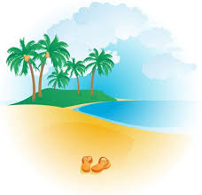
Walkin on the beach, oh
I love it when
I’m walkin on the beach, oh.

Slide 3
I love it when the
sun shines down,
warms me all around,
oh. oh.

Slide 4
Walkin’ on the shore, oh.
I love it when
I’m walking on the shore, oh.

Slide 5
I love it when the salty air
dances everywhere
oh. Oh.

Slide 6
Walkin’ along with the
sand in my toes.
Feelin’ the spray on
my hair and my nose

Slide 7
Watchin’ the water and watchin’ the waves.
Spendin’ my evenings and spending my days.

Slide 8
I love it, love it. Oh.
I love it, love it. Oh.
I love it, love it. Oh.
I love it, love it. Oh.

Slide 9
Walkin’ on the beach, oh.
I love it when
I’m walking on the beach, oh.

Slide 10
I love it when the gulls swoop by
makes me want to fly, oh. Oh.

Slide 11
Walkin’ on the shore, oh.
I love it when
I’m walkin’ on the shore, oh.

Slide 12
I love it ‘cause the
waves and foam make me feel
at home, oh. Oh.

Slide 13
Walkin’ along with the
sand in my toes.
Feelin’ the spray on
my hair and my nose.

Slide 14
Watchin’ the water and watchin’ the waves.
Spendin’ my evenings and spendin’ my days.

Slide 15
I love it, love it. Oh.
I love it, love it. Oh.
I love it, love it. Oh.
I love it, love it. Oh.

Slide 16
On the beach.
On the beach.
Walkin’ on the beach.

