Slide 2
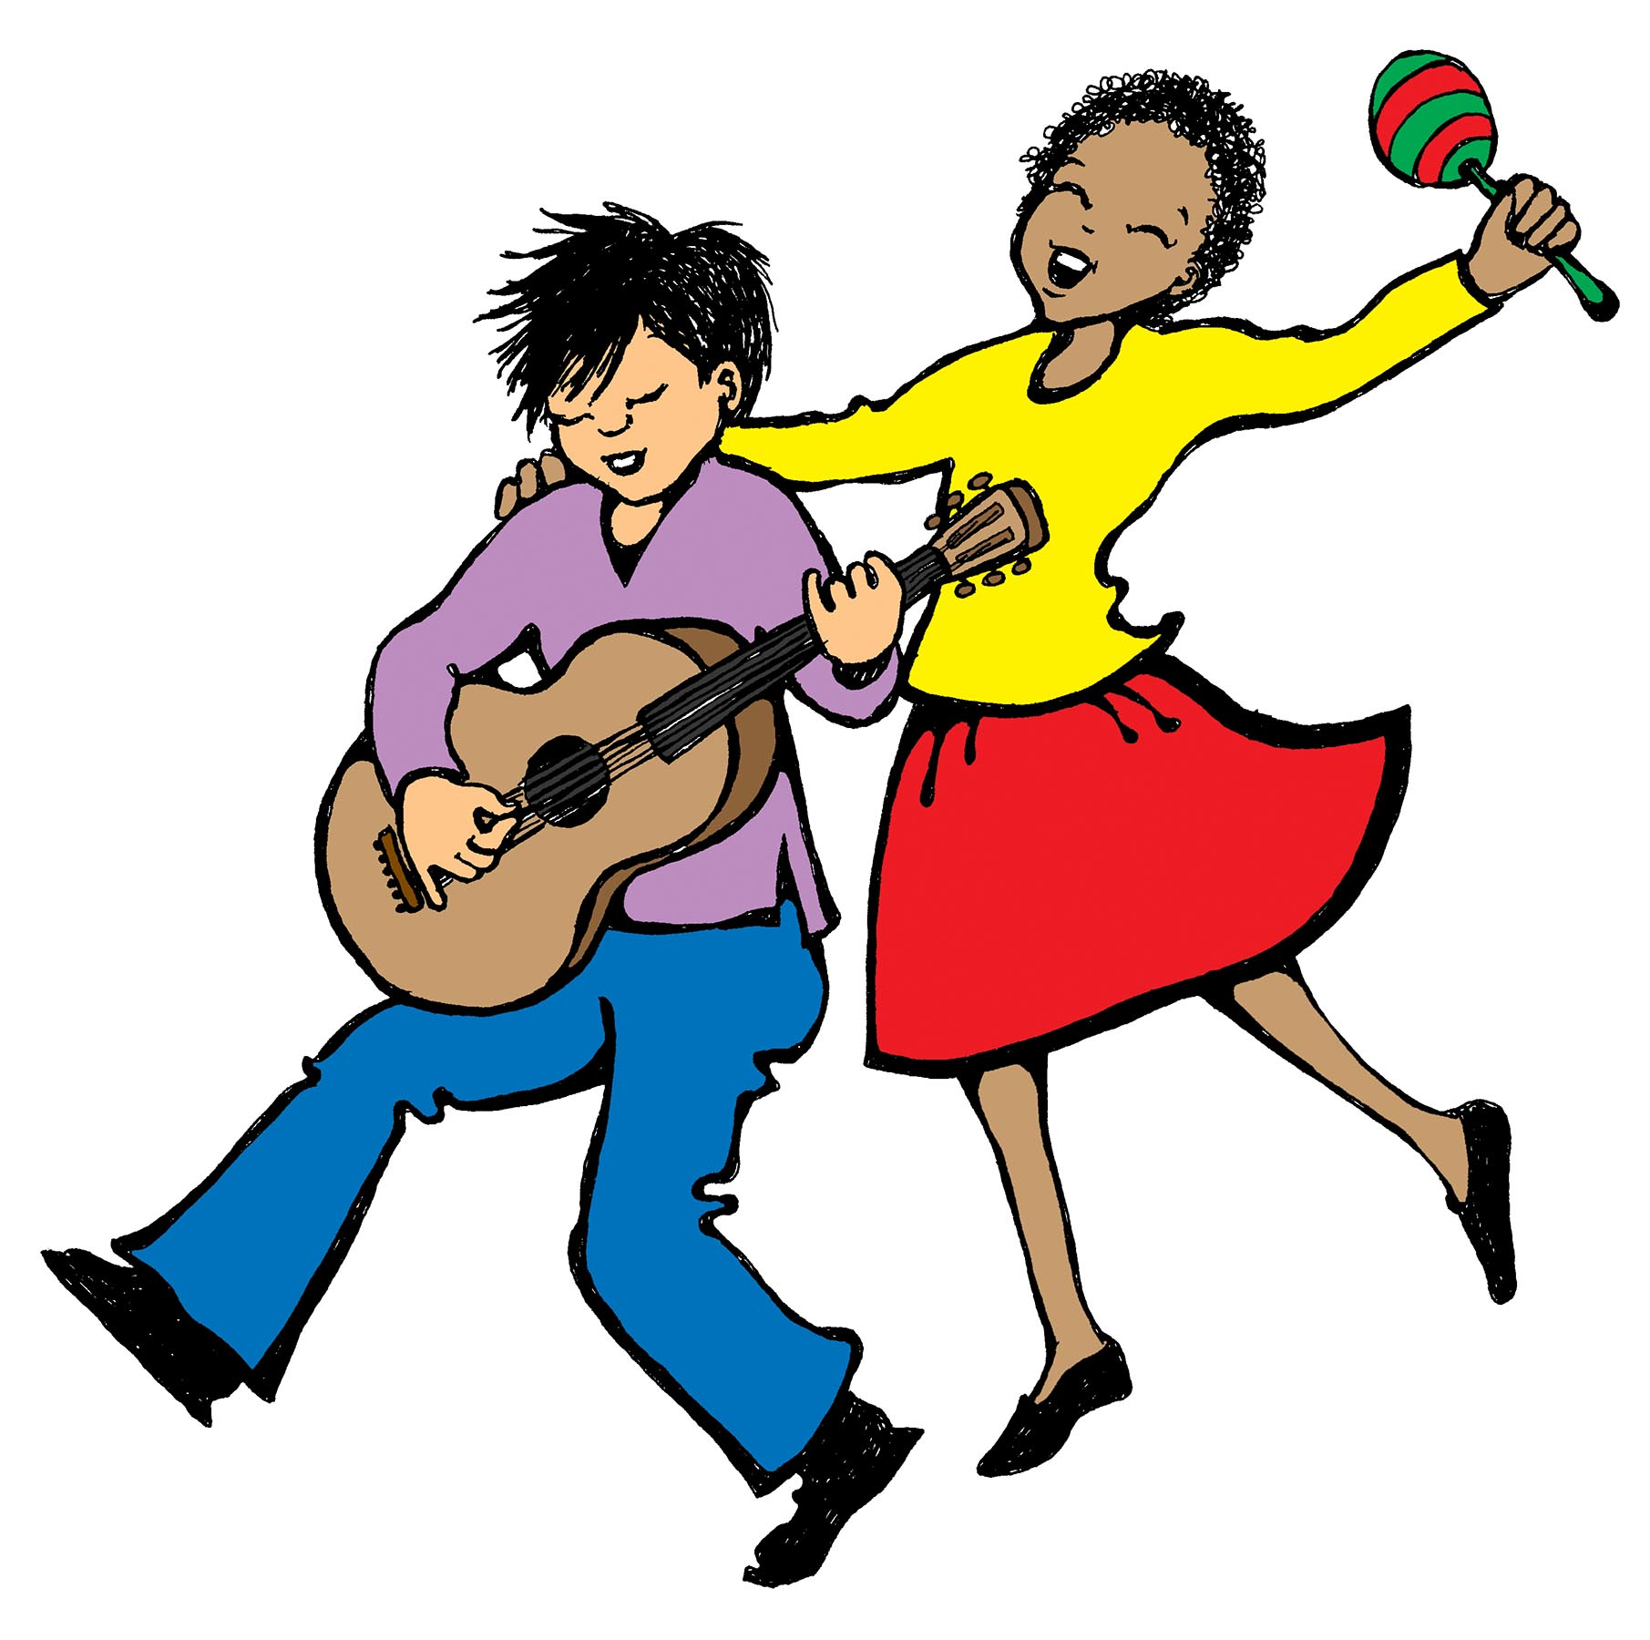
Catch the rhythm.
Hear the rhythm.
Feel the rhythm.
Dance the rhythm.

Slide 3
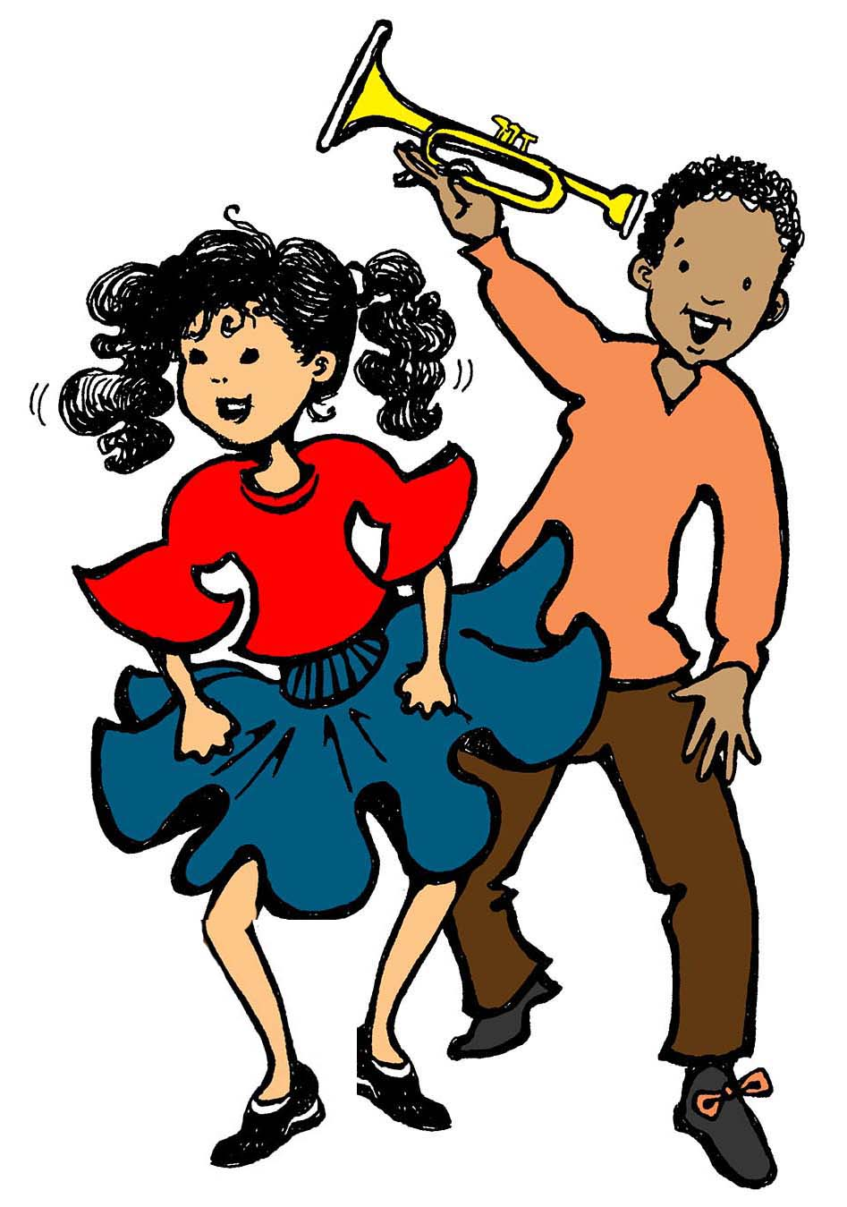
Catch the rhythm.
Hear the rhythm.
Feel it in your feet.

Slide 4
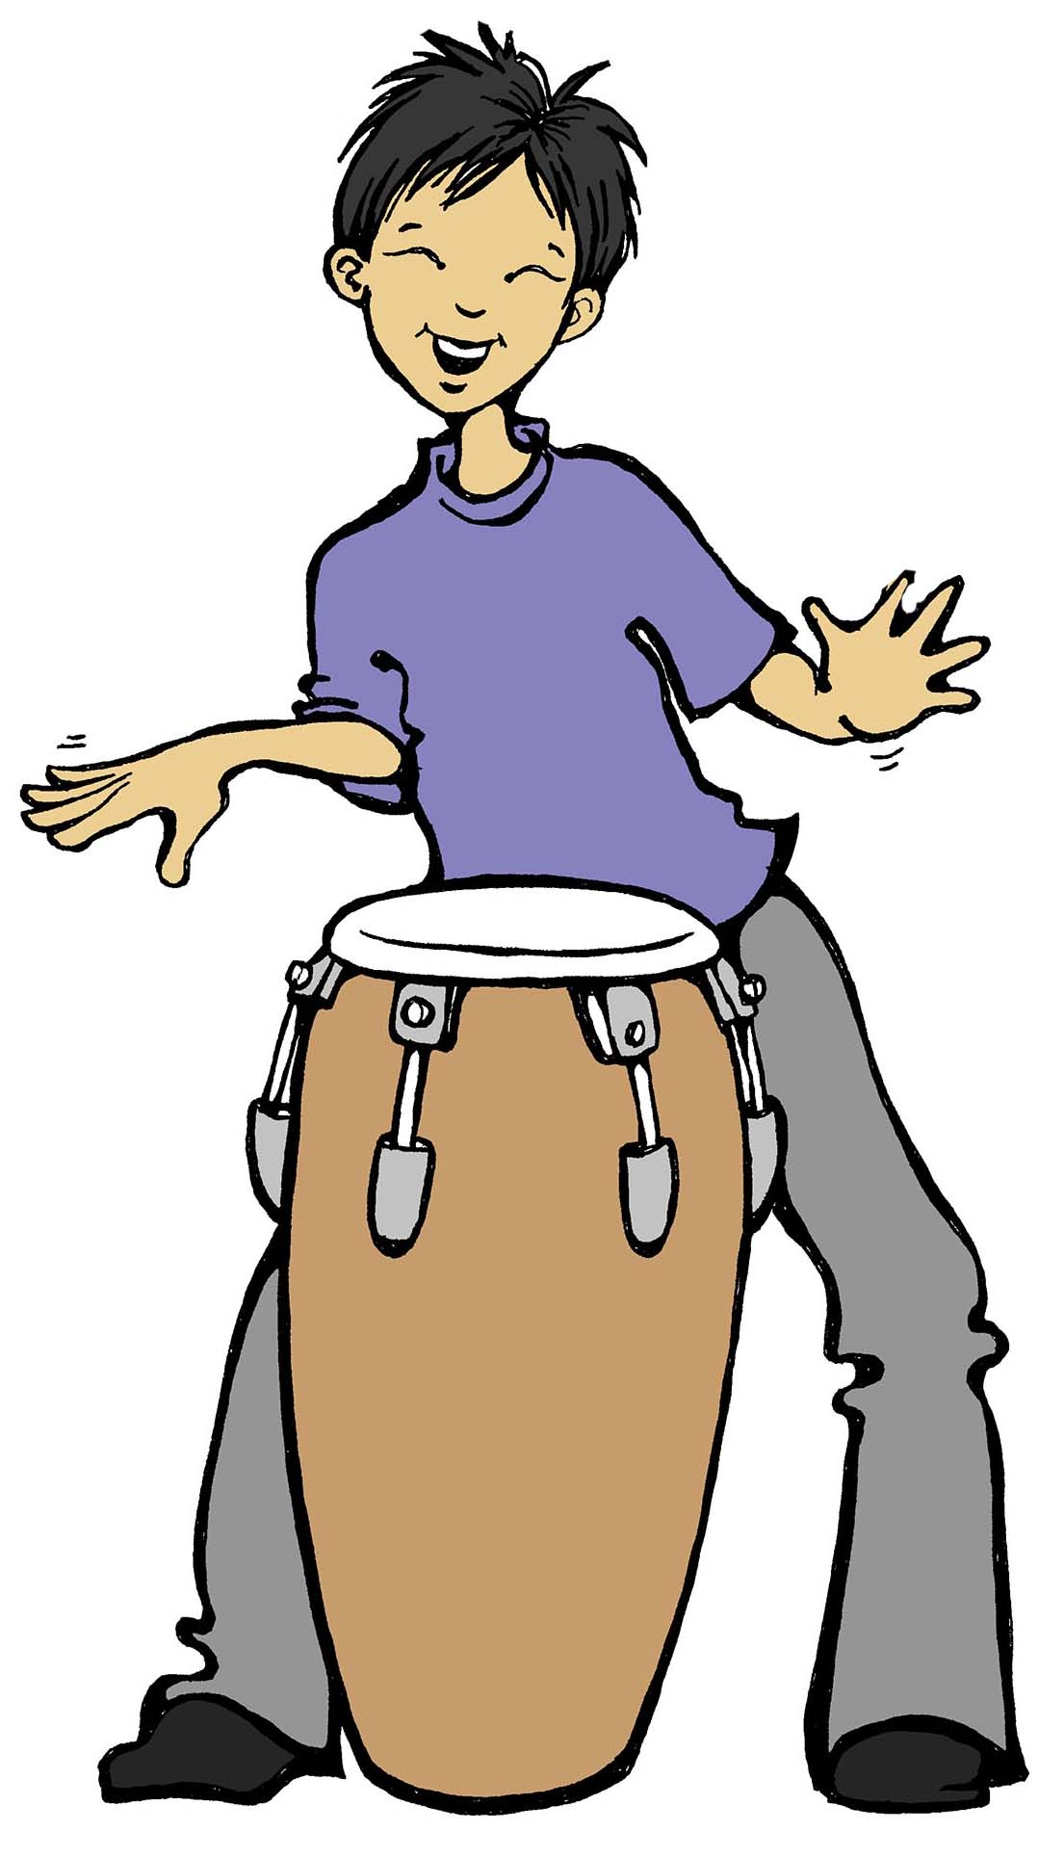
Catch the rhythm.
Hear the rhythm.
Feel the rhythm.
Dance the rhythm.

Slide 5
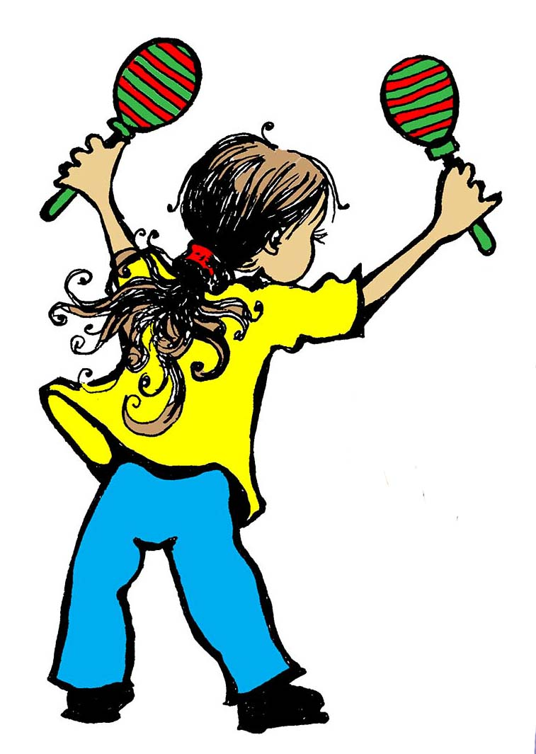
Catch the rhythm.
Hear the rhythm.
Feel it in your feet.

Slide 6
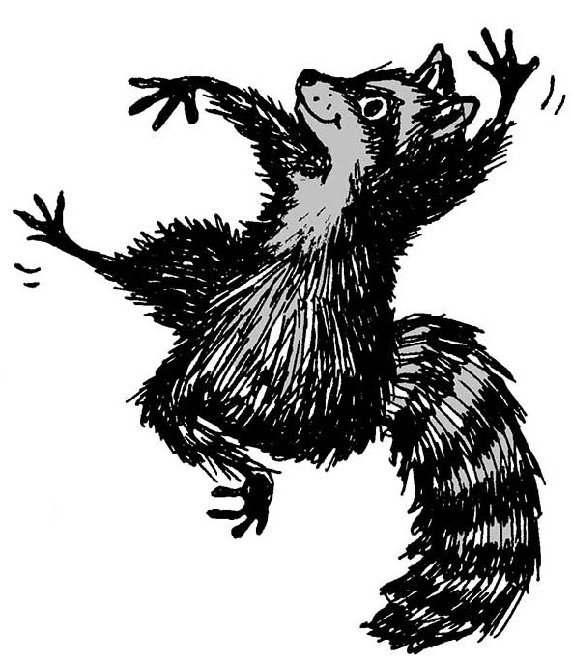
There’s no sense resisting.
You’ll find yourself twisting.
The drive is insisting somehow.

Slide 7
The pulse is resounding.
It leaves your heart pounding.
You want it surrounding you now!

Slide 8
Catch the rhythm.
Hear the rhythm.
Feel the rhythm.
Dance the rhythm.

Slide 9
Catch the rhythm.
Hear the rhythm.
Feel it in your feet.

Slide 10
Catch the rhythm.
Hear the rhythm.
Feel the rhythm.
Dance the rhythm.

Slide 11
Catch the rhythm.
Hear the rhythm.
Feel it in your feet.

Slide 12
There’s no sense resisting.
You’ll find yourself twisting.
The drive is insisting somehow.

Slide 13
The pulse is resounding.
It leaves your heart pounding.
You want it surrounding you now!

Slide 14
Catch the rhythm.
Hear the rhythm.
Feel the rhythm.
Dance the rhythm.

Slide 15
Catch the rhythm.
Hear the rhythm.
Feel it in your feet.

Slide 16
Catch the rhythm.
Hear the rhythm.
Feel the rhythm.
Dance the rhythm.

Slide 17
Catch the rhythm.
Hear the rhythm.
Feel it, (divisi, optional): feel it,
feel it in your feet!

Slide 18
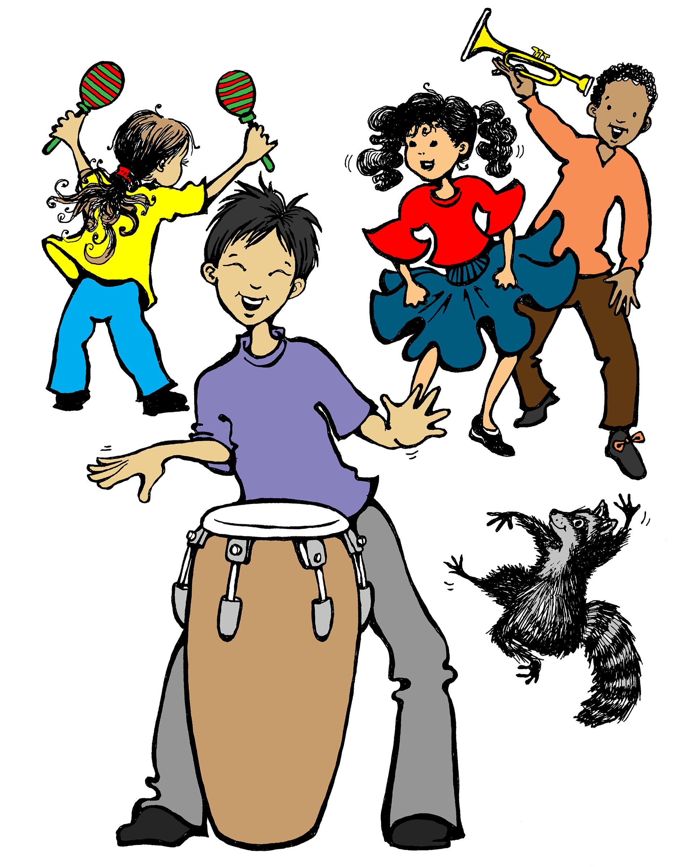
Feel it in your feet!

