Slide 1
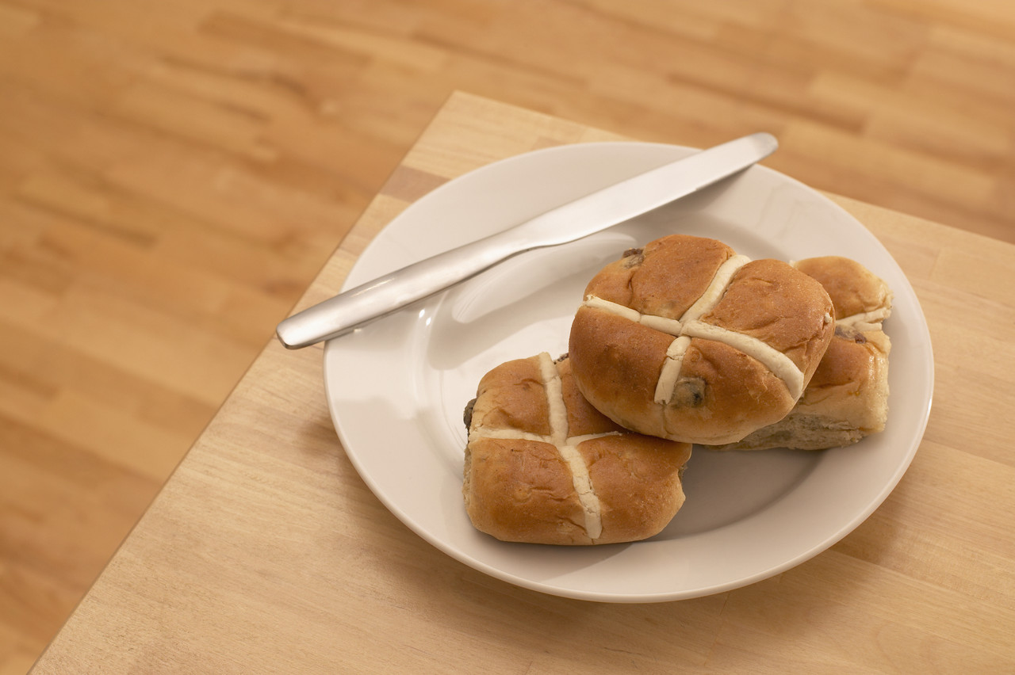
HOT CROSS BUNS
English Folk Song

Slide 2
Lyrics
Hot cross buns,
Hot cross buns,
One a penny, two a penny,
Hot cross buns.

Slide 3

Rhythms
Hot cross buns,
Hot cross buns,
One a pen-ny, two a pen-ny,
Hot cross buns.
4
4

Slide 4
Pitches (with solfa for singing)
Hot cross buns,
Hot cross buns,
One a pen-ny, two a pen-ny,
Hot cross buns.
4
4
m
r
d
m
r
d
d
d
d
d
r
r
r
r
m
r
d

Slide 5
Pitches with solfa on the staff
Hot cross buns, hot cross buns,
m
m
4
4
r
r
d
d
One a pen-ny, two a pen-ny, hot cross buns.
r
r
r
r
m
r
d
d
d
d
d

Slide 6
Rhythms
Sing the rhythms on “doo”
Play the rhythms on your recorder, using “B” only
Hot cross buns,
Hot cross buns,
One a pen-ny, two a pen-ny,
Hot cross buns.

Slide 7
Pitches (with letter names for recorder playing)
Sing the song on pitch names while moving your fingers on the recorder
Play the song on your recorder
Remember to have your thumb on, 1 finger for B, 2 fingers for A and 3 fingers for G
Hot cross buns,
Hot cross buns,
One a pen-ny, two a pen-ny,
Hot cross buns.
b
a
g
b
a
g
g
g
g
g
a
a
a
a
b
a
g

Slide 8
Pitches with letter names on the staff
Sing the song on pitch names while moving your fingers on the recorder
Play the song on your recorder
Remember to have your thumb on, 1 finger for B, 2 fingers for A and 3 fingers for G
Hot cross buns, hot cross buns,
b
b
4
4
a
a
g
g
One a pen-ny, two a pen-ny, hot cross buns.
a
a
a
a
b
a
g
g
g
g
g

