Slide 1

Chapter Intro 2
Scarcity is the basic economic problem that requires people to make careful choices about how to use limited resources.

Slide 2

Section 1
The Fundamental Economic Problem
Societies do not have enough productive resources to satisfy everyone’s wants and needs.

Slide 3
Section 1
The Fundamental Economic Problem
(cont.)
The study of how scarcity affects most decisions we make is economics.
Economists talk about people’s needs and wants. A need is necessary for survival.
A want is something we would like but not necessary for survival.

Slide 4
Section 1
The Fundamental Economic Problem
(cont.)
Everything we do has a cost, due to limited resources.
TINSTAAFL—There is no such thing as a free lunch.

Slide 5

Section 1
Which do you purchase more often?
A. Things you want
B. Things you need
A
B

Slide 6
Section 1
Three Basic Questions
Scarcity forces every society to answer the basic questions of WHAT, HOW, and FOR WHOM to produce.

Slide 7
Section 1
Three Basic Questions (cont.)
We live in a world of scarce resources.
Scarcity means that three questions should be answered.
What to produce
How to produce
For whom to produce

Slide 8
Section 1
The Factors of Production
Four factors of production—land, capital, labor, and entrepreneurs—must be present to produce goods and services.

Slide 9
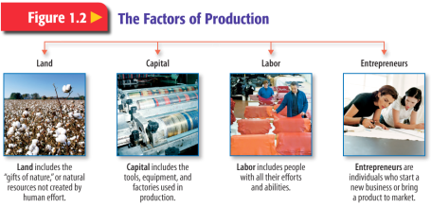
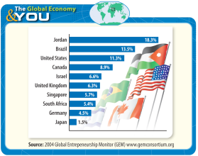
Section 1
The Factors of Production (cont.)
All four factors of production are required to produce goods and services.
Land
Capital (sometimes called capital goods)
Labor
Entrepreneurs
The Factors of Production
The Global Economy & YOU

Slide 10
Section 1
The Scope of Economics
Economics analyzes how societies satisfy wants through careful use of relatively scarce resources.

Slide 11
Section 1
The Scope of Economics (cont.)
Economics is a social science—it deals with the behavior of individuals as they satisfy unlimited and competing wants through careful use of scarce resources.

Slide 12
Section 1
The Scope of Economics (cont.)
Four key elements to the study of economics
Description
Gross domestic product (GDP) is a key measure of a nation’s economic output.
Analysis
Explanation
Prediction

