Slide 1
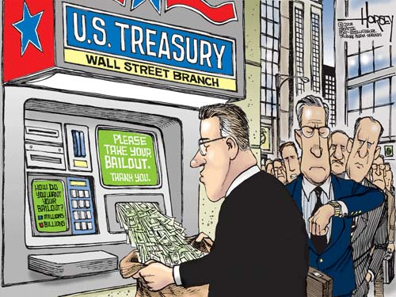
MARKET STRUCTURES
ECONOMICS CHAPTER 7

Slide 2
BELLWORK
IS IT EVER “OK” FOR THE GOVERNMENT TO REGULATE PRICES?
  Why/Why Not?

Slide 3
FOCUS QUESTION
WHAT ARE THE FOUR TYPES OF MARKET STRUCTURES & WHAT ROLE DOES THE GOVERNMENT PLAY?

Slide 4
WHAT IS “GOOD COMPETITION”?
PERFECT COMPETITION: A market structure that requires a set of ideal conditions:
  Large # of buyers and sellers
  Identical products
  Buyers and sellers act independently
  Buyers and sellers are well-informed
  Buyers and sellers are free to enter into, conduct, or get out of business.

Slide 5
MONOPOLISTIC COMPETITION
MONOPOLISTIC COMPETITION: Market structure that has all the conditions of Perfect Competition except for identical products.
  Characterized by PRODUCT DIFFERENTIATION—real or perceived differences
  To make products stand out, competitors rely on NONPRICE COMPETITION —the use of advertising, giveaways, or other promotions.

Slide 6



OLIGOPOLY
OLIGOPOLY: Market structure in which a few very large sellers dominate the industry.
  Products may have distinct features
  Tend to act together with price changes so many firms prefer to compete on a non-price basis.
    Can lead to PRICE-FIXING, or agreeing to charge the same amount for a product.

Slide 7
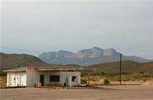
TYPES OF MONOPOLIES
NATURAL MONOPOLY: A situation where the costs of production are minimized by having a single firm produce the product.
  Example: ?
GEOGRAPHIC MONOPOLY: A monopoly based on the absence of other sellers in a certain geographic region.

Slide 8
TYPES OF MONOPOLIES
TECHNOLOGICAL MONOPOLY: Monopoly based on ownership or control of a manufacturing method, process, or other scientific advance.
  Example: New drug patents
GOVERNMENT MONOPOLY: a monopoly owned and operated by the government.
  Example: uranium production

Slide 9
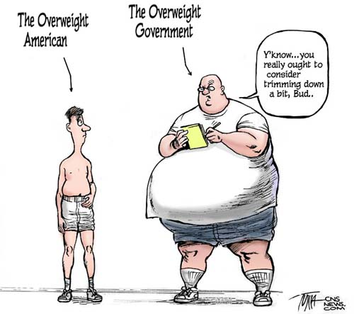
THE GOVERNMENT’S ROLE IN THE ECONOMY

Slide 10

GOVERNMENTS ROLE
1. MAINTAINING COMPETITION
2. PROTECTING CONSUMERS
3. IMPROVING ECONOMIC EFFICIENCY

Slide 11
HOW DOES THE GOVERNMENT MAINTAIN “GOOD COMPETITION”?
The government maintains good competition through legislation and regulation…
  SHERMAN ANTITRUST ACT (1890): Outlawed all contracts “in restraint of trade” to halt the growth of trusts and monopolies.
  CLAYTON ANTITRUST ACT (1914): Strengthened the Sherman Antitrust Act by outlawing price discrimination.
    PRICE DISCRIMINATION: The practice of selling the same product to different consumers at different prices.

Slide 12
FOCUS QUESTION
WHAT ARE THE FOUR TYPES OF MARKET STRUCTURES & WHAT ROLE DOES THE GOVERNMENT PLAY?

Slide 13

RECALL
What are the four types of market structures?

Slide 14
FOCUS QUESTION
WHY DO MARKETS FAIL AND WHAT CAN THE GOVERNMENT DO TO PREVENT THEM FROM FAILING?

Slide 15
WHY DO MARKETS FAIL?
1. Inadequate Competition
  Leads to higher prices
  No incentive to use resources efficiently or keep
  Quality high.
  Enron: https://www.youtube.com/watch?v=2GdvKh3Gr3E
  https://www.youtube.com/watch?v=ketwlV2hNtE
2. Inadequate Information:
  Knowing what consumers want.
  Keeping consumers informed about products.
  You don’t know what the interest rate on your house is but buy it anyway. You later realize you can’t afford the house and the bank takes it.

Slide 16

Horizontal Merger
Combining similar companies to form one larger company.
Combine the Cellular companies
above to create one company
Called “All-Call Cellular.

Slide 17
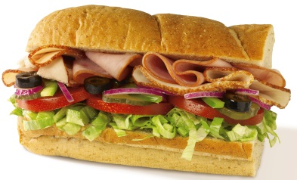

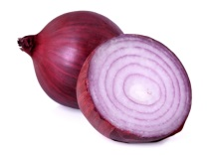

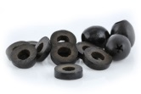
Vertical Merger
A merger between two or more companies in the same industry where one company supplies goods to the other company.
Subway Owns
Turkery Farm
Onion Farm
Lettuce/Tomato Farm
Black Olive Farm

Slide 18
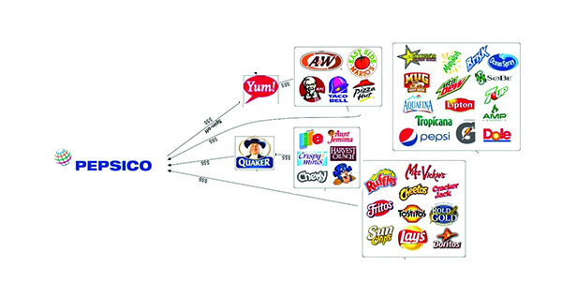
Conglomerate
A corporation that is made up of a number of different, seemingly unrelated businesses. In a conglomerate, one company owns a controlling stake in a number of smaller companies, which conduct business separately.

Slide 19
WHY DO MARKETS FAIL?
3. Resource Immobility:
  Land, labor, and capital do not move to where returns are the highest.
  EX: You move you Car Factory to Ohio but the majority of your employees can’t move to Ohio with you. The people that live around the new factory already have jobs or aren’t good at making cars. Your business could fail!

Slide 20
WHY DO MARKETS FAIL?
4. PUBLIC GOODS (need for):
  Products collectively used
  by everyone.
  Markets would not supply
  these (no incentive)
  Ex: Floodwalls: Everyone knew the floodwalls in New Orleans were no good. The government didn’t fix them because they figured they were good enough and there hadn’t been a flood in years. Hurricane Katrina hit and because the government hadn’t fixed the floodwalls the entire city was devastated.
  EX 2: A higher no one uses… the government isn’t going to rush to fix the pot holes.

Slide 21
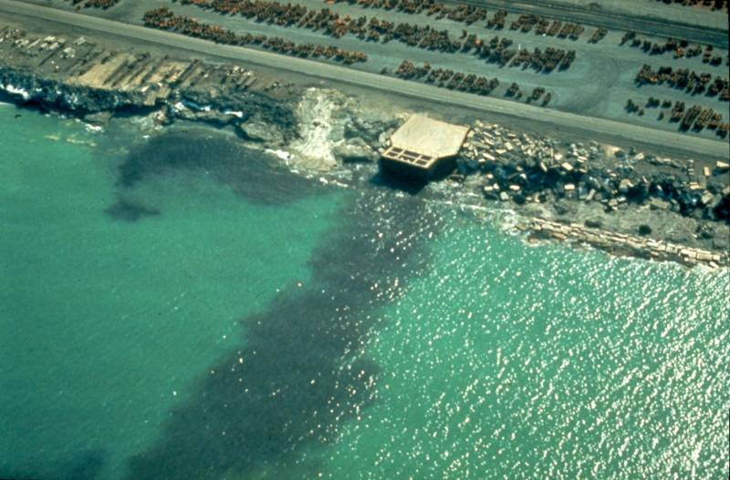

WHY DO MARKETS FAIL?
5. EXTERNALITIES: unintended side effect that neither benefits or harms.
  NEGATIVE EXTERNALITY:
  harmful unintended side effect
  POSITIVE EXTERNALITY:
  beneficial unintended side effect

Slide 22
CORRECTING MARKET FAILURES
THINK-PAIR-SHARE: What are ways the government can help prevent the failure of markets?

Slide 23
IMPROVING ECONOMIC EFFICIENCY
The government has the ability to correct two market failures:
  Protect Competition
  Improving Economic Efficiency

Slide 24


PROTECTING COMPETITION
The government restricts the formation of trusts and monopolies through legislation.
  SHERMAN ANTITRUST ACT: Law that makes monopolies and trusts illegal.
In 2001, the Federal Government blocked a merger between U.S. Airways and United citing it would limit competition within the airline industry.

Slide 25

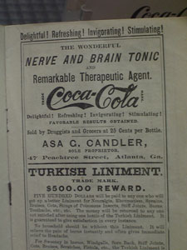
IMPROVING ECONOMIC EFFICIENCY
Correcting Inadequate Information:
  PUBLIC DISCLOSURES: the requirement that businesses reveal certain information to the public.
  “Truth in Advertising Laws” prevent sellers from making false claims about their product.

Slide 26



IMPROVING ECONOMIC EFFICIENCY
Providing Public Goods:
  Roads, highways, bridges
  Schools, museums, libraries

Slide 27
FOCUS QUESTION
WHY DO MARKETS FAIL AND WHAT CAN THE GOVERNMENT DO TO PREVENT THEM FROM FAILING?

