Slide 1
Basic Economics Ch. 1 Sec. 2

Slide 2
VOCABULARY
Good: a tangible item (book, car, sneakers) that satisfies a want or need.
Consumer good: Goods intended for final use by consumers like you and me not businesses.
Durable good: An item that lasts for three years or more (Car).
Nondurable goods: An item that is easily worn out for less than three years (Food, Perfume).
Service: Work or labor performed for someone (Haircut, gardening, massage).
Value: $$$ worth of a good or service determined by the market.
Paradox of value: is the apparent contradiction that, although water is on the whole more useful, in terms of survival, than diamonds, diamonds command a higher price in the market.
Utility: The usefulness of a good or service and how it satisfies someone.
Wealth: The total of products that are tangible, scarce, useful and transferable from one person to another (Everything you own, determines your wealth).
Market: Place that allows buyers and sellers to come together (can be local, national, or global).
Factor Markets: Where factors of production are bought and sold (Businesses pay wages to employees while employees provide their labor to the businesses).

Slide 3
VOCABULARY Cont….
Product Markets: where goods and services are bought and sold (When consumers buy products/services from businesses).
Economic Growth: When a nations total output of goods and services grows over time (the more a country produces and sells, the higher its economic growth).
Productivity: measure of the amount of output (product) produced with a given amount of productive factors.
Human Capital: The skill, talent and productivity that employees bring to a company.
Division of labor: Organizing work so that each employee is responsible for one part of the work (Restaurants, car factory).
Specialization: Assignment of tasks to employees who can perform them more efficiently.
Economic Interdependence: The dependence of one person’s, firm’s or nations activities on another’s (without farms, consumers wont have groceries. Without specialized tools, farmers wont have equipment for their farms. Without farmers those who specialize in farm equipment wont have customers.

Slide 4
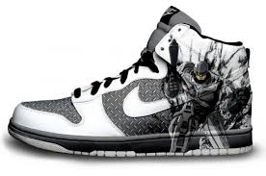
Goods & Services
Goods are tangible (can touch).
Services are work or labor performed for someone.

Slide 5
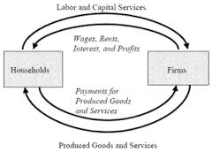
Transactions in Markets
Product Market
Where goods and services are bought and sold
Factor Market
Where the factors of production are bought and sold.
<-FACTOR MARKET ->
Consumer→
← Businesses
<-PRODUCT MARKET ->

Slide 6
Economic Growth & Productivity
When productivity is high the result is economic growth.
Every time a business or nation produces more of something overtime, its economic growth increases.

Slide 7
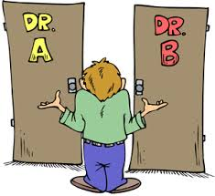
How is value related to scarcity and utility?
A product is considered higher in value if it is SCARCE (limited) and provides satisfaction of a want or need(Utility).
Product A is scarce, but does not satisfy my need.
Product B is scarce and satisfies my need.
Which product is more valuable to me?

Slide 8
Human Capital-its benefits?
The skills, abilities, health and knowledge of people benefits firms more.
In company A: Tom does not receive health benefits therefore he is constantly sick and missing important training on the updated machinery for the product he makes.
In company B: Adam receives health benefits therefore rarely misses work and is present for the training classes provided for the product he produces therefore is skilled at what he does.
Which company is investing in their human capital?

Slide 9
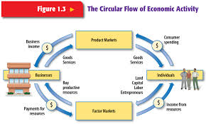
The Circular Flow of Economic Activity
Businesses hire employees and pay $$$
Businesses utilize human capital to make and sell products/services
Consumers buy products/services using $$$
Business then use $$$ to make products/services
How can the flow of economic activity be increased?
Consumers can buy more products/services where then businesses can use that $$ to make/provide more and more of something.

Slide 10
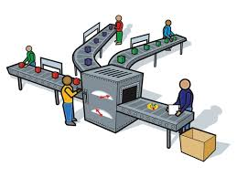
Division of Labor & Specialization
Labor is divided into a number of different tasks (Division).
When factors of production (land, labor, capital, entrepreneur) perform only one task and perform that task well, they specialize in that one task.
Land: A dessert can only support life that requires minimal water as opposed to a forest.
Labor: On a car assembly line, someone who installs tires the entire month would have a difficult time installing the headlights on the car.
Capital: A machine that tightens screws would be incapable of sewing together clothing.
Entrepreneur: Someone who risks their time and money to run a grocery store would have a more difficult time working in a factory that manufactures clothing
Specialization increases productivity!!

Slide 11
Economics Chapter 1 Sec. 3
Economic Choices and Decision Making

Slide 12
Trade-offs
An alternative that is available whenever a choice is to be made.
I have enough to buy a new pair of shoes or tickets to a concert, how do I choose?
Decision-making grid: helps analyze economic problem and make a wise choice.
Sneakers would be the better choice
 |  | CRITERIA
Alternatives | Costs $50 or less | Durable? | Parents Approve? | Can use more than once?
Sneakers | no | yes | yes | yes
Concert Tickets | yes | no | no | no

Slide 13
Opportunity Cost
Cost of the next best alternative use of the money, time, or resources when making a choice.
When I chose the sneakers over the concert tickets, my opportunity cost was the concert tickets.
The next best choice given up is the opportunity cost.

Slide 14
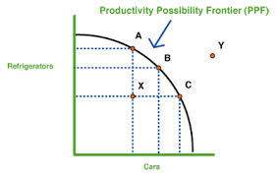
Production Possibilities Frontier:
shows the different combinations of two products that can be produced if all resources are fully employed.
<-Cannot be reached

Slide 15
Economic Model:
Simplified version of a complex concept or behavior expressed in the form of an equation, graph, or illustration.
Concepts are easier to grasp if we graph or chart them!

Slide 16
Cost-Benefit Analysis:
Before making any major decisions, it is a good idea to weigh the benefits against the costs.
This is what we did when we made a decision making grid for the sneakers and concert tickets.
It allows us to choose the product or service that would satisfy our needs best, given how much it costs.
Suppose you like two different pairs of shoes evenly but one costs more than the other? It would benefit you more if you satisfied your wants if you bought the sneaker that costs less.

Slide 17
Standard of Living:
the quality of life based on the ownership of the necessities and luxuries that make life easier.
When the cost of living goes up, for example gas prices, it becomes more expensive to fill our tank, pick up our friends and go on a joy ride.
Therefore, our standard of living becomes more expensive to fulfill.

Slide 18
Complete the graphic organizer to illustrate your final choice…
Final Choice
Jeans
Trade-offs (Choices)
Purse
Make-up
Jeans
Sneakers
Top 2 Choices
Jeans
Make-up
→
Opportunity Cost
Make-up
Analyze trade-offs & opportunity cost to help make decisions about what is best.

Slide 19
What decisions-making strategies do economists recommend using?
Economic models
Cost-benefit analysis

Slide 20
Why is it important for the governments to understand trade-offs and opportunity costs?
Helps make decisions about what goods and services to produce using the maximum resources available.

Slide 21
How does economics play a part in politics?
Most of today’s political problems have important economic aspects.
We as citizens take part in voting in representatives who we think can strengthen the economy.
For example:
how do we balance the budget?
How can the country get out of debt?
How can we strengthen relationships with countries who provide us with goods and services that we need and want?

Slide 22
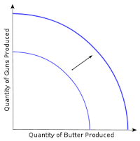
What does it mean when the PPF shifts forward?
It means there has been economic growth. For example:
Growing population
More resources to use
Improved technology
Increased productivity

