Slide 1
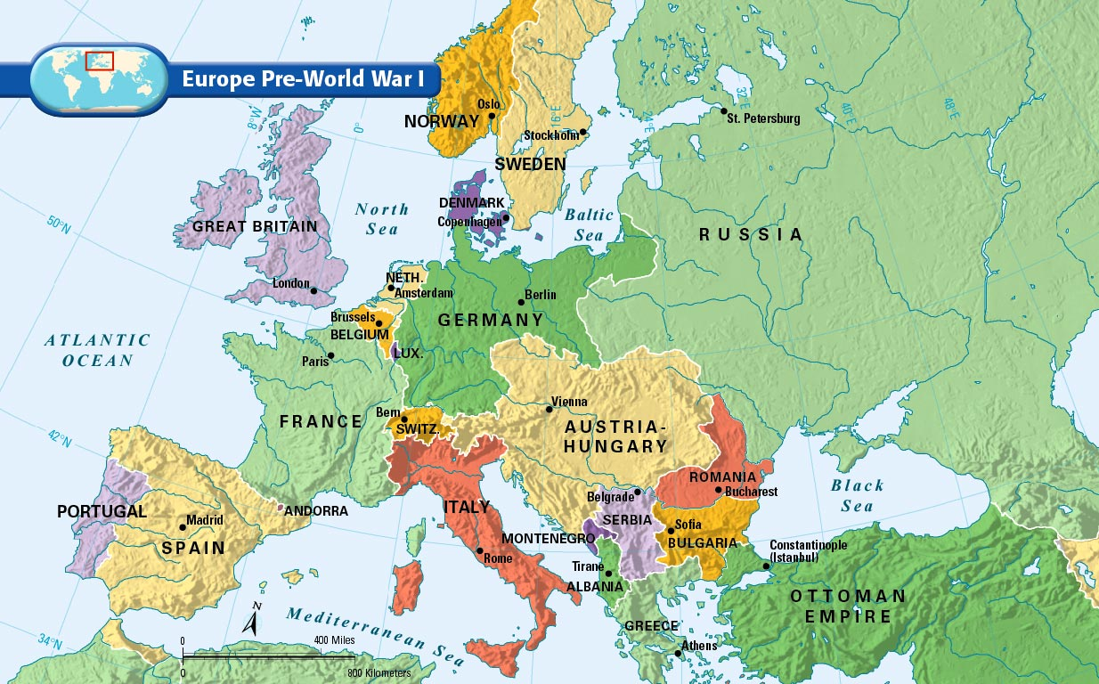
Bellwork #18 03/06/17-
How did WWI change the map of Europe?
How do you think the change in the map effected the countries politically and socially?
Based on the map, Who were the big winners and losers?

Slide 2
