Slide 1
The Progressive Era
What was it?

Slide 2
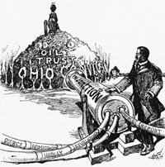
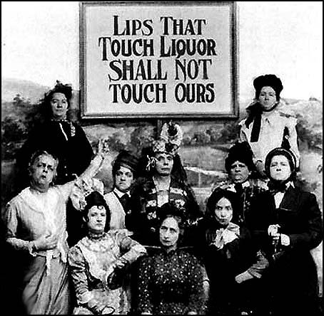
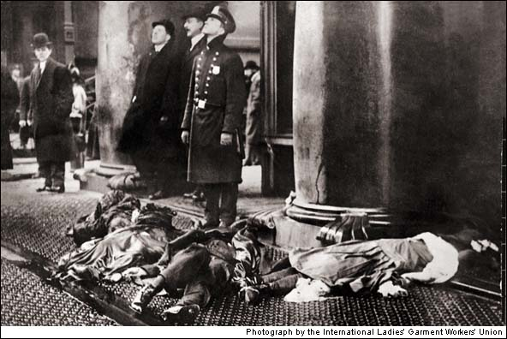
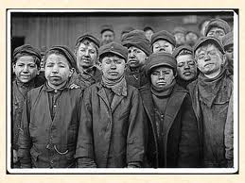

Slide 3
The Main Idea
Progressives focused on three areas of reform: easing the suffering of the urban poor, improving unfair and dangerous working conditions, and reforming government at the national, state, and local levels.
Unit Focus
What issues did Progressives focus on, and what helped energize their causes?
How did Progressives try to reform society?
How did Progressives fight to reform the workplace?
How did Progressives reform government at the national, state, and local levels?

Slide 4
Goals of Progressives
decrease the role of special interest groups in government
make the government more honest and responsive to citizen needs
increase popular participation in the American system.
create a more active, stronger role for the Federal government to protect the public interest.
get the government responsible for the social welfare of its citizens (i.e., a rejection of social Darwinism).

Slide 5
Roots of the Progressive Movement
The rapid growth of Big Business combined with the social problems associated with too fast growth in the cities led many Americans to attempt to reform the American system in the face of rising tensions within society as a result of industrialization
Population in 1900 a. US population was 76 million with 1 out of 7 being foreign born b. In the next fifteen years, another 13 million immigrants arrived
Past Reform Efforts- Abolition, Women’s Rights, Temperance, Populism

Slide 6
People involved
native born
middle-upper class
educated
middle-class women
muckrakers- progressive journalists
not concerned with foreign policy
Notables: Jane Addams (Hull House), Robert LaFollette, Upton Sinclair, Ida Tarbell (Muckrakers)

Slide 8
The Critics…
Conservative politicians and business leaders argued that government regulation would undermine free regulation,free enterprise and prosperity.
Federal courts tended to limit government power to regulate. But never a complete blockade of reform.
Socialists wanted a complete change of the system, not merely reform. Even so, Socialism and Progressivism overlapped on some issues.
Socialist leader Eugene V. Debs won 400,000 votes in 1904 and nearly a million in 1912 as presidential candidate.
Upton Sinclair, a famous muckraker, was not a Progressive but a Socialist

Slide 9
Progressivism and Its Champions
Industrialization helped many but also created dangerous working environments and unhealthy living conditions for the urban poor.
Progressivism, a wide-ranging reform movement targeting these problems, began in the late 19th century.
Journalists called muckrakers and urban photographers exposed people to the plight of the unfortunate in hopes of sparking reform.
Jacob Riis
Danish immigrant who faced New York poverty
Exposed the slums through magazines, photographs, and a best-selling book
His fame helped spark city reforms.
Ida Tarbell
Exposed the corrupt Standard Oil Company and its owner, John D. Rockefeller
Appealed to middle class scared by large business power

Slide 10
Public Health and Cities
No clean water
Sewage systems
Tenements
Ventilation & fire codes
Zoning & regulation
Tuberculosis & disease

Slide 11
Activity: Jacob Riis, Photographer
Police photographer
Photography and social justice
Muckraker

Slide 12
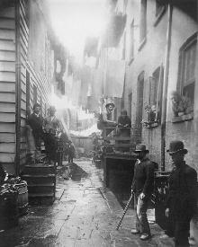
Bandit's Roost, 59 1/2 Mulberry Street c. 1888

Slide 13
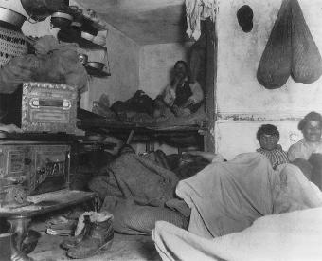
Five Cents Lodging, Bayard Street c. 1889

Slide 14
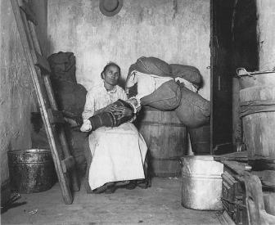
Home of an Italian Ragpicker 1888

Slide 15
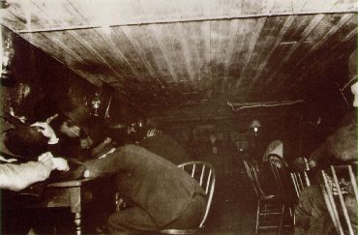
Basement of a Pub in Mulberry-Bend at 3:00 am c. 1890

Slide 16
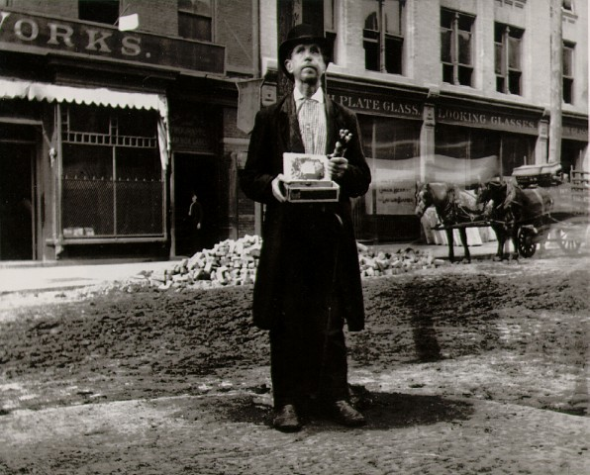
Blind Beggar c. 1890

Slide 17
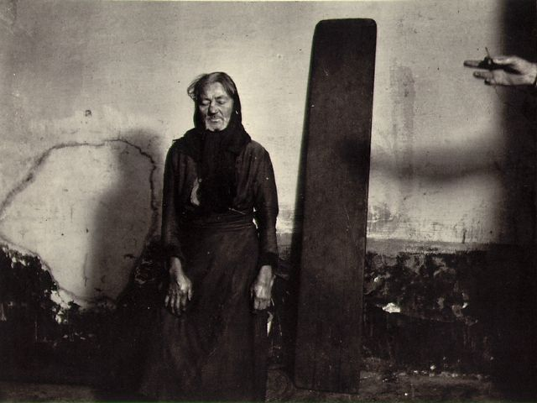
Police Station Lodger, A Plank for a Bed c. 1890

Slide 18
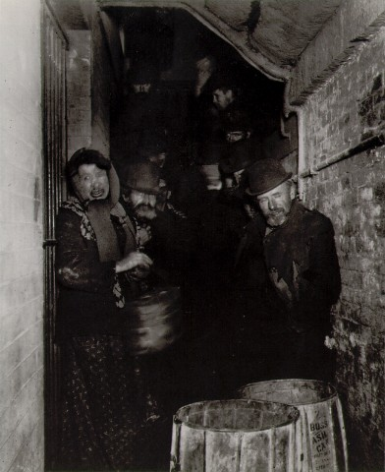
Mulberry Street Police Station Waiting for the Lodging to Open c. 1892

Slide 19
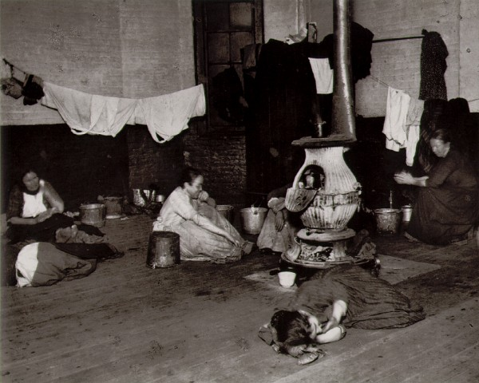
Women's Lodging Room in the West 47th Street Station c. 1892

Slide 20
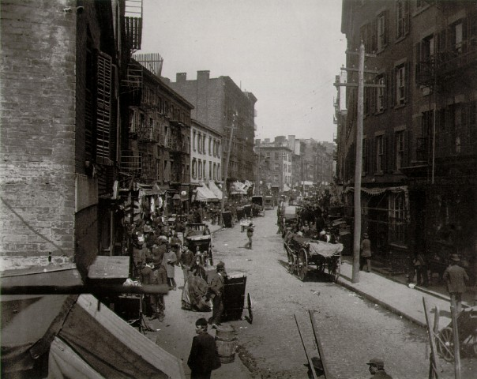
Mulberry Bend c. 1896

Slide 21
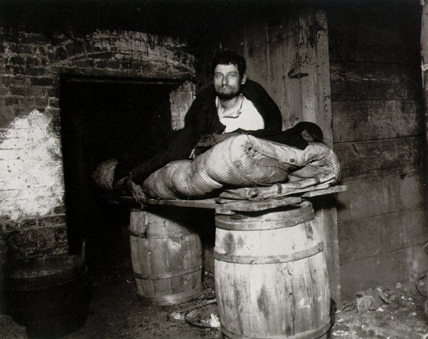
One of Four Peddlers Who Slept in the Cellar of 11 Ludlow Street Rear c. 1892

Slide 22
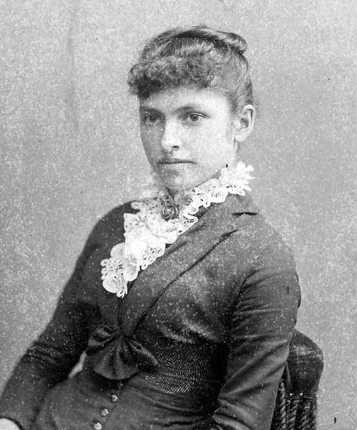
Reforming the Workplace
By the late 19th century, labor unions fought for adult male workers but didn’t advocate enough for women and children.
In 1893, Florence Kelley helped push the Illinois legislature to prohibit child labor and to limit women’s working hours.
In 1904, Kelley helped organize the National Child Labor Committee, which wanted state legislatures to ban child labor.

Slide 23
Child Labor
No regulations
Few public schools
Cotton fields, factories and coal mines
Immigrants
Working class poor, southerners

Slide 24
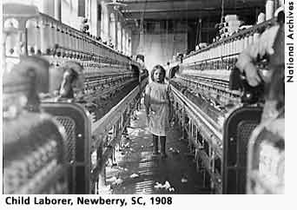
Reforming the Workplace
By 1912, nearly 40 states passed child-labor laws, but states didn’t strictly enforce the laws and many children still worked.
Businesses fought labor laws in the Supreme Court, which ruled on several cases in the early 1900s concerning workday length.

Slide 25
Labor Law in the Supreme Court
Lochner v. New York
1905: The Court refused to uphold a law limiting bakers to a 10-hour workday.
The Court said it denied workers the right to make contracts with their employers.
This was a blow to progressives, as the Court sided with business owners.
Muller v. Oregon
The Court upheld a state law establishing a 10-hour workday for women in laundries and factories.
Louis D. Brandeis was the attorney for the state of Oregon and a future Supreme Court Justice.
He argued that evidence proved long hours harmed women’s health.
Bunting v. Oregon
Brandeis’ case, or the Brandeis brief, as his defense was called, became a model for similar cases.
Using the tactics of its case for women, in Bunting v. Oregon the state led the Court to uphold a law that extended the protection of a 10-hour workday to men working in mills and factories.

Slide 26
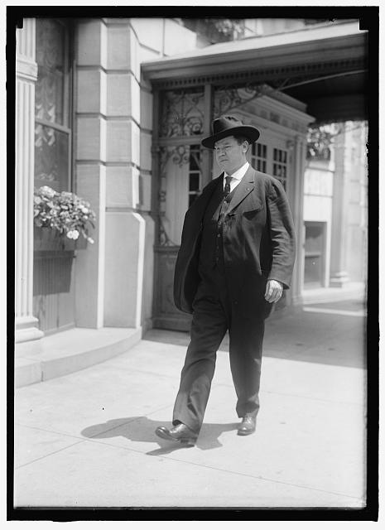
The Unions!..The IWW
By 1912, the IWW led 23,000 textile workers to strike in Massachusetts to protest pay cuts, which ended successfully after six weeks.
However, several IWW strikes were failures, fearing the IWW’s revolutionary goals
formed to oppose capitalism, organizing unskilled workers that the American Federation of Labor ignored
Under William “Big Bill” Haywood, used traditional tactics like strikes and boycotts but also engaged in radical tactics like industrial sabotage.

Slide 27
Activity: Triangle Shirtwaist Fire

Slide 28
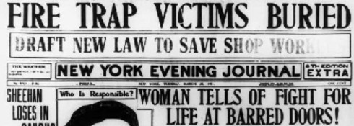
Triangle Shirtwaist Fire
In 1911, a gruesome disaster in New York inspired progressives to fight for safety in the workplace.
doors were locked to prevent theft, the flimsy fire escape broke under pressure, and the fire was too high for fire truck ladders to reach.
New York laws became a model for workplace safety nationwide.

Slide 29
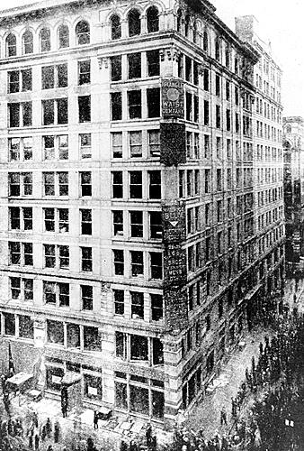
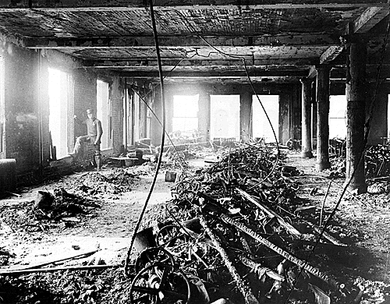

Slide 30
Reform at the State and local level

Slide 31
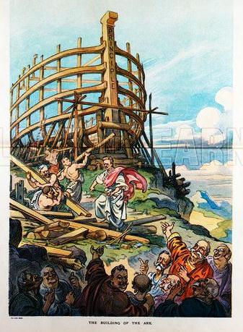
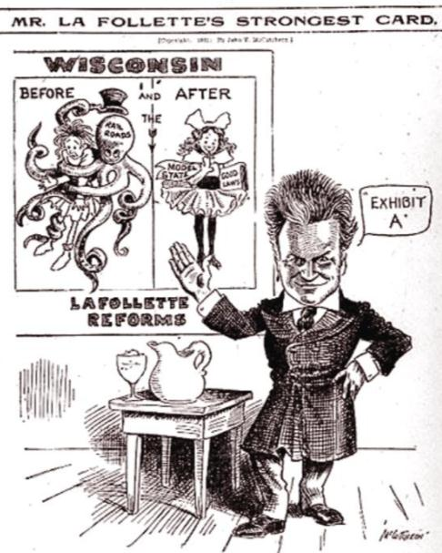
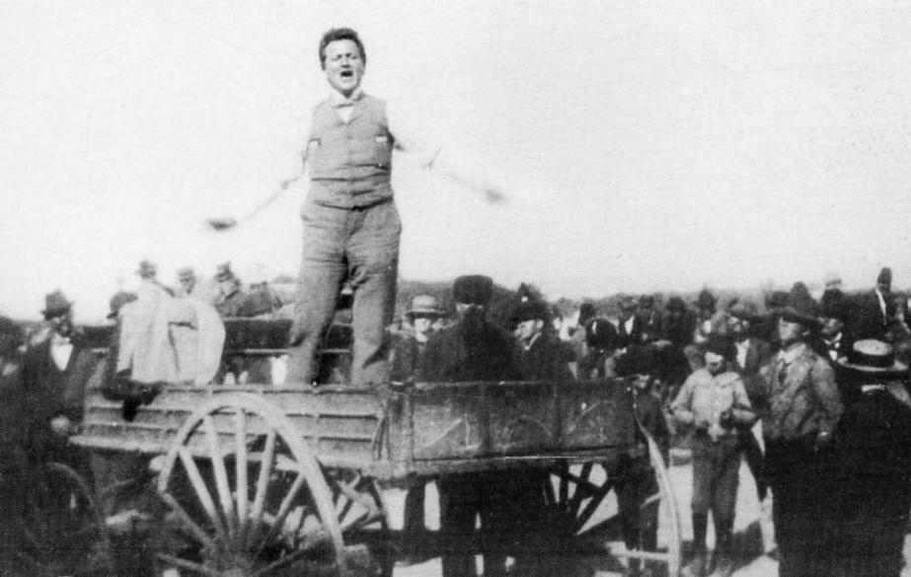
The most significant state reform was governor Robert La Follette’s “Wisconsin Idea”
Wisconsin was the first state to create an income tax, form industrial commissions, and adopt regulations on big businesses
Wisconsin politicians teamed with academic “experts” from the University of Wisconsin to create state laws
La Follette
Wisconsin was a model for other progressive state reforms

Slide 32
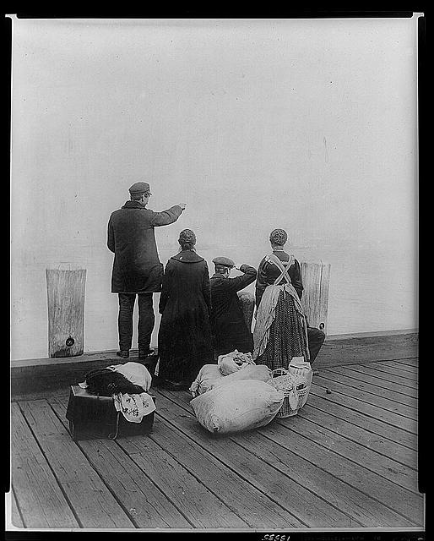
Immigration Review!

Slide 33
Things to Know…
What is old/new immigration?
Why were people immigrating to the United States?
What countries are immigrants coming from?
What is Ellis Island?
What is Angel Island?
What struggles did new immigrants have?

Slide 34
Immigration…
What were the push pull factors of the immigrants to the United States?
Millions of immigrants entered the US in the early 20th centuries wanted a new life or escaping from famine, land shortages or religious or political persecution

Slide 35
Europeans
Between 1820 and 1920 approximately 30 million Europeans arrived in the US. Many left due to religious persecution. Others left because the population increase in Europe caused shortage of land and jobs.
Old Immigration
New Immigration

Slide 36
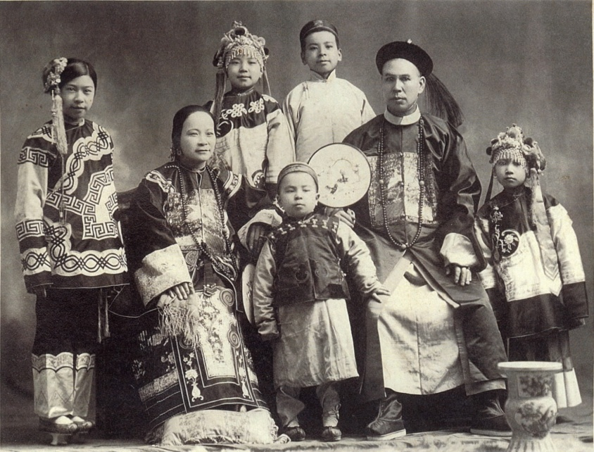
Chinese & Japanese
Between 1851-1883 about 300,000 Chinese arrived in the US. Many came to get rich through gold but most ended up working on the railroads. By 1920 more than 200,000 Japanese lived on the West Coast.

Slide 37
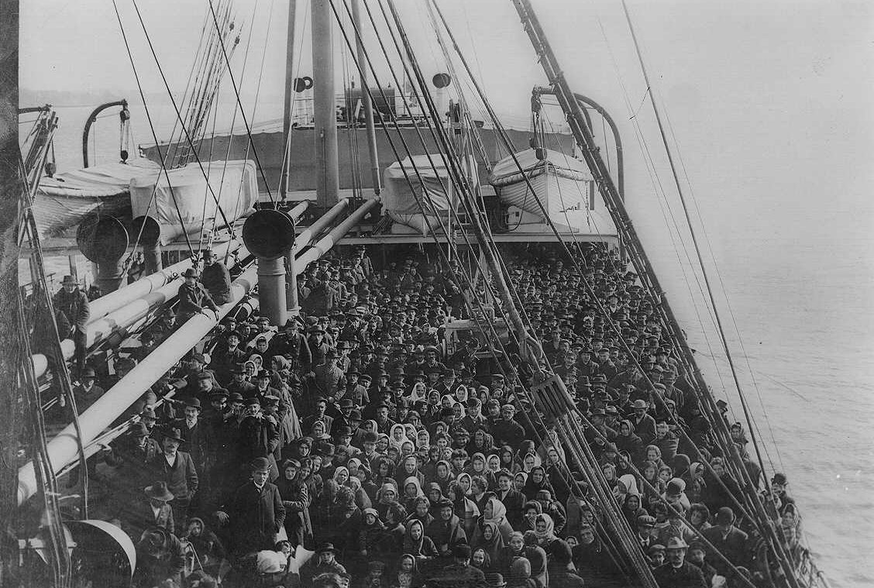
Life in the New Land…
Difficult Journey- most immigrants traveled to US by steamship
Most traveled in steerage, the lowest price accommodations.
They were rarely allowed to go on deck for air or exercise.
They shared louse-infected beds and shared toilets-causing diseases to spread quickly. Many did not survive.

Slide 38
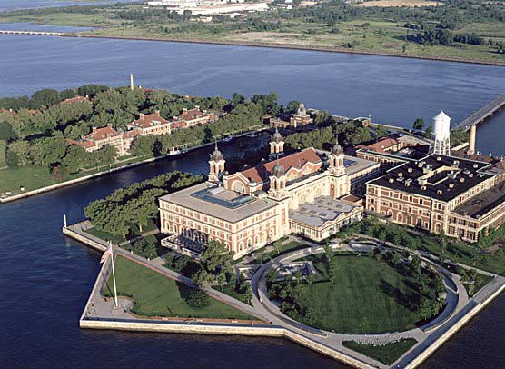
Ellis Island
European immigrants arrived at Ellis Island
On average they were detained 1-2 days before processing
The processing took more than 5 hours.
There was doctors examinations, government inspection and had to prove they could work and hadn’t been convicted of a felony

Slide 39
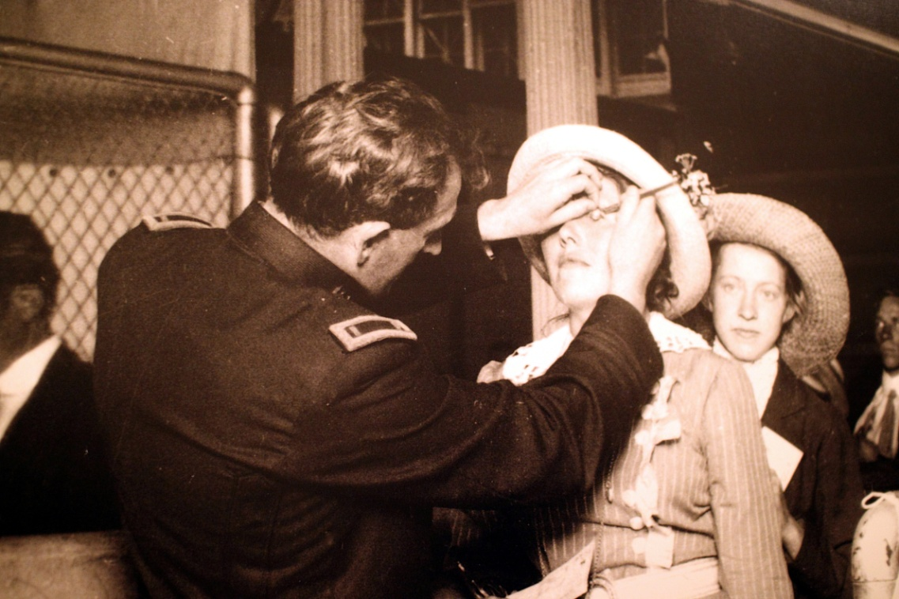
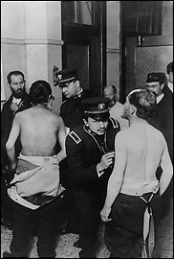
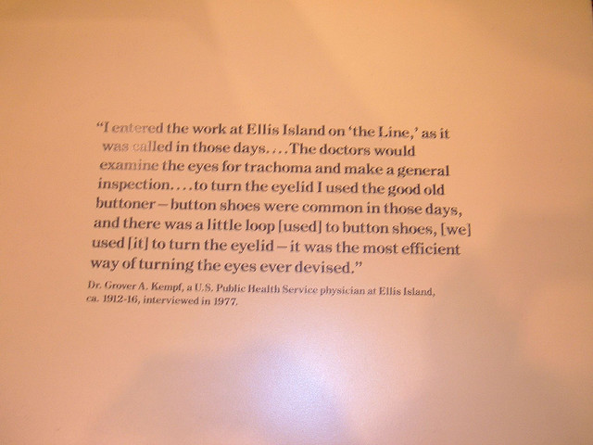
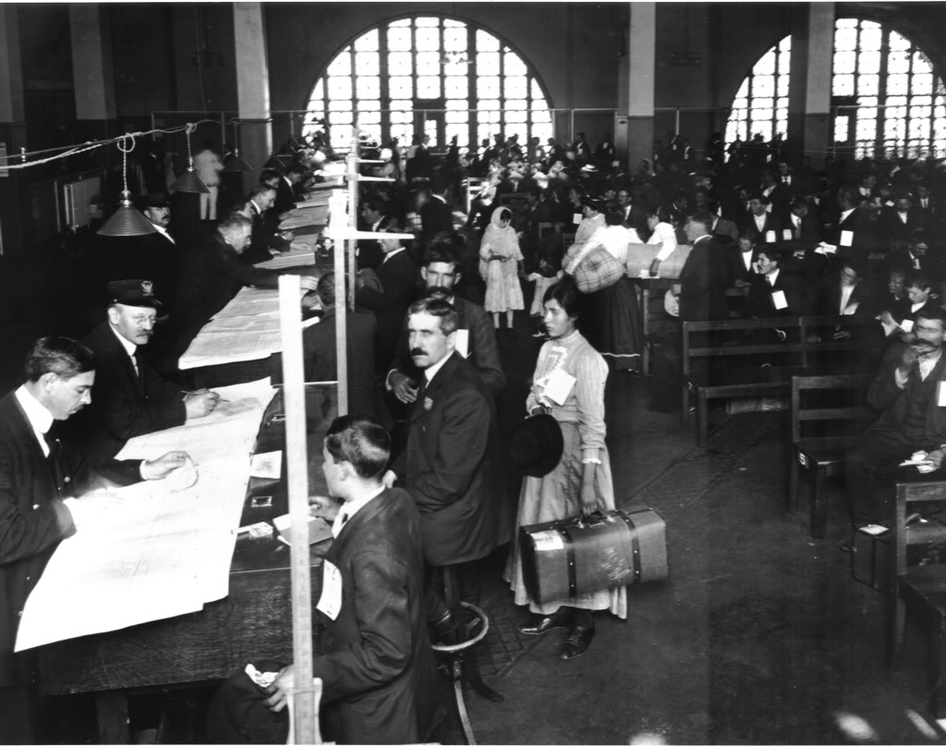

Slide 40
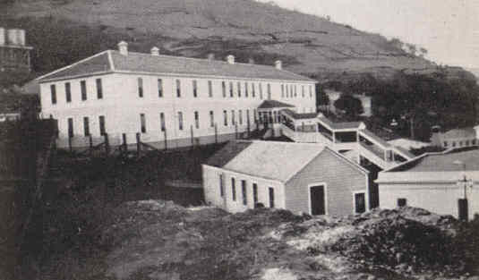
Angel Island
Asian Immigrants (most Chinese) arrived at Angel Island in San Francisco Bay.
Between 1910-1940 about 50,000 Chinese came through at Angel Island.
Immigrants endured harsh questioning and long stays in filthy ramshackle buildings.

Slide 41
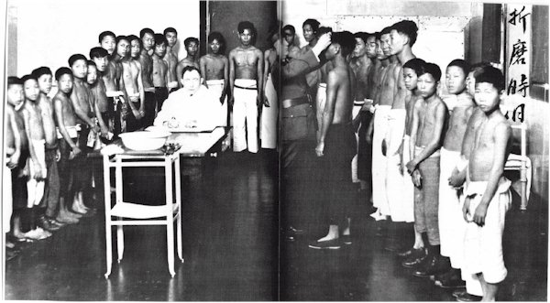
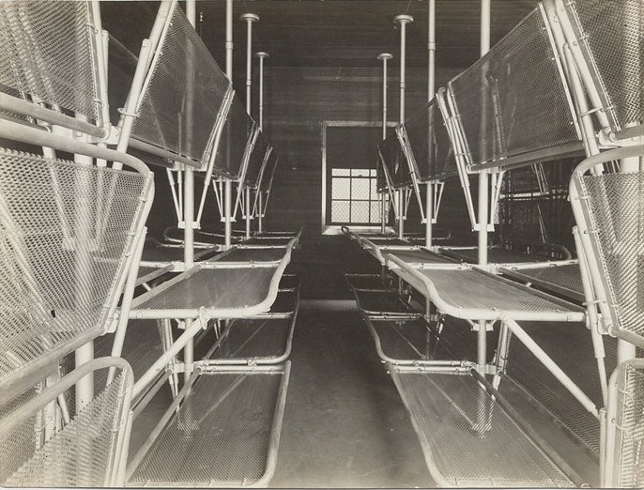
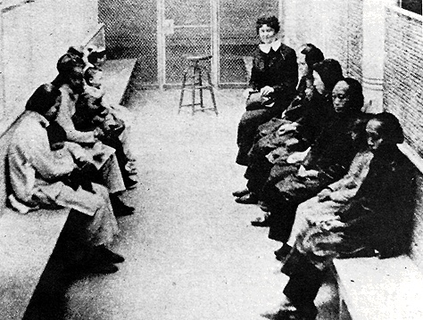

Slide 42
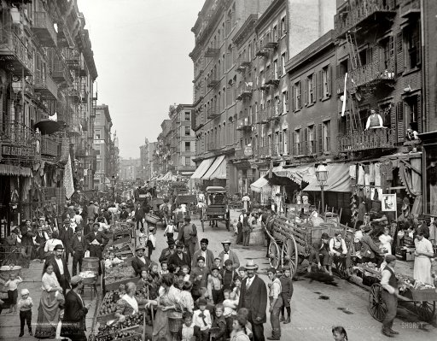
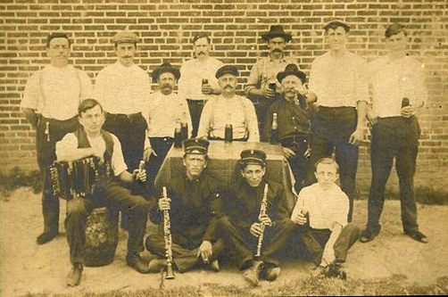
Settled in Cities
Little Italy, NYC
Majority of Immigrants (except Asians) settled in large cities of the Northeast and Midwest.
Immigrants frequently ghettoized themselves, settling in ethnically solid neighborhoods that persist to the present day.
Immigrants went to the cities because rent was low and there were unskilled jobs
Polish Immigrants in Fishtown, Philadelphia

Slide 43
Immigration Restrictions
Americanization movement was designed to assimilate people of wide-ranging cultures into the dominant culture.
Churches and schools taught immigrants to read English, US History & Government.
The Rise of Nativism-Many native born Americans thought that US was a melting pot-a mixture of people who blended together and give up their native languages & customs. Nativism led to the growth of immigration restrictions.

Slide 44
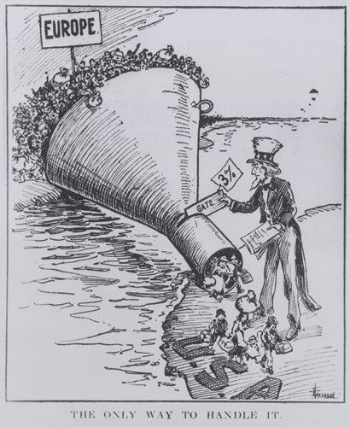
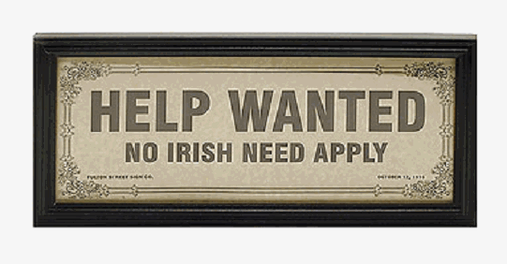

Slide 45
Immigration Restrictions
Anti-Asian Sentiment-Nativism took hold in the labor movement. People (especially in the West) believed that their jobs would go to Chinese immigrants.
In 1882 Congress passed the Chinese Exclusion Act- banned entry to all Chinese except students, teachers, merchants, tourists & government officials for ten years.
Gentlemen’s Agreement- anti-Chinese feelings spread to Japanese & other Asian immigrants. The Gentlemen’s Agreement-from 1907-1908 Japan’s government agreed to limited the immigration of unskilled workers and US .

Slide 46
Alleviate social problems…
The Settlement House Movement-Social Gospel Movement preached salvation through service to the poor.
Settlement houses-community centers in slum neighborhoods. Coping with the problems of the cities, especially in poorer areas, was beyond the ability of city governments and of churches.
They offered education and training, including English language
The most famous of these workers Jane Addams, whose Hull House in Chicago offered an education to anyone who lived in the slums.

Slide 47
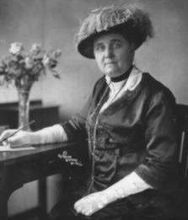
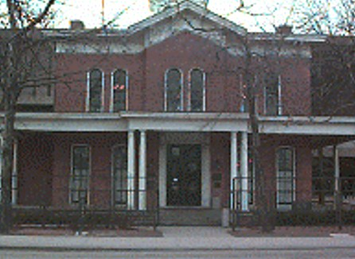
Jane Addams…

Slide 48
Woman Suffrage Movement
National American Woman Suffrage Association (NAWSA) established a wide base of political support though lobbying and gracious, ladylike behavior.
The National Woman’s Party picketed the White House, staged demonstrations and put down the government.
The uniting efforts of these groups and patriotic women during WWI created overwhelming support from congress to pass the 19th Amendment, granting women the right to vote in 1920.

Slide 49
The Progressive Presidents
And reform…

Slide 50
Activity- Chapter 28 and 29 (679-685)
 | Teddy Roosevelt | William Howard Taft | Woodrow Wilson
Background (jobs before President)
View of Office (how should government address social ills?)
View of Business( Trusts-good? Bad? Indifferent?)
Legislation (what was passed during term)
Conservation (how did they support the environment?)
1912 Election (which party? Platform?)

Slide 51
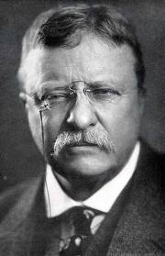
Theodore Roosevelt

Slide 52
Teddy Roosevelt
sickly, shy youth whom doctors forbade to play sports or do strenuous activities.
In his teenage years, Roosevelt reinvented himself, taking up sports and becoming vigorous, outgoing, and optimistic.
Roosevelt came from a prominent New York family and attended Harvard University, but he grew to love the outdoors.
He spent time in northern Maine and in the rugged Badlands of North Dakota, riding horses and hunting buffalo.
In 1884, when Roosevelt was 26, both his mother and his young wife died unexpectedly.
Trying to forget his grief, he returned to his ranch in Dakota Territory, where he lived and worked with cowboys.
He returned to New York after two years and entered politics.

Slide 53
View of the Presidency
From Governor to Vice President
Roosevelt’s rise to governor of New York upset the Republican political machine.
To get rid of the progressive Roosevelt, party bosses got him elected as vice president, a position with little power at that time.
President William McKinley was shot and killed in 1901, leaving the office to Roosevelt.
At 42 years old he was the youngest president and an avid reformer.
Unlikely
President
Roosevelt saw the presidency as a bully pulpit, or a platform to publicize important issues and seek support for his policies on reform.
View of Office

Slide 54
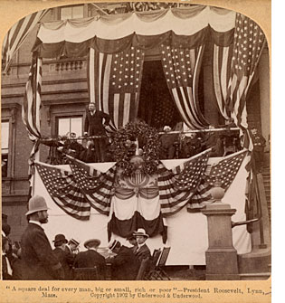
The Square Deal
became campaign slogan and the framework for his entire presidency.
promised to “see that each is given a square deal, because he is entitled to no more and should receive no less.”
promise revealed his belief that the needs of workers, business, and consumers should be balanced.
called for limiting the power of trusts, promoting public health and safety, and improving working conditions.

Slide 55
Dismay Over Food and Drug Practices
Food
Food producers used clever tricks to pass off tainted foods:
Dairies churned fresh milk into spoiled butter.
Poultry sellers added formaldehyde, which is used to embalm dead bodies, to old eggs to hide their smell.
Unwary customers bought the tainted food thinking it was healthy.
Drugs
Drug companies were also unconcerned for customer health:
Some sold medicines that didn’t work.
Some marketed nonprescription medicines containing narcotics.

Slide 56
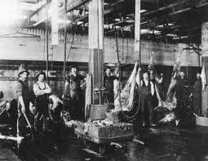
Consumer Reform
Muckrakers like Upton Sinclair ( The Jungle) exposed the lack of state/federal regulation for consumer safety.
http://www.fda.gov/default.htm
Meat Inspection Act- gave the department of agriculture the power to check and regulate meat shipped
Pure Food and Drug Act- took steps toward banning badly prepared food and dangerous drugs.

Slide 57
The Jungle…
Mikolas] is a beef-boner, and that is a dangerous trade[….] Your hands are slippery, and your knife is slippery, and you are toiling like mad, when somebody happens to speak to you, or you strike a bone. Then your hand slips up on the blade and there is a fearful gash. And that would not be so bad, only for the deadly contagion. The cut may heal, but you can never tell. Twice now, within the last three years, Mikolas has been lying at home with blood-poisoning—once for three months and once for nearly seven. The last time, too, he lost his job, which means six weeks more of standing at the doors of the packing-houses, at six o’clock on bitter winter mornings, with a foot of snow on the ground and more in the air. There are learned people who can tell you out of the statistics that beef-boners make forty cents an hour, but, perhaps, these people have never looked into a beef-boner’s hands.

Slide 58
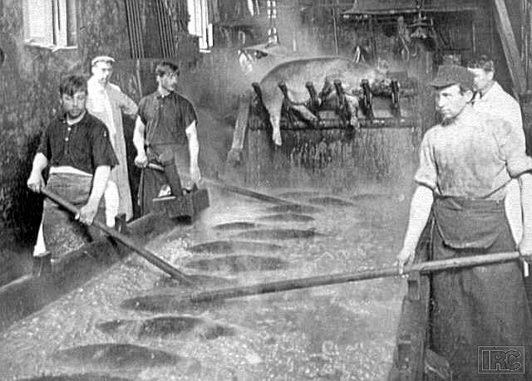
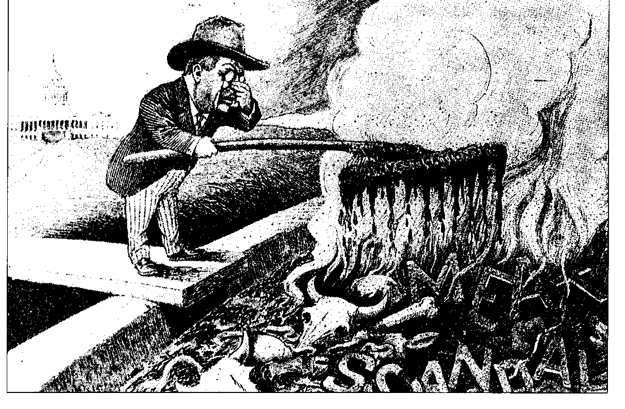

Slide 59
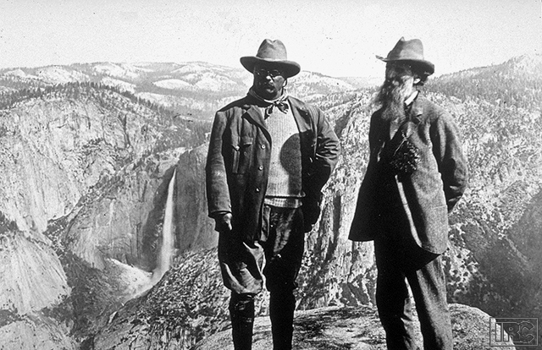
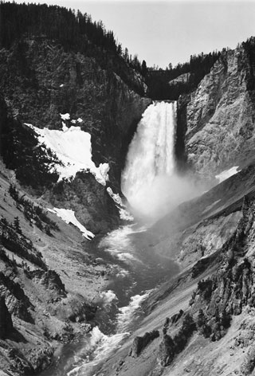
Environmental Reforms
Newlands Reclamation Act 1902 set aside proceeds from the sale of public lands for irrigation projects in the West when the projects were larger than the states could handle
Led to National Park Service- set aside government to establish a system of national parks. (under Wilson)

Slide 60
Trusts and Monopolies…
A trust was an arrangement by which stockholders in several companies transferred their shares to a single set of trustees.
In exchange, the stockholders received a certificate entitling them to a specified share of the consolidated earnings of the jointly managed companies.
The trusts came to dominate a number of major industries, and were, in effect, monopolies.
A monopoly is a situation in which there is a single supplier or seller of a good or service for which there are no close substitutes

Slide 61
Regulating Big Business
believed big business was essential to the nation’s growth but also believed companies should behave responsibly.
spent a great deal of attention on regulating corporations, determined that they should serve the public interest.
In 1901, when three tycoons joined their railroad companies together to eliminate competition, their company, the Northern Securities Company, dominated rail shipping from Chicago to the Northwest.
Roosevelt directed the U.S. attorney general to sue the company for violating the Sherman Antitrust Act

Slide 62
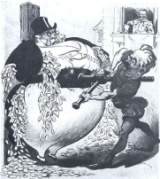
The Trust Buster!
Elkins Act- Railroad companies must publish rates.
Hepburn Act-Allowed government to regulate railroad rates.

Slide 63
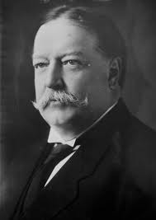
William Howard Taft

Slide 64
The Main Idea
Progressive reforms continued during the Taft and Wilson presidencies focusing on business, banking, and women’s suffrage.

Slide 65
Progressivism under Taft
President Roosevelt didn’t run for a third term, instead supporting William Howard Taft, a friend and advisor who, despite a more cautious view on reform, pledged loyalty to the Roosevelt program.
Upon his election, Taft worked to secure Roosevelt’s reforms rather than build upon them.
Taft worked to secure several reforms, such as creating a Labor Department to enforce labor laws and increasing national forest reserves.
Taft’s administration is also credited with the passage of the Sixteenth Amendment, which granted Congress the power to levy taxes based on individual income.

Slide 66
Election Reforms
Progressives wanted fairer elections and to make politicians more accountable to voters.
Proposed a direct primary, or an election in which voters choose candidates to run in a general election, which most states adopted.
Backed the Seventeenth Amendment, which gave voters, not state legislatures, the power to elect their U.S. senators.
Some measures Progressives fought for include
Direct primary: voters select a party’s candidate for public office | 17th Amendment: voters elect their senators directly | secret ballot: people vote privately without fear of coercion
initiative: allows citizens to propose new laws | referendum: allows citizens to vote on a proposed or existing law | recall: allows voters to remove an elected official from office

Slide 67
Trouble in Taft’s Presidency
President Taft lost the support of most of the Progressive Republicans, despite the reforms he helped secure.
Tariff Trouble
In April 1909, Congress passed a bill on tariffs, or taxes charged on import and export goods.
The House passed a version that lowered tariffs on imports, but the Senate added so many amendments that it became a high-tariff bill instead.
Taft nevertheless signed the Payne-Aldrich Tariff into law.
Conservation Trouble
1910: Secretary of the Interior Richard Ballinger let business leaders illegally buy millions of acres of protected public land in Alaska.
When Gifford Pinchot, head of the U.S. Forest Service, accused Ballinger, Taft fired Pinchot, not Ballinger.
Progressives thought this showed Taft was not committed to conservation, and Roosevelt refused to support Taft from that point on.

Slide 68
The Republican Party Splits
In the 1910 congressional elections, Roosevelt campaigned for the Progressive Republican who opposed Taft.
Roosevelt proposed a program called the New Nationalism, a set of laws to protect workers, ensure public health, and regulate business.
Reformers loved the New Nationalism, but Roosevelt’s help wasn’t enough to secure a Republican victory.
Republicans lost control of the House of Representatives for the first time in 16 years.
By the presidential election of 1912, the Republican Party was split.
The Republican party nominated President Taft as its candidate, outraging Progressive Republicans.
The Progressives split to form their own party, the New Progressive (“Bull Moose”) Party, with Roosevelt as its candidate.
With the Republicans split, Democrat Woodrow Wilson easily took the election, receiving almost 350 more electoral votes than Roosevelt and over 400 more than Taft.

Slide 70
Woodrow Wilson

Slide 71
Woodrow Wilson
Southerner
New Jersey, Princeton
Elected 1912 & 1916

Slide 72
Woodrow Wilson & Progressivism
Progressive ideas that differ from Roosevelt
Wilson believed that trusts should be broken up instead of regulated by the government.
He didn’t think government should get bigger; he thought business should be made smaller. “New Freedom”

Slide 73
Clayton Antitrust Act of 1914
Sought to strengthen Sherman Antitrust Act of 1890.
Made certain business practices illegal.
A corporation could no longer acquire the stock of another corporation if it created a monopoly.
If a company violated the law, its officers could be prosecuted.

Slide 74
Federal Trade Act of 1914
Set up the Federal Trade Commission (FTC)
Help investigate and regulate business practices
Help to shut down unfair business competition and unfair business practices, such as inaccurate labeling.
FTC handed down 400 cease and desist orders during Wilson’s administration.

Slide 75
Tax During Wilson’s Administration
By 1917 the government gained more money from income tax than it had ever gained from tariffs.
Wilson cut tariff rates from 40% to under 30%
Ratified 16th Amendment, which legalized a federal income tax.
The graduated tax ranged from 1% on incomes over 4,000 to 6% on incomes over 500,000.

Slide 76
Federal Reserve System
Wilson established the Federal Reserve Banking system to regulate credit availability and money supply.
He created 12 regional districts with federal banks where national and state banks could become members.
The Federal Reserve Banks could regulate money supply and print money in emergency situations.

Slide 77
Social and Environmental Reform
18th Amendment- illegal to sale, manufacture or buy alcohol.
19th Amendment- women granted the right to vote
National Parks Service Act

