Slide 1
Period 5
1844-1877: The Civil War and Reconstruction Era

Slide 2
Northern vs Southern Society
Compromise of 1850Compromise of 1850
Compromise of 1850Compromise of 1850

Slide 3
Influential African Americans
Frederick Douglas- escaped slave, gained fame as a gifted writer, speaker and advocate of freedom and equality (published newspaper- The North Star and wrote, Narrative of the Life of Frederick Douglas= Great American autobiographies
Harriet Tubman- escaped slave, but returned to south to help more than 300 slaves escape via the underground railroad
Sojourner Truth- charismatic speaker who campaigned for emancipation and women’s rights
Abolitionists determination and the South’s inflexibility pushed the issue of slavery into the political spotlight

Slide 4
Manifest Destiny Treemap
Examples of America Practicing Manifest Destiny
Maine
Mexico/Texas
California
Oregon

Slide 5
Wilmot Proviso
Congressional bill prohibiting the extension of slavery into any territory gained from Mexico
Shows sectionalism- Northerners feared new states in west would become slave states
Bill defeated in Congress by vote on sectional lines- North in favor/ South against (all but 2)
Emergence of Free Soil Party- a regional, single issue party devoted to the goals of Wilmot Proviso- wanted to keep the western soil free for white men.

Slide 6
Free Soil Party
Collection of anti-slave Whigs and “Barnburners” – discontented northern Democrats (as opposed to “Fire-eaters”- pro-slavery Southern Democrats)
They did not oppose slavery just on moral grounds. They also said that it destroyed the chances of free white workers from rising up from wage-earning dependence to the esteemed status of self-employment.
Only way to achieve this upward mobility was to have free soil out west for white settlers
Competing with slave labor meant lower wages for whites and the inability to have social mobility and to own property.

Slide 7
Mexico Conflict
Treaty of Guadalupe-Hidalgo ends Mexican American War
Sets Rio Grand as boundary between US and Mexico
US received Mexican territory from Texas to the Pacific (modern Southwest: Arizona, New Mexico, California, Nevada & Utah), and the US paid Mexico $15 million for the land. =Mexican Cession

Slide 8
Compromise of 1850
Settlers flooded California (Why?) and wanted statehood, created a state constitution that prohibited slavery
Originally created by Stephen Douglas (not the African American) and Henry Clay
Compromise of 1850
Admitted California as a free state
Stronger Fugitive Slave Law
Utah and New Mexico would get popular sovereignty
Abolished the slave trade in Washington DC (but not slavery itself)

Slide 9
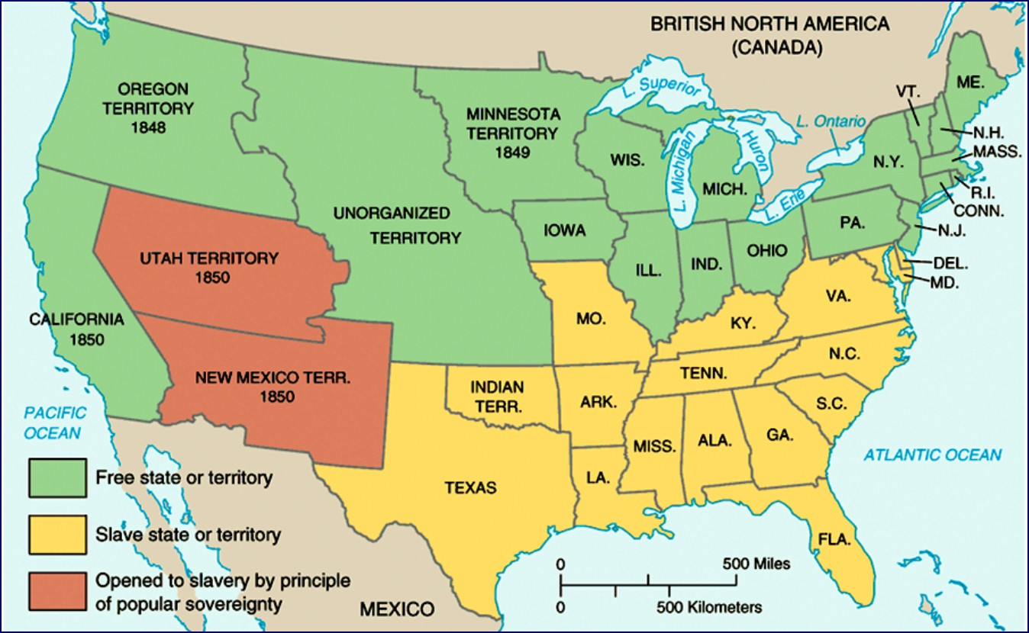
Compromise of 1850

Slide 10
Popular Sovereignty
Was left up to territories to decide the slave issue when they wrote the state constitution
Positives:
Was in line with democratic tradition of self-determination
Politicians liked it because it was a pseudo compromise between free-soilers demands for abolition in the territories and also the South’s plea to Congress to allow slavery.
It put the issue of slavery in the hands of the people and removed the government
Negatives:
Most important issue of the day turned into a local issue and not a national issue
Most importantly, the possibility that slavery spread and expanded

Slide 11
Fugitive Slave Law of 1850
Known as the Bloodhound Bill
Fleeing slaves could not testify on their own behalf
Denied trail by jury
Federal commissioner who handled case got 5 dollars if runaway was freed and 10 dollars if they were not
Northerners who aided a runaway slave were subject to heavy fines and jail sentences

Slide 12
Fugitive Slave Law of 1850
North was so outraged at the law that it caused many moderates to turn to the abolitionist movement.
“We went to bed one night old-fashioned, conservative, Compromise Union Whigs and waked up stark mad abolitionists.”
Massachusetts made it a penal offence if any official tried to enforce the new fugitive slave law.
Slave law was bad overall for the South. North became more pro-abolition and they never enforced the law. So South did not gain anything from the compromise.

Slide 13
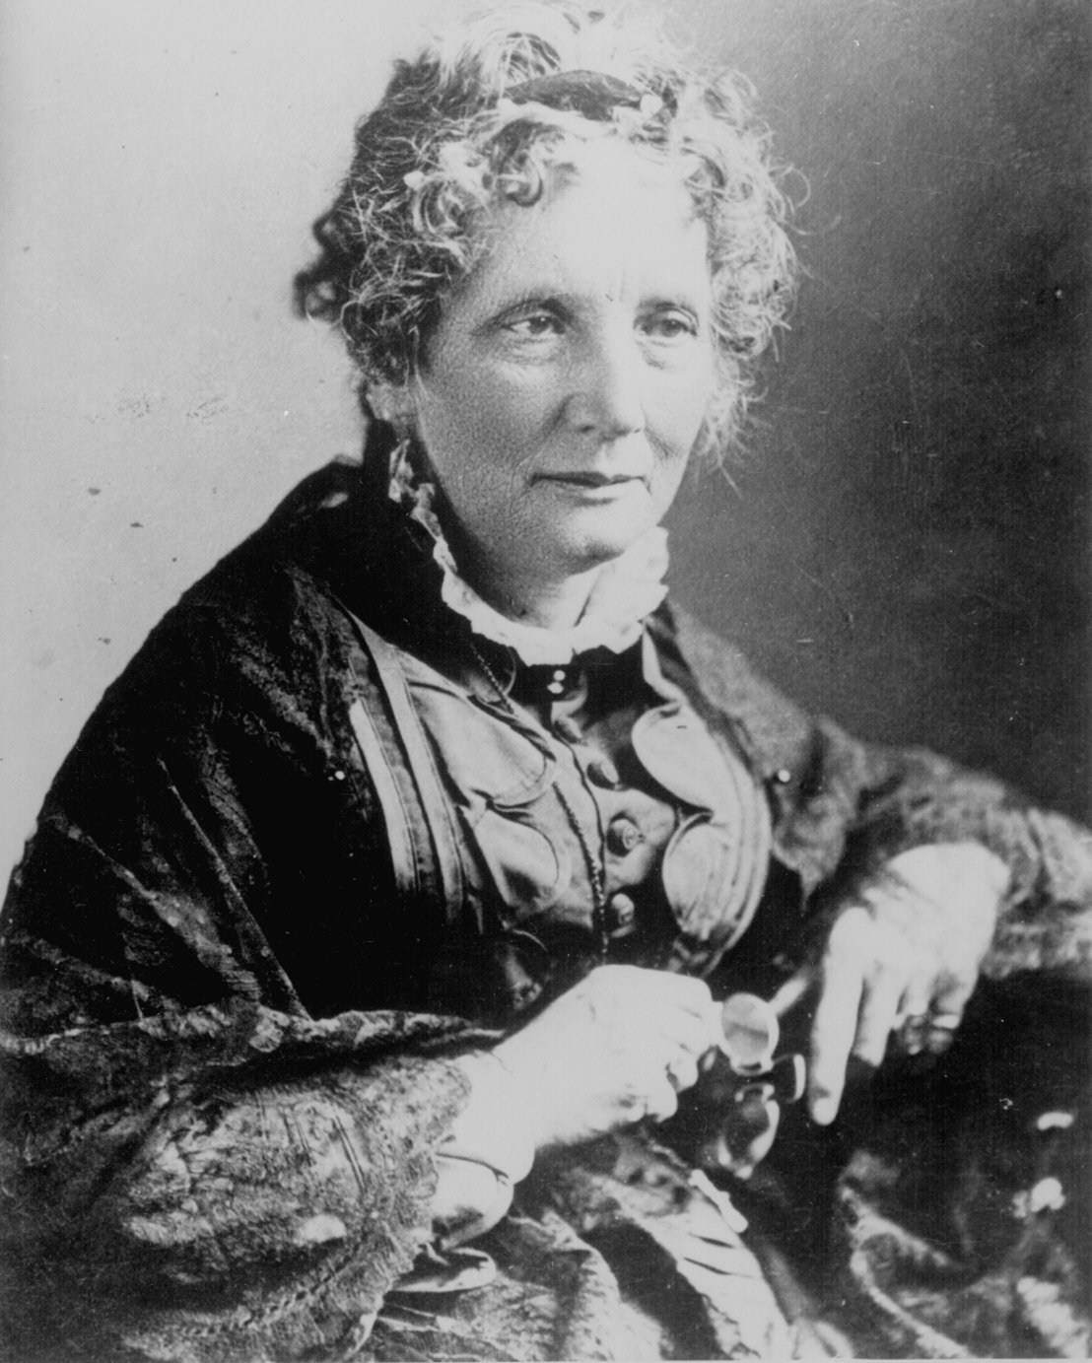
Harriet Beecher Stowe
“So this is the lady who started the Civil War.” -- Abraham Lincoln

Slide 14
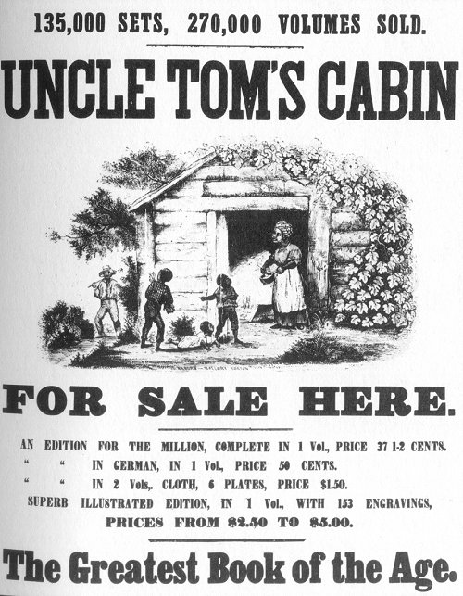
Uncle Tom’s Cabin (1852)
Sold 300,000 copies in the first year.
2 million in a decade
Antislavery sentiments in North grew stronger
Damning depictions of plantation life on information provided her by abolitionist friends
Extremely powerful piece of propaganda- awakens people who never gave issue much thought

Slide 15
Averting Sectionalism
Compromises or Agreements to forestall Division of the Union
3/5’s comp
Great comp
Ban international slave trade
Mo comp
Nullification
Gag rule
Admitting Texas
Comp 1850
Pop sov- K/N Act
Dred Scott
Critten Comp
3/5 comp
Great Comp
Mo. Comp
Nullification- comp bill
K/N Act
Comp 1850
Dred Scott
Critten Adm
You may need more braches than are here.

Slide 16
Kansas-Nebraska Act
Settlers entering Kansas and Nebraska territories found no established civil authority (why is this important?)
Replaces the Missouri Compromise with the idea of popular sovereignty
Both abolitionists and proslavery groups rushed into the territories so that they could form governments and win the future states for there sides
Just prior to election for Kansas’s legislature, thousands of Missourians relocate to Kansas =Border Ruffians
Gangs from both sides of slavery issue roam the territory attacking the opposition leading to more than 200 people dead. =Bleeding or Bloody Kansas

Slide 17
John Brown
Led a raid on a proslavery camp murdering 5 and starting the violence that becomes Bloody Kansas
Attacked Haper’s Ferry- led a slave revolt on Haper’s Ferry to attain weapons, but attack fails and Brown is excuted for his actions
He will become loved in the North, but hated in the South

Slide 18
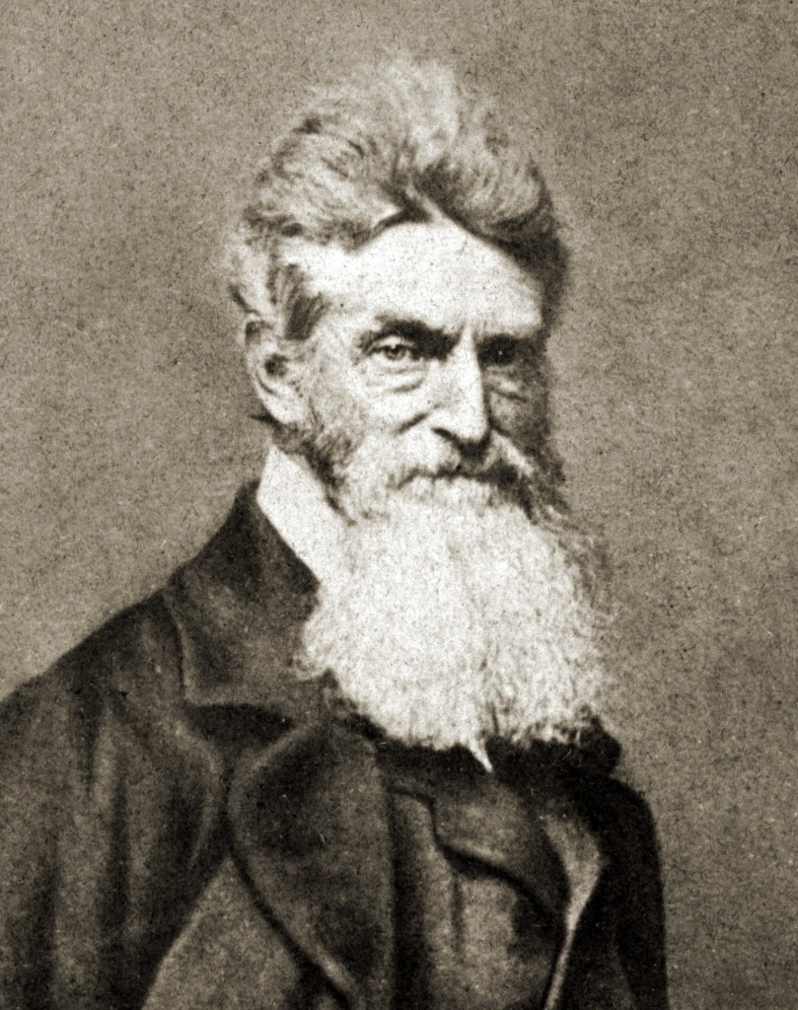
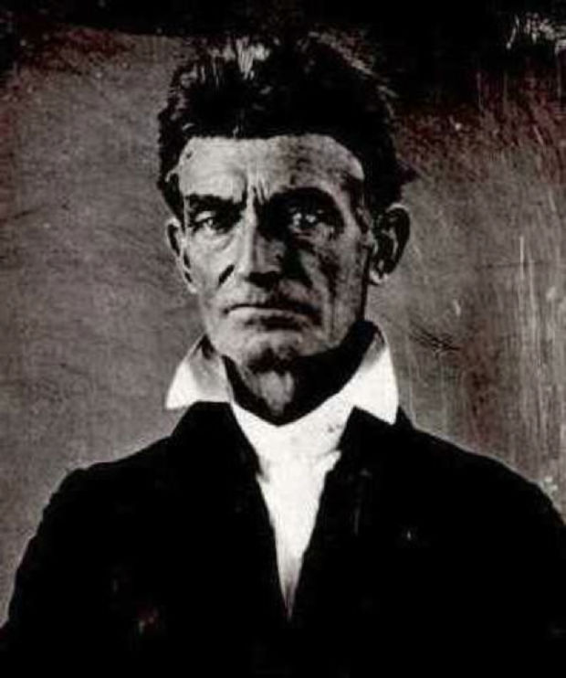
John Brown Martyr or Crazy?

Slide 19
Lincoln/ Douglas Debates
Over a Senate seat
Stephen Douglas viewed as leading Democrat in US Senate
Lincoln gained fame as a Whig opposed to the Mexican War and K/N Act
Lincoln delivers his famous house divided speech (“this nation cannot exist permanently half slave and half free)
Douglas destroys his political career over defending popular sovereignty (becomes known as Freeport Doctrine- slavery cannot exist where local laws did not protect it… vote of the people)
Lincoln loses the election for the Senate seat to Douglas

Slide 20
Rise of the Republicans
Kansas/Nebraska Act ends the Whig party
Anit-slavery Whigs + Northern Democrats + Free-Soilers= Republican Party
Republicans dedicated to keeping slavery out of the territories, development of national roads, liberal distribution of Western land, and protective tariffs
Grew quickly in the North (Why/ Reason?)

Slide 21
Election of Abraham Lincoln
From humble beginnings
Democratic party split over issue of slavery
North voted for Douglas, South for Breckinridge
Lincoln wins based off the split and his overwhelming support in the North
Three months before Lincoln’s inauguration, South Carolina seceded from the Union- next few months 6 more seceded and form Confederate States of America
Jefferson Davis becomes CSA President

Slide 22
Start of the Civil War
Lincoln will maintain control of federal forts in the south after succession
The Confederacy will attack Fort Sumter in April,1861 and officially start the Civil War
Missouri, Kentucky, Maryland and Delaware were slave states that fought for and remained loyal to the Union
Northerners fought to preserve the Union
Southerners fought for their States’ rights to govern themselves and maintain their way of life

Slide 23
Important Generals
North
Ulysses S. Grant
AKA The Butcher
Wins the war at the cost of his Men
William Sherman
Sherman’s march to the sea, he will travel down through the south and burn towns and fields as he goes
South
Robert E. Lee
Best general of the war
Respected by both north and south
Stonewall Jackson
Well respected general by his men
Killed during battle at Vicksburg, Lee will say that the southern army never got over his loss

Slide 24
Important Battles
Anaconda War strategy- North will try to encircle the South slowly cutting off their supplies
Gettysburg- Turning point of the war, Northern victory and they will go on the offensive, South never gets back on Northern soil
Antietam- Bloodiest single day of war ever for the US
The loss of Southern troops and the strength the North showed prevented the British and French governments from helping the South
Lincoln used the opportunity to launch the Emancipation Proclamation

Slide 25
Lincoln During the War
Found that the Civil War required active and prompt presidential action
Lincoln suspended the writ of habeas corpus
Took away protections of unlawful imprisonment
He will issue the Emancipation Proclamation as a war necessity because constitutionality it would be questioned
Federal officials ordered the suspension of certain newspapers and arrested editors
WHAT DOES THIS SHOW? –Be able to answer

