Slide 1
APUSH Period 2
1607 - 1754

Slide 2
Spain, French, & Dutch
“Spanish, French, Dutch, and British colonizers had different economic and imperial goals involving land and labor that shaped the social and political development of their colonies as well as their relationships with native populations.”
Spain established strict control over colonization and converted and exploited many natives
  A major goal of Spain was to make $
    All trade must go through a few Spanish controlled ports
  Small amount of Spaniards ruled indigenous population
  Spain sought to convert natives to Christianity, forced many into the encomienda system, and used as trading partners
French and Dutch colonization:
  Both countries sent few Europeans and built relationships with the Natives
  French – intermarried with natives and built extensive trading partnerships
    Coureurs de bois – French fur traders – trade beaver furs; would live among natives
  Dutch – Like the French, the Dutch build extensive trade routes – mostly in NY
    Encouraged settlement of the New World – New Netherland

Slide 3
England
C)English Colonization:
  Large number of immigrants
    Both male and female – unlike other European countries
      Sought economic prosperity, religious freedom (Puritans), and better living conditions (England was overcrowded)
      English colonies also welcome immigrants from other countries
    Colonies were based on agriculture
      Tobacco became a large cash crop
      Headright system encouraged immigrants – benefitted the wealthy
  Unlike the French and Spanish, English colonists sought to live separately from Native Americans
    Conflicts with natives – Powhatans, Bacon’s Rebellion, Pequot War, King Philip’s War

Slide 4
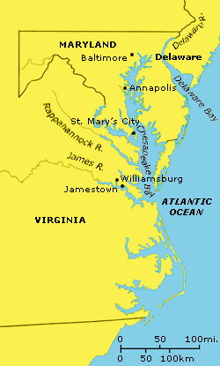
Atlantic Coast
“In the 17th century, early British colonies developed along the Atlantic coast, with regional differences that reflected various environmental, economic, cultural, and demographic factors.”
Chesapeake colonies (MD and VA) and North Carolina:
  Relied heavily on tobacco – plantations developed – long work days and growing seasons
  Exhausted land (because of Tabaco) – led to expansion and conflicts with natives
  Up to the late 17th century, most labor was made up of indentured servants
  After Bacon’s Rebellion (1676), there was a switch to African slavery

Slide 5
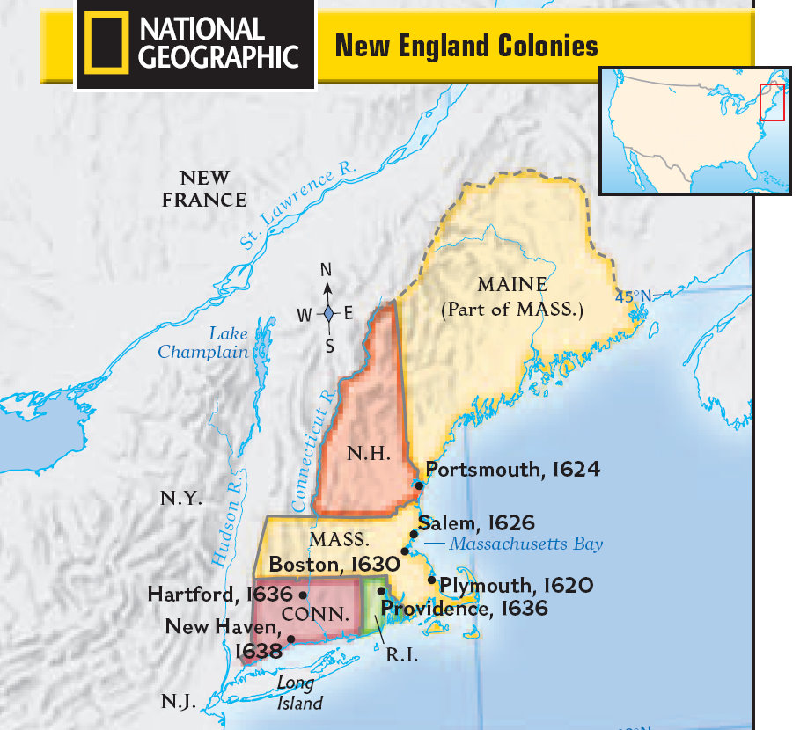
Northern Colonies
New England colonies:
  Established by Puritans (wanted to purify the Anglican Church – John Winthrop)
  Established small towns with small farms
    Schools were established for towns with 50 families; extended families were common
  Some agriculture, fishing, commerce – Boston becomes a major port city
  Colder climate, rocky terrain did not allow large plantations

Slide 6
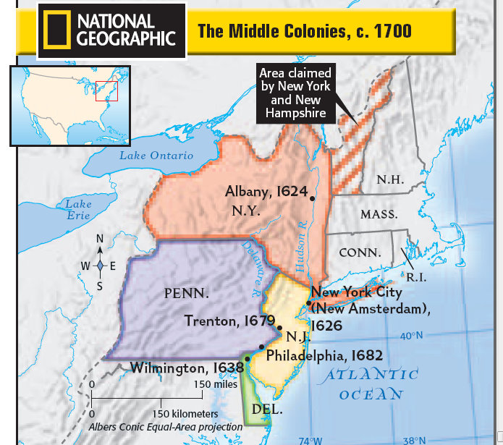
Middle Colonies
Middle Colonies:
  Tended to be the most diverse demographically, religiously, and ethnically
    Quakers in Pennsylvania (William Penn) – religiously tolerant
    Women in Pennsylvania had more rights – Quakers allowed women equal positions in church
    Immigrants from Germany
  Economy was based on the exportation of cereal crops - wheat

Slide 7
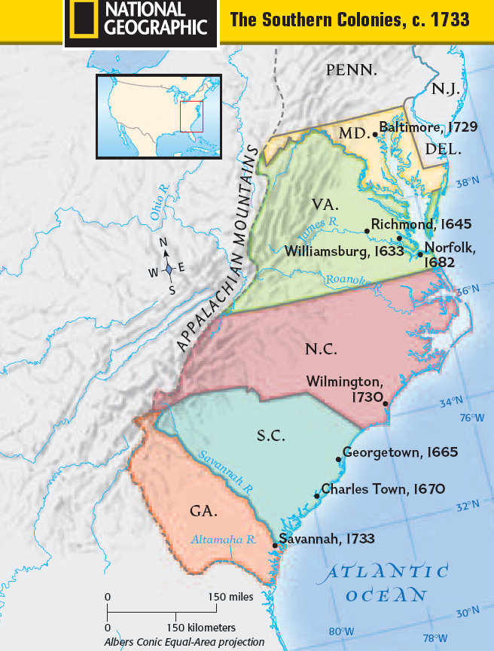
Southern Colonies
D) Southern colonies and West Indies:
  In South Carolina and Georgia, rice was a major staple crop
    Very arduous labor – long days and long growing season
    Many white laborers refused to work in rice fields – led to an increase in slave labor
  In the West Indies (Barbados) sugar cultivation was a major part of the economy
    Like South Carolina and Georgia, slave labor was heavily used
  In many instances, slaves made up a majority of the population
    Led to the development of slave codes
      laws to regulate slave behavior
      Gave incredible power to slave owners

Slide 8
Self- Government
E) Emergence of democratic, self-government in the British colonies:
  Caused by:
    Distance from Britain
    Lax attention (Salutary Neglect – “hands-off” approach to the colonies)
  New England colonial government:
    Town meetings -> elected legislatures
      White, land-owning, church members could vote
  Southern colonial government:
    Planters dominated assemblies
    Virginia House of Burgesses – 1st representative government in British colonies, many members were elite plantation owners

Slide 9
Colonial Trade
“Competition over resources between European rivals and American Indians encouraged industry and trade and led to conflict in the Americas.” - Page 32of the Curriculum Framework
A) Atlantic economy:
  Exchange of goods, African Americans, and Native Americans between Europe, Africa, and the Americas
European colonies focused on producing goods to Europe (Mercantilism)
  Goods that were valued in Europe were exported from the colonies (fur, tobacco, etc.)
  New sources of labor -> Native American labor, indentured servants, and African slave labor
B) Impacts of trade on Natives:
  Cultural changes – Natives lost land, many Europeans sought to assimilate them
  Economic changes – Land was lost and altered by Europeans
  Demographic changes – drastic decrease in population due to diseases

Slide 10
Natives & Europeans
C) Interactions between Natives and Europeans:
  Fostered (promoted the growth of) both accommodation and conflict
  Europeans allied with Native groups against opposing Native groups
    Pequot War, Metacom’s War
  British were able to offer more goods to natives, whereas the French were more tolerant of natives (and intermarried with natives)
  During the French and Indian (7 Years) War, almost all natives were allied with the French – not the Iroquois
D) European and colonial interests often varied:
  Both sides increasingly distrusted each other
  British colonists sought to expand (especially post 7 Years’ War), Britain forbade it
  Frontier defense became a major issue –seen in Bacon’s Rebellion
  Trade divided the two groups – colonists smuggled to get around British taxes

Slide 11
Native American Conflicts
E) British and Native American conflicts:
  Were caused by:
    Competition over land, resources, and boundaries
  Led to military conflicts:
    Metacom’s War (King Philip’s War)
      Conflict between Natives and British colonists in New England
      Natives were defeated, not much of a threat thereafter in New England
F) Spanish and Native American resistance:
  Pueblo Revolt: Pueblo Indians successfully overthrew the Spanish for 12 years
  After the Spanish regained control, they became more accommodating to Native American culture, particularly religion

Slide 12
Religion
“Transatlantic commercial, religious, philosophical, and political exchanges led residents of the British colonies to evolve in their political and cultural attitudes as they became increasingly tied to Britain and one another.” - Page 33of the Curriculum Framework
A) Diverse religious and ethnic groups (Catholics, Quakers, Puritans, etc.) led to….
  Pluralism – multiple groups existing together
  Intellectual exchange from different European groups
Which were strengthened by:
  1st Great Awakening – (Edwards and Whitefield – led to increase in conversions, new branches of Christianity)
  Enlightenment – questioning of government (Locke – natural rights, Montesquieu – separation of powers)
Notes:
Key Concept 2.2 “The British colonies participated in political, cultural, and economic exchanges with Great Britain that encouraged both stronger bonds with Britain and resistance to Britain’s control.”

Slide 13
Britain Expansion
B) How did the British colonies experience Anglicization (using more English norms and customs) over time?
  Colonial governments were based on English models
  Frequent contact with Britain via trans-Atlantic print culture – spread of ideas, and goods via trade and newspapers
  Spread of Protestant Evangelicalism – George Whitefield, from England, and others traveled across the colonies to spread his message
C) The British sought to increase control of its colonies through its pursuit of mercantilism
  Conflicts with colonists and Natives led to erratic (inconsistent) enforcement
    Britain sought to limit colonial expansion to limit conflict with Natives (especially post 7 Years’ War – 1763)
  Navigation Acts – required colonists to export specific goods only to England or English colonies – tobacco
    Led to widespread smuggling from colonial merchants
  Dominion of New England – combined Massachusetts with the rest of New England, and later New Jersey and New York
    Assemblies were eliminated and a new governor was appointed – Sir Edmund Andros who was very unpopular

Slide 14
Resistance to British
D) Colonial resistance to the British stemmed from:
  Colonial self-government – Colonists (white, land-owning men in most cases) were able to vote for colonial representatives; had no say in Parliament
  Ideas of liberty – Colonists saw themselves as British and wanted the same rights
  Enlightenment – Challenged traditional ideas of government, encouraged limiting the power of government
  Religious independence and diversity – 1st Great Awakening challenged traditional church authority; led to challenging authority in other areas (government(
  Perceived corruption in the imperial system
    Corrupt rulers like Sir Edmond Andros of the Dominion of New England; he eliminated colonial assemblies

Slide 15
Slave Trade
“Like other European empires in the Americas that participated in the Atlantic slave trade, the English colonies developed a system of slavery that reflected the specific economic, demographic, and geographic characteristics of those colonies.” - Page 34 of the Curriculum Framework
A) Why did all the British colonies participate in the slave trade to some degree?
  Large amounts of land
  High demand in Europe for colonial goods, particularly tobacco
  Shortage of indentured servants, especially post-Bacon’s Rebellion
Where was slavery found in the British colonies?
  Small farms in New England had some slaves
  Port cities in the north and south
  Plantations in the Chesapeake (MD and VA) and the South (NC, SC, GA)
  Most African slaves were sent to the Caribbean

Slide 16
Impact of Slavery
B) Impact of slavery in the south?
  Emergence of a strict, racial system
  Prohibition of interracial relationships (again, contrast with Spanish colonies)
  Children of mothers that were slaves were enslaved (didn’t matter who the father was)
C) Africans resisted slavery and sought to maintain some levels of autonomy (family, culture, religion) How did Africans resist slavery?
    Overtly – through rebellion (Stono Rebellion, 1739)
    Covertly – breaking tools, running away, working slowly
  How did Africans maintain some levels of autonomy?
    Family – surrogate families for slaves that were sold
    Culture – language and music
    Religion – Combined elements of African religions with Christianity

