Slide 1
APUSH Period 3
French & Indian war through Creation of the New Republic

Slide 2
Albany Plan of Union
Developed by Benjamin Franklin
Representatives for 7 colonies met in Albany, New York
Plan provided for intercolonial government and system of collecting taxes for colonies defense
Colonists did not want to relinquish control over taxes, and were not prepared to unite under a single colonial legislature
Plan fails- Franklin frustrated- led to “Join or Die” snake

Slide 3
French & Indian War
War result of colonial expansion
English settlers moved into Ohio Valley
French stepped up to protect profitable fur trade in region
Most Natives allied themselves with the French- Why? (French= Huron/ English= Iroquois)
Treaty of Paris ends war- England undisputed colonial power, control Canada and everything east of the Mississippi Valley

Slide 4
Native Americans After F & I war
English victory spells trouble for NA
No longer use French & English disputes for their own advantages
Negotiated allegiances in return for land, goods, and right to be left alone
English raised prices of goods and stopped paying rent on western land
Pontiac’s Rebellion was response to poor treatment- attacked forts in Ohio Valley (including fort Detroit)

Slide 5
Proclamation of 1763
As a result of Pontiac’s Rebellion
British troops gave small pox invested blankets to Native tribes (Why?)
Paxton Boys murdered several Susquehanook tribesman
Group of Scots-Trish frontiersmen in Pennsylvania
Proclamation of 1763
King forbid settlement west of the Appalachians
Agitated colonial settlers who saw it as unwarranted British Interference in colonial affairs

Slide 6
Significance of Proclamation of 1763
1763 viewed as a turning point in British-colonial relations because it ends Salutary Neglect
Viewed as first of new series of restrictions placed on the colonies by the British
Marks the first step in the “road to revolution”
Established a pattern of delineating “Indian Territory”
this pattern will be adopted and pursued by the United States long after the revolution leading to Indian Removal Act

Slide 7
“Shot Heard Around the World”
English dispatched troops to Concord, Mass to confiscate a stash of weapons
Had to pass through Lexington where they confronted Minutemen (colonial militia) leading to Battle of Lexington
8 minutemen killed, 10 injured
On to Battle of Concord-
Massachusetts militia inflicted numerous casualties on the British “Redcoats” and forced them to retreat
Basically, colonial farmers repelled the worlds largest empire’s army

Slide 8
Second Continental Congress
After the battles of Lexington and Concord
Congress prepared for war:
by establishing a Continental Army
Choose George Washington to lead the army because he was both well liked and Southerner (Why is this important?)
Olive Branch Petition- after Bunker Hill- last ditch effort for reconciliation to avoid conflict with England (John Dickinson)
King George considered colonists to be in full rebellion
Kind of interesting that 1 year before D of I colonial learders were trying to reconcile with England

Slide 9
Common Sense
Pamphlet published by Thomas Pain
Argued for colonial independence and merits of republicanism over monarchy
Would argue that a smaller nation has never ruled over a larger nation
Wrote in plain spoken language assessable to the majority of colonists
Help sway colonist (to the patriot cause) that were worried about the wisdom of attacking the powerful England

Slide 10
Declaration of Independence
Created by Thomas Jefferson
Declaration of Independence
Stated the colonies’ grievances
Articulated the principle of individual liberty
Pronounced government’s fundamental responsibility to serve the people
Not Perfect- Largest Flaw was that it only pertained to white property owners
Signed on July 4, 1776- leading to Revolutionary War for independence

Slide 11
Key Battles of Revolutionary War
Bunker Hill
Colonial defeat when they run out of ammunition, but moral victory- more Redcoats die than colonial troops
Battle of Trenton
Washington crosses the Delaware river to surprise Hessian troops, another moral victory, create propaganda campaign
Battle of Saratoga
Using gruella tactics major victory for colonials and proves to France that they can win the war.
France will join war on the side of colonials leading to supplies and navel help
Yorktown
British general Cornwallis forced to surrender after siege

Slide 12
Another Treaty of Paris
Treaty of Paris 1783-
Granted the United States independence
Along with generous territorial rights (Why?)

Slide 13
Revolutionary War Revolutionary?
While both African Americans and women played significant roles in the revolution (how?)
Neither the D of I (All men are created equal) or the revolution (republican ideology), abolished slavery
it would take another war and almost 100 years to get slavery banned
Greater political and economic equality for women took longer

Slide 14
Women and Free Blacks
Abigail Adams wrote famous letter to husband the case for women’s rights
Her famous quote, “Remember the ladies and be more generous and favorable to them than your ancestors.”
Free blacks in the colonies grew, but their increased presence among free whites was accompanied by growth of racist publications and legislation

Slide 15
Articles of Confederation
Created before end of Revolutionary War
First national constitution sent to colonies for ratification by Continental Congress
Intentionally created little central governmental power (NO STRONG CENTRAL GOVERNMENT)… were afraid of trading British imperial rule for a self created tyrannical government
No power given to government to tax or regulate trade
Required unanimous consent to amend
A of C concerned with prohibited government from gaining to much power rather than functioning effectively

Slide 16
Articles of Confederation
The government unable to levy taxes to pay for the war, printed money to finance the war which created crazy high inflation
Had no way to create protective tariffs so foreign goods became cheaper than American goods (today we have protected tariffs to encourage American manufacturing)

Slide 17
A of C Negatives
No executive branch
Weak judicial branch
Each state has single, equally powerful vote
Conflict between large and small states
Congress could not enforce tax collection
Why?

Slide 18
A of C Positives
Clearly defined powers
Created post offices
Land Ordinance of 1785: arranged NW territories into townships
Public Education: each township had a designated section for a tax supported school house
Northwest Ordinance of 1787: basis of governing NW Terr. & rules for becoming a state
Banned slavery territories above the Ohio River
Freedom of religion

Slide 19
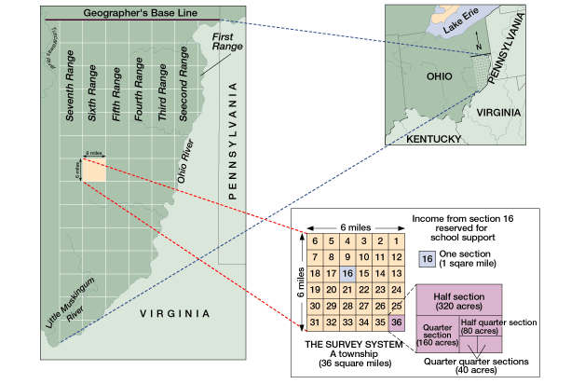
Land Ordinance of 1785
Arranged NW territories into townships

Slide 20
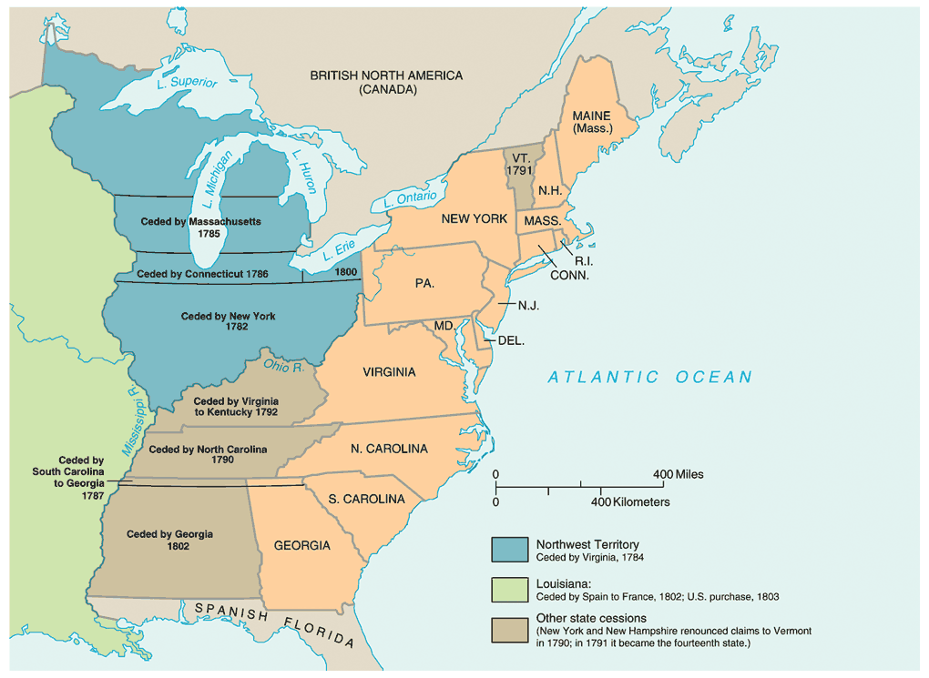
Northwest Ordinance
Northwest Ordinance of 1787: basis of governing NW Terr. & rules for becoming a state

Slide 21
On the small sheet
Describe:
The Northwest Ordnance of 1787
Shays’ Rebellion
1 weakness of the Articles of Confederation
Great Compromise
A Federalist belief

Slide 22
Shays’ Rebellion
Former military man, Daniel Shay leads a rebellion made up of poor farmers in western Massachusetts
Revealed lingering resentment on the part of backcountry farmers toward costal elites
Over issues of cheaper paper money, taxation, suspension of property takeover (foreclosing), and unlawful imprisonment
Rebellion was eventually crushed, but reveled that America needed a strong central government not provided by the A of C.

Slide 23
Conventions
Annapolis Convention: Led by A. Hamilton, only 5 states show up, promise to meet next year to revise A of C
Philadelphia Convention: purpose to revise A of C, end up creating a brand new governing document- THE CONSTITUTION

Slide 24
Constitutional Compromises
Virginia Plan (Large State)
Representation in Congress should be based on population
New Jersey Plan (Small State)
Representation in Congress should be equal
Great Compromise: (Connecticut Compromise)
Roger Sherman
2 house (bicameral) legislature: 1 based on population (House of Representatives), 1 equal per state (Senate)

Slide 25
Constitutional Compromises
South wanted slaves to count as population, north didn’t
3/5 Compromise:
60% of slaves will count towards population in the house
Slave Trade Compromise: slave trade can continue until end of 1807
How does the end of the slave trade affect slaves?

Slide 26
More Constitutional Info
Electoral College:
Used to elect President rather than popular vote
Popular vote winner in each states wins electoral votes
Michigan = 16 votes (California the most at 55)
The Elastic Clause (Necessary and Proper):
Congress shall have the power to… make all Laws which shall be necessary and proper for carrying into Execution the foregoing Powers…"

Slide 27
Constitutional Provision
Separation of powers- 3 branches
Congress power to declare war
Legalized slavery
Created electoral college
Provides way to impeach the President
Provides process to ratifying Constitution
9 out of 13 required
Federalism- sharing power between state and federal government

Slide 28
Federalists & Anti-federalists
Federalists: In favor of a strong central government (Madison, Hamilton, Washington, Jay, etc.)
Anti-Federalists: In favor of a weaker central government with states having more power (Patrick Henry, Jefferson)
Why did Anti-Federalists adopt the Constitution?
Federalists promises Bill of Rights
Federalists Papers: pamphlet to gather support for the Constitution

Slide 29
Bill of Rights
James Madison created Bill of Rights
Promised to the anti-federalists if they supported the Constitution
Several freedoms, notably freedoms given to states (10th amendment): satisfied the anti-federalists

Slide 30
Washington Presidency
Established the cabinet:
Heads of various departments that offer advice
No where in Constitution is cabinet mentioned
State: Jefferson, Treasury: Hamilton, War: Henry Knox
Quarrels between Hamilton and Jefferson

Slide 31
Judiciary Act of 1789
Organized the Supreme Court
1 chief justice and 5 associate justices
John Jay, writer of The Federalist Papers and a staunch Federalist, becomes the first Chief Justice

