Slide 1
Civil Rights
1948 Pres. Truman integrates the military
1954 Brown v. Board of Education of Topeka, Kansas
Overturns separate but equal (from…)
“Separate educational facilities are inherently unequal”
1955 Montgomery Bus Boycott- Rosa Parks- led by MLK Jr.
1957 Central High School Little Rock, Arkansas
“The Little Rock Nine”
Pres. Eisenhower sends federal troops to escort students

Slide 2
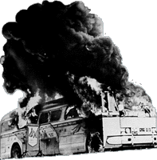
The Struggle for Civil Rights
Sit-ins
College students in Greensboro, NC stage sit-ins at the Woolworth’s lunch counter
Freedom Rides:
Federal government provides protection
FBI wiretapped MLK Jr.
“Ole Miss”
Kennedy sent 400 troops to register James Meredith

Slide 3
Struggle Continued
Birmingham, AL
½ of population was black, but made up 15% of voters
Letter from a Birmingham Jail
Martin Luther King and the Southern Christian Leadership Council (SCLC) focus on segregation in Birmingham. Protests there end in violence, riots, and arrests of adults and children.
March on Washington
200,000
“I have a dream”
Memphis, TN, King is shot by James Earl Ray. He was 39 years old.

Slide 4
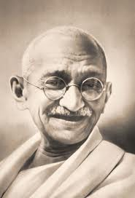
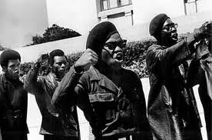
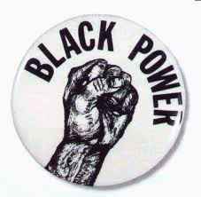
Different views on protest
KING: Non-violent, passive resistance
Influenced by Ghandi
Black Power: proactive, militant, focus on black pride and African heritage.
Term popularized by Stokely Carmichael of SNCC

Slide 5
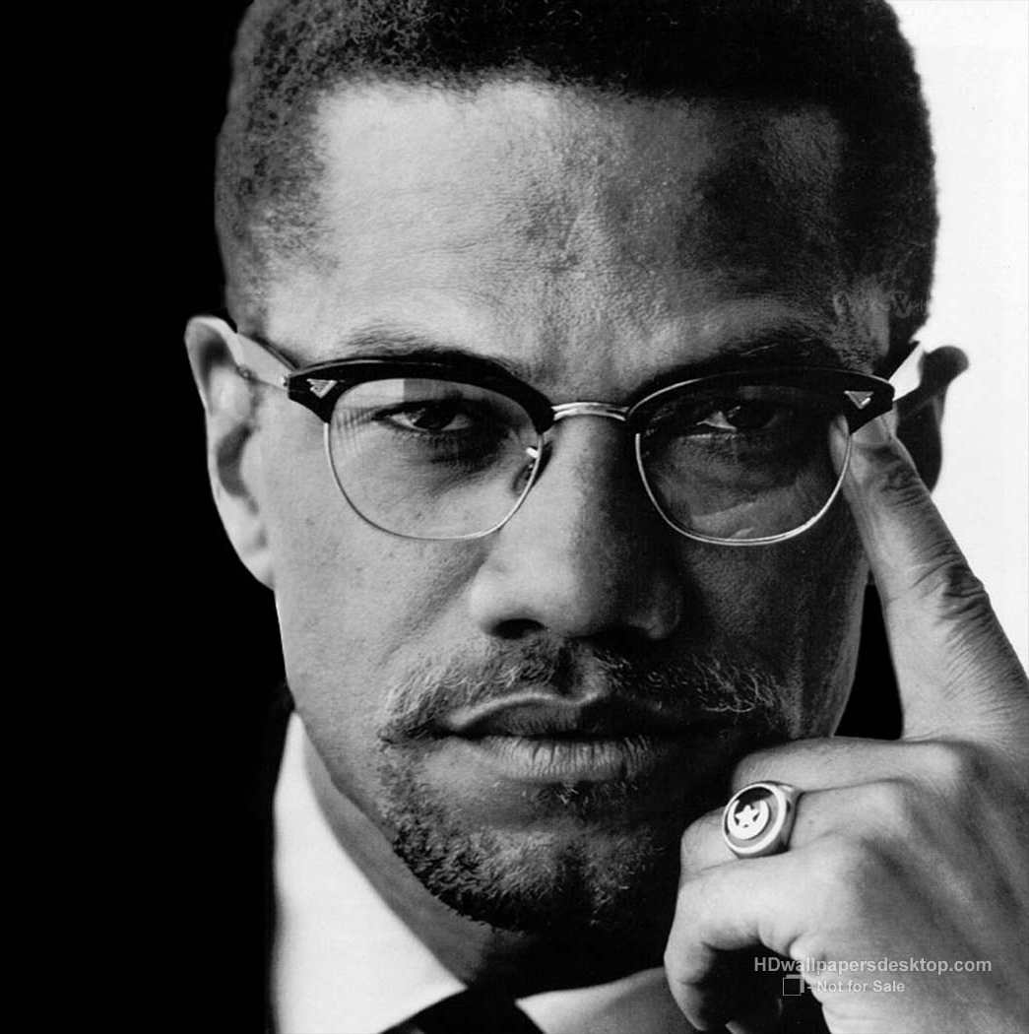
Black Power
Detroit, LA Riots (1965):
Changed the black struggle
Separatism
Militant
Malcolm X:
Nation of Islam
Assassinated in 1965
Stokely Carmichael:
Leader of “snick,” Student Nonviolent Coordinating Committee
Promoted Black Power
As the 60s went on, more of a focus was on economic equality

Slide 6
Malcolm x
Born Malcolm Little, he learned the ideas of black pride and self-reliance from his father, a follower of Marcus Garvey and member of the UNIA.
While in prison, he converted to Islam and joined the Nation of Islam.
Upon release, he changed his name; the X represented the African heritage he would never know.
He preached the superiority of blacks and separation from whites; he scorned King’s non-violence saying black people should use any means to protect themselves.
In 1964, Malcolm X made a pilgrimage to Mecca. After seeing Muslims of different races treating each other as equals, his views changed.
At a meeting in Feb. 1965, Malcolm X was assassinated by two members of the Nation of Islam, although imprisoned for their crime, proclaimed their innocence.

Slide 7
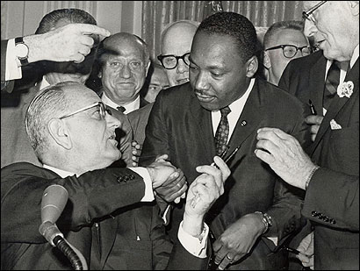
The LBJ Brand on the Presidency
Civil Rights Act of 1964:
Banned racial discrimination in private facilities
Empowered federal government to end segregation in schools
Equal Employment Opportunity Commission:
Purpose was to eliminate discrimination in hiring
“War on Poverty”

Slide 8
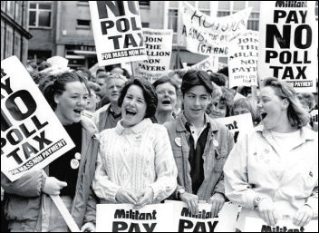
Battling for black rights
Poll taxes and literacy tests discouraged black voting
24th Amendment:
Eliminated poll taxes
“Freedom Summer:”
Voter-registration campaign
Voting Rights Act of 1965:
Eliminated literacy tests
Use of voter registrars

