Slide 1
Chapter 32: American Life in the “Roaring Twenties”

Slide 2
Chapter 32 Themes
Return to Republican presidents and a rejection of progressive reform and policies
Return to isolationism, social conservatism, and the arrival of mass consumption
Period of rapid cultural change due to changes in technology, mass marketing, entertainment. But back lash is increased cultural anxiety and sharp critique of American life.
Return of KKK, increase in anti-immigrants and new laws in immigration, Red Scare, Prohibition, and Scopes Monkey Trial

Slide 3
Chapter 32 Ideas
New Technology
Mass produced cars
Radio
Hollywood
Planes
Mass marketing
Flapper Girls
Speakeasies and rise of Organized Crime (Gangsters)
Harlem Renaissance and Jazz
Marcus Garvey and UNIA
Lost Generation
Modernism
Stock Market Boom and Bust

Slide 4
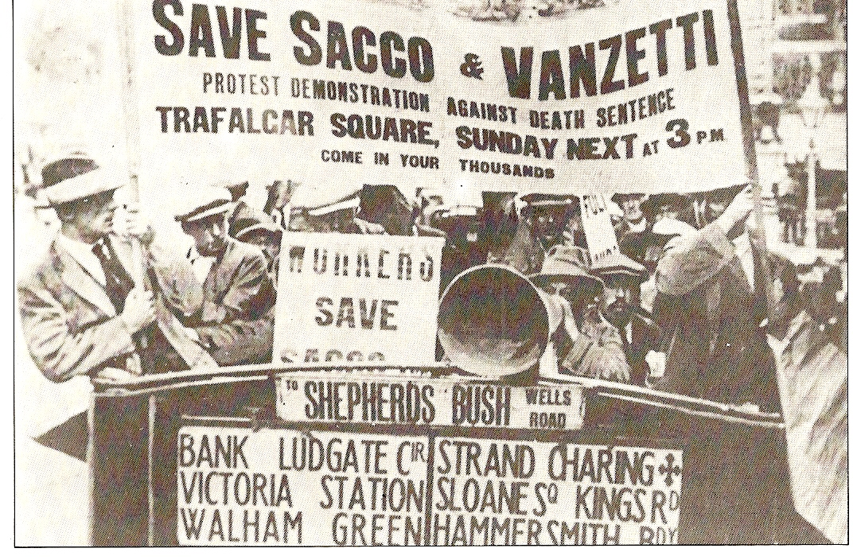
Seeing Red
As communism swept through Russia, fear that labor unions were influenced by Bolsheviks
“Red Scare” of 1919-20 (1st Red Scare)
Crusade led by Attorney General Mitchell Palmer against suspected communists
1,000s of Americans were arrested
Impact of the Red Scare:
Business people used it to help break unions
Sacco and Vanzetti
Two Italian immigrants (anarchists, atheists, draft dodgers) charged with murder, found guilty and executed
Showed tensions between immigrants and nativists

Slide 5
Hooded Hoodlums of the KKK
Re-emerged in the 1920s and was similar to 1860s – 70s KKK movement of anti-foreignism
By mid-1920s, 5 million Americans paid dues as members
Scandals, including embezzlement, helped lead to the decline of the clan

Slide 6
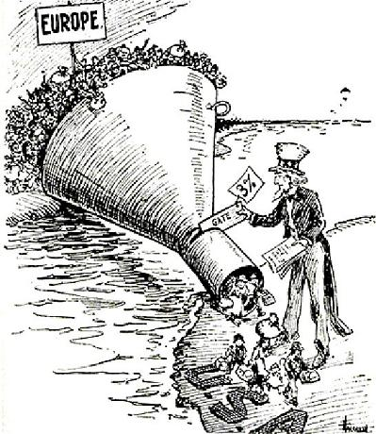
Stemming the Foreign Flood
Just like many times before, nativists fear
“new” immigrants
Emergency Quota Act of 1921:
Restricted number of immigrants from a country to 3% of total people from that country living in US in 1910
Favored Southern and Eastern Europe
Immigration Act of 1924:
Quotas for foreigners was cut from 3% to 2%, used 1890 census instead, hurt “New Immigrants”
Shut out Japanese immigrants: “Hate America” rallies
Marked an end of era of unrestricted immigration

Slide 7
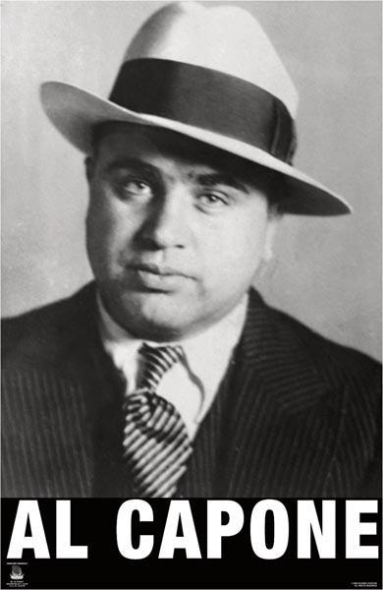
The Prohibition “Experiment”
Popular in South and West
Southerners wanted to keep alcohol away from blacks
Westerners hated “Saloon”
Problems with prohibition
People liked to drink, weak enforcement, many people hostile to law
Many government officials were bribed
Increase in organized crime
Positives of Prohibition:
Bank savings increased
Absenteeism in industry decreased

Slide 8
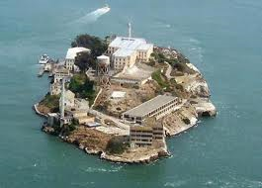
The Golden Age of Gangsterism
Huge demand for illegal alcohol.
Large cities, such as Chicago, flourished with crime
Al Capone, notorious gangster, was very popular
St. Valentine’s Day Massacre: 7 gang members killed
Dies of syphilis later in life
Eventually, organized crime spreads to other activities: prostitution, gambling, and narcotics

Slide 9
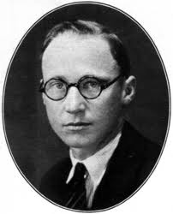
Monkey Business in Tennessee
John Dewey:
Professor at Columbia, “learn by doing”,
“education for life”
Christian Fundamentalists:
Those that interpret the bible literally
Detested Darwin’s theory of evolution
“Monkey Trial”
John Scopes, biology teacher from Dayton Tennessee, violated a law by teaching evolution
Prosecutor: William Jennings Bryan, Defense Attorney: Clarence Darrow
Scopes found guilty, paid $100 fine
Helped fuel religion vs. secularism for many more years

Slide 10
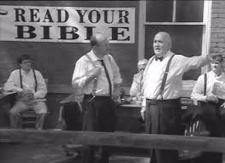
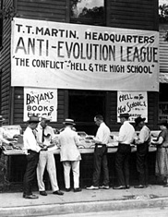
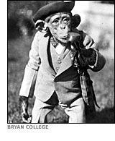
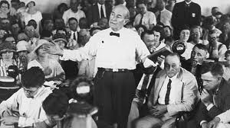
Scopes Monkey Trial

Slide 11
The Mass-Consumption Economy
For much of the 1920s, economy boomed
Cars, once reserved for the rich, became available to many – 30 million by 1930
What fueled Mass-Consumption?
Advertising!
Sports became huge as well, particularly baseball
Buying on Credit:
“Possess today and pay tomorrow”
Problem later in the 20s and even today

Slide 12
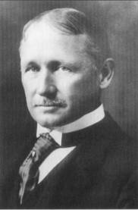
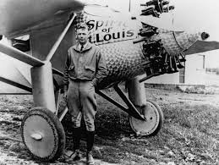
Cars and Planes
RR industry hurt by cars
What industries did RR hurt when it came out?
Taylorism:
Promoted efficiency in production. Workers were shown movements to eliminate wasted movement
12/17/03: 12 seconds and 120 feet that changed life forever
Charles Lindbergh:
First solo flight w/o radio from America
to Europe
Becomes overnight sensation

Slide 13
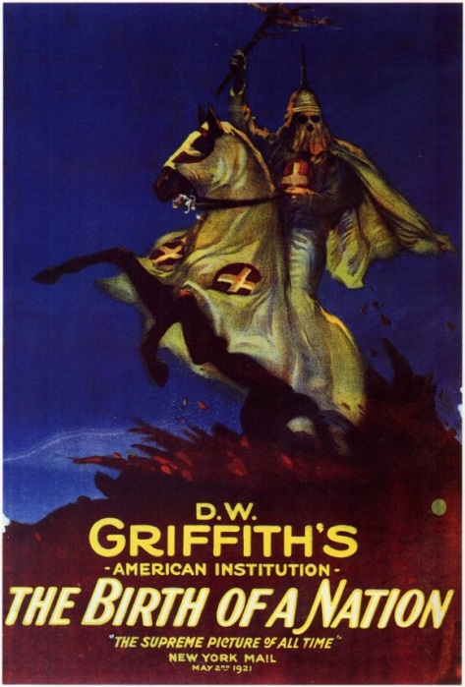
Hollywood’s Filmland Fantasies
Birth of a Nation (1915)
Glorified the KKK, one of first full-length, popular movies
Hollywood became popular due to warm weather
Propaganda machine during WWI
Disney during WWII was instrumental
in anti-German propaganda movies
1927, first “talkie” – The Jazz Singer

Slide 14
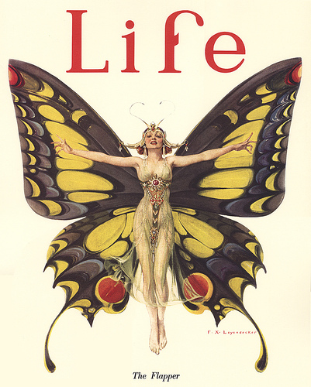
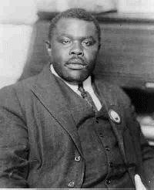
The Dynamic Decade
1920 census
First time ever, more Americans lived in
urban areas
***Margaret Sanger***
Advocated birth control, contraceptives
Birth control was illegal in many places
Upset many fundamentalists
Flappers
Short(er) dresses and short hair
Smoked, drank, and (gasp!) danced
Marcus Garvey
United Negro Improvement Association (UNIA)
Promote resettlement of American blacks in their own “African homeland”

Slide 15
Wall Street’s Big bull Market
1920s stock market soared (Bull market)
Later crashed in 1929 (Bear market)
Bull market driven by:
Speculation
Buying “on margin”

