Slide 1
Chapter 10: Launching the New Ship of State
1788-1800
Starring George Washington, Alexander Hamilton, John Adams, and Thomas Jefferson

Slide 2
The First Party System
Purpose: to gain an understanding of:
The first system of political parties in the United States.
The presidencies of Washington and Adams
The consequences of Hamilton‘s domestic policies
The impact of the French Revolution on the United States
Basic assumptions of Federalists and Republicans
Various political conflicts between Federalists and Republicans

Slide 3
Positive and Negatives
Positives (Assets)
Booming Population
Western Lands
Natural Resources
Inventive People
New Constitution
LEADERS:
Washington
Jefferson
Hamilton
Adams
Madison
Franklin
Negatives (Liabilities)
Massive Debt (54 million)
Sectionalism
State’s Rights
Foreign Affairs
No real currency
No hard money (specie)
Untried government

Slide 4
America in 1790
Population continuing its huge growth
Almost 4 million people
Population doubles almost every 25 years
Cities are blossoming also
Philadelphia (42,000), New York (33,000), Boston (18,000)
Still mostly rural though, about 90 percent and almost everyone lived east of Appalachians (5% did not)
Many looked down on America for its roughness and pioneer lifestyle.
Spaniards control New Orleans and by default the Mississippi and agents for the Spanish and British are moving restlessly among the frontiers handing out promised of independence.

Slide 5
Washington Presidency
Elected unanimously in 1789 and 1792, only president to achieve this
Triumphal procession to the temporary capital in New York, and took oath of office on April 30, 1789 looking over Wall Street.
Commanded and led by strength of character as opposed to political acumen

Slide 6
Washington Presidency
His government included Alexander Hamilton and Thomas Jefferson, the principal political leaders of the next two decades.
Despite Washington‘s wish for a consensus government, he consistently favored Hamilton
Soon, personality conflicts and political disagreements resulted in open factionalism.

Slide 7
Washington Presidency
Legacy –
Cabinet (not in Const)
Thomas Jefferson- Secretary of State
Alexander Hamilton- Secretary of the Treasury
Henry Knox-Secretary of War
Isolationism
Nationalism over real Federalism
Limited use of Veto
Two-Terms
Stay away from Congress
Propose a budget
Strong Commander-In-Chief

Slide 8
Bill of Rights
One of the first tasks was to include the Bill of Rights to the Constitution
Two ways to amend:
Constitutional convention at the request of 2/3 of the states
2/3 vote in both houses of congress

Slide 9
Bill of Rights
James Madison decides to look for the votes in congress, fearing a convention would open up Pandora's box.
Madison committed to writing them himself.
Passed in 1791, the first 10 amendments and safeguard some of the most precious American Principles

Slide 10
Bill of Rights
Amendment I: Congress shall make no law respecting an establishment of religion, or prohibiting the free exercise thereof; or abridging the freedom of speech, or of the press; or the right of the people peaceably to assemble, and to petition the Government for a redress of grievances.
Amendment II: A well regulated Militia, being necessary to the security of a free State, the right of the people to keep and bear Arms, shall not be infringed.
Amendment III: No Soldier shall, in time of peace be quartered in any house, without the consent of the Owner, nor in time of war, but in a manner to be prescribed by law.
Amendment IV: The right of the people to be secure in their persons, houses, papers, and effects, against unreasonable searches and seizures, shall not be violated, and no Warrants shall issue, but upon probable cause, supported by Oath or affirmation, and particularly describing the place to be searched, and the persons or things to be seized.
Amendment V: No person shall be held to answer for a capital, or otherwise infamous crime, unless on a presentment or indictment of a Grand Jury, except in cases arising in the land or naval forces, or in the Militia, when in actual service in time of War or public danger; nor shall any person be subject for the same offence to be twice put in jeopardy of life or limb; nor shall be compelled in any criminal case to be a witness against himself, nor be deprived of life, liberty, or property, without due process of law; nor shall private property be taken for public use, without just compensation.

Slide 11
Bill of Rights
Amendment VI: in all criminal prosecutions, the accused shall enjoy the right to a speedy and public trial, by an impartial jury of the State and district wherein the crime shall have been committed, which district shall have been previously ascertained by law, and to be informed of the nature and cause of the accusation; to be confronted with the witnesses against him; to have compulsory process for obtaining witnesses in his favor, and to have the Assistance of Counsel for his defense.
Amendment VII: in Suits at common law, where the value in controversy shall exceed twenty dollars, the right of trial by jury shall be preserved, and no fact tried by a jury, shall be otherwise re-examined in any Court of the United States, than according to the rules of the common law.
Amendment VIII: Excessive bail shall not be required, nor excessive fines imposed, nor cruel and unusual punishments inflicted.
Amendment IX: The enumeration in the Constitution, of certain rights, shall not be construed to deny or disparage others retained by the people.
Amendment X: The powers not delegated to the United States by the Constitution, nor prohibited by it to the States, are reserved to the States respectively, or to the people.

Slide 12
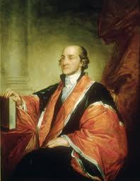
Judiciary Act 0f 1789
Created effective federal courts
Organized the Supreme Court, with one chief justice and 5 associates. ( today there is one chief justice and 8 associates)
Also established the federal and circuit courts and the office of attorney general.
John Jay was the first chief justice.

Slide 13
Hamilton and the Financial Crisis
Hamilton was a financial wizard and rival to Jefferson.
Favored strong central government role
First task was to correct the financial and economic problems facing the new Nation
His approach was to favor the wealthier groups
They would gratefully lend monetary and political support to the government
New Federal government would survive, the propertied classes would be enriched, and prosperity would TRICKLE DOWN!!!!!!

Slide 14
Hamilton and the Financial Crisis
Alexander Hamilton proposed a Five-step program to get US finances into decent shape.
1. Bolster national credit by increasing publics confidence in government.
Fund national debt “at par”
Assume debts incurred by the states during the war, as a national obligation.

Slide 15
Hamilton and the Financial Crisis
2. Assumption, or taking on the debt from the states, meant, to Hamilton, that states would be chained more tightly to the national chariot
Wealthy creditors allegiance shifts from states to federal government, part of his political strategy to strengthen the central government
Assumed 21.5 million in debts from the States
3. HAMILTON WANTS A LIMITED NATIONAL DEBT
Ties wealthy to working for a strong government
Done correctly one can use other people’s money without high interest rates.•
Pay off MOST of the debt with Tariffs and Excise taxes
More people who owe you money, the more who will have a interest in the success of the nation. (They have too much money at stake for it to fail)

Slide 16
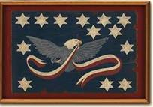
Hamilton and the Financial Crisis
4. Have tariff tax and excise tax to raise money
Tariff tax depended on vigorous foreign trade
First passed in 1879, only 8% on dutiable imports (also gave protective wall around American industries, Hamilton saw industrialized America in the future and wanted to protect emerging manufacturers.
Excise Tax on some domestic products
Notably on Whiskey
7 cents a gallon
Whiskey flowed so freely on frontier, it was often used as money

Slide 17
Hamilton and the Financial Crisis
5. The National Bank
As a major part of his financial reform, Hamilton proposes a National Bank.
A private institution in which the government is the biggest stockholder and federal surplus money could be deposited there.
Stimulate business by having dollars remain in circulation (through loans)
Bank would print paper money and provide national currency
All this is great, but is it constitutional

Slide 18
Jefferson’s and the National Bank
Washington asked for Jefferson’s opinion, who vehemently attacked the bank
Jefferson believed anything not explicitly granted as a power to the federal government was a power granted to the states. (10th amendment)
Thus, it was the states and not Congress who had the right to charter banks.
Constitution and states rights advocates stated it should be followed strictly, so they became the strict constructionists

Slide 19
National Bank: Who won, Jefferson or Hamilton?
Hamilton claims that what the Constitution did not forbid, it permitted. Jefferson believed the opposite.
Hamilton uses the clause that states Congress may pass any law deemed “necessary and proper.”
Since the national government and Congress was permitted to collect taxes and regulate commerce, it would be both “proper” and “necessary” to have a national bank.
Hamilton followed “loose construction” of the Constitution

Slide 20
National Bank: Who won, Jefferson or Hamilton?
In the end, Hamilton’s financial views prevailed.
Washington accepted his arguments.
Strongest support from the North and weakest from South
Bank chartered in 1791, for 20 years. Located in Philly, capital of $10 million, 1/5th owned by the federal government
When opened to public sale, sold out in less than 2 hours
http://www.youtube.com/watch?v=_UR4_8pISIA&feature=relmfu

Slide 21
National Capital
Famous political cartoon showing Congress moving to Philadelphia.
New York was capital from 1787-1790. Philadelphia from 1790-1800.
Washington D.C was from 1800- present. D.C part of deal with Virginia to have
Capital in D.C. as a result of the Assumption Bill. South and Virginia gain in prestige
And commerce.

Slide 22
Whiskey Rebellion-1794

Slide 23
Whiskey Rebellion-1794
http://www.youtube.com/watch?v=cH8tIuP4AMU
Started exactly like Shays
The roads were so bad that it was cheaper to turn grain into whiskey, then transport that to the east coast
Hamilton taxed the whiskey, because he could no longer tax the grain (and to prove that the gov’t COULD).
Enraged western farmers because it seemed to them that Hamilton’s plans favored the rich over the poor.

Slide 24
Reaction to Hamilton’s Programs
All of Hamilton’s financial success (assumption, excise tax, tariffs, bank, and suppression of the Whiskey Rebellion) brings some political liability too:
Encroached upon state rights.
Many citizens, especially western settlements, weary of Constitution. Now, their worries are warranted because of the revenue-raising and strengthening of the central government policies of Hamilton.
CONSEQUENTLY, OPPOSITION BEGINS TO FORM. AS A RESULT, POLITICAL PARTIES BEGIN (NOT EXISTANT AT THE TIME OF WASHINGTON’S INAUGURATION) FORMING WITH THE FEDERALISTS (HAMILTONIANS) AND THE DEMOCRATIC-REPUBLICANS (JEFFERSONIANS)
http://www.youtube.com/watch?v=Vy7FJJ_ud84&feature=related

Slide 25
FRENCH REVOLUTION
The French Revolution after 1789 split US public opinion.
Some (like Jefferson and Madison) cheered another republican revolution.
Others (like Hamilton and Adams) abhorred the radicalization of the French Revolution.
Franco-US treaty of 1778 ties US to help protect France West Indies if England goes to war with France
Genet irritates G. Washington and pays the price
BASTILLE DAY, JULY 14, 1789.
SO, WHAT DOES THIS HAVE TO DO
WITH THE UNITED STATES?

Slide 26
FRENCH REVOLUTION
However, early support turns to distaste as French Revolution turns into the Reign of Terror
Federalists show disgust
Jefferson and followers regret bloodshed, but one cannot expect to be carried from “despotism to liberty in a feather bed.”
Jefferson preferred to honor French alliance as English entered into war against the French
A few lost heads is worth the price
of LIBERTY!!!!!!

Slide 27
Washington and the French Revolution
Many, mostly Jeffersonians, wanted to enter the war on the side of the French, recent friend, versus the British, recent foe.
Washington wanted to avoid war at all costs.
Nation was militarily weak, economically instable, and politically disunited.
Washington reasoned that in a generation, with a population increase and more stability, United States could be a world power, but at the moment, it was best to continue the path of nationalism and remain neutral
Strategy of delay, buying time as birthrate of Americas made it strong in future

Slide 28
Neutrality Proclamation of 1793
Claimed neutrality in the war fought between Britain and France, also, American citizens were to remain impartial towards both camps.
Jefferson was angry, since he sided with French and also that Washington did not consult Congress

Slide 29
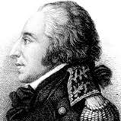
French Problems and Genet
France also posed problems for America. Edmond-Charles Genet, a diplomat from France, hired American sailors to seize British ships in the Atlantic, and recruited Americans for an army to attack British territory in the Florida peninsula.
President Washington, angry that these actions could lead America into a war, wanted Genet deported back to France
Ironically, when the government of France changed hands because of a coup, Genet was granted political asylum in America and remained in the country until his death in 1834.
In the end, Washington’s Proclamation showed a basic principal in foreign affairs:
Self-Interest rules the day
In 1778, both France and America benefitted, but in 1793, only France would benefit from the alliance. Hence, Washington stayed out of the mess.

Slide 30
British and Frontier Problems
Washington’s idea of neutrality tried by British
Chain of frontier posts on U.S. soil for ten years
Liked fur trade and wanted a strong Indian nation as a buffer zone
Sold arms to Miami Confederacy and Little Turtle
Miami Confederacy and Little Turtle defeated American Generals and gave U.S. some of their worst defeats in history of the Frontier.
Battle of Fallen Timbers
Led by General “Mad Anthony” Wayne, routed the Miami in battle.
British refused to give fleeing Miami shelter.
Wayne offered the peace pipe and Treaty of Greenville signed
Treaty states: vast tracts of Old Northwest ceded to U.S government.
Native Americans got 20,000 and 9,000 annually. Right to hunt lands ceded and most importantly, their sovereignty was recognized.

Slide 31
British and the High Seas
British tried to starve out French in West Indies.
In process, seized about 300 American ships , forced men into service and imprisoned many more.
Lack of respect of neutrality
Many cried for war with Britain, mainly Jeffersonians.
Federalists and Hamilton resisted all demands for drastic measures because Britain at heart of trade necessary for United States

Slide 32
John Jay
Sent to London by Washington in 1794 to avert war with Britain
Jeffersonians were alarmed at the choice of Jay because he was an Anglophile and further alarmed them when he kissed the Queen’s hand.
Hamilton sabotages negotiations by revealing to England Jay’s bargaining strategy.
As a result, Jay does not accomplish much
Britain promised to evacuate chain of posts on U.S. soil
Pay damages for the seizure of ships, but did not make any promises about FUTURE seizure of ships or about supplying arms to Native Americans
Jay was forced to agree to pay debts owed to British merchants from pre-Revolutionary accounts

Slide 33
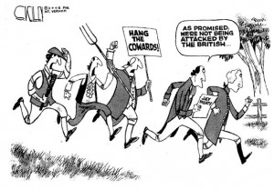
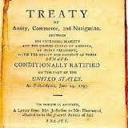
Jay’s Treaty
This unpopular document rallies the Democratic-Republican Party
Viewed treaty as giving too much to the British
Also, in their eyes, betrayed the Jeffersonian South.
Pay debts from war etc. While wealthy merchants being paid for recent seizures
Effigies of John Jay were burned and hanged in protest

Slide 34
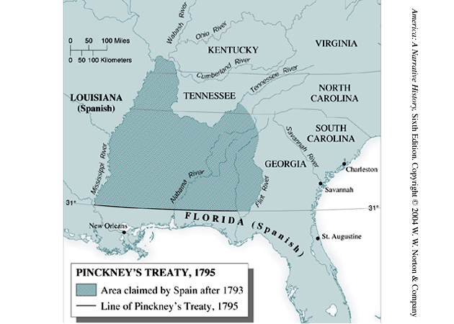
Pinckney’s Treaty
Jay’s Treaty had unforeseen consequences
Spain, fearing a stronger Anglo-American alliance, moved to strike a deal with the United States
Pinckney’s Treaty
U.S granted rights to navigate the Mississippi
Also granted land, which was disputed, north of Florida

Slide 35
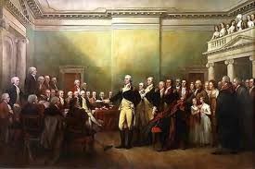
Washington’s Retirement
Exhausted from diplomatic and partisan battles, Washington decides to retire after his second-term. Thus, creating the standard of a two-term limit.
Farewell Speech
Strongly advised against “permanent alliances.” This highlights the isolationist theory often adopted by U.S. foreign policy post-WWII.
Under Washington, Federal government grew in strength.
West was expanding
Merchant Marines growing and making trade viable
No overseas wars or entanglements

Slide 36
1796 Election Results (16 states in the Union)
 | John Adams | Massachusetts | Federalist | 71 | 51.4%
 | Thomas Jefferson | Virginia | Democratic-Republican | 68 | 49.3%
 | Thomas Pinckney | South Carolina | Federalist | 59 | 42.8%
 | Aaron Burr | New York | Democratic-Republican | 30 | 21.7%
 | Samuel Adams | Massachusetts | Federalist | 15 | 10.9%
 | Oliver Ellsworth | Connecticut | Federalist | 11 | 8.0%
 | George Clinton | New York | Democratic-Republican | 7 | 5.1%
 | Other | - | - | 15 | 10.9%
Total Number of Electors | 138
Total Electoral Votes Cast | 276
Number of Votes for a Majority | 70

Slide 37
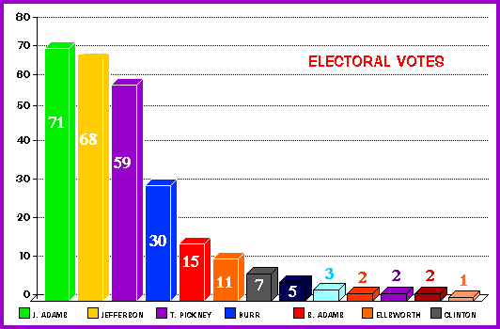
1796 Election
Under the original constitution elector voted twice for president.
Whoever got the most was president—
whoever got the 2nd most became V.P.. How could this be a problem?

Slide 38
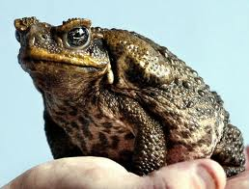
Election of 1796
Partisan politics at its finest:
Fisher Ames, referring to the Jeffersonians: “fire-eating salamanders, poison sucking toads.”
Both parties were at odds with each other and mud-slinging occurred on both sides.
Most of this occurs because Washington was not present to impose some restraint
Personalities dominated the partisan politics, but Jeffersonians riled against the forceful-crushing of the Whiskey Rebellion and also Jay’s Treaty

Slide 39
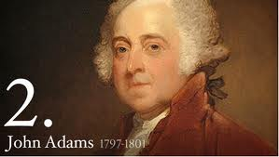
John Adams
An intellectual aristocrat with little appeal to the masses and little desire to cultivate any.
Stepped into Washington’s big shoes
Hated by Hamilton, who led the war faction of the federalists known as the “High Federalists.”
Inherited a violent quarrel with France

Slide 40
John Adams
John Adams, the second president, found himself caught between the followers of Jefferson and those of Hamilton. His one term as president was mostly a failure, largely because he could not develop an effective way to govern with Congress divided and the United States powerless to stop either France or Britain from interfering with American trade across the ocean.

Slide 41
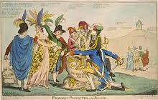
John Adams
1796 John Adams was elected president in a fully partisan election 1789.
XYZ affair demolished relations with France.
1798-1799 Quasi- War with France
Adams expands the Navy and creates the Marines
Alien and Sedition Acts

Slide 42
X Y Z Affair
French viewed Jay’s Treaty as a violation of the Franco-American Treaty of 1778.
In response, French Navy started to seize defenseless American Merchant vessels (about 300 in total)
Also did not accept America’s new envoy to France
John Adams, steering clear of war, appoints a diplomatic commission of three men, including John Marshall,
Approached by three go-betweens before reaching Tallyrand, and asked to pay $250,000 just to talk to Tallyrand.
Americans said hells no!!!!!!!

Slide 43
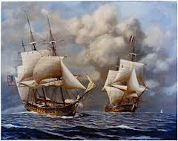
X Y Z Affair and Quasi-War
War fever went through United States. Federalists happy, Jeffersonians disappointed in behavior of the French.
War preparations began. Navy Department created and expanded and Marine Corp reestablished.
Quasi-War, mainly confined to the seas, and undeclared, wages on from 1798-1800.

Slide 44
Peace with France
Tallyrand wanted peace, so he said a new minister would be fully respected and received
1799, Adams submits name to Senate for a new minster to France. Again, a last try at peace and keeping the young nation out of war.
Napoleon came to power. Wanted to end things.
Convention of 1800.
Annul the 22 year alliance
U.S. would pay damage claims of American shippers
Ends only peace time military alliance for over the next century and a half. Reaffirms policy of no foreign entanglements

Slide 45
Alien and Sedition Acts (Adams Blunders)
Alien And Sedition Acts attempted to muzzle Democratic-Republican critics.
Alien Act
Residency for citizenship (Naturalization) raised
from 5 to 14 years
Can deport “dangerous” aliens
Sedition Act
Illegal to defame public officials (written to expire in
1801 just in case the fed’s lose the next election)
For the first two years it is very popular--seen as
necessary to control immigrants and ensure domestic

Slide 46
Alien and Sedition Acts
Alien act, while perhaps legal during war, was against the American ideals and the Constitution. Gave way too much power to the Executive branch
Sedition Act was a slap at two freedoms in the Bill of Rights, freedom of speech and press.
So……………who is this geared towards and who gets angry?
10 Jeffersonians put on trial under the Sedition Act. All convicted by prejudiced Federalist judges.
E.g Spitting Lion, Matthew Lyon, sentenced four months in jail for writing about Adams: “unbound thirst for unbound pomp, foolish adulation, and selfish avarice.”

Slide 47
Kentucky and Virginia Resolutions
Kentucky (Jefferson), Virginia (Madison)
Secretly penned, fearing sedition.
Stressed compact theory. That the 13 states entered into a compact with the federal government.
So federal government was an agent or creation of the states
So states were the final judges if the federal government ahd broken the compact/contract,
So federal regime exceeded its powers granted to her by the states in passing the Alien and Sedition Acts.
So nullification (refusal to accept them) was the right remedy.

Slide 48
Federalists vs Democratic Republicans
Federalists
Hamilton, Adams
Leadership by responsible,well- educated elite (the“BEST”)
Afraid of excessive democracy as anarchy or mob rule
Pro-England
Favor trade, and commerce( Especially w/ENGLAND)
Strongest in New England
LOOSE CONSTRUCTION
Supported by merchants, manufacturers, and shippers.
Strong central government
Republicans
Jefferson, Madison
Government should be directly responsive to “the people“
Afraid of aristocratic tyranny”; champion egalitarian values
Pro-France
Favor agricultural economy (small farmer is the backbone of the nation)
Strongest in South and West
STRICT CONSTRUCTION
Weak central government and strong state rights
Primarily agrarians and farmers

