Slide 1
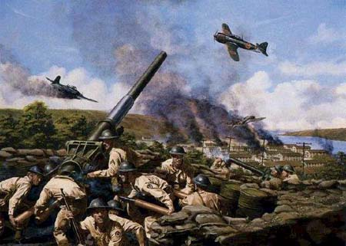
Chapter 17-Section 3-The War in the Pacific

Slide 2
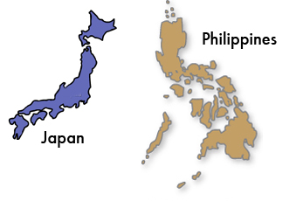
The Pacific Theater
Japan victorious in the Pacific Theater at first taking control of Hong Kong, Indochina, Asia and most of Pacific
Japan took the Philippines from American control
Forced General McArthur to flee to Australia
He reluctantly leaves but vows to return before the war is over

Slide 3
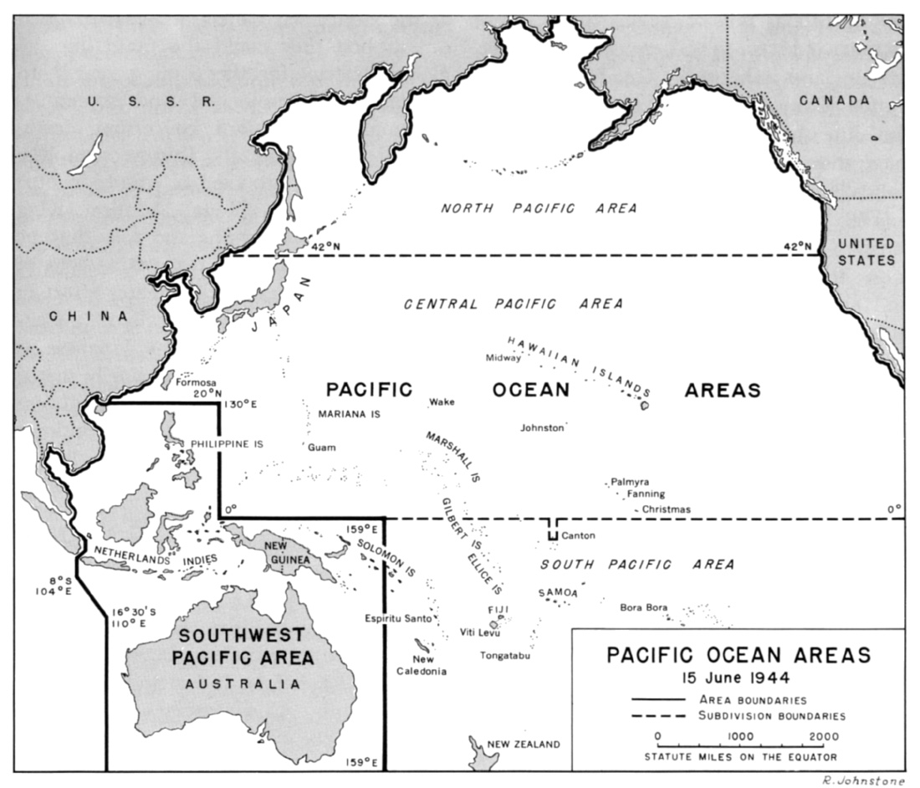

Slide 4
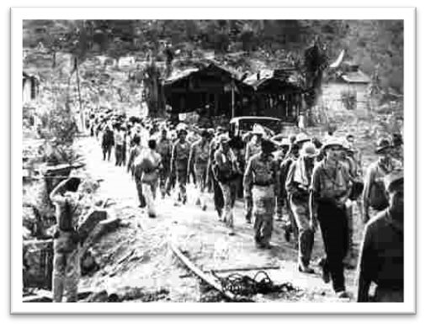
The Pacific Theater
The Bataan Death March-
The forced march of American and Filipino prisoners of war by the Japanese during World War II.
The 63-mile march where an estimated 60,000–80,000 prisoners from the southern end of the Bataan Peninsula in the Philippines on April 9, 1942.
Its estimated that somewhere between 5,000 to 18,000 Filipinos and 500 to 650 Americans died during the march

Slide 5
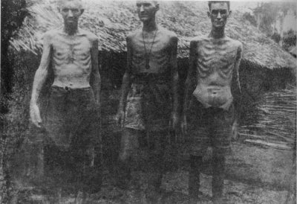

Slide 6
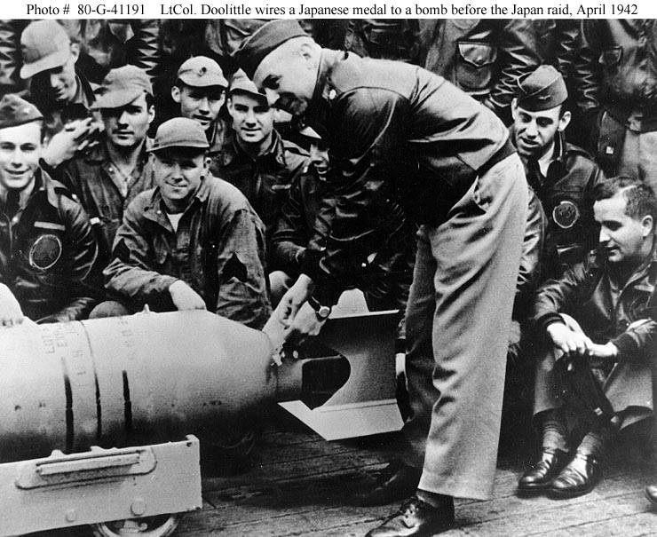
U.S. Needed a Victory
Doolittle’s Raid-
American Lt. Col. Jimmy Doolittle led 16 bombers in an attack on Tokyo and other cities in April 1942
Attack did little damage to the city of Tokyo and was strategically pointless, but it boosted America’s morale by showing Japan we would fight back

Slide 7
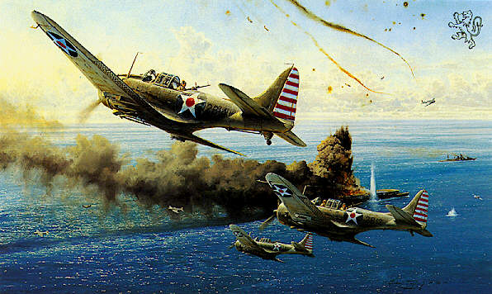
U.S. Needed a Victory
The Battle of the Coral Sea-
This battle took place off the cost of Australia
Americans and Australians pilots stopped Japanese forces during a five-day battle
Completely aerial battle between planes launched from carriers
First time in history a battle was fought without land or naval forces
No clear winner in the battle but the Allies were able to turn Japan back and block the invasion of Australia

Slide 8
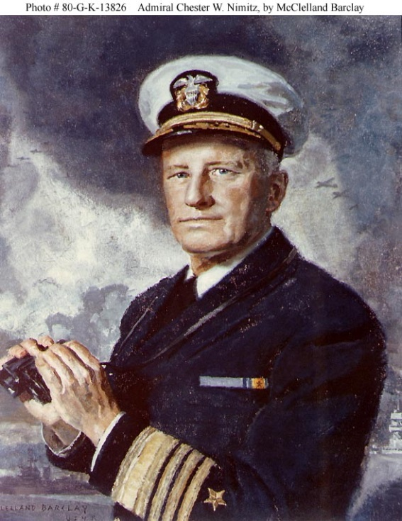
U.S. Needed a Victory
Battle of Midway-
Naval battle around Midway Island located in the Central Pacific Ocean
Admiral Chester W. Nimitz was placed in charge
The U.S. destroyed four Japanese carriers and two hundred fifty airplanes
This decisive win was the turning point in the war
We were finally able to break the Japanese code and locate their fleet with our scout planes

Slide 9
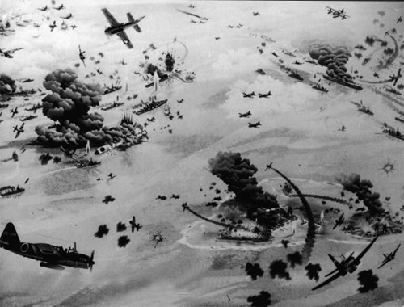

Slide 10
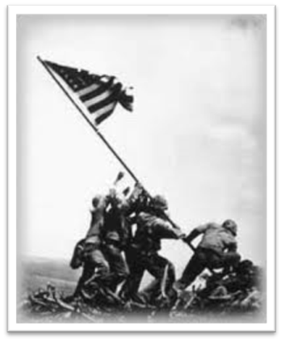
U.S. On the Offensive
The Americans used the strategy of island hopping in which the U.S. would capture lightly-defended islands throughout the Pacific, one by one, until they had “hopped” their way towards Japan
The Pacific Ocean was so BIG that the U.S. needed a way to get closer to Japan
This would get the U.S. within striking distance of Japan & allow the U.S. to set up bases to refuel/resupply at all of the conquered islands along the way
One of the most famous conflicts too place on Iwo Jima in 1944. An island needed for bomber attacks on Japan
21,000 Japanese soldiers attempted to defend the island
Only two hundred of these soldiers survived while nearly 6,000 U.S. Marines died

Slide 11
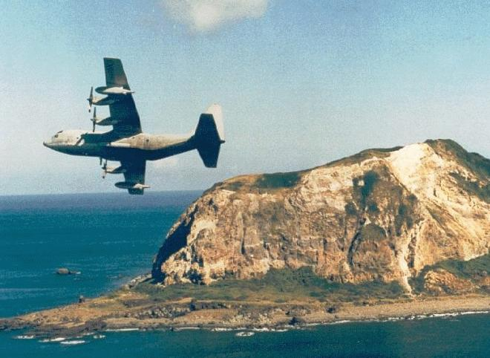

Slide 12
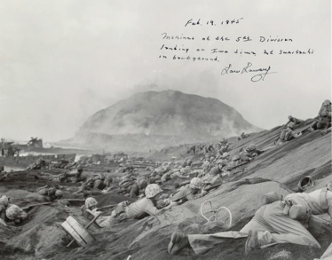

Slide 13
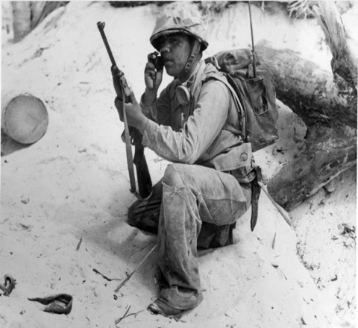
U.S. On the Offensive
Battle of Guadalcanal-
Took place in August 1942
Americans win first major land victory on the island of Guadalcanal
The U.S. military also started using Navajo Indians as “Code-talkers”
Helped the U.S. communicate safely without the Japanese translating our messages or breaking our codes
Only about 25 non-Navajo people in the entire world could speak the language
Made up words for terms that didn’t exist in their language for example the names of birds meant “airplanes” while a word like “egg” actually meant “bomb”

Slide 14
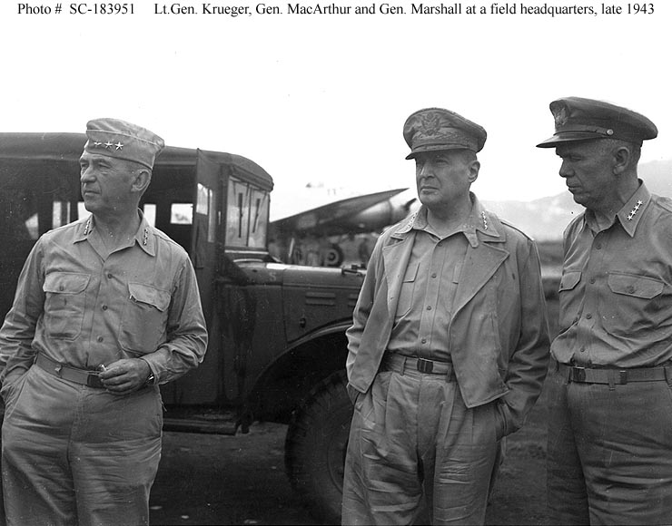
U.S. On the Offensive
The Philippine Islands-American returned to the Philippines in October 1944 after “Island Hopping” our way there
General MacArthur made good on his promise to “return” to the Philippines

Slide 15
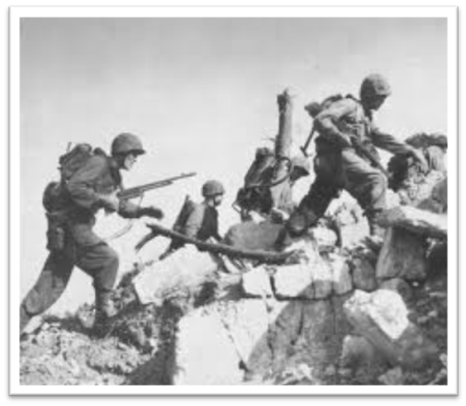
U.S. On the Offensive
The Battle of Okinawa took place in 1945
Japanese defend this island fiercely
110,000 Japanese Soldiers die during the battle
There were 1,900 kamikaze attacks
Japanese suicide pilots who flew planes loaded full of explosives
Their goal was to crash their planes into enemy ships
Often were inexperienced pilots with outdated equipment
Japanese Generals commit the Japanese ritual suicide known as hari kari rather then surrender
Last hurdle before U.S. would invade Japan
7,600 U.S. soldiers died as well

Slide 16
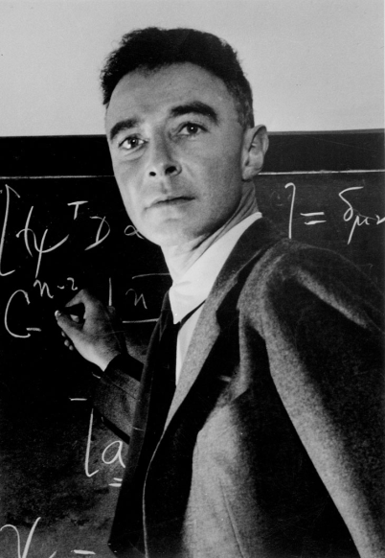
The Manhattan Project
U.S. feared that an invasion of Japan would result in 200,000 American casualties and perhaps as many as one to two million Japanese casualties
U.S. considers using an “Atomic Bomb” to end the war quickly
Bomb had been developed as part of the “Manhattan Project” led by J. Robert Oppenheimer in 1942
First tested in New Mexico in 1945
It was a success, but no one realized the long term effects it could have on those exposed

Slide 17
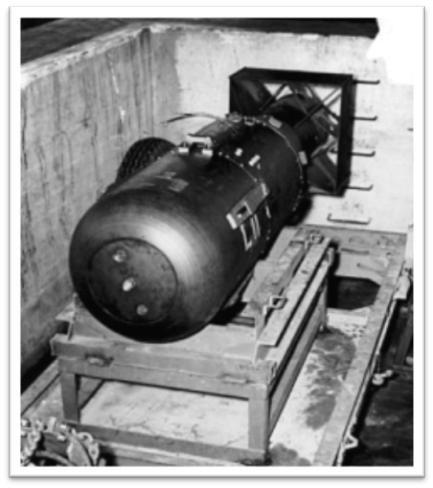
The Manhattan Project
President Truman had no knowledge of the atomic bombs existence prior to becoming president.
However, once he decided to use it, he warned Japan to either surrender or else face “complete destruction”
Japan refused so the U.S. dropped two bombs.
The first bomb named “Little Boy” on Hiroshima killing nearly 70,000 and the second bomb on Nagasaki named “Fat Man” killing 40,000 killed civilians.
On September 2nd, 1945 five days after the attack Japan surrendered to the United States

Slide 18
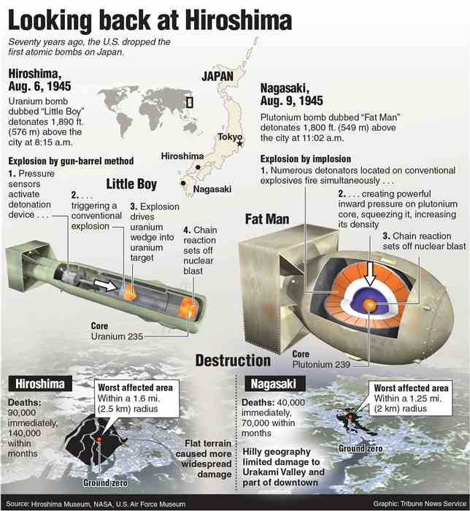

Slide 19
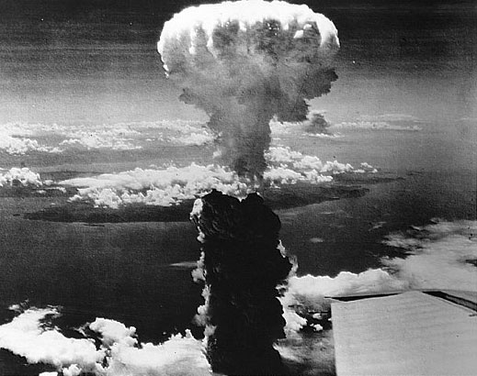

Slide 20
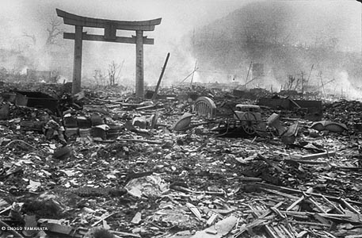

Slide 21
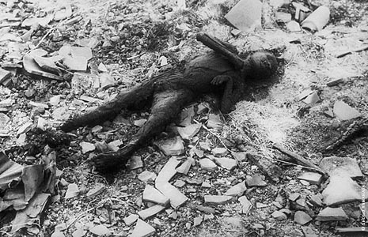

Slide 22
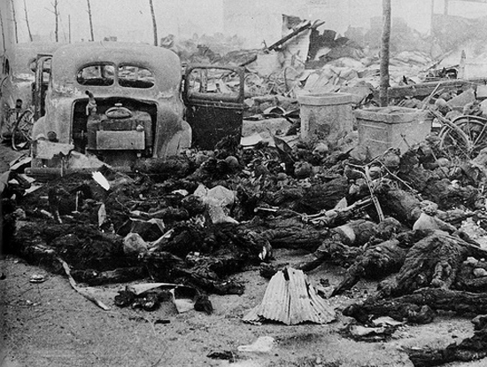

Slide 23
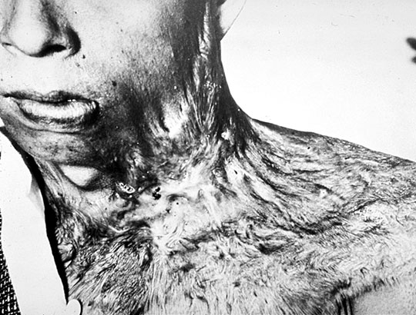

Slide 24
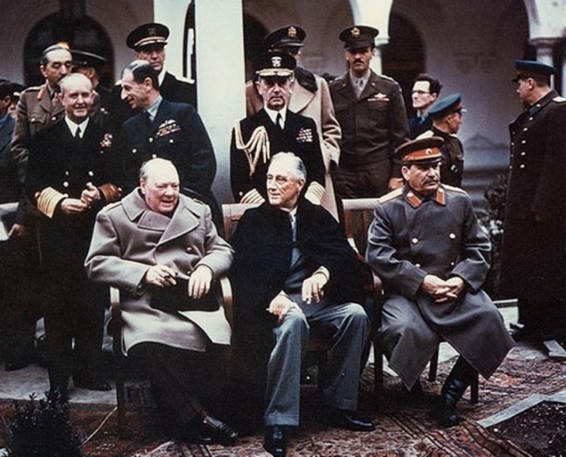
Rebuilding
FDR, Churchill and Stalin met from February 4th to the 11th, 1945 to discuss Europe's postwar re-organization at what was referred to as the Yalta Conference.
The Soviets wanted to punish Germany for their actions however, after reflecting on the damage the Treaty of Versailles inflicted on Germany following WWI Britain suggested leniency

Slide 25
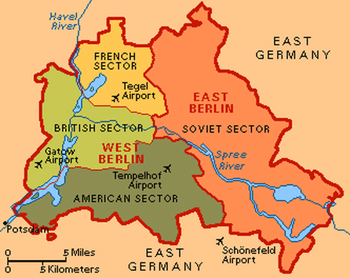
Rebuilding
In the end Germany would undergo denazification and demilitarization before it was divided into four zones controlled by the U.S., Britain, France and The USSR with a goal of eventually creating a free and independent Germany
Russia agreed to free elections in Poland and Eastern Europe
Stalin would join the U.S. in their fight against Japan along with agreeing to hear plans for membership in the United Nations.
It was also agreed that they would prosecute any Nazi war criminals they discovered

Slide 26
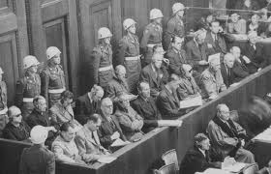
Nuremberg Trials
The Nuremberg Trials-Following WWII two sets of trials took place for Nazis involved in crimes committed during the Holocaust.
The first, and most famous, began on November 20, 1945.
Someone had to be responsible for Death Camps so many Nazi military leaders and industrialists were put on trial
Two hundred people were found guilty of committing war crimes
Twelve of the twenty-four convicted were sentenced to death

Slide 27
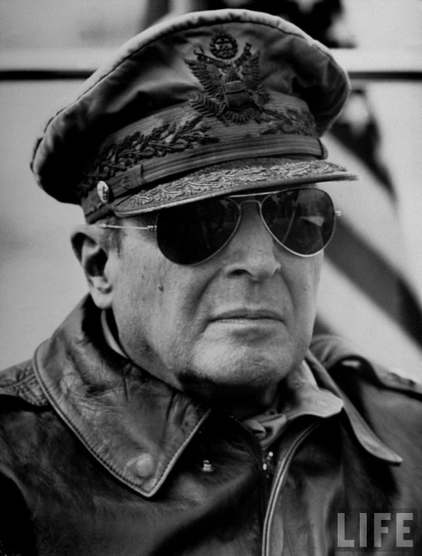
Japans Future
Following the bombings the U.S. maintained a positive presence in Japan helping them rebuild
This effort was led by General McArthur who helped institute a new constitution
Nicknamed the “McArthur Constitution” included an introduction of capitalist and free market ideas as well as for the first time in Japan’s history a guarantee of women's suffrage
Japanese officials who had committed war atrocities were also put on trial like the Nazis

