Slide 1
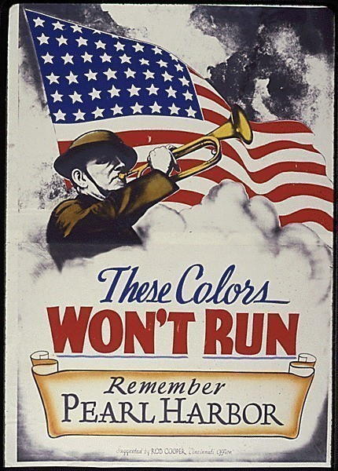
Chapter 17-Section 1 Mobilizing for Defense

Slide 2
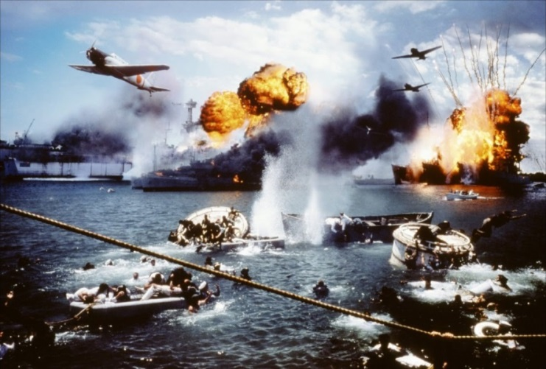
Americans Join the War Effort
Following Japan’s attack on Pearl Harbor Japan felt that the United States would shrink after the bombing and stay out of the fighting.
Instead the result was far different as Americans surged towards war.

Slide 3
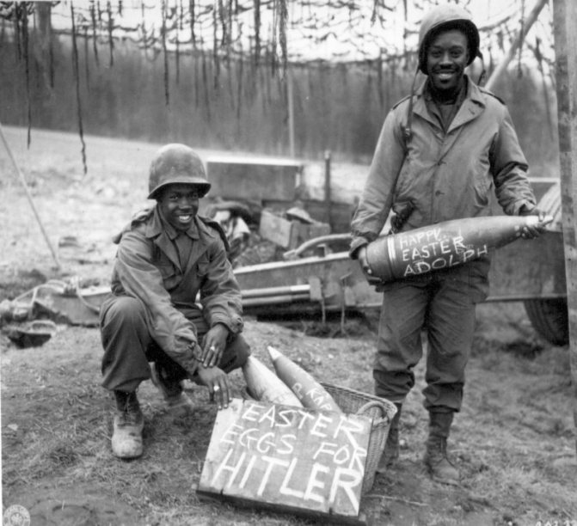
Americans Join the War Effort
Selective Service Act-Following the attack on Pearl Harbor five million men volunteer for the Selective Service System. However, in order to truly fight a two front war we would need an additional ten million soldiers.
New recruits spent about eight weeks in basic training in an attempt to mold them into well disciplined GIs.

Slide 4
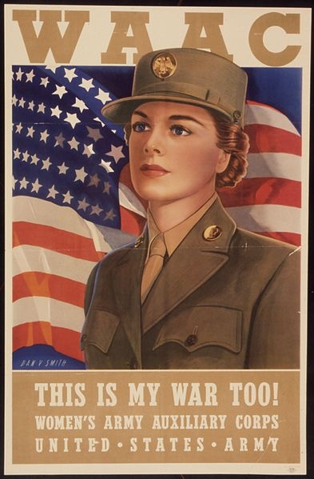
Americans Join the War Effort
The Women’s Axillary Army Corps (WAAC) was the women’s branch of the U.S. Army created on May 14, 1942. WAAC was established "for the purpose of making available to the national defense the knowledge, skill, and special training of women of the nation."
Nearly 150,000 American women served in the Women’s Army Corps during World War II. Many of these women served throughout the world with the Army Ground Forces, the Army Service Forces, and the Army Air Forces, in a variety of supporting, non-combat roles. The majority of WAACs served with the Army Service Forces.
WAAC were originally trained in three major specialties: switchboard operators, mechanics, and bakers. Later WAC members served dozens of specialties like Postal Clerks, Nurses, Driver, Stenographer, and Clerk-Typist. WAC armorers maintained and repaired small arms and heavy weapons that they were not allowed to use.

Slide 5
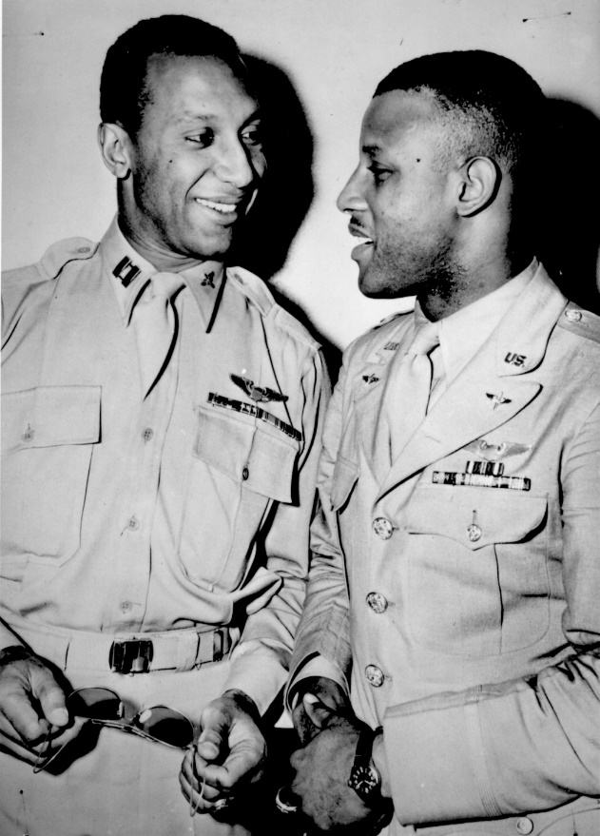
Americans Join the War Effort
Recruiting and Discrimination
Many minority groups who had been denied basic citizenship rights questioned whether they should fight for democracy in other countries while they were being oppressed by their own.

Slide 6
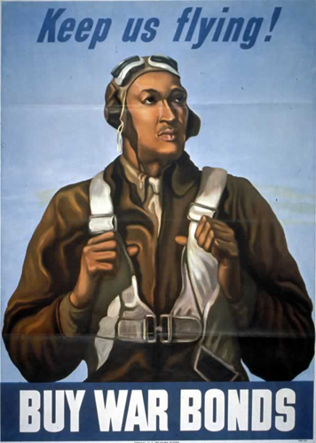
Americans Join the War Effort
Dramatic Contributions-
African-Americans—Over one million African-Americans served in WWII. One of the most famous groups of African American soldiers was the Tuskegee Airmen. They were the first group of African American pilots in the U.S. military.
Latino-Americans-They fought in every major American battle in the war. Roughly, 500,000 Mexican-Americans served plus over 65,000 Puerto Ricans and smaller numbers of others.
Hispanic-Americans constituted 3.1% to 3.2% of the total who served.
Jewish-Americans-Approximately, 550,000 Jewish-Americans served in the armed forces during World War II, account for 3.5% of the roughly 16 million American soldiers in total, the highest number of Jewish soldiers of any participating country.

Slide 7
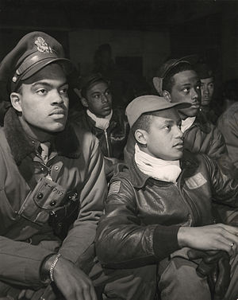
Americans Join the War Effort
Dramatic Contributions-
Polish-Americans-They composed 8% of the U.S. military during World War II, with over 1,000,000 joining the U.S. armed forces
Italian-Americans-Over 1.5 million Italian-American soldiers served in World War II, accounting for 10% of the armed forces, of whom 14 won Medals of Honor.
Arab-Americans-Over 30,000 Arab-Americans are estimated to have served during the war, accounting for 0.2% of soldiers. Most were of Lebanese descent.
Armenian-Americans-During World War II, about 18,500 Armenians served

Slide 8
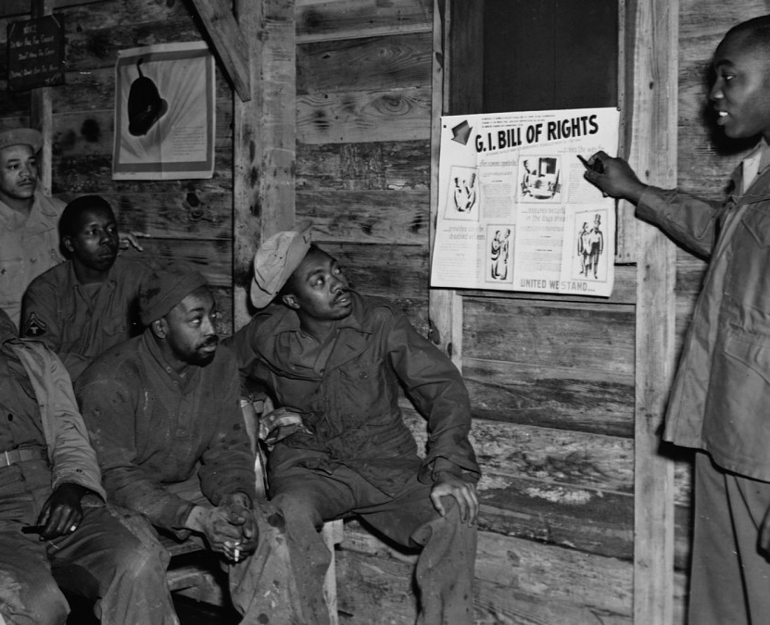

Slide 9
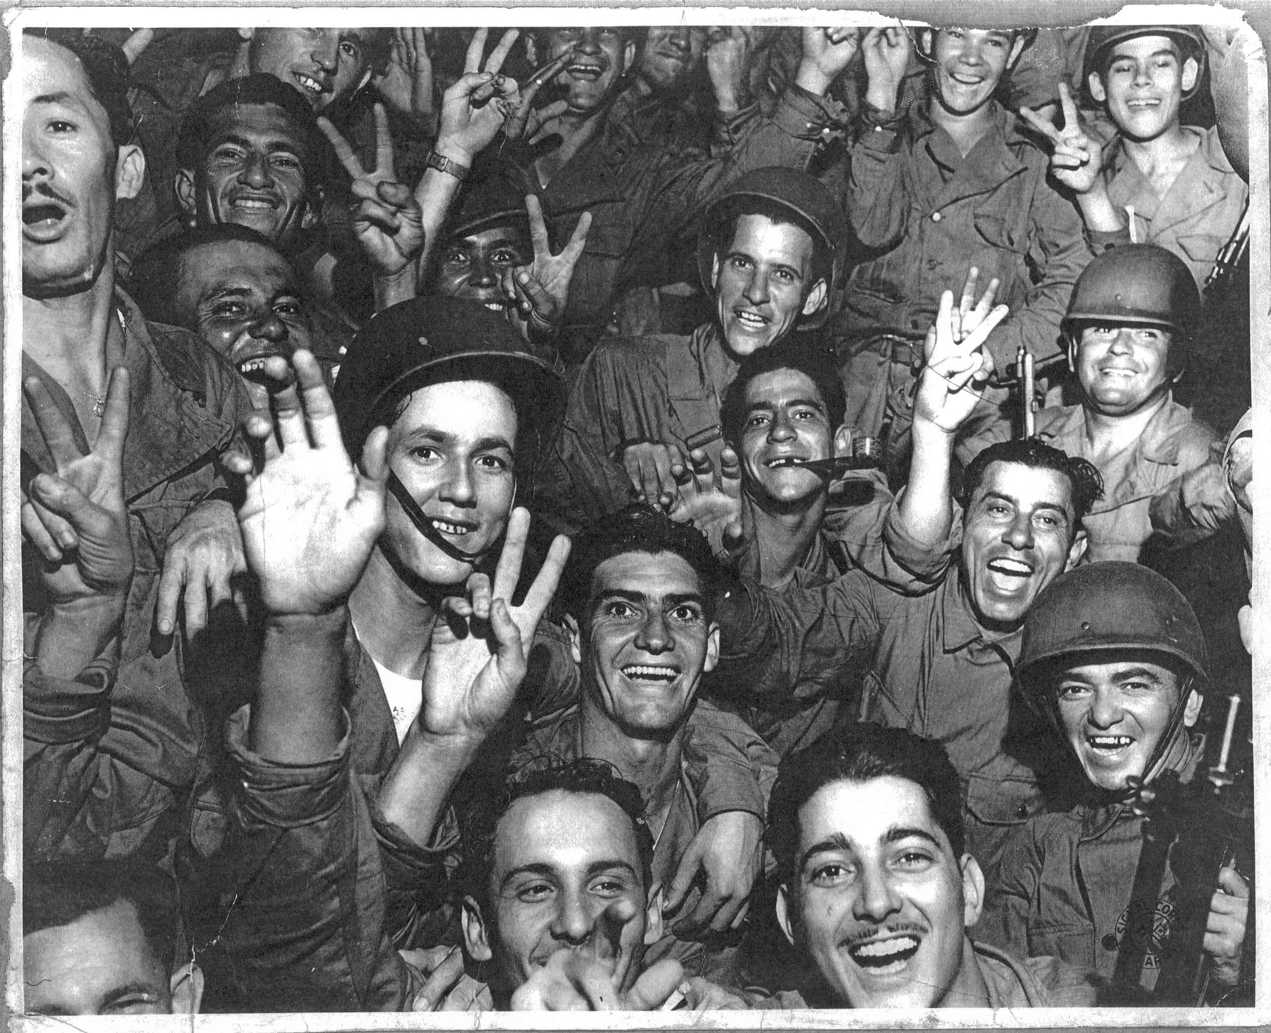

Slide 10
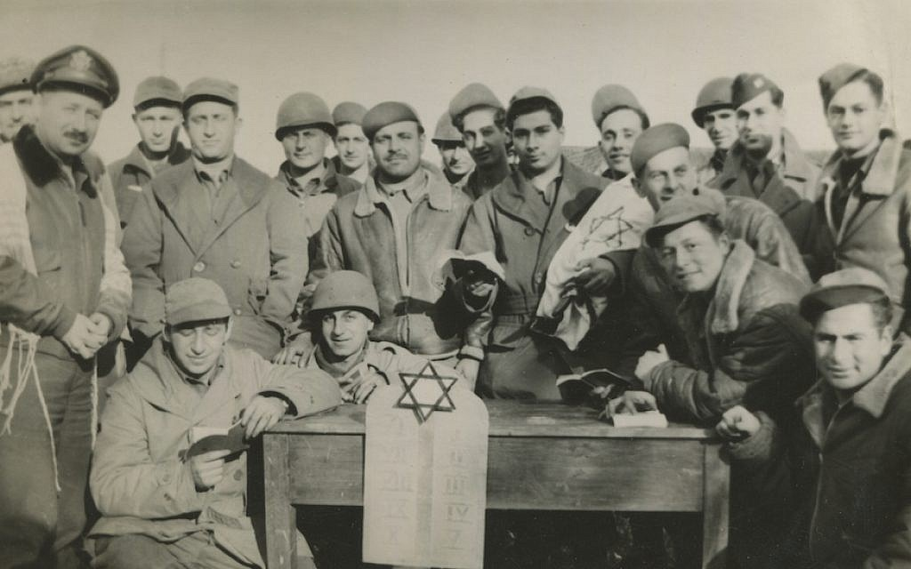

Slide 11
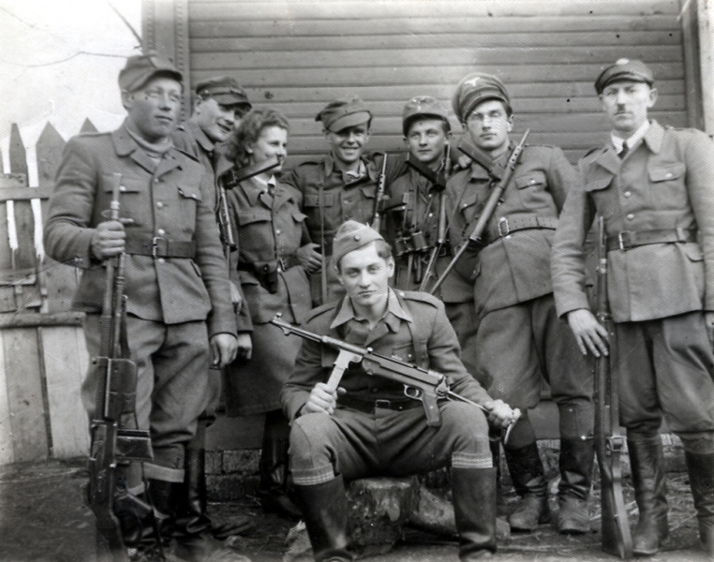

Slide 12
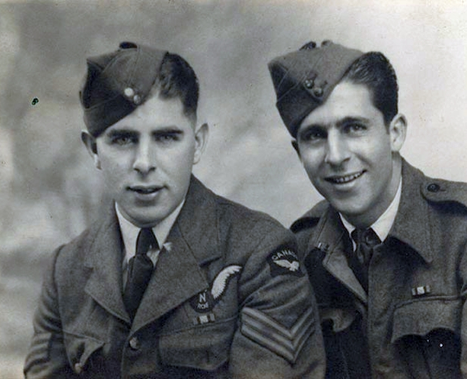

Slide 13
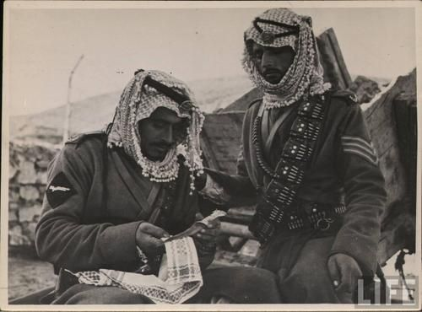

Slide 14
A Production Miracle
As the war raged on in Europe the United States rapidly restructured their industrial production to meet the need for war materials.
Manufacturing plants remodeled in order to produce military goods
Ex. The Ford Motor company plant in Willow Run stopped producing cars and began building bomber planes and Henry Kaiser created a model for producing one naval ship every four days
Of course, all that military hardware had a hefty price tag. The federal government spent about $350 billion during World War II or twice as much as it had spent in total for the entire history of the U.S. government up to that point.
About 40 percent of that came from taxes; the rest came through government borrowing, much of that through the sale of bonds.

Slide 15
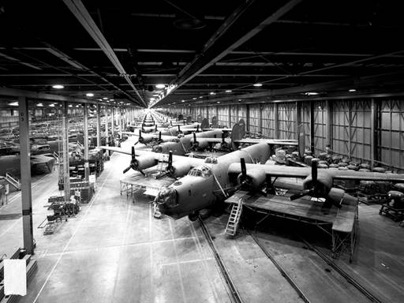

Slide 16
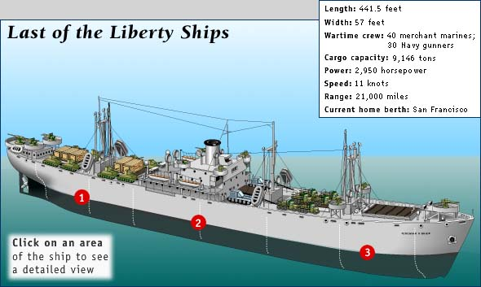

Slide 17
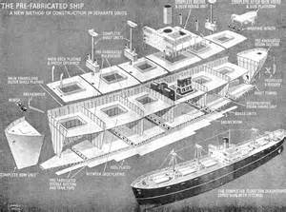

Slide 18
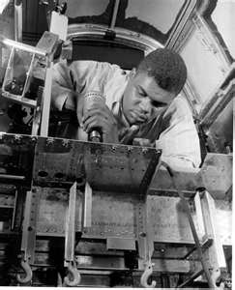
A Production Miracle
Labor’s Contribution-
Roughly eighteen million Americans worked in factories during WWII
The work force comprised of two million minority workers and six million women
Out preformed everyone's expectations

Slide 19
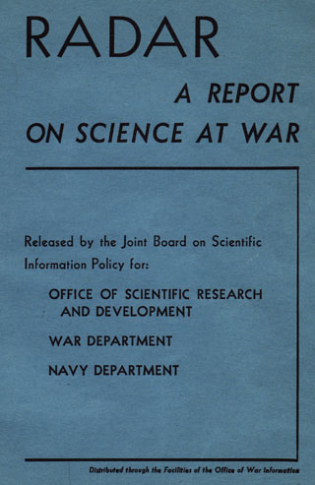
A Production Miracle
The Office of Scientific Research and Development (OSRD) was an agency of the United States federal government created to coordinate scientific research for military purposes during World War II.
It was created formally by Executive Order 8807 on June 28, 1941. It superseded the work of the National Defense Research Committee (NDRC), was given almost unlimited access to funding and resources, and was directed by Vannevar Bush, who reported only to President Roosevelt.

Slide 20
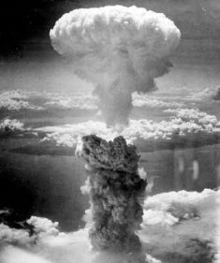
A Production Miracle
The Office of Scientific Research and Development’s research included projects devoted to creating new and more accurate bombs, reliable detonators, work on the proximity fuse, guided missiles, radar and early-warning systems, lighter and more accurate hand weapons, more effective medical treatments like penicillin, more versatile vehicles, and, most secret of all which later became the Manhattan Project.
The Manhattan Project the code name for the American project set up in 1942 to develop an atom bomb. The project culminated in 1945 with the detonation of the first nuclear weapon, at White Sands in New Mexico. and developed the first atomic weapons.

Slide 21
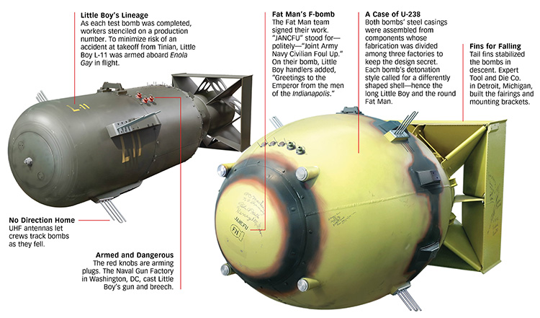

Slide 22
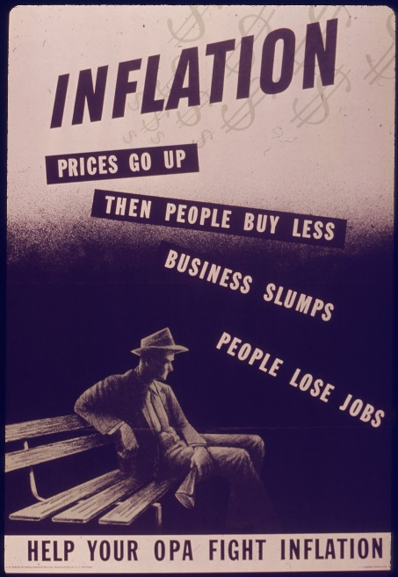
The Federal Government Takes Control
Office of Price Administration (OPA) was the federal agency tasked with establishing price controls on nonagricultural commodities and rationing essential consumer goods during World War II (1939–1945).
The OPA had the power to place ceilings on all prices except agricultural commodities, and to ration scarce supplies of other items, including tires, automobiles, shoes, nylon, sugar, gasoline, fuel oil, coffee, meats and processed foods.
At the peak, almost 90% of retail food prices were frozen. It could also authorize subsidies for production of some of those commodities.

Slide 23
The Federal Government Takes Control
The War Production Board (WPB) was an agency of the United States government that supervised war production during World War II.
The WPB directed conversion of industries from peacetime work to war needs, allocated scarce materials, established priorities in the distribution of materials and services, and prohibited nonessential production.
It rationed such commodities as gasoline, heating oil, metals, rubber, paper and plastics. It was dissolved shortly after the defeat of Japan in 1945 and was replaced by the Civilian Production Administration in late 1945.
From 1942 to 1945, WPB supervised the production of $183 billion worth of weapons and supplies, about 40% of the world output of munitions.
Britain, the USSR and other allies produced an additional 30%, while the Axis produced only 30%.
One fourth of the US output was warplanes; one fourth was warships.

Slide 24
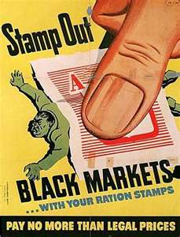
The Federal Government Takes Control
Rationing-The policy of giving up scarce resources, goods, or services for the good of others.
Most saw it as a necessary sacrifice for the good of the nation

Slide 25
Items Rationed During WWII
Rationed Items
Tires (January 1942 to December 1945)
Cars (February 1942 to October 1945)
Bicycles (July 1942 to September 1945)
Gasoline (May 1942 to August 1945)
Stoves (December 1942 to August 1945)
Sugar (May 1942 to early 1947)
Coffee (November 1942 to July 1943)
Processed Foods (March 1943 to November 1945)
Canned fish and meat, cheese, canned milk, fats (May 1942 to late 1947)

Slide 26
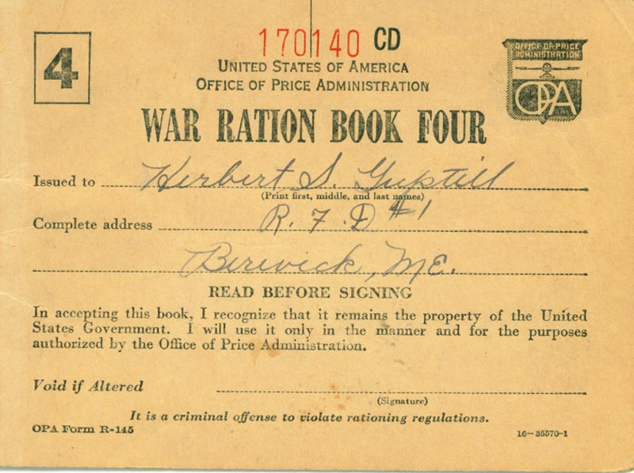

Slide 27
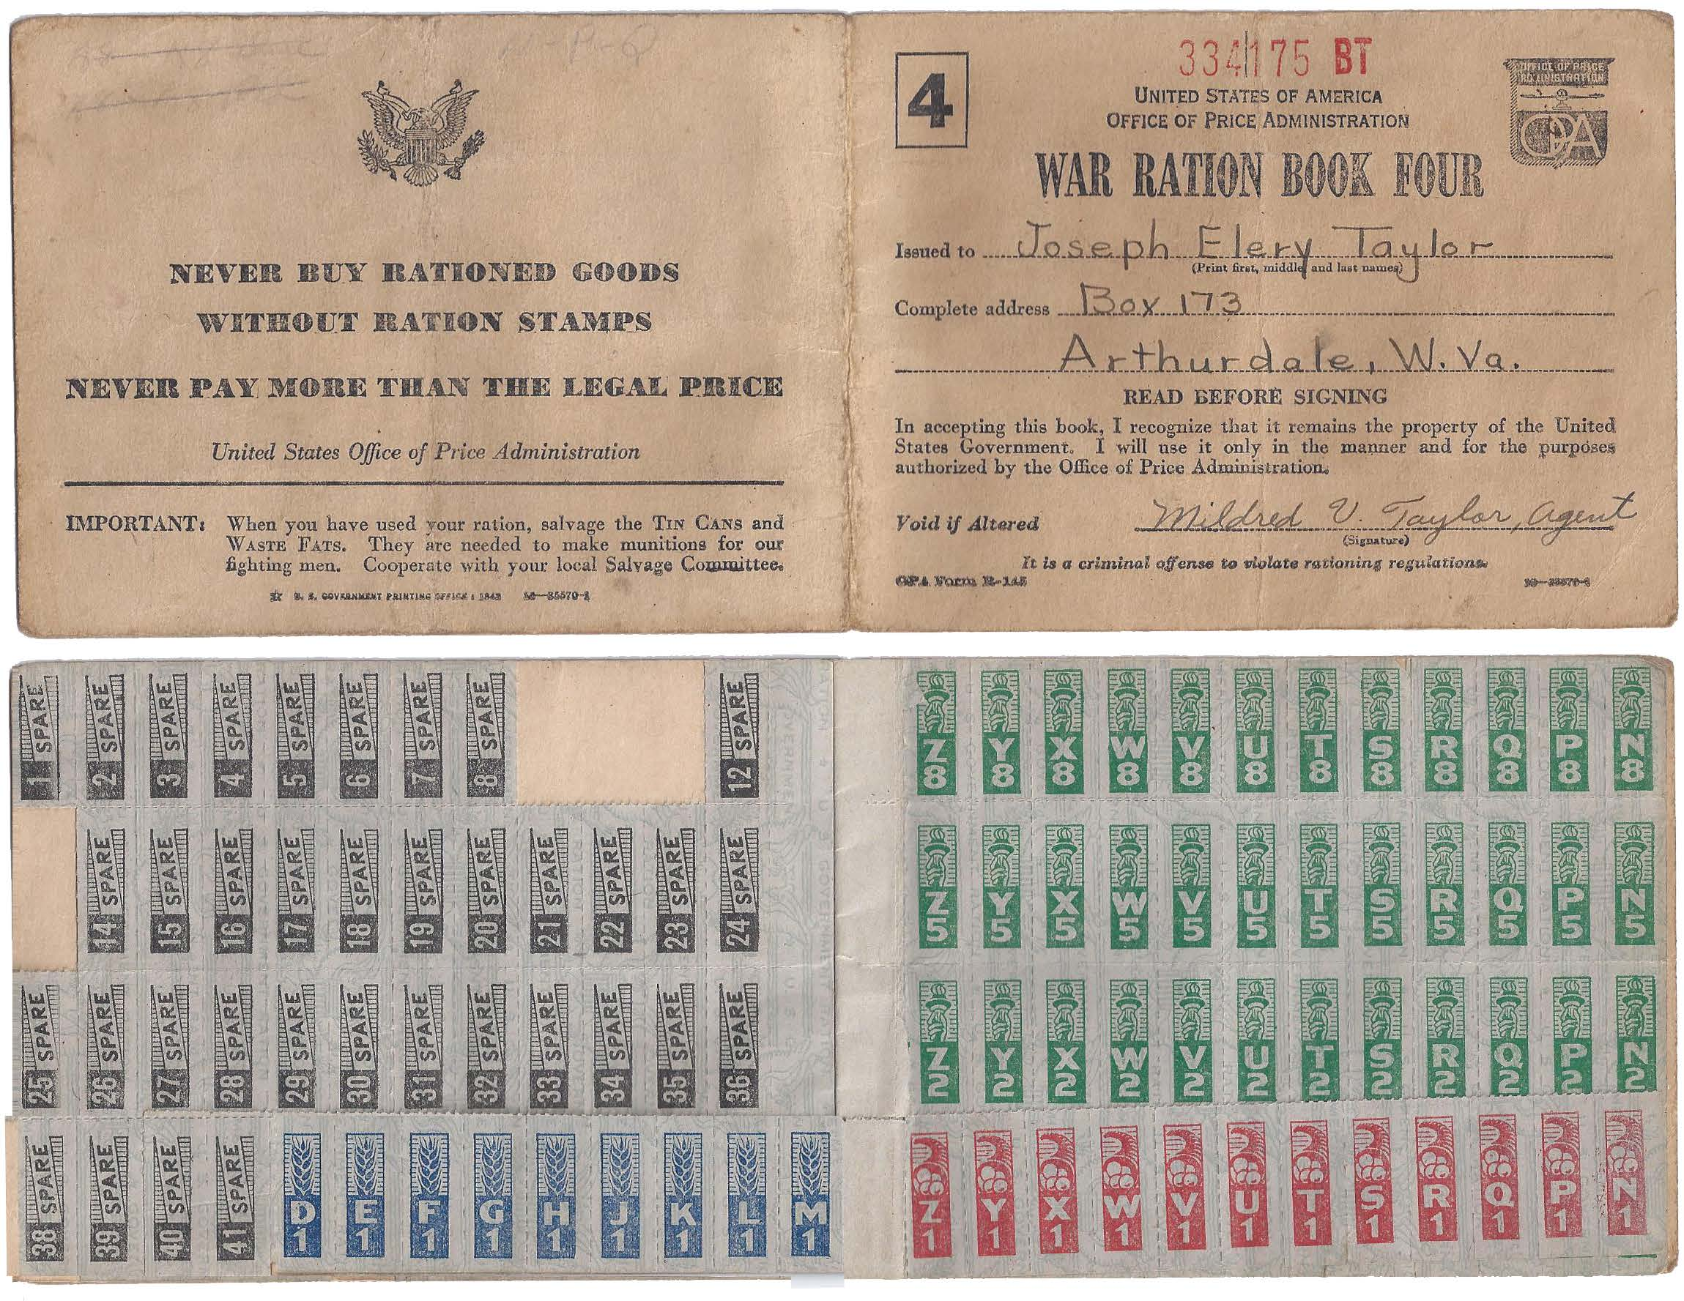

Slide 28
