Slide 1
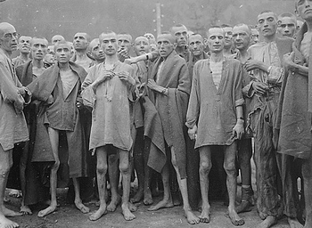
Chapter 16-Section 3-The Holocaust

Slide 2
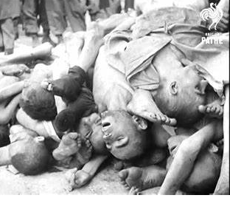
The Persecution Begins
The Holocaust-A systematic extermination of nearly eleven million people across Europe in the late 1930’s and early 1940’s
  It was driven by Anti-Semitism which mainly targeting Jew but they also gypsies, Freemasons, Jehovah’s Witnesses, Catholics, Slavs, homosexuals, those who were mentally ill, physically ill and those who were terminally ill

Slide 3
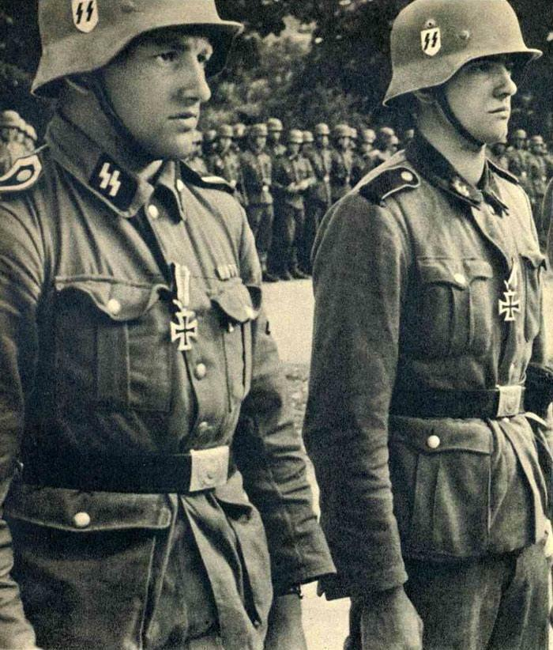
The Persecution Begins
The Holocaust introduced the use of death squads known as the German SS and forced the relocation of Jewish prisoners into ghettos
Living conditions in the ghettos were terrible
  Dead bodies were left out in the open
  People were forced to live in crowed apartments and work long hours in factories
    Placed like the Warsaw ghettos were meant to hold 5,000 people but held nearly 50,000

Slide 4
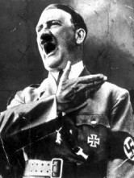
The Persecution Begins
After taking power Hitler begins blaming the Jews for many of Germany’s failures
In 1935, Germany began passing the Nuremberg Laws which Jews stripped of their citizenship, property, forced to wear the star of David on their clothing
In 1938 Polish Jews were expelled and forced into detention centers

Slide 5
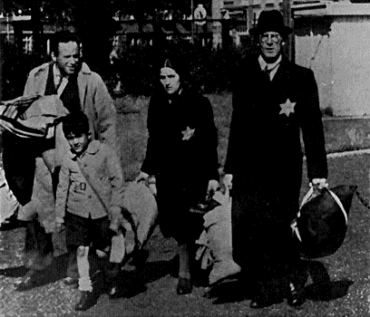

Slide 6
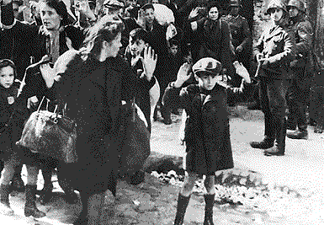

Slide 7
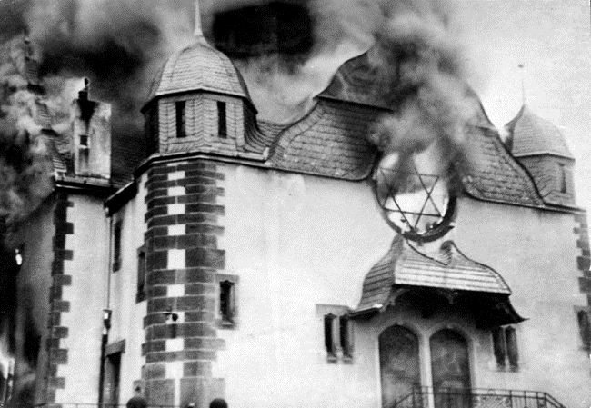
The Persecution Begins
On the night of November 9th through the morning of November 10th, 1938 an Anti-Jewish rampage took place in in Germany.
It was referred to as Kristallnacht meaning “The Night of the Broken Glass”.
  Buildings were burned, Jews were beaten
  Roughly one hundred people were killed and nearly 30,000 people were arrested
  The German government blamed Jewish citizens for the destruction

Slide 8
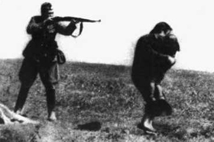
Hitler’s “Final Solution”
Final Solution- A policy of genocide that focused on quickly and systematically killing of an entire population of people

Slide 9
Hitler’s “Final Solution”
In 1942 with a massive amount of captives the Germans began using mass exterminations
  Bullets had become too expensive and starvation was taking far too long so they needed a faster way
The Nazis began using two types of Concentration Camps to house their prisoners referred to as labor and death camps
  They began using gas chambers where they could execute between two thousand and twelve-thousand people a day
The Nazi’s opened their first concentration camp Chlemo in 1941
  There were twenty-three main camps Auschwitz being the largest with nearly nine hundred sub camps

Slide 10
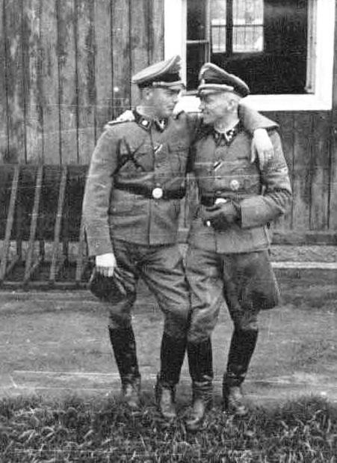
Hitler’s “Final Solution”
Largest single massacre of Holocaust named after Reinhard Heydrich the main architect of the Holocaust
  It took place from March 1942 until November 1943 and was carried out at three camps, run by the SS
    Belzec, Sobibor and Treblinka
The goal was to quickly execute every Jew at these camps within two hours of their arrival
  Nearly 1,700,000 Jews were killed during Operation Reinhard

Slide 11
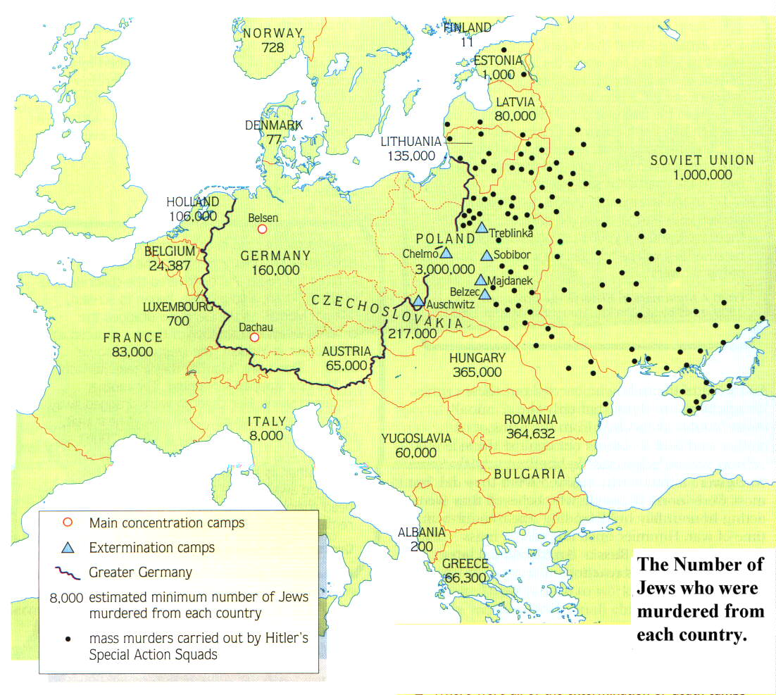

Slide 12
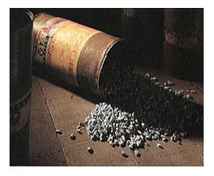
Hitler’s “Final Solution”
Auschwitz-Poland
Started operations in January 1940
  Himmler chose Auschwitz as the place to pilot the Final Solution
Four gas chambers/crematories were in constant use by 1943
  The chambers used Zyklon B gas
The camp was under the command of Rudolph Hoess
At their peak operation they recorded 12,000 kills in one day

Slide 13
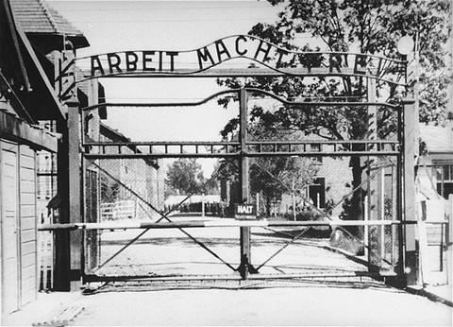

Slide 14
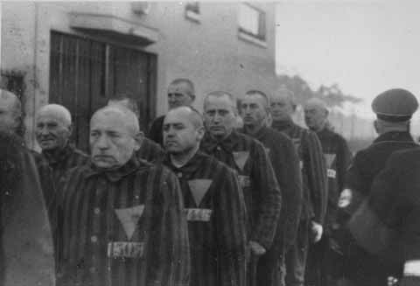

Slide 15
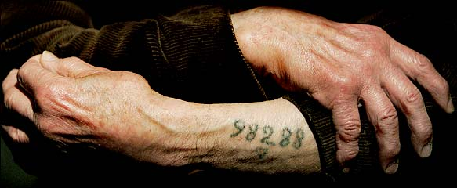

Slide 16
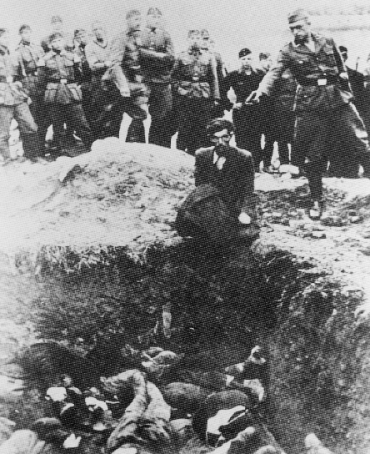

Slide 17
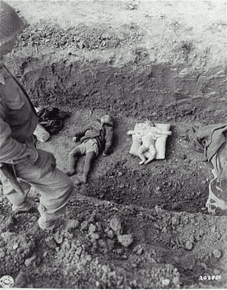
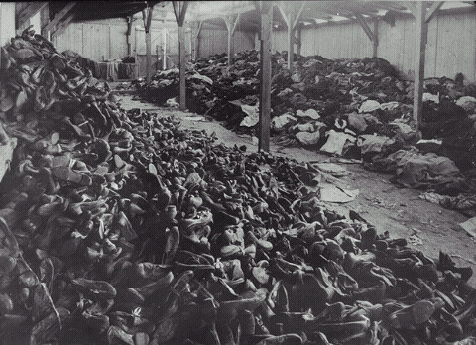

Slide 18
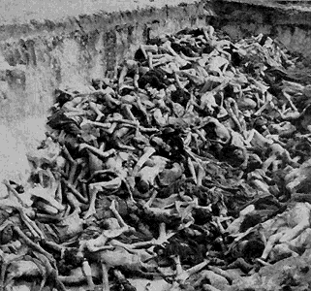

Slide 19
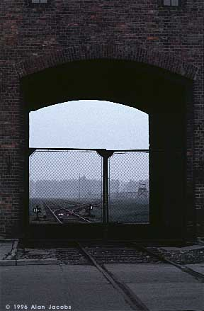
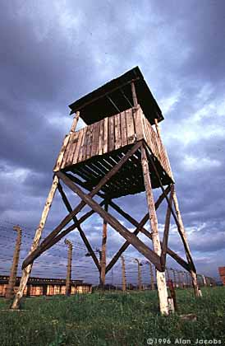

Slide 20
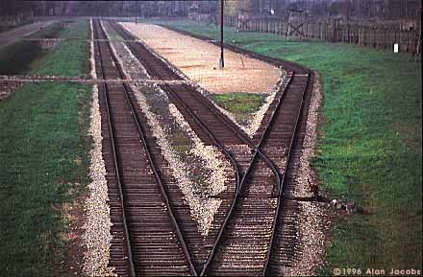

Slide 21
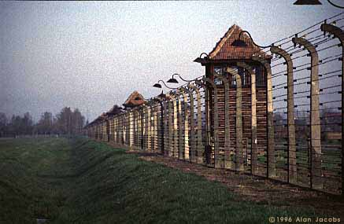

Slide 22
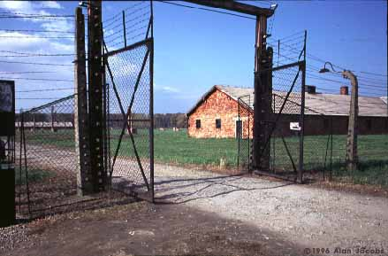

Slide 23
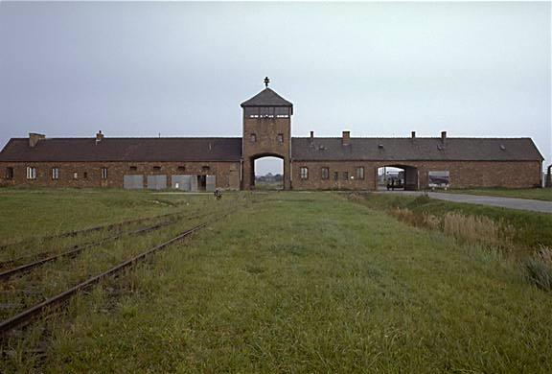

Slide 24
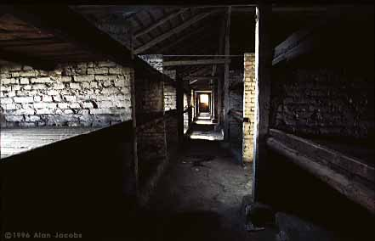

Slide 25
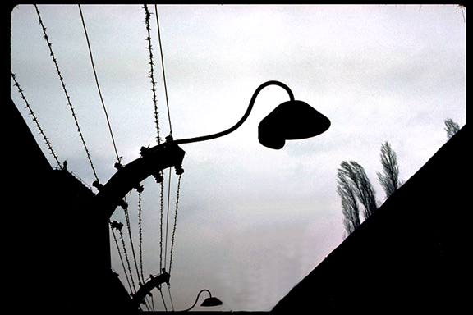

Slide 26
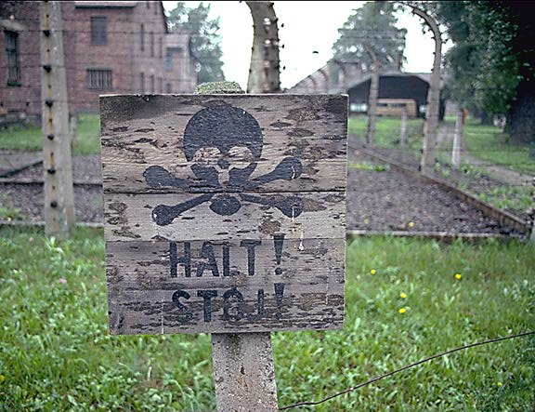

Slide 27
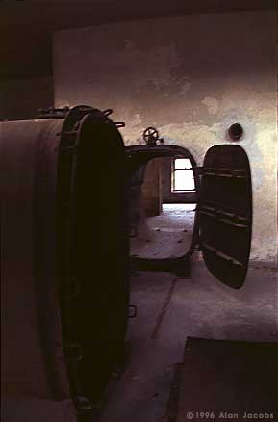

Slide 28
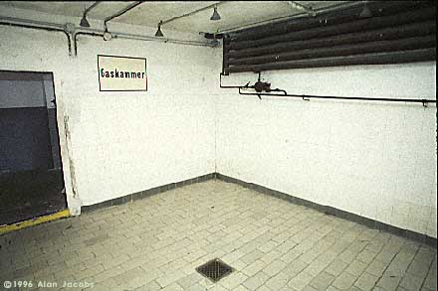

Slide 29
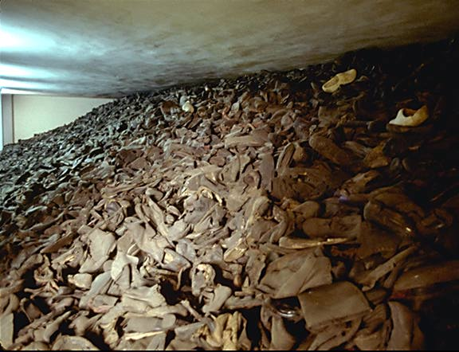

Slide 30
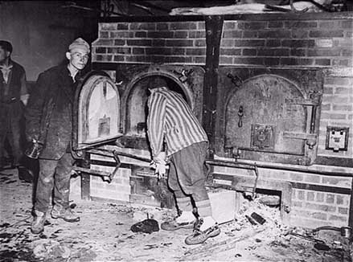

Slide 31
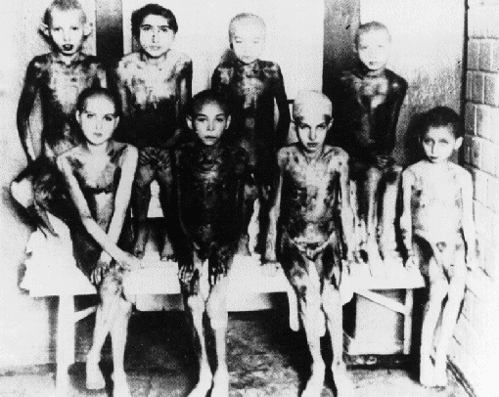

Slide 32
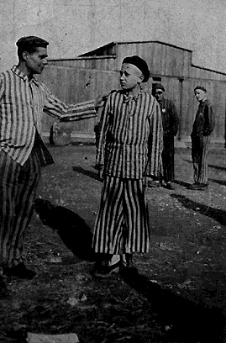
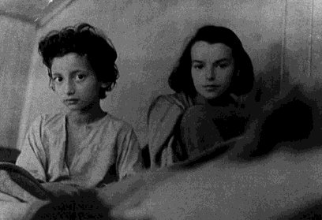
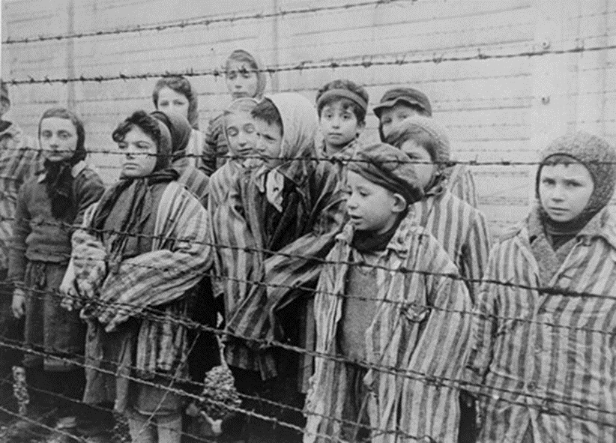

Slide 33
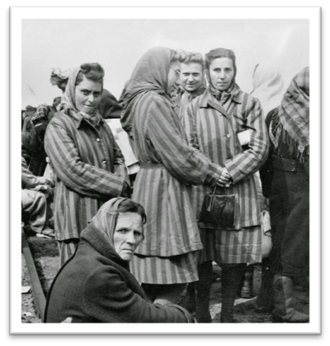
Concentration Camps
Ravensbrück-Northern Germany
A work camp which housed women only
It was actually ran by German women who were criminals
  Roughly 80% were political prisoners
  They sewed socks and worked with furs
Nearly 50,000 killed
14,000 were rescued by Swedish a diplomat

Slide 34
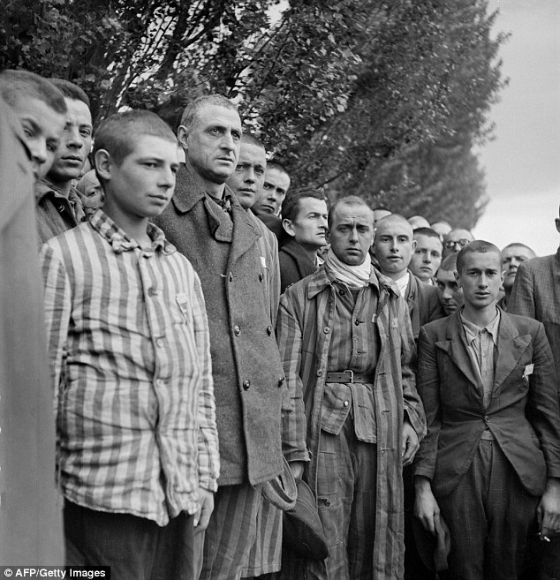
Concentration Camps
Belzec-Southeast Poland
Opened in March of 1942
Jewish prisoners from the Lubin ghettos in Poland were sent here
It operated until December 1942 when the camp was dismantled and plowed over

Slide 35
Concentration Camps
Sobibor-Poland
Opened in May of 1942
The camp contained three gas chambers for mass executions
The largest attempted escape from a concentration camp happened here when three-hundred Jewish and Polish captives attempted to run to safety
  However, only fifty prisoners survived the escape attempt
Treblinka-Located east of Warsaw in Poland
Jews from the Warsaw Ghettos were sent here
The operated ten gas chambers where the bodies were buried in open pits after
It remained open until August of 1943

Slide 36
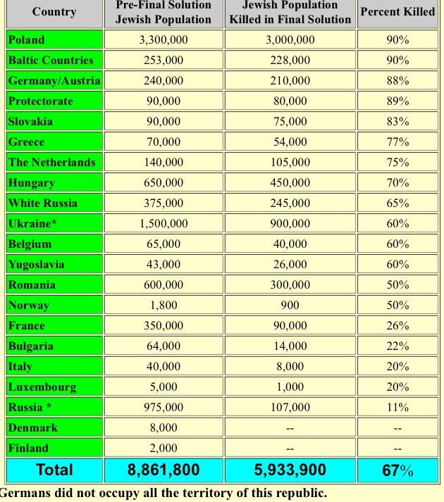
Death Totals

Slide 37
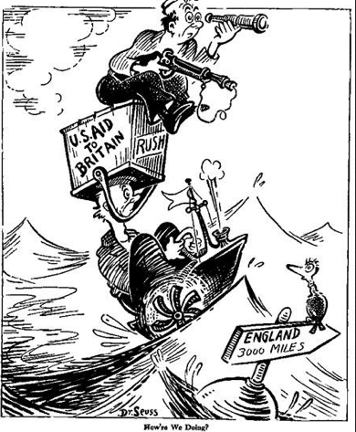
Moving away from Neutrality
Cash and Carry-
  Warring nations could buy arms as long as they had money
Some people said it was a good compromise in terms of directly staying out of the fight while others said going to eventually pull us into the war
Britain was holding on by a thread so the U.S. provided them with ships for their naval bases
Jews also began fleeing to the United States, Britain, France, and Palestine
  But the numbers are limited
  Specifically in Americans because many did not want refugees for fear of job competition and spies

