Slide 1
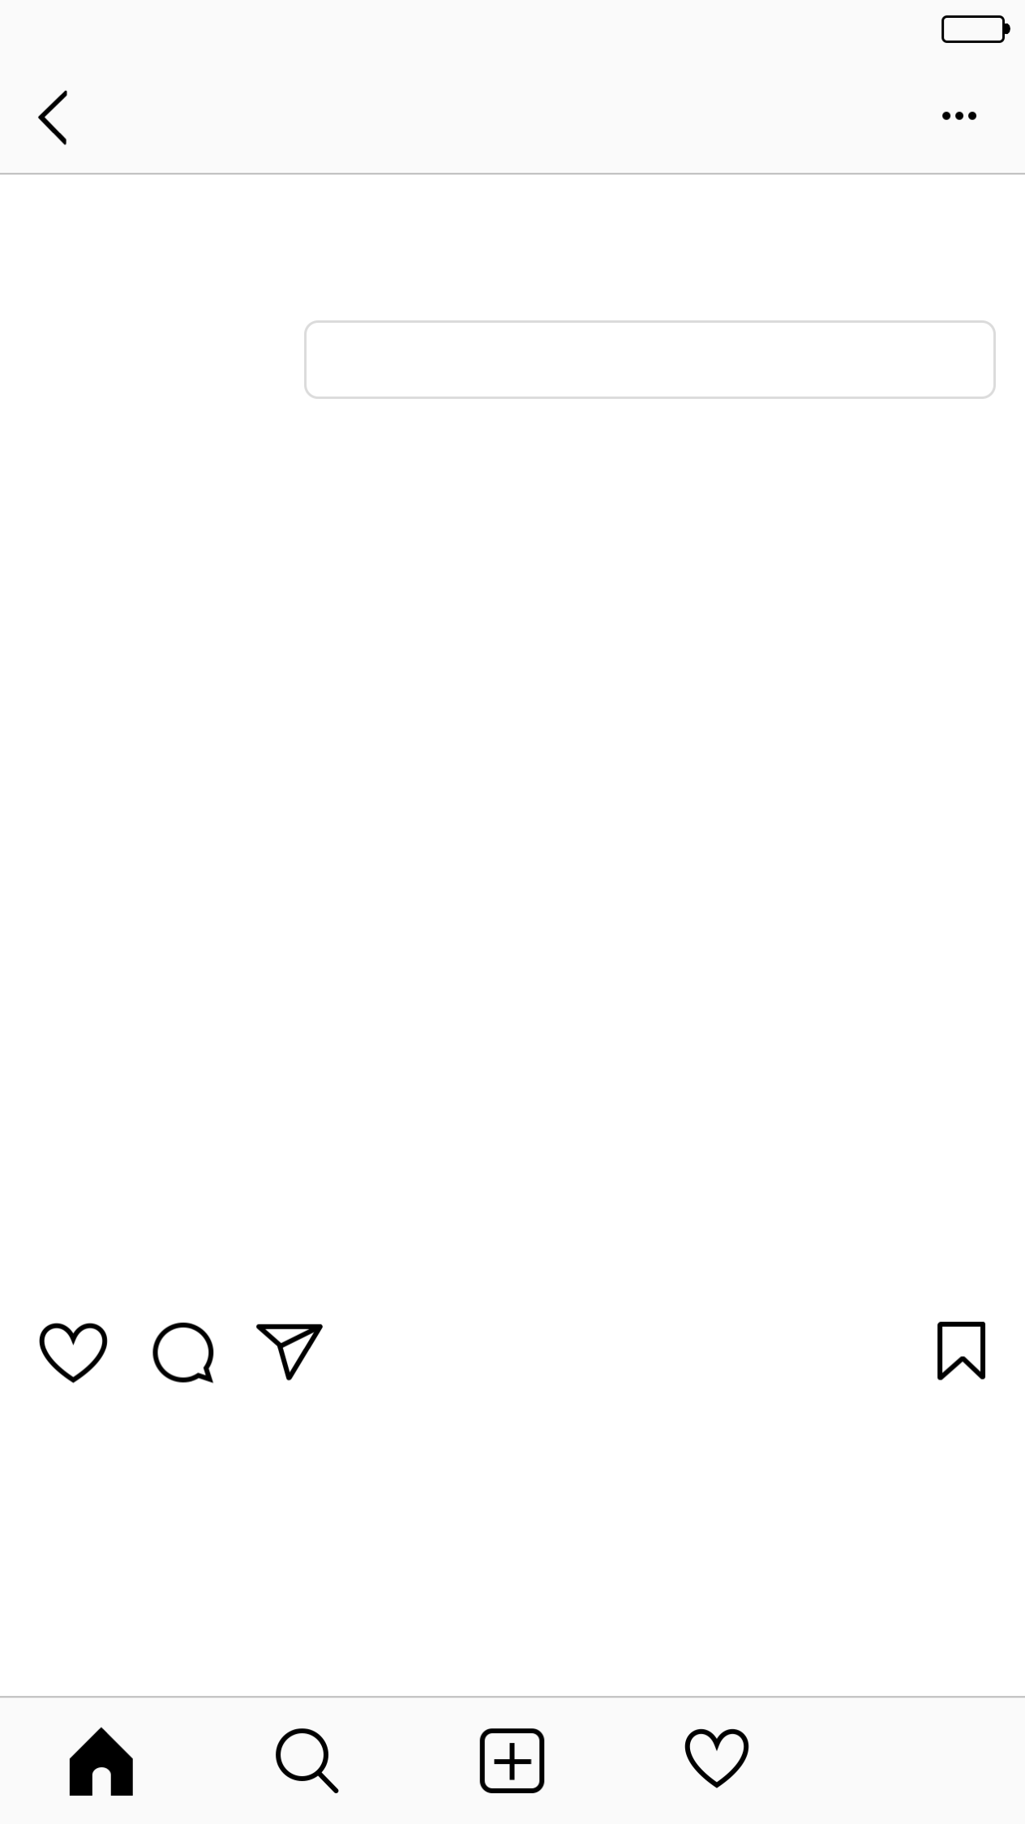

Verizon
4:27 PM
Username
19
posts
62
followers
55
following
Edit Profile
Name
Bio
Followed by friend, friend, and friend
24 likes
Username Caption and #optionalhashtag
View all 8 comments
1 HOUR AGO

Slide 2
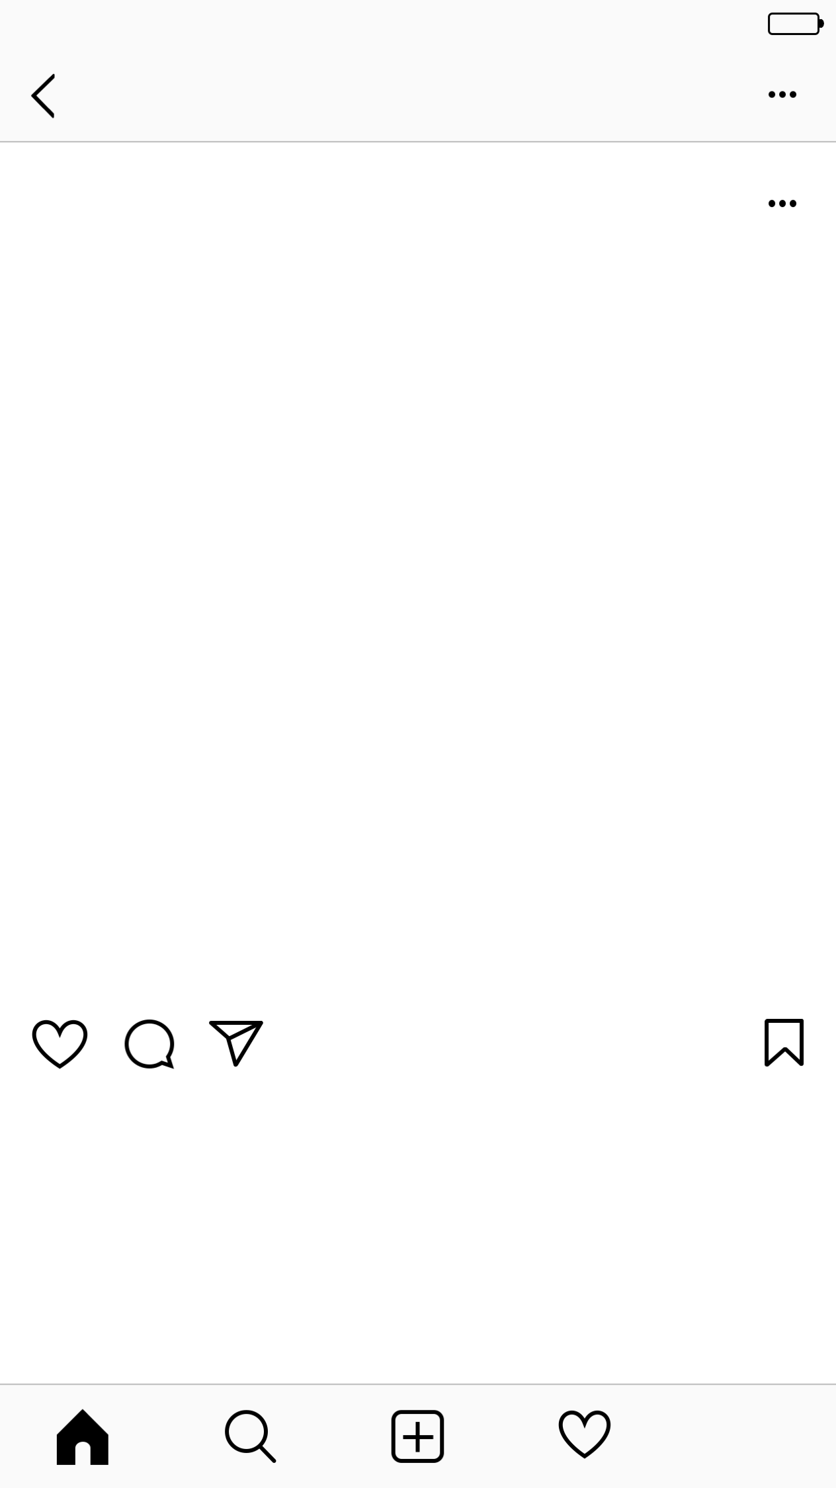
Verizon
4:27 PM
Username
Username
30 likes
Username Caption and #optionalhashtag
View all 2 comments
10 HOURS AGO

Slide 3
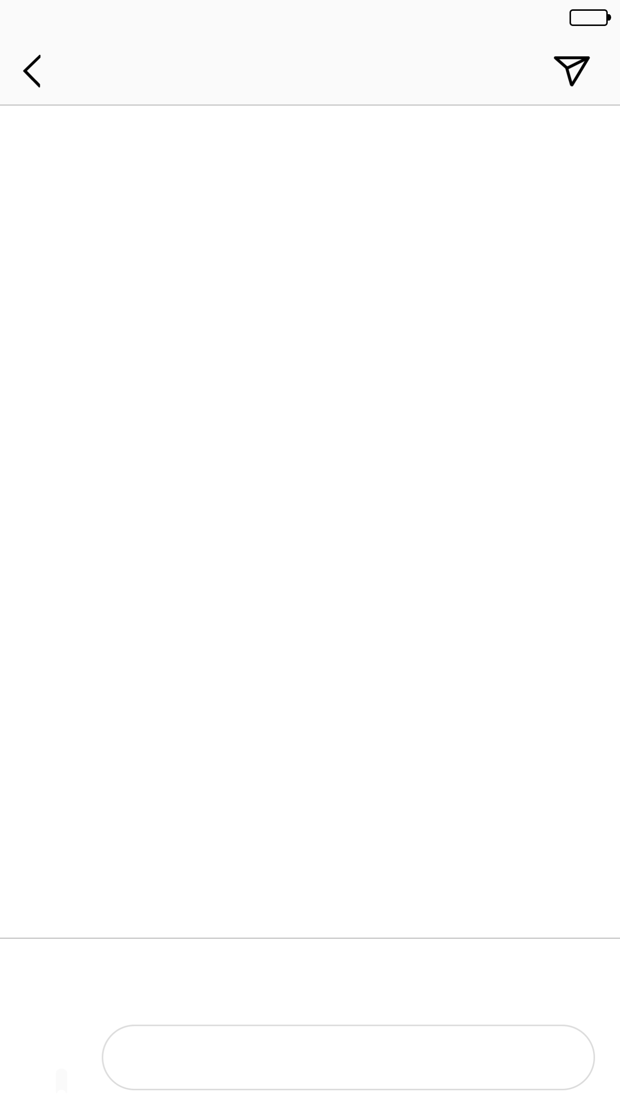
Verizon
4:27 PM
Comments
username Comment
username Comment
username Comment
username Comment
username Comment
username Comment
username Comment
username Comment
username Comment
🎃
💜
🙌
🔥
👏
😂
😍
😊
Add a comment...

